Slide 1
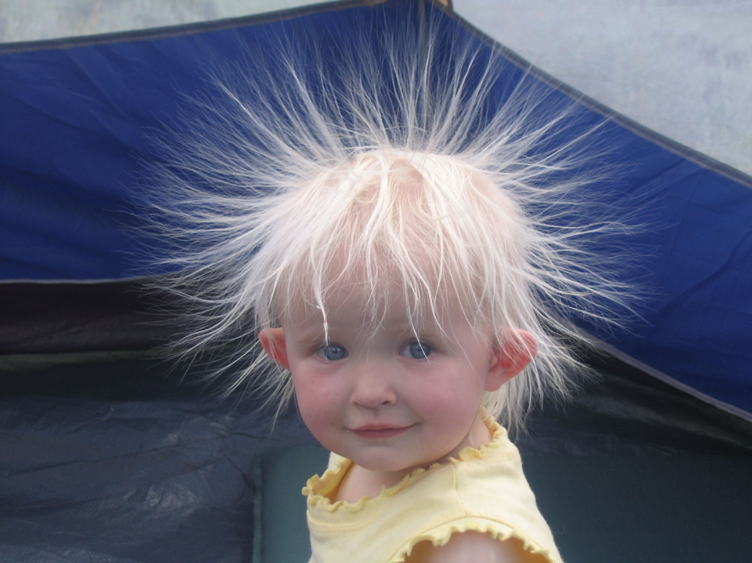
I See,
I Think,
I Wonder…
Google image used for noncommercial use

Slide 2
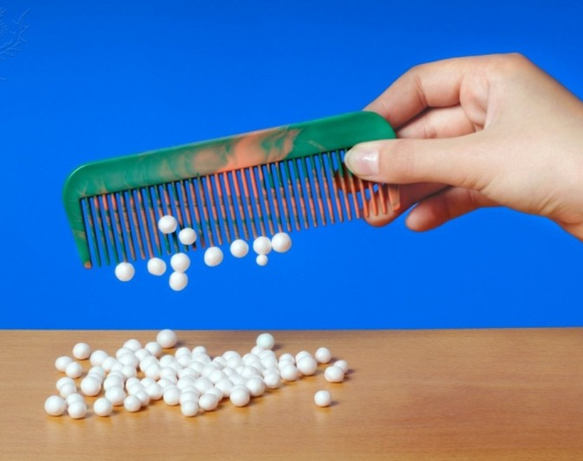
I See,
I Think,
I Wonder…
Image from Britannica ImageQuest

Slide 3
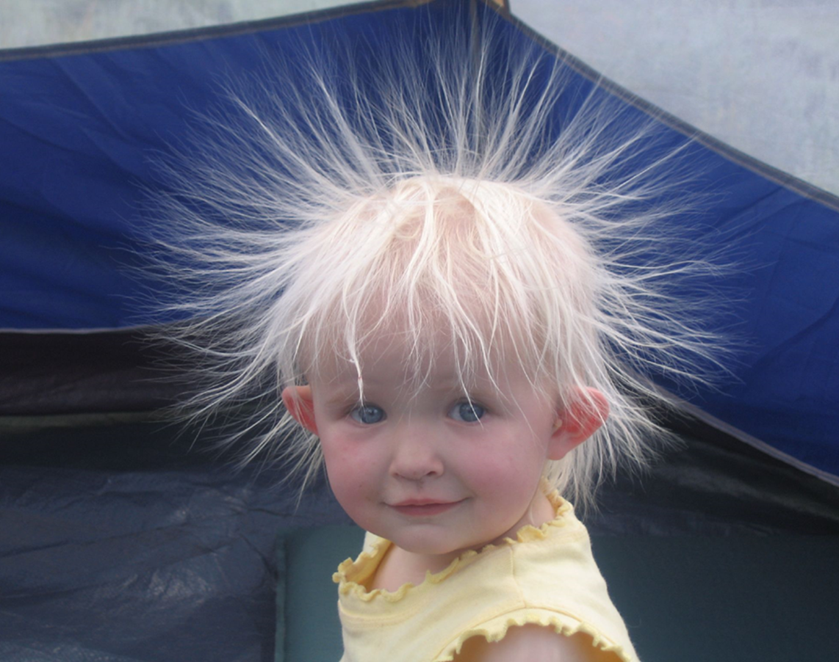

What do the two pictures have in common?

Slide 4
Have you ever been shocked after …
walking on a carpet or putting on a sweater?
combing your hair?
getting out of a car with cloth seats?
Can you explain what caused the shock?

