Slide 1
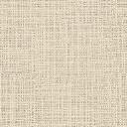


Elements of Visual Art
Texture

Slide 2
The Elements of Visual Art
Artists use the elements of art, the basic parts and symbols of artwork, to create visual arts . The seven elements of art include:
    Line
    Shape
    Form
    Space
    Value
    Color
    Texture
Every artwork includes some of these elements and many artworks include them all. The ways in which artists have used and combined these elements make each artwork unique.
    ART (Blue) , Scott Foresman , p. 15

Slide 3
Texture definitions
    The element of art that refers to how things feel, or look as if they might feel if touched. Texture is perceived by touch and sight; objects can have rough or smooth textures and matt or shiny surfaces.. AACPS Art Office, 7-04
The surface quality of an object that we sense through touch. All objects have a physical texture. Artists can also convey texture visually in two dimensions. Texture is found on the surface of painting, sculpture, and building materials.
In a two-dimensional work of art, texture gives a visual sense of how an object depicted would feel in real life if touched: hard, soft, rough, smooth, hairy, leathery, sharp, fuzzy, slick, grainy etc. In three-dimensional works, artists use actual texture to add a tactile quality to the work. http://www.getty.edu/education/for_teachers/building_lessons/elements.html
Textures can also be described by the way they reflect light, such as matte or glossy. Chapman, Laura. Art : Images and Ideas. Davis1992
Texture can be
  tactile or visual.
  Trompe l’oeil is way to imitate texture.

Slide 4
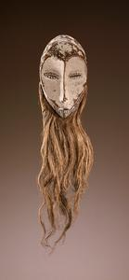
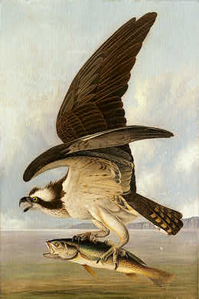
Texture
Tactile texture is REAL or ACTUAL texture and is the way a surface would feel if you could touch it.
Visual texture is sometimes called SIMULATED or IMPLIED texture. It is the way a surface appears through the sense of vision.
Maskette
(lukwakongo)
Lega peoples
Democratic Republic of the Congo
Late 19th-early 20th century
Wood, plant fiber, pigment
John James Audubon
Artic Hare, c 1841
Osprey and Weakfish, 1829
National Gallery of Art

Slide 5
Tactile
Real
Actual
Texture
sculpture
superficial
architecture
painting
smooth or three- dimensional
textiles

Slide 6
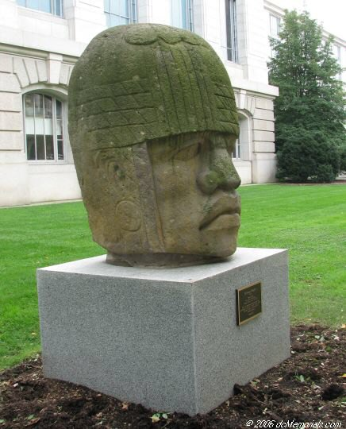
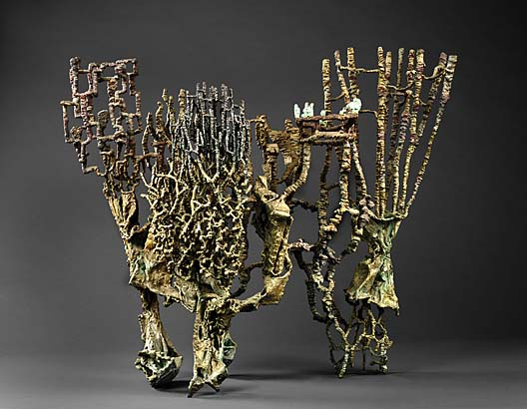
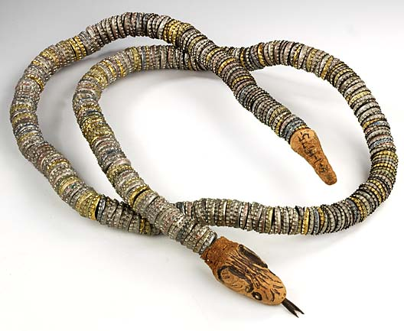
Olmec Head
Mexico
Circa 800 BC
National Museum of Natural History
Banquet
1961 Ibram Lassaw Born: Alexandria, Egypt 1913 Died: East Hampton, New York 2003 bronze 32 x 38 x 25 in. (81.2 x 96.4 x 63.5 cm.) Smithsonian American Art Museum
Bottlecap Snake
1975 Felipe Archuleta Born: Santa Cruz, New Mexico 1910 Died: Tesuque, New Mexico 1991 mixed media: bottlecaps, carved wood, inner tube, wire, ink marker, paint, wood pulp, and adhesive 1 3/4 x 80 7/8 x 1 3/4 in. (4.5 x 205.5 x 4.5 cm) Smithsonian American Art Museum

Slide 7
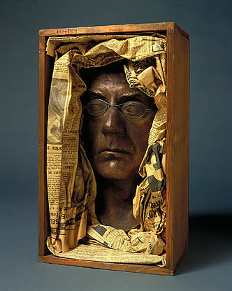
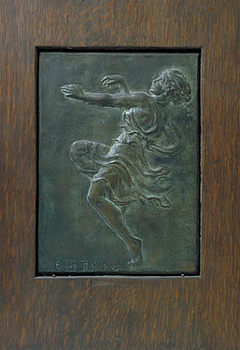
Bacchic Dancer
1909 Emily Clayton Bishop Born: Smithsburg, Maryland 1883 Died: Smithsburg, Maryland 1912 cast bronze mounted on wood 15 1/4 x 10 5/8 x 1 1/8 in. (38.6 x 27.0 x 3.0 cm.) Smithsonian American Art Museum
Autoportrait
1933 Man Ray Born: Philadelphia, Pennsylvania 1890 Died: Paris, France 1976 mixed media: bronze, glass, wood, and newsprint 14 x 8 1/4 x 5 3/8 in. (35.6 x 21.1 x 13.7 cm.) Smithsonian American Art Museum

Slide 8
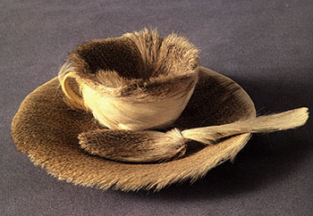
Meret Oppenheim, Fur covered cup, saucer, and spoon, 1936 (a.k.a. The Object)
Notes:
8

Slide 9
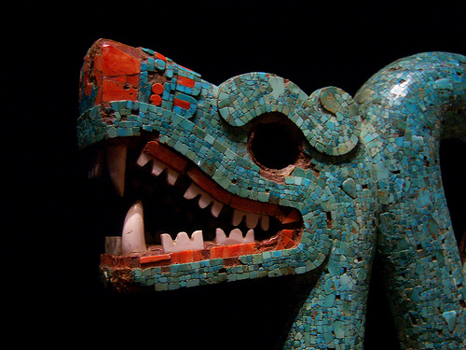
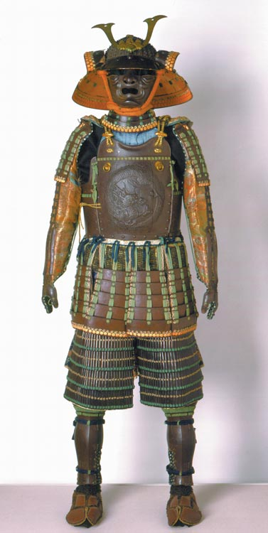
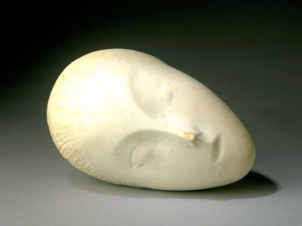
Aztec Serpent Mosaic, 15th Century,
British Museum – Castaway in Wales
Myochin Morisuke
Japan, 1573-1602
Suit of Armor
Iron lames with silk tapes, brocade, and other materials, Momoyama period, 1578
San Diego Museum of Art
Constantin Brancusi
French, b. Hobitza, Romania, 1876 - 1957
Sleeping Muse I, (1909-1910)
Marble
6 3/4 x 10 7/8 x 8 3/8 in.
Texture can be SMOOTH

Slide 10
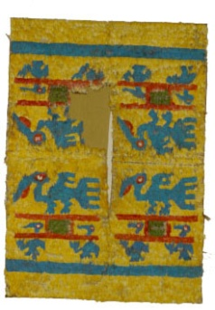
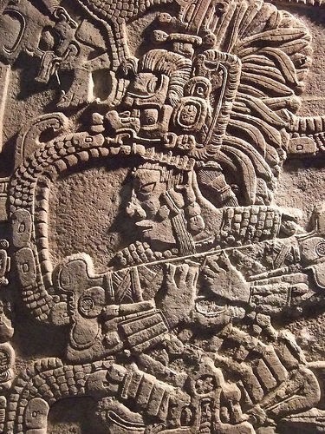
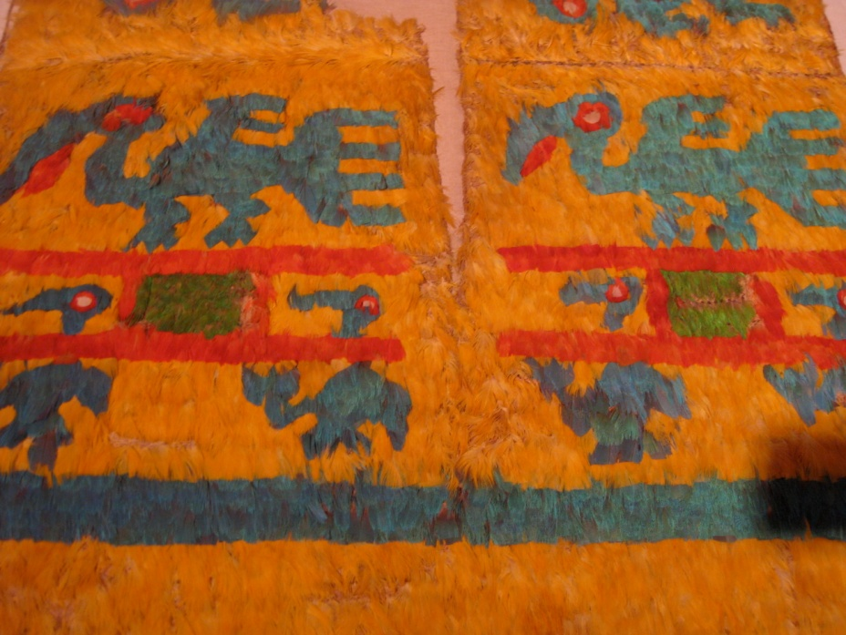
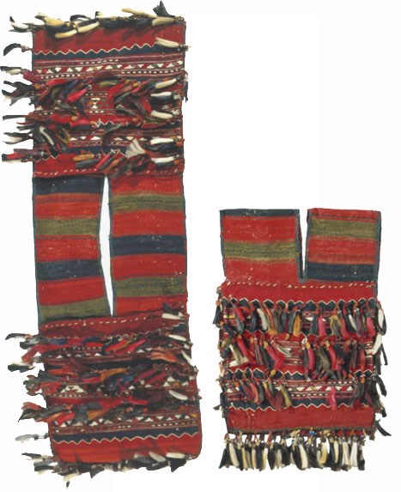
Mayan Stela with Queen Ix Mutal Ahaw Limestone
761 CE
Mexico Guatemala or Belize
Featherwork tabard
Peru, north coast, Chimu style
ca. 15th century
Cotton and feathers
The Textile Museum
Bag
Turkey, Bergama region
First half of the 20th century
The Textile Museum

Slide 11
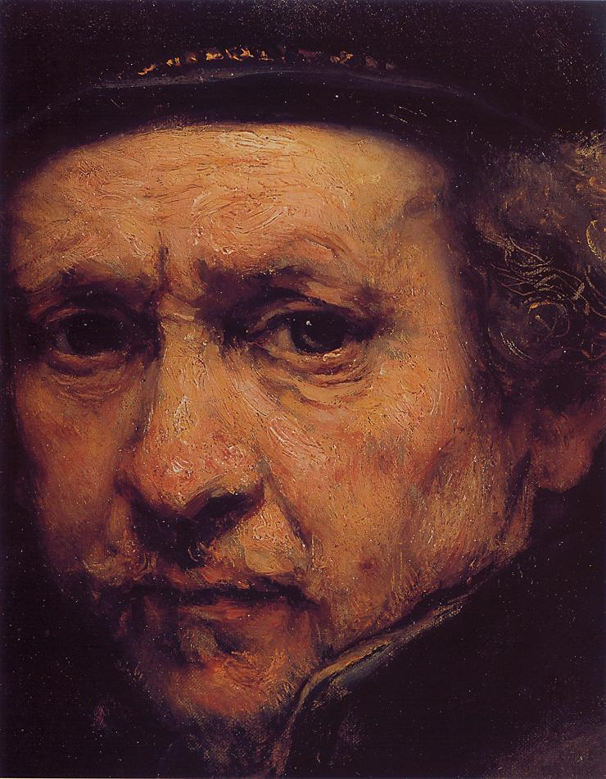
Impasto– the application of thick oil paint in a texture that would be rough if you were to touch it
Rembrandt
Notes:
11

Slide 12
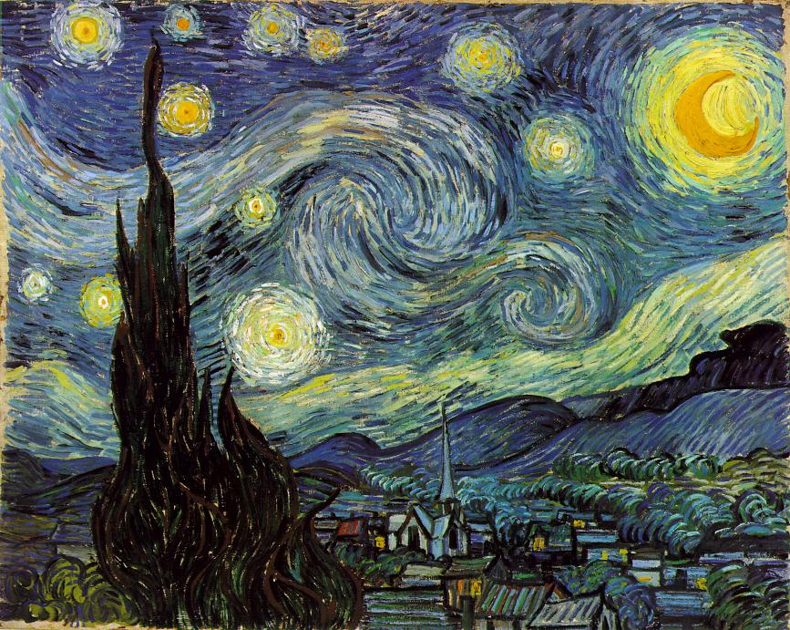
VAN GOGH, Vincent
The Starry Night
1889, Oil on canvas, 29 x 36 1/4 in
Notes:
12

Slide 13
Visual
Implied
Simulated
Texture
What TEXTURE
do you see?

Slide 14
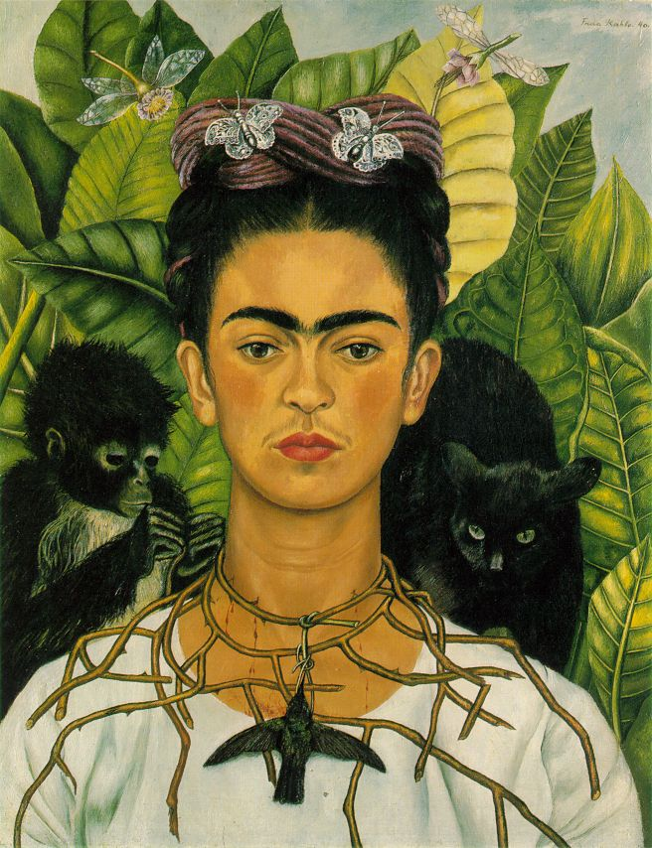
Kahlo, Frida
Self-Portrait
1940
Oil on canvas
24 1/2 x 18 3/4 in
Harry Ransom Humanities Research Center, Austin

Slide 15
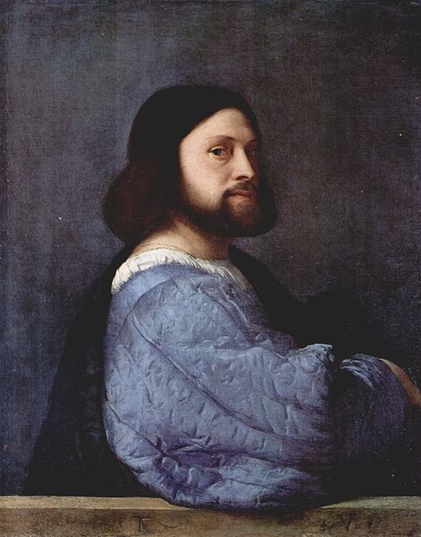
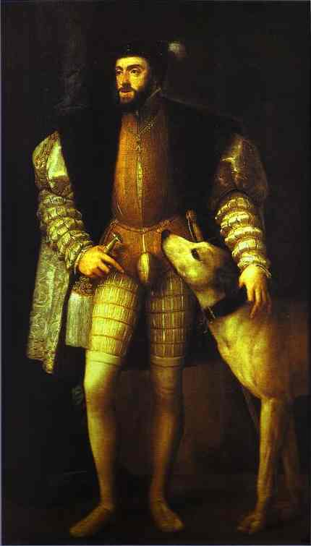
Titian
Portrait of a Man. c.1512. Oil on canvas. The National Gallery, London, UK.
Portrait of Charles V. 1533. Oil on canvas. Museo del Prado, Madrid, Spain

Slide 16
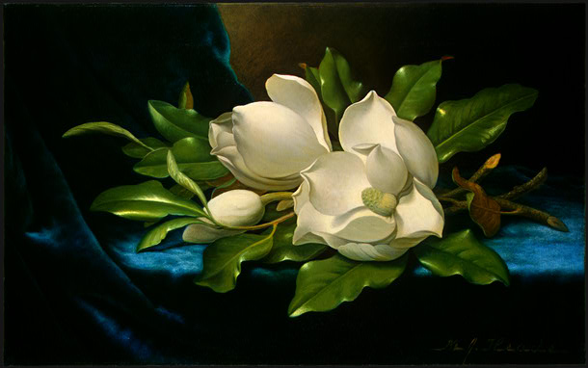
Martin Johnson Heade (painter)
American, 1819 - 1904
Giant Magnolias on a Blue Velvet Cloth, c. 1890
oil on canvas
National Gallery of Art

Slide 17
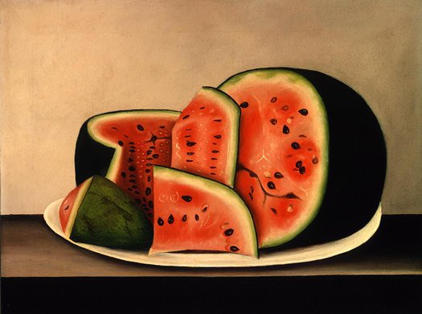
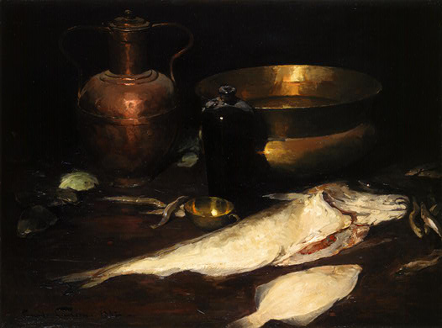
American 19th Century
Watermelon on a Plate, mid 19th century
National Gallery of Art
Emil Carlsen (artist)
American, 1853 - 1932
Still Life with Fish, 1882
oil on canvas
National Gallery of Art

Slide 18
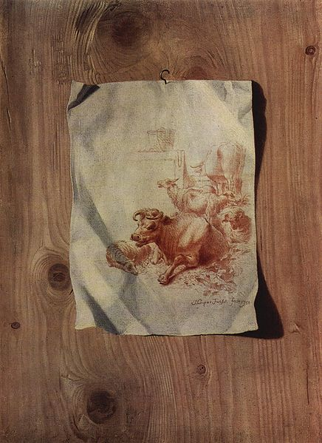
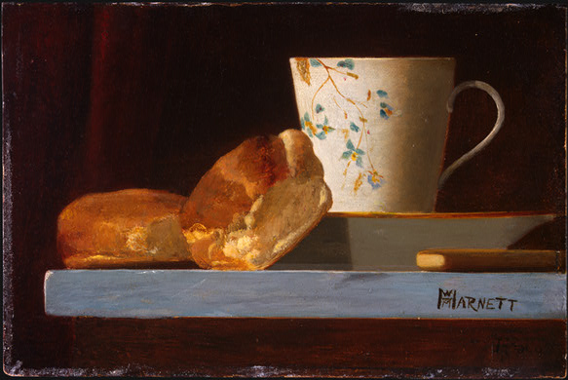
Trompe l’oeil (trump loy, French) means to fool the eye . Trompe l’oeil painting tricks the viewer into perceiving that the actual objects represented are in fact there; usually a still-life painting and used in murals. It is an art technique involving extremely realistic imagery in order to create the illusion that the depicted objects have texture and to be in three dimensions.
John Frederick Peto
Breakfast, c. 1890s
Collection of Mr. and Mrs. Paul Mellon
1999.79.29
Trompe l'œil by Henry Fuseli (1750)

Slide 19
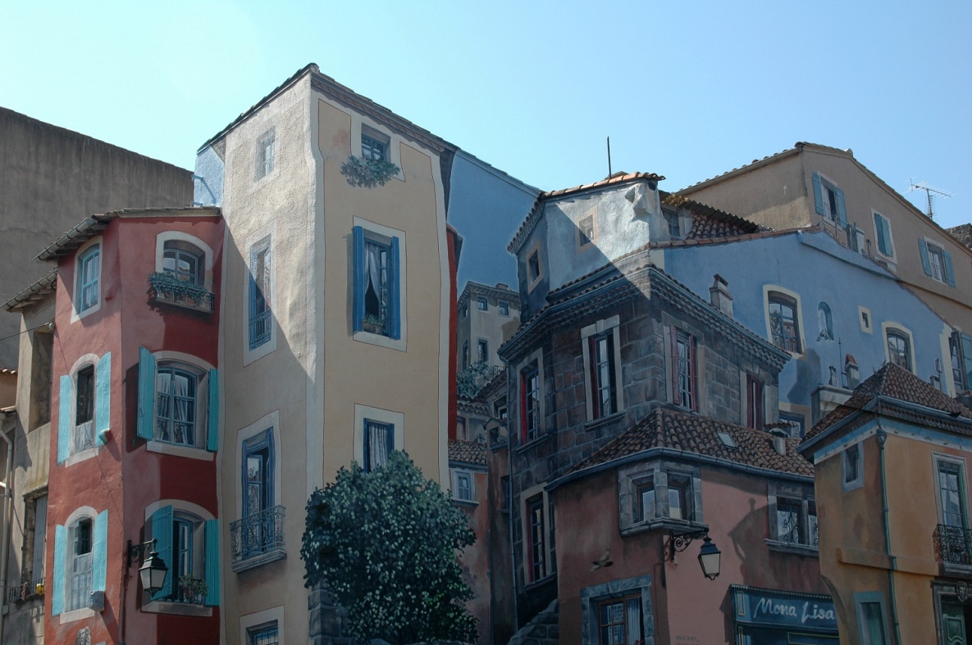
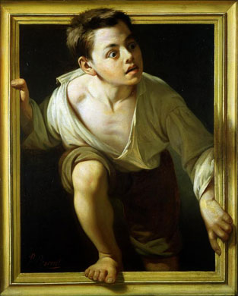
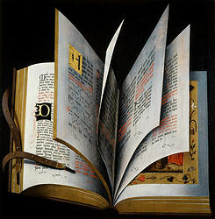
Ludger tom Ring the Younger
Open Missal, c. 1570
oil on oak panel transferred to Masonite
National Gallery Of Art
Escaping Criticism by Pere Borrell del Caso, 1874

