Slide 1
How do we keep buildings safe from lightning?

Slide 2
Lightning Facts:
Lightning is an electric current.
Lightning can heat the air it pass through to 50,000 degrees Fahrenheit.
Lightning usually strikes trees and tall buildings because they are elevated.
Lightning strikes can cause building fires.

Slide 3
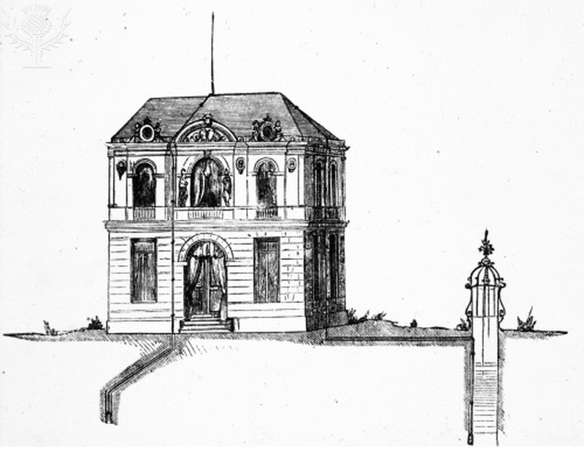
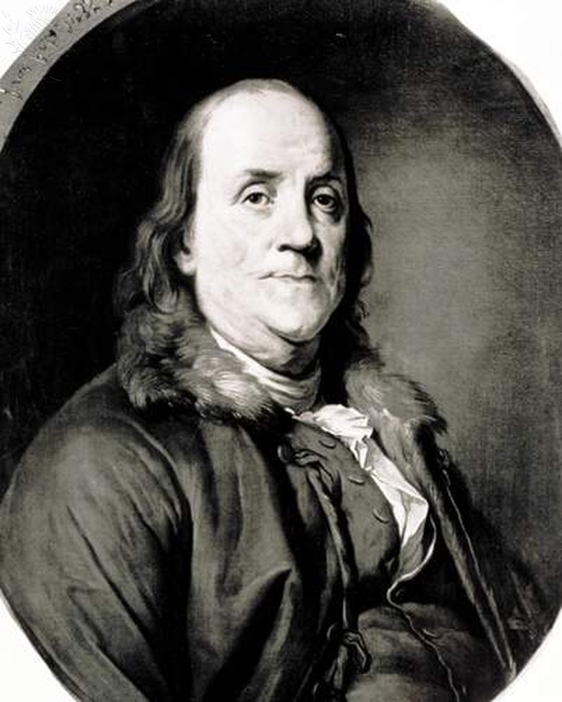
Benjamin Franklin invented a lightning rod to protect important buildings from strikes.

Slide 4
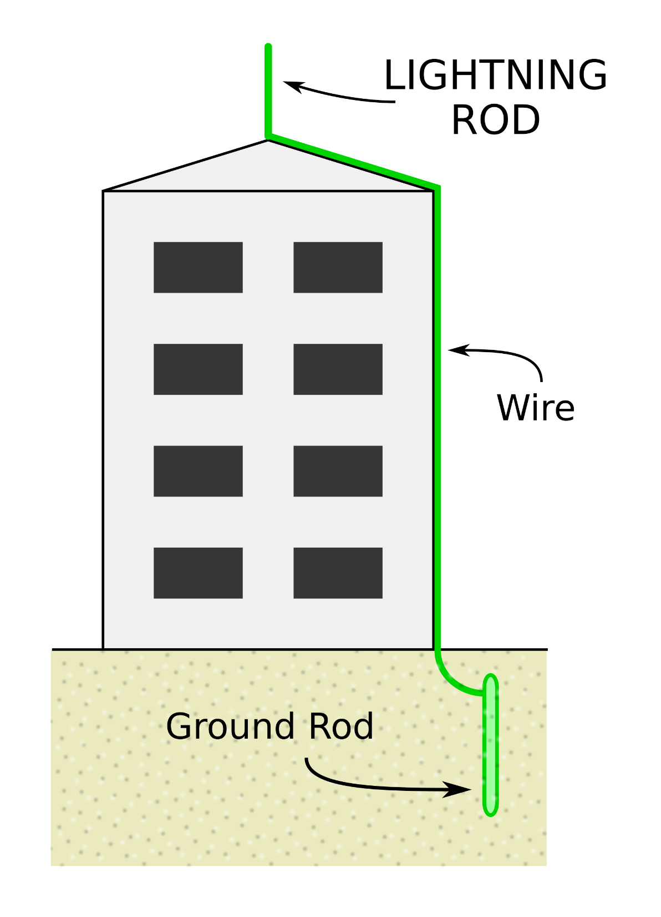
How do lightning rods work?
Lightning rods stand taller than other buildings or trees in the area.
They are made of metal (aluminum or copper) which conducts electricity.
When lightning strikes, the electricity travels down into the ground instead of into the building.

Slide 5
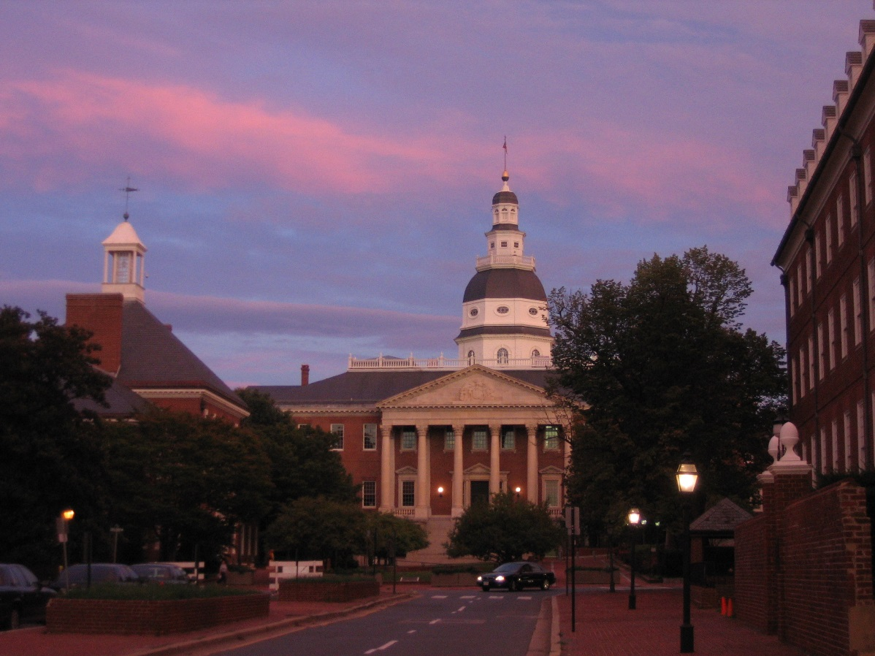
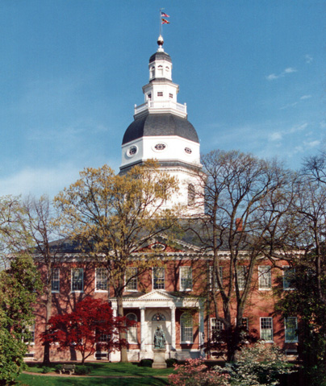
Maryland’s State House in Annapolis has a Franklin-style lightning rod.
It is more than 200 years old.

Slide 6
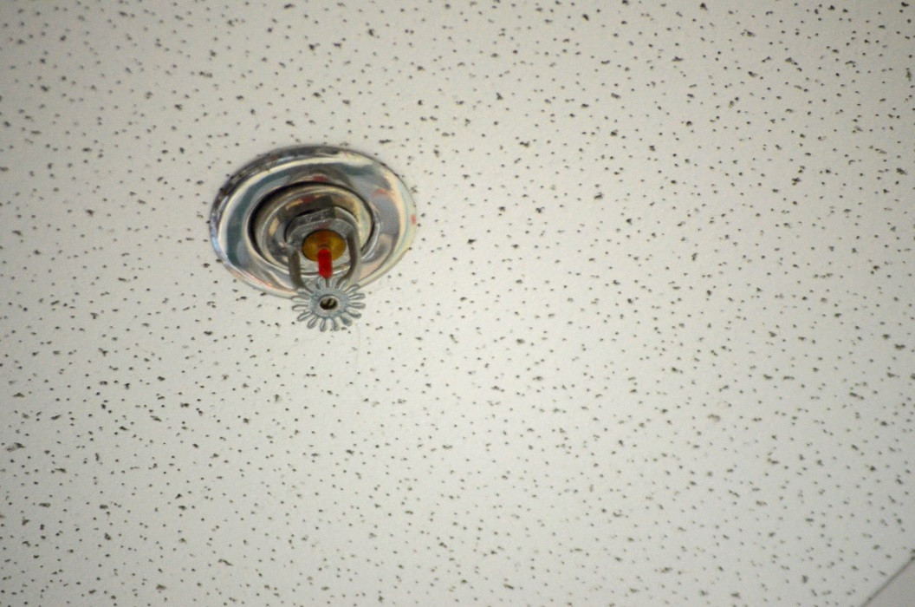
In July 2016, lightning struck the Maryland State House. The strike activated the water sprinkler system, but no fire occurred.
Officials are not sure where lightning struck the building.

Slide 7
Do you think the lightning rod on the Maryland State House helped to protect it from the dangerous strike?
Why or why not?

Slide 8
For more information about the Maryland State House being struck by lightning, visit the following web article:
Franklin-designed Lightning Rod Saves Historic Maryland Building

Slide 9
Photo Credits:
Photos on slides 3, 4 and 6 taken from the Encyclopedia Britannica rights-cleared ImageQuest site.
Photos on page 5 taken from msa.maryland.gov

