Slide 1
Fact and Opinion
Notes:
This is an opportunity to define fact and opinion. Students use the artwork to come to an understanding of what a fact and opinion is. This is meant as a quick lesson to teach fact and opinion and then lead into choosing credible sources. Students look at a “false fact” and discuss where they could search to prove this fact. Use this an opportunity to transition into teaching credible sources.

Slide 2
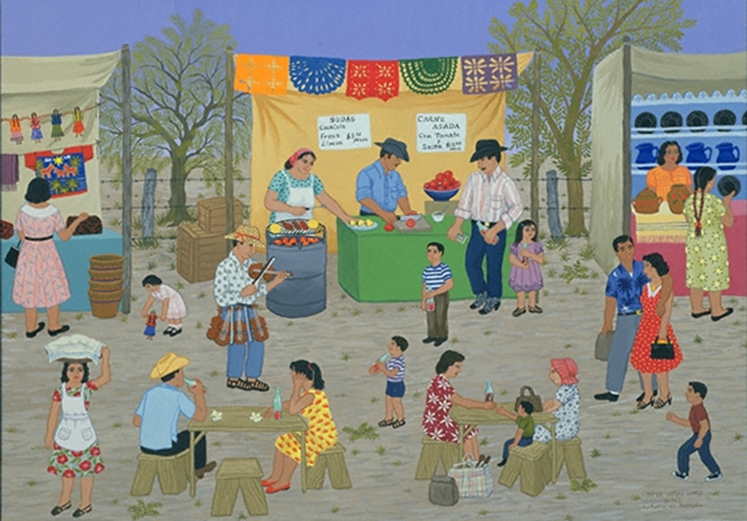
Write down 3 things you see in this painting
I see….
Notes:
Teacher notes: Let students share out some of the things they see.

Slide 3
Write down 3 things you feel about this painting
I feel…
Notes:
Teacher note: Let students share out what they feel.
Compare some of the feelings. Is is ok that some of us feel different things about this painting?

Slide 4
How is what you see different from what you feel?
Notes:
Teacher note: Go back to the examples of what they see. Does everyone see the same thing? (For example, I see trees in the background. Does everyone see trees in the background? Yes. This is true about the painting)
How about how we feel? Is that the same for everyone? (No, students will feel differently about the painting)
Pose the question, why are there many different answers when I ask you how you feel? Share out.

Slide 5
Blue is the best color.
You go to school in Anne Arundel County.
George Washington was a great president.
The Chesapeake Bay Bridge is the longest bridge in America.
Notes:
How we feel about something is an example of an opinion. Does anyone know what we call something that is true for everyone? (A fact)
Share examples. Ask students, is this a fact/true/can be proven or is it an opinion? How do you know? Challenge the students to change the statement to make it a fact if they can.
When a fact appears, ask students how they know it is a fact. (it can be proven) How can we prove it? What sources will help us prove this statement?
The final statement about the Chesapeake Bay bridge is not an opinion, but it is also not a fact. Use this as an opportunity to explain that there are statements that appear to be facts, but are in fact not true. We call these false facts. Challenge students to come up with ways to prove this statement (internet search).

Slide 6
Do your facts pass the test?
A fact is…
accurate
true
can be proven
Notes:
Revisit our statements about what we saw in the first image…Were these statements facts? How do you know?

Slide 7
All facts are not created equal.
It is OK to question facts…think about who said it!
If a friend says you are sick…is that a fact? Do you trust the source?
What if a doctor says you are sick? How does that change your feelings?
Notes:
Good to question information, is it a opinion, a fact or is it a false fact? How would you find out? What do you need to consider when trying to prove if information is actually a fact?
This will lead into the idea of using credible sources when looking for facts.
If students need more practice with fact and opinion, provide additional examples or challenge them to create their own examples of each, including a possible false fact.

