Slide 1
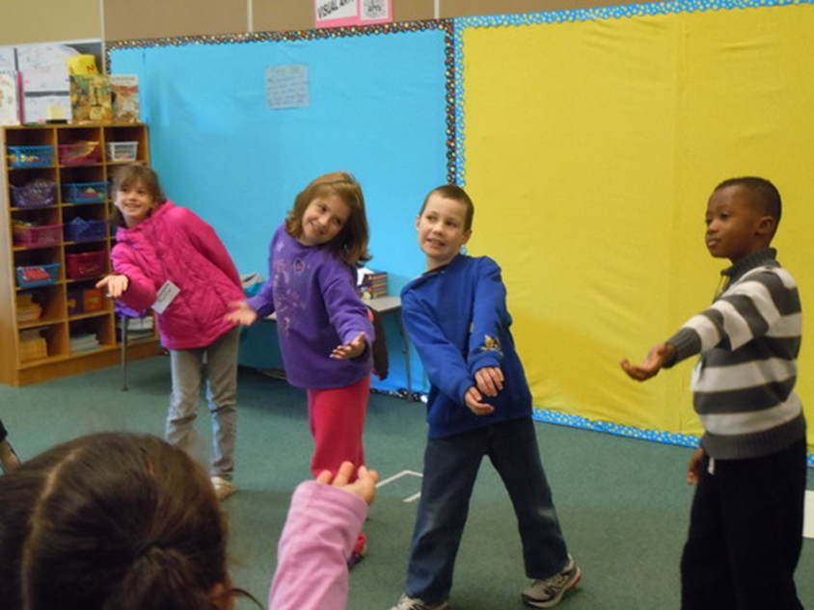
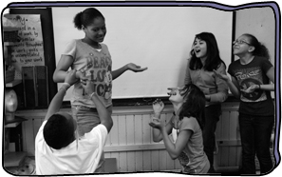

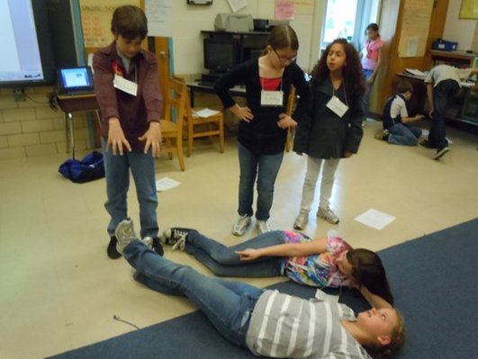
Drama Strategy: Freeze Frame
( frozen statue)

Slide 2

Acting Tools and Skills
Imagination
Voice
Body
Cooperation
Concentration
Notes:
In Freeze Frame we use all of the actor’s tools except Voice!
Imagination – You must imagine what it looks like and what it feels like to be the character in the scene. You
• Agree to pretend to be characters and objects in different settings.
• Interact with real and /or imagined characters and objects.
• React to imaginary sights, sounds, smells, tastes, and textures.
Mind – In your mind, when you plan, enact, observe and reflect on your work you
• Analyze a character’s personality, traits, thoughts, and feelings
• Differentiate between reality and fantasy
• Recall and/or retell the predetermined story in correct sequence
• Reflect upon dramatic work to improve its quality.
Voice – If you incorporate dialogue to communicate information you
• Vary vocal tone and pitch to create character voices and/or sound effects
• Create and deliver dialogue that is in character – accurately communicating information about the character and his/her circumstances
• Speak with expression that reflects the personality, traits, thoughts, and feelings of the character.
o Project – speak loudly enough to be heard
o Articulate – speak clearly enough to be understood
o Modify word tempo – speak slowly enough to be understood
Cooperation –its important to cooperate to make the audience see the ideas and/or feelings you are trying to communicate as a whole. You
• Follow instructions
• Listen to peers and the teacher
• Remain silent when cued
• Remain frozen when cued
• Collaborate with peers and the teachers
• Alter actions and responses based on side coaching—suggestions and prompts provided by the teacher during the drama
• Demonstrate respect for ideas contributed by peers
Concentration- You must be able to focus intently on the given drama task. You
• Remain in character
• Speak only as the character
• Control inappropriate laughter
• Attend and respond appropriately to the other characters
• Disregard actions and noises unrelated to the drama
Audience- When you are an audience member observing the work of others, you
• Differentiate reality from fantasy
• Agree to pretend and accept the fictional world of drama
• Demonstrate respect for the work of the actors
o Watch quietly
o Listen carefully
o Refrain from distracting others
o Show appreciation

Slide 3
Step 1: Personal Space
Find your KINOSPHERE bubble (your personal space with room to move without touching others). Stand in a neutral position ( hands down at your side, feet slightly apart) so you are ready to move!
Notes:
Creates a safe personal space in which to experiment with drama or dance.
Guided imagery helps establish the fictional reality.
Facilitates classroom management. “If you bump into someone else’s bubble- it will break and you must sit down to repair it.”
Practice moving around in the personal space, play a few rounds of elimination exercises.
Students must have arms length space in front, back and side.

Slide 4
Step 2: Shake and Freeze
Find a Point of Concentration. When I say, “Freeze!” you want their eyes fixed on that dot or spot.
Shake your arms, legs, heads, shoulders and move about in your personal space, until I say “Freeze!”. You should stop and focus your eyes on the Point of Concentration.
Remain focused and stay focused on the spot no matter what as I walk around the room.
Notes:
Shake and Freeze –to introduce Freeze Frame
In this activity students hone their concentration skills by learning to fix their eyes and energy on one particular focal point.
1. Invite students to stand in their Personal Space.
2. Provide for the students a specific spot that you want them to focus on, e.g. the letter b in the alphabet chart on the wall, the doorknob, the purple magnet on the board, etc. Make the spot very specific. Explain to the students that this spot is called their Point of Concentration. Explain to the students that when you say, “Freeze!” you want their eyes fixed on that dot or spot.
3. Ask the students to shake their arms, legs, heads, shoulders walk around in circle, reverse the pattern and then say, “Freeze!” The students should then focus their eyes on the Point of Concentration.
4. Ask the students to stay focused on that spot as you walk around the room and look at each of them. Side coach the students as you walk.
5. If this is difficult for the students, have them hold their concentration for a shorter period of time or don’t walk around the room at first. Give them time to build their ability to focus. Once the students get better at this you can increase the challenge by having them:
Find their own Point of Concentration when you say, “Freeze!” Side coach them to be sure to choose a spot that does not move and is not a person. If they are facing another person, the spot should be over that person’s head.
Find their Point of Concentration in a different direction than their body is facing when they you say, “Freeze!” For example, if when you stop them they are facing the window, they would need to instantly find a Point of Concentration behind them, beside them, etc.
Have a student walk around the room instead of the teacher and look at each student. It is more difficult for students to remain focused when a peer looks at them.
6. Ask the students to relax and discuss what they learned through the activity.

Slide 5
Step 3: FREEZE FRAME/
Wax Museum
  FREEZE FRAME: Everyone, independently, strike a frozen pose for the following scenes (remember—no talking, no props.) Start at a neutral position! Hold your action pose for 3 seconds.
    Hitting a home run
    Arguing with your sister
    Being surprised by a loud noise
    Trying to open a cap of a jar that is stuck
5
Notes:
Use for word development, concepts, parts of speech, character traits, concepts . . .
Individual, pair, or small group
Drama CUES to Use:
Actors, show me you are ready for drama--Hands and laps clear. All eyes focused on the speaker.
When I say go, but not before I say go--Students watch, listen and wait for further instructions.
Places--Students stand in their correct places prepared to begin the drama.
Action--Students begin acting. They move and/or speak as their characters.
Freeze--Students stop whatever they are doing, are silent, and stand still.
Curtain--Indicates the end of the scene or drama. Upon hearing this students are no longer in character.

Slide 6
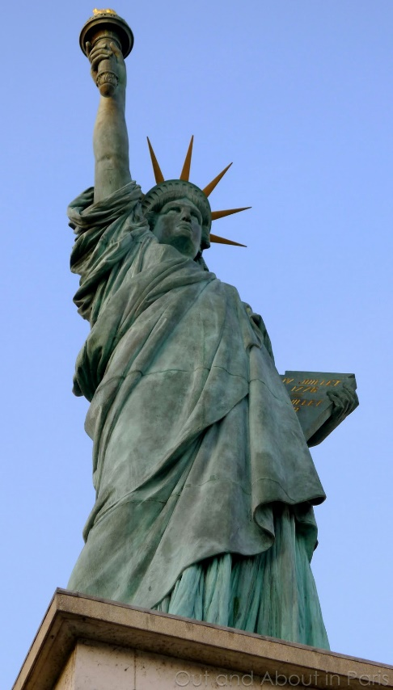
It’s YOUR Turn!
Actors: Are you ready??

