Slide 1
Looking at Mobiles Alexander Calder
For additional information and lesson plan ideas see:
http://mcachicago.org/archive/collection/CalderLesson.html
http://www.albrightknox.org/research/educator-resources/lesson-plans/lesson:alexander-calder-s-visual-poetry-mobiles-and-stabiles/#materials
http://artsedge.kennedy-center.org/educators/lessons/grade-5/Alexander_Calder_Master_of_Balance
For an interactive mobile maker see:
http://www.nga.gov/education/classroom/interactive/mobile.htm
Notes:
A mobile is a type of kinetic sculpture constructed to take advantage of the principle of equilibrium. It consists of a number of rods, from which weighted objects or further rods hang. The objects hanging from the rods balance each other, so that the rods remain more or less horizontal. Each rod hangs from only one string, which gives it freedom to rotate about the string.
See: lesson ideas

Slide 2
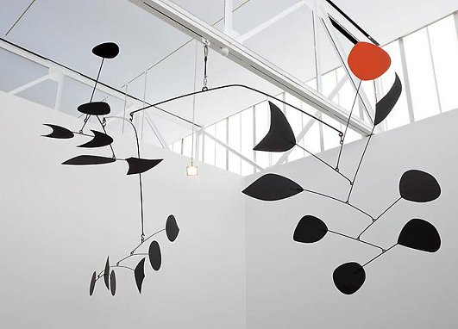
What do you SEE, THINK, WONDER?
Notes:
Alexander Calder

