Slide 1
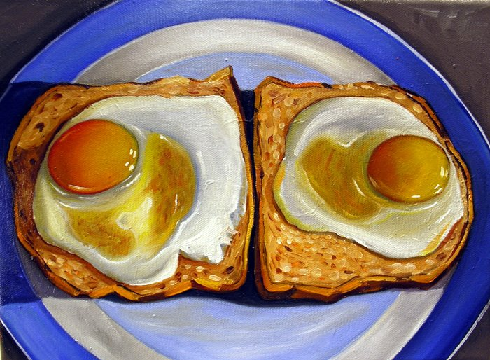
Notes:
Vic Vicini: Sunny Side Up

Slide 2
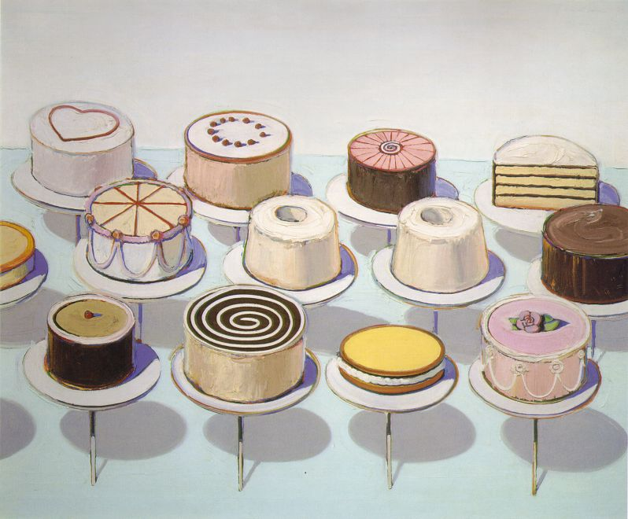
Notes:
Thibeaud

Slide 3
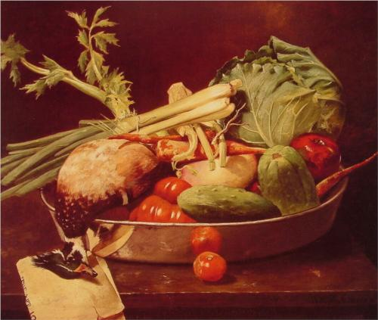
Notes:
Chase: Still Life with Vegetables

Slide 4
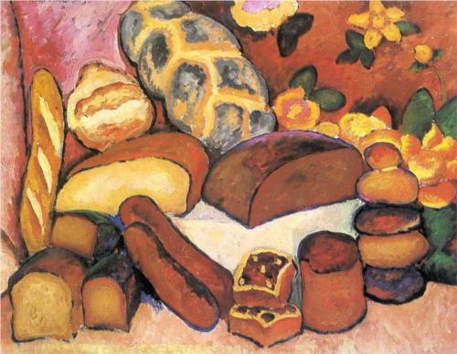
Notes:
Still life with bread Mashkov

Slide 5
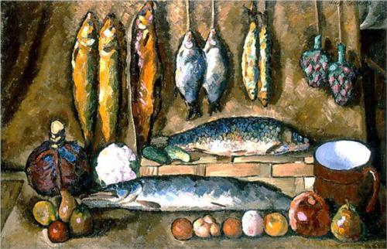
Notes:
Mashkov

Slide 6
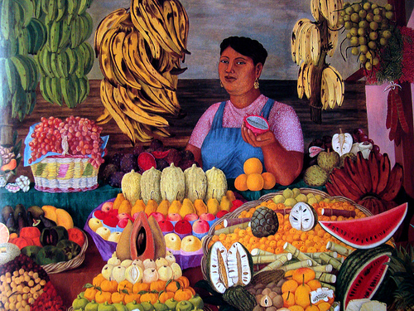
La vendedora de frutas, 1951, Olga Costa
Notes:
Costa, Olga (b Leipzig, 1913; d Guanajuato, 28 June 1993). Mexican painter of Russian descent. She went to Mexico in 1925 and attended the Academia de San Carlos, Mexico City (1933–6), where she met the painter JOSÉ CHÁVEZ MORADO, whom she married. In 1941 she co-founded the Galería Espiral, and in 1943 she founded the Sociedad de Arte Moderno, one of the first galleries to promote foreign artists in Mexico. From 1945 she exhibited regularly at the Galería de Arte Mexicano, Mexico City. Costa painted costumbrista subjects, depicting regional customs, as well as still-lifes, portraits and landscapes. Her style was traditionalist, without being folkloric in a popular manner. Her best-known work is perhaps the Fruit Seller (1951; Mexico City, Mus. A. Mod.). From 1966 she lived in Guanajuato, where she played an active role in local artistic activities. In April 1993 the Museo-Casa Olga Costa-José Chávez Morado was opened in León, Guanajuato.

Slide 7
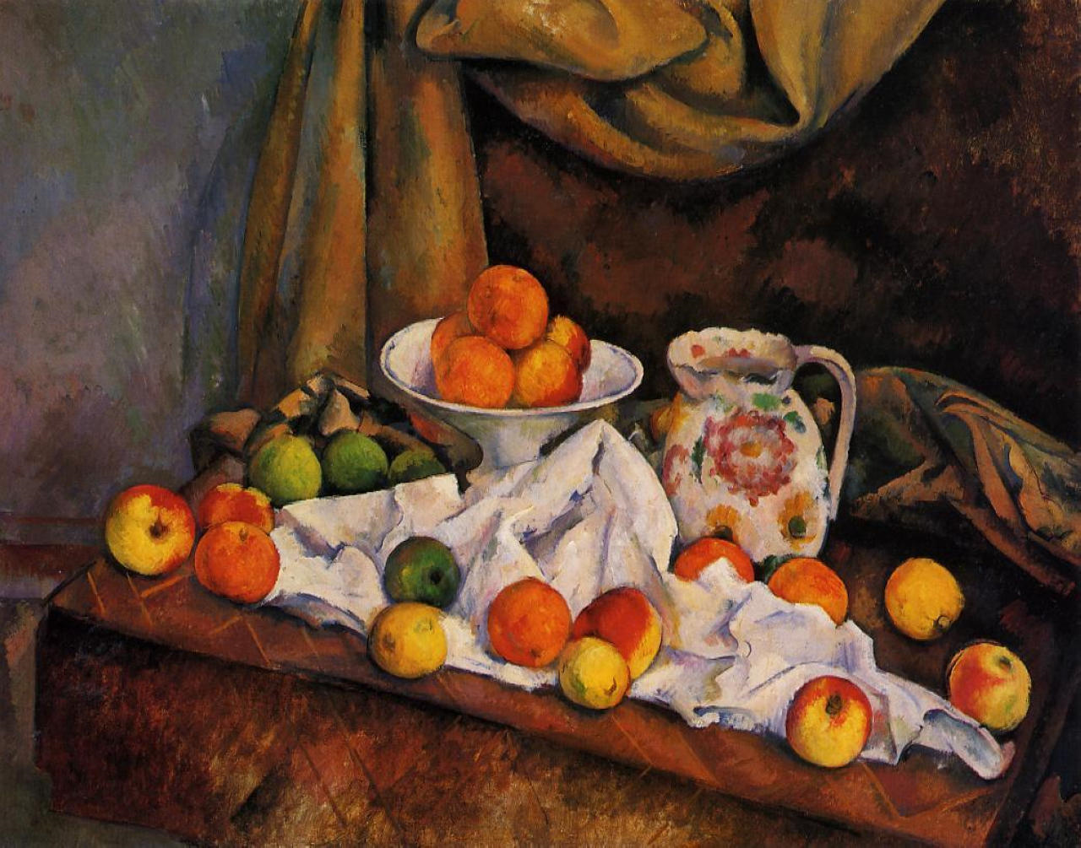
Notes:
Paul Cezanne: Fruit, Bowl, Pitcher and Fruit.

