Slide 1
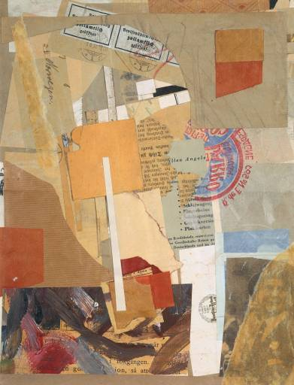
The Art of Collage
Kurt Schwitters, Opened by Customs, 1937-8, paper collage, oil and pencil on paper, 33.1 x 25.3 cm, Tate Gallery, London.

Slide 2
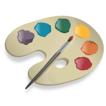
\
Word Splash: Predict how you think these words will connect to the lesson about collage. Write one or two sentences that contain as many of these words as you can to explain what you think you will learn.
foreground
overlap
jazz
texture
photos
depth
torn

Slide 3
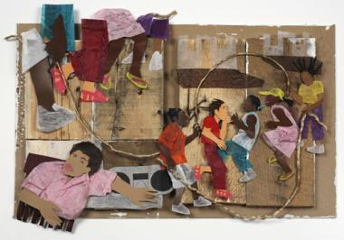
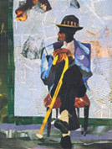
COLLAGE:
The word collage comes from the French word coller which means to glue or paste.
Pablo Picasso created this technique when he first glued a piece of oilcloth to one of his paintings.
Collage is, therefore, an artwork in which the artist glues bits of cut or torn paper; photographs or images torn from publications, fabric, or other materials to a flat surface.
Look at these examples

Slide 4
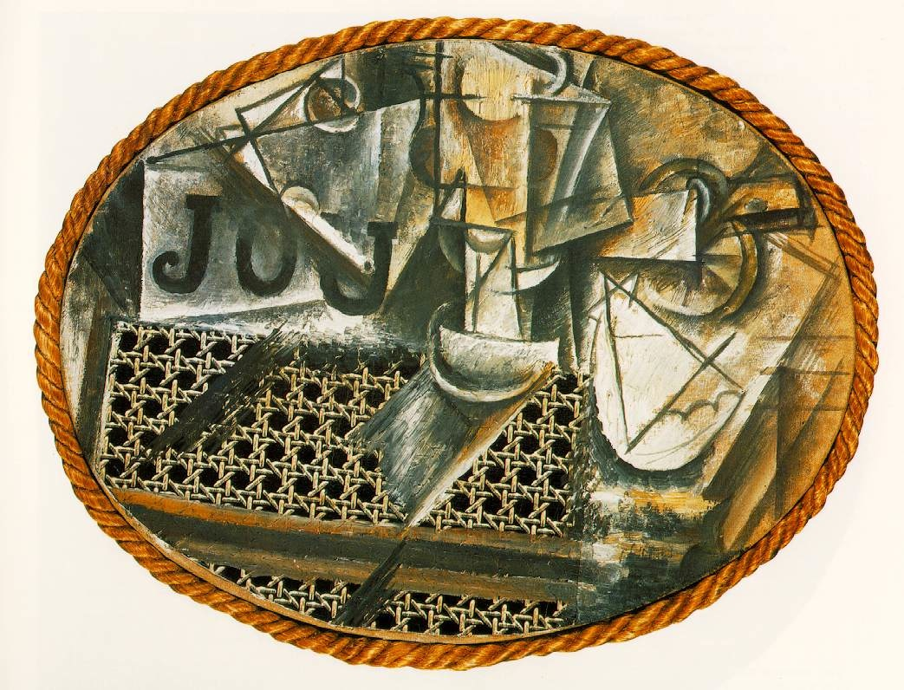
The first use of collage in fine art came from Picasso in 1912, one example being "Still-Life with Chair-Caning", in which he used printed oil-cloth that looked like chair-caning, as well as a rope encircling the painting to form a frame.
Notes:
The definition of collage, as found in the Oxford English Dictionary, is “an abstract form of art in which photographs, pieces of paper, newspaper cuttings, string, etc. are placed in juxtaposition and glued to the pictorial surface; such a work of art" [1]. Although it is considered an "abstract form of art", the materials used are pictorial and textual representations of recognizable objects. When placed next to each other, however, these representations may lose their autonomous meaning by creating a new, collective [2]. Collage came into the focus of the art world in the 20th century, often employing the "object trouve", or the "found object", and fixing these objects on a two-dimensional surface. Art historians often attribute the conception of collage as a reflection of the disorientation that resulted from the pace of the modern world. The first use of collage in fine art came from Picasso in 1912, one example being "Still-Life with Chair-Caning", in which he used printed oil-cloth that looked like chair-caning, as well as a rope encircling the painting to form a frame. Picasso's use of collage was followed by other Cubists, namely Juan Gris and Georges Braque. Picasso also began using cutouts from the newspaper, Le Journal, suggesting the implications of everyday events in art. Later in his career, Picasso being working with collage on three dimensional surfaces, as shown in his cardboard work, "Guitar" [3].

Slide 5
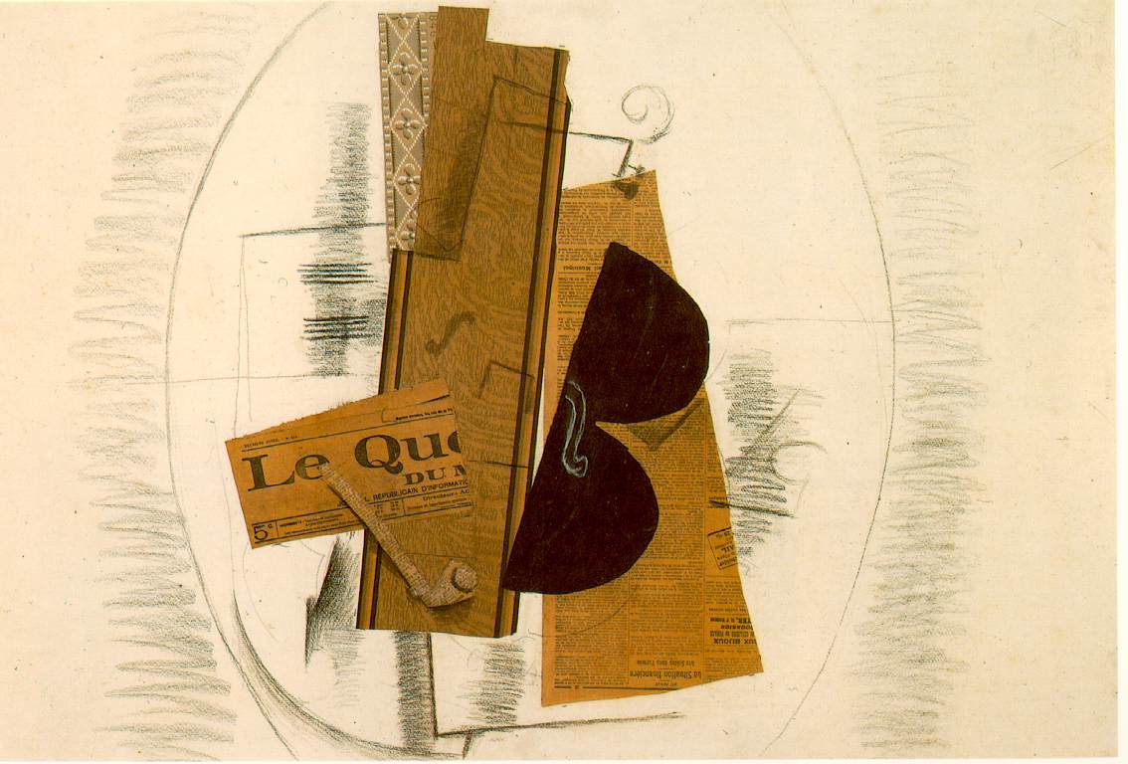
Georges Braque: Violin and Pipe (Le Quotidien)(1913)
Notes:
Braque's paintings of 1908–1913 began to reflect his new interest in geometry and simultaneous perspective. He conducted an intense study of the effects of light and perspective and the technical means that painters use to represent these effects, appearing to question the most standard of artistic conventions. In his village scenes, for example, Braque frequently reduced an architectural structure to a geometric form approximating a cube, yet rendered its shading so that it looked both flat and three-dimensional by fragmenting the image. He showed this in the painting "House at L'estaque". In this way, Braque called attention to the very nature of visual illusion and artistic representation.
Fruitdish and Glass, papier collé and charcoal on paper, 1912.
Beginning in 1909, Braque began to work closely with Pablo Picasso, who had been developing a similar approach to painting. At the time Pablo Picasso was influenced by Gauguin, Cézanne, African tribal masks and Iberian sculpture, while Braque was mostly interested in developing Cézanne's idea's of multiple perspectives. “A comparison of the works of Picasso and Braque during 1908 reveals that the effect of his encounter with Picasso was more to accelerate and intensify Braque’s exploration of Cézanne’s ideas, rather than to divert his thinking in any essential way.”^{[1]} The invention of Cubism was a joint effort between Picasso and Braque, then residents of Montmartre, Paris. These artists were the movement's main innovators. After meeting in October or November 1907,^{[2]} Braque and Picasso, in particular, began working on the development of Cubism in 1908. Both artists produced paintings of monochromatic color and complex patterns of faceted form, now called Analytic Cubism.
A decisive moment in its development occurred during the summer of 1911^{[3]}, when Georges Braque and Pablo Picasso painted side by side in Céret, in the French Pyrenees, each artist producing paintings that are difficult—sometimes virtually impossible—to distinguish from those of the other. In 1912, they began to experiment with collage and papier collé.
Their productive collaboration continued and they worked closely together until the outbreak of World War I in 1914 when Braque enlisted in the French Army, leaving Paris to fight in the First World War.

Slide 6
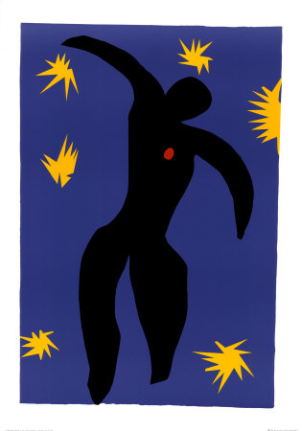
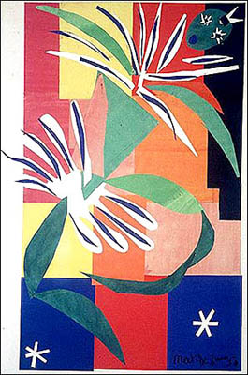
“Icarus”
Watercolor and gouache on cut and pasted papers
Henry Matisse

Slide 7
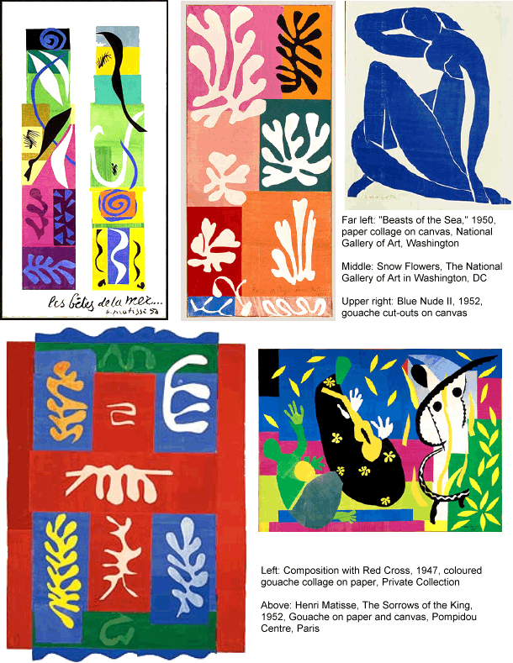

Slide 8
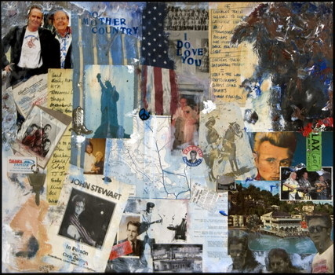
P.J. Stewart

Slide 9
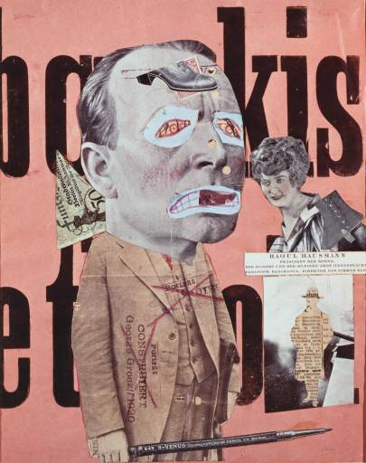
Raoul Hausmann, Untitled, undated, lithograph and photographic collage on paper, 31.8 x 25.4 cm, Tate Gallery, London.

Slide 10
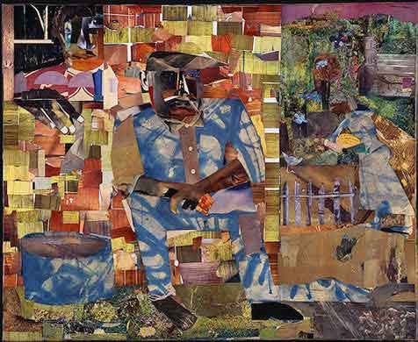
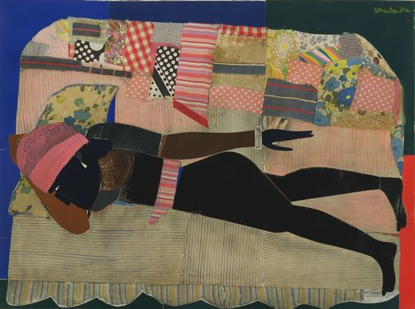
The collage art of Romare Bearden (1911-1988).
Combining inspiration from jazz and the blues, classical mythology, Chinese calligraphy, the African American experience, and certain European painters and collage artists, Bearden's work is incredibly diverse in medium, symbols, and style.
Tomorrow I May Be Far Away, 1967
Patchwork Quilt

Slide 11
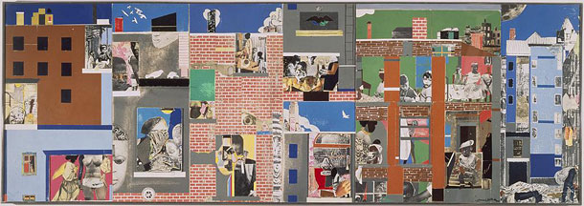
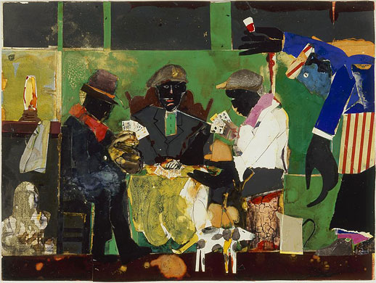
The Block II
What kind of shapes and visual textures do you see in Bearden’s collages ?
The card players

