Slide 1
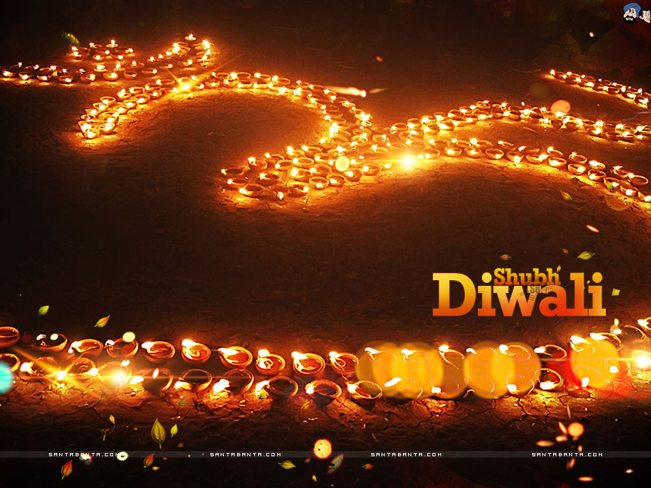
The Art of Diwali
Festival of Lights
India

Slide 2

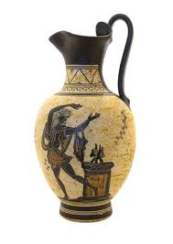
Artifact Examination
Become an
ANTHROPOLOGIST!
Can you figure out the story?
An artifact is any object made by or used by human beings.
Every artifact tells a story about the people who made it and used it.

Slide 3
Look!
Ask Questions!
What does it look like?
-describe the COLOR, SHAPE, LINE
What is it MADE of?
Who and what is it USED FOR?
What is it?
Notes:
Ask Questions.
Of what kind of materials is this object made?
How was this object made? Who made this object? Why?
Who mused this object? How was this object used?
Does the design of the object suit the purpose and/or use?
Are there any marks, stains, changes, damages, alterations of this object?
What size is the object?
Is the object decorated? How? Why?
Is this an item a person might have one or several? Why?
Are other items made out of the same materials? How?
Is this object used with other items? How?
Is this object made by using other items as part of the process? How?
Is this object used to make other items? How?
Are any items today similar to this object?
What are the similarities or differences? Why?
PIECE TOGETHER THE BIGGER PICTURE

Slide 4
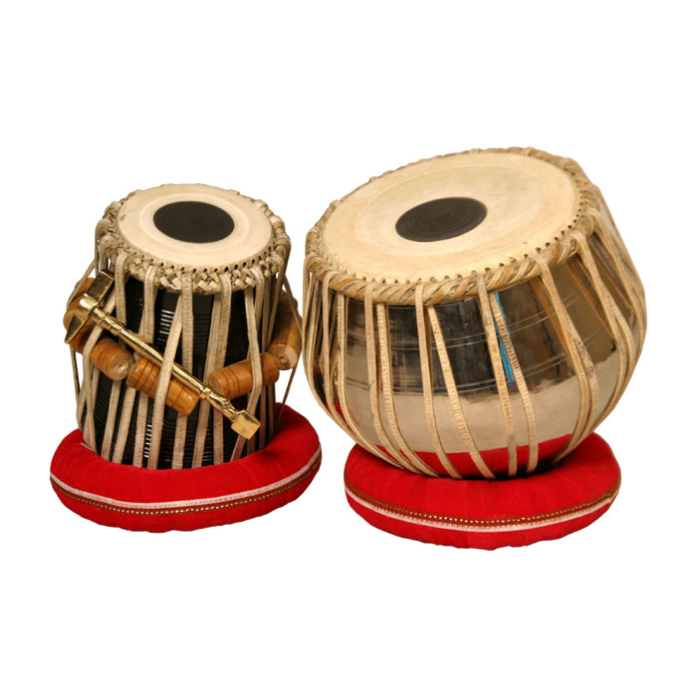
What COLORS do you see?
What types of LINES do you see?
What MATERIAL is the artifact made of?
What might it be used for?
What is it?
http://www.teachertube.com/viewVideo.php?video_id=158534
Notes:
A set of tabla is comprised of two drums: a smaller drum called dayan (and also known as tabla), which is played with the dominant hand, and a larger drum, the bayan (also known as duggi) which is played with the off hand. Both drums are roughly 10 inches high.
Both drums feature complex drum heads, known as puri, consisting of several parts. There is a main skin which is covered by a second layer of skin on top, cut away in the middle to leave a ring around the edge. These layers are woven together around the edge using a long leather strap, called the gajra. Finally, the distinctive black dot in the middle of the skin is called the siyahi (also known as the gob), which is a compound made from iron powder, flour, and other ingredients. The siyahi attenuates the harmonic overtones of the drums, giving them their pitched quality. The siyahi on the dayan is centered, while the siyahi on the bayan is off to one side.
The dayan is a slightly conical drum made of wood, with a wider base and a skin covering the narrower open end. The head of the drum can vary from a little under 5 inches up to 6.5 inches, depending on the style of music being played. The head of the drum is fastened to the body by means of a very long leather strap which is woven around the drum in a V pattern, starting at a ring at the base of the drum and going up through a hole in the gajra, then back down and so on. There are always 16 holes around the edge. Wooden cylinders are wedged in between the straps (one cylinder for every 2 holes/4 strap lengths) to increase the tension and enable tuning.
The bayan is a large, bowl-shaped drum made of metal (copper or brass are favored, although one can find aluminum and iron bayans as well). Clay is also used, but is more rarely seen. The diameter of the bayan is usually around 9 inches. The head is fastened to the body in the same way as the dayan, but without the need for wooden cylinders. In some cases, short wooden rods of a much narrower diameter will be used to keep up tension. Another method of fastening the head uses a light rope which is then tightened using sliding metal rings.

Slide 5
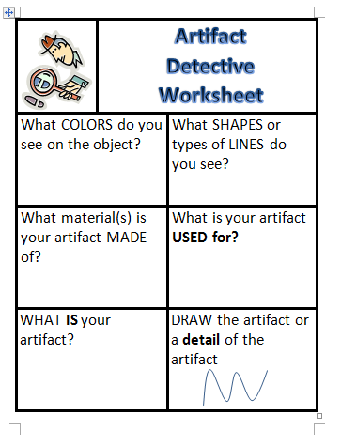
Artifact Detectives
Work with a partner
Look and ask questions
Fill in the answers

Slide 6
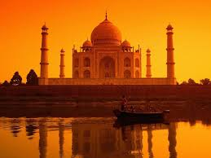
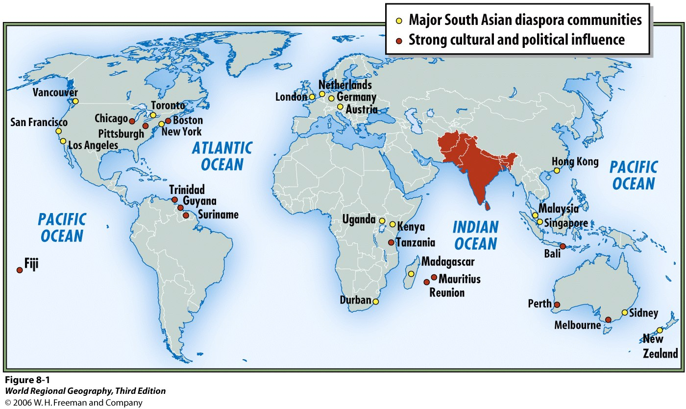
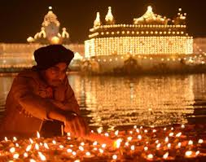
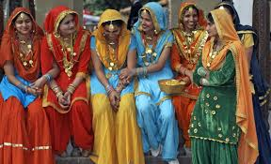
Where do they come from?

Slide 7
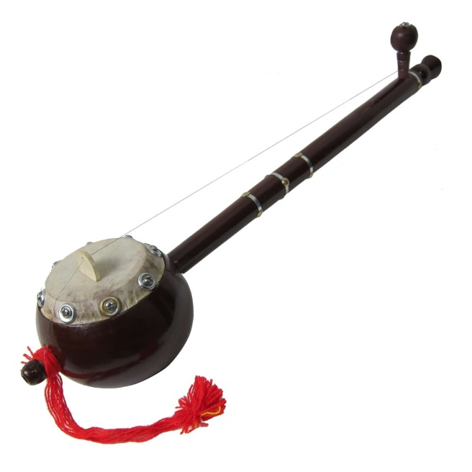
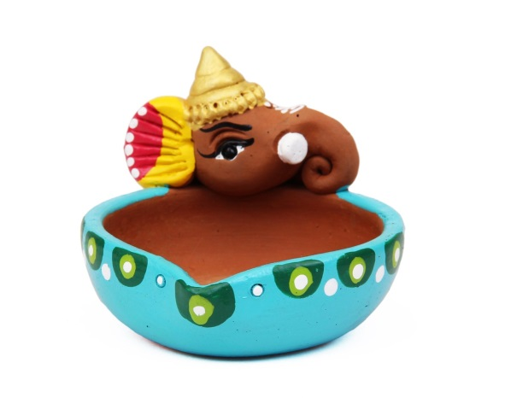
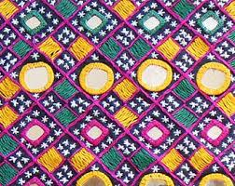
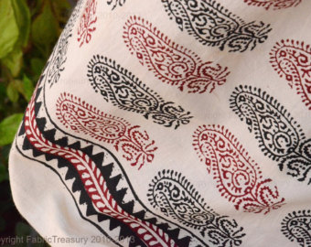
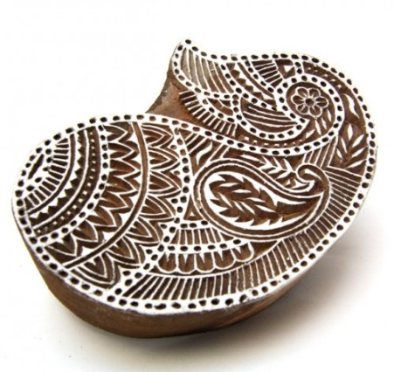
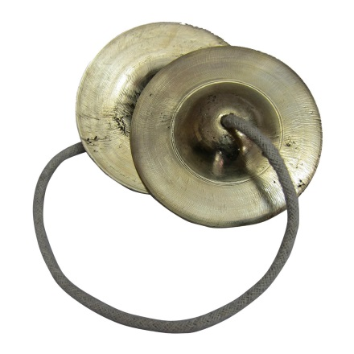
Diya
Iktara
Hand Embroidered
Mirrored Fabric
Paisley Indian Wood Block Textile Printing Fabric Stamp
Manjeera
Notes:
Iktara is a single string folk music instrument. It is usually associated with Mirabai, the saint singer of Rajasthan whose poetry proclaims her devotion to Lord Krishna. This instrument is very often used to accompany ballads in Punjabi folk singing. The stem is about 20 inches long, and the bowl is about 4 inches wide. Stem and bowl, both are made in wood. The single string passes over a small wooden bridge and is wound on a peg on the stem. A drone instrument able to produce the basic notes, it is often decorated with tassels and brightly painted.NB: This is a folk music instrument and is handcrafted by the artisans of village India. The folk music instruments are usually meant for sale in the rural local markets. The artisans use very simple and age old tools to make folk music instruments. Almost all folk music instruments therefore lack the finesse that we often see in classical instruments.
manjeera is a traditional percussion instrument of India. In its simplest form it is a pair of small hand cymbals. It is also known as manjeera, tala, jalra, khartal or kartal. Manjira has a significant importance in Gujarati Folk Music. Initially Manjira were played in Aarti of God & Goddess. In Gujarat, Manjira possess a significant importance & played in Bhajan, Santvani & Dayro. Though Manjira is a Small Metal Instrument, but it produces a sweet tinkling sound when struck together while doing Jugalbandhi with other Instruments. However, Manjira Playing is not an easy task, it requires a lot of Riyaaz (Practice) & deep knowledge of Sur & Taal. They often accompany folk or devotional music. It is used in various religious ceremonies of India, especially bhajans.

Slide 8
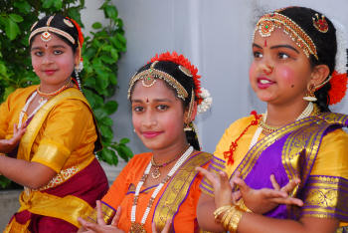
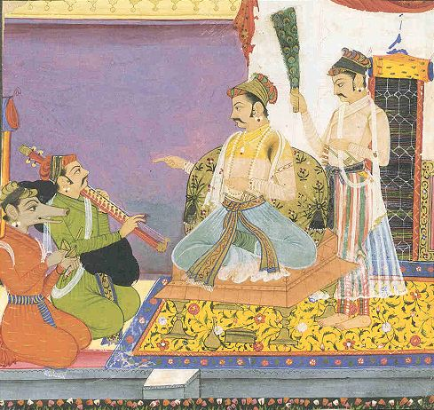
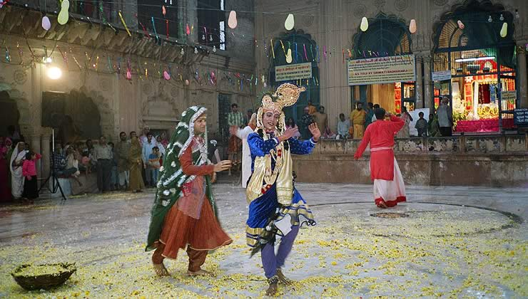
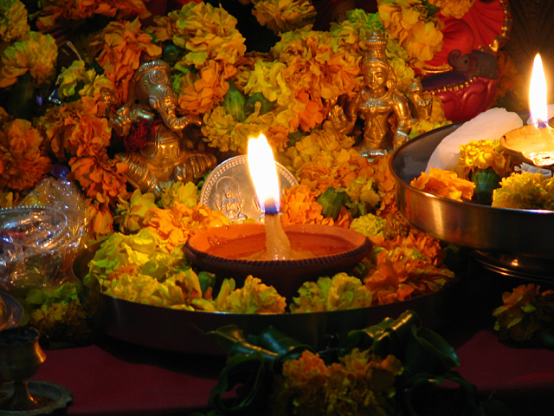
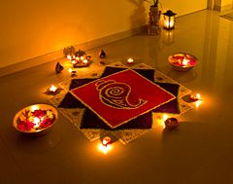
http://www.youtube.com/watch?v=9xB_X9BOAOU Music
http://www.folkways.si.edu/balakrishna-of-travancore/ragas-songs-of-india/world/music/album/smithsonian Music
http://www.pbs.org/thestoryofindia/gallery/photos/19.html
Diwali is the largest and most famous holiday celebrated in India. It marks the Hindu New Year. It is celebrated for five days.
http://video.nationalgeographic.com/video/places/countries-places/india/diwali-lights-festival/
Notes:
http://www.pbs.org/thestoryofindia/gallery/photos/19.html

Slide 9
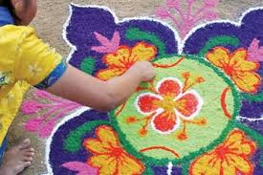
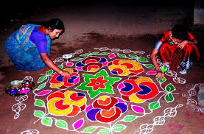
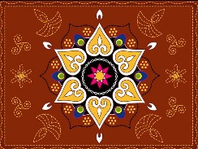
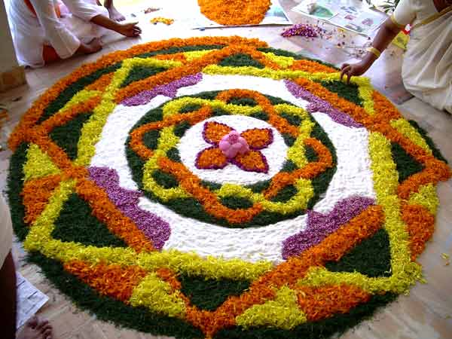
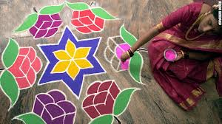
On the first day of Divali, Hindu families clean out their houses and leave the windows and doors of their houses open so that Lakshmi, the goddess of wealth, can come in. Colorful Rangoli patterns are drawn with colored rice flour or flowers on floors at the entrance of the home. The most popular design is a lotus flower.
Notes:
In preparation for Diwali, house and shops are scrubbed clean and doorsteps are decorated with multi-coloured designs called 'Rangoli'. Houses are painted inside and outside. New pots and pans are bought. Even the animals are washed, groomed and decorated. People wear their best clothes or buy new ones. Very often gifts are exchanged between families and friends.
Elaborate foods are prepared, and the food most typical of Diwali is a variety of sweetmeats beautifully decorated with nuts, spices and silver paper. The silver paper used
is edible. The lighting of fireworks is another essential feature of the Diwali festivities.

Slide 10
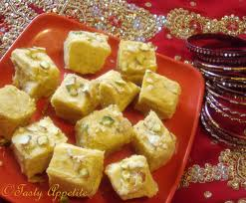
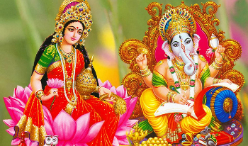
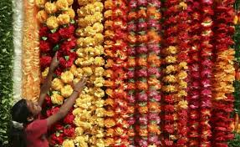
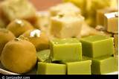
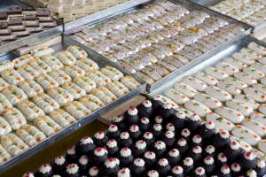
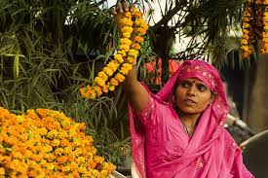
On Diwali you make offerings of sweets, dried fruits and flowers to Lakshmi and Ganesh for wealth and good luck. These are shared with friends and neighbors.

Slide 11
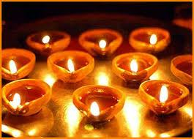
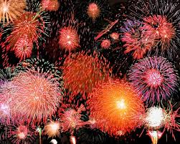
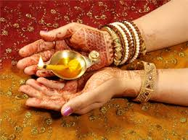
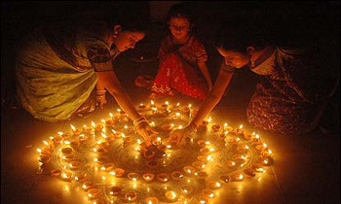
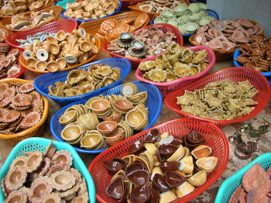
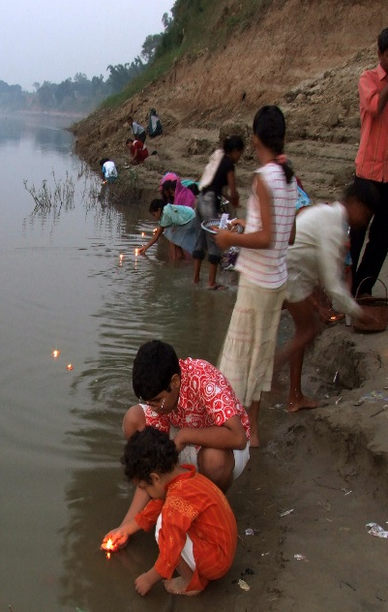
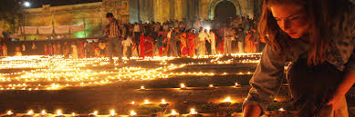
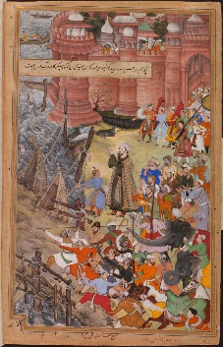
Festival of Lights
Diwali’s name comes from the Sanskrit deepavali, "row of lights." In the evening, families and communities light hundreds of small oil lamps, called diyas, on rooftops, yards, rivers, streets and on walls to help Lakshmi find her way into people's homes. They also light fireworks.

Slide 12
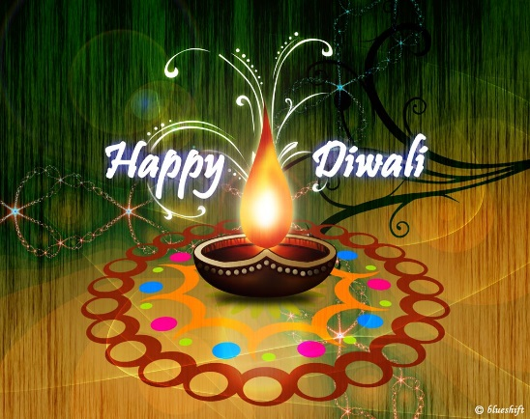
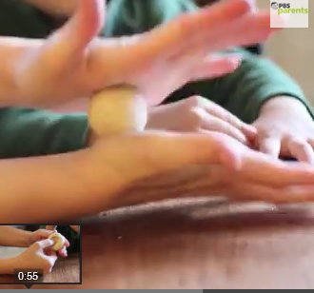
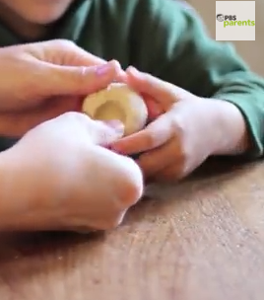
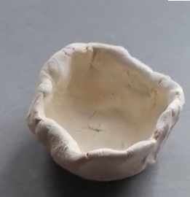
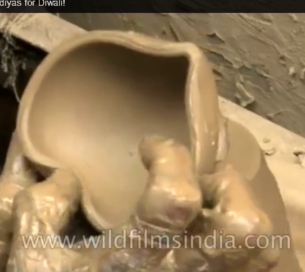
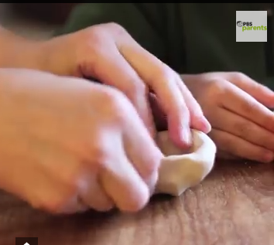
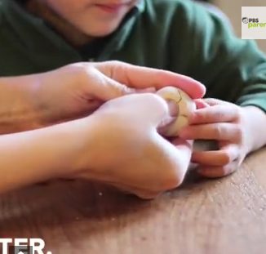
Let’s make a DIWALI Diya!
Become a pinch pot sculptor!
Step 1
Roll clay into a ball in your palm.
Step 2
Pinch a deep dent into the center with your thumb
Step 3
Pinch all the way around the edges.
Step 4
Continue pinching until you have formed a bowl.
Step 5 Use fingers to pinch one edge of your bowl into the shape of a diya.
See an Indian potter make a diya: http://www.youtube.com/watch?v=RI2XfyIS72U#t=52
Notes:
Pictures and instructions from: http://www.pbs.org/parents/crafts-for-kids/pinch-pots/
Pinch Pot method http://www.videojug.com/film/how-to-make-a-pinch-pot
Roll the clay into a ball
Stick thumbs into the center of the ball, pinching the sides to make a hollow (you're making a bowl shape, not a donut)
It should not be too deep (the flame of the candle should stick up over the top of the diya
Flatten out the bottom of the ball to make a nice flat surface for the Diya (so it will sit sturdily on a table without risk of it falling).
Let air dry or bake dry depending on the type of clay you are using.
Use acrylic paint to decorate the pot however you like. Some inspiration:
the colors of India's flag are green and deep orange
typically, Diyas were earthen pots so any brown, orange, yellow colors would be appropriate
Let dry.
Add tealight candle which you can actually light (make sure the flame doesn't touch the edges of the pot)
http://www.videojug.com/film/how-to-make-a-pinch-pot

