Slide 1
Landscapes in Art
Definition:
(noun) - Landscapes are works of art that feature scenes of nature: mountains, lakes, gardens, rivers, etc. They can be oil paintings, watercolors, gauche, pastels, or prints of any kind.
Derived from the Dutch word landschap, landscape can also refer to:
cityscapes - views of an urban setting
seascapes - views of the ocean
waterscapes - views primarily featuring fresh water (think of Monet on the Seine)
History:
http://www.museumnetworkuk.org/landscapes/history/history14th.htm
Notes:
Landscape painting ranked fourth in the hierarchy of genres set up by the Academy. History painting, portraiture, and genre painting were considered more important. Still life was considered less important.

Slide 2
Do you see it?
No matter where the landscape artist chooses to set up his easel, he will have to confront the central problem posed by all landscapes-creating the illusion of deep space on a flat canvas. When done well, the effect can be spellbinding. We feel that we can enter the painting and continue walking for miles. Landscape artists know that there are certain techniques that work. Five "space tricks"
1. A winding path. A path or river that winds through the landscape from foreground to background can make us believe that the picture describes a deep space. 2. Changes in size. A tree that is close to us appears much larger than a tree of the same size that is far away. 3. Overlap. A boulder that is close to us overlaps and partially hides a much larger cliff behind it. 4. Changes in clarity. A distant mountain range appears more hazy and less distinct than a mountain that is closer. 5.Diagonal composition. Land that moves away from us on the diagonal appears to move back into space.
FROM http://www.smithsonianeducation.org/educators/lesson_plans/landscape_painting/creating_illusions.html

Slide 3
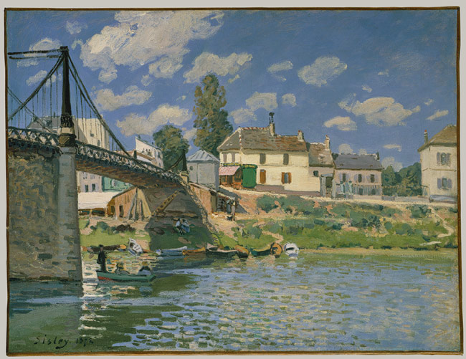
Notes:
The Bridge at Villeneuve-la-Garenne, 1872 Alfred Sisley (British, 1839–1899) Oil on canvas

Slide 4
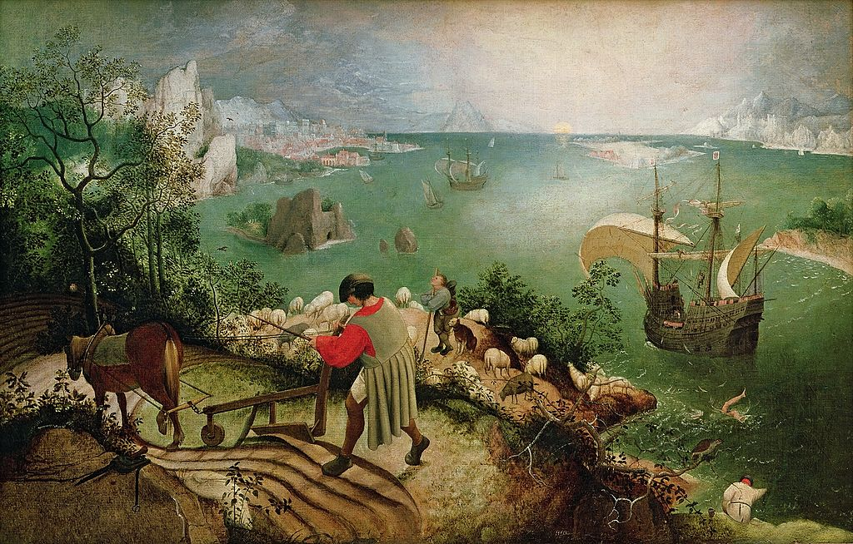
Notes:
Brueghel, Pieter the Elder_ Landscape with the Fall of Icarus_1555

Slide 5
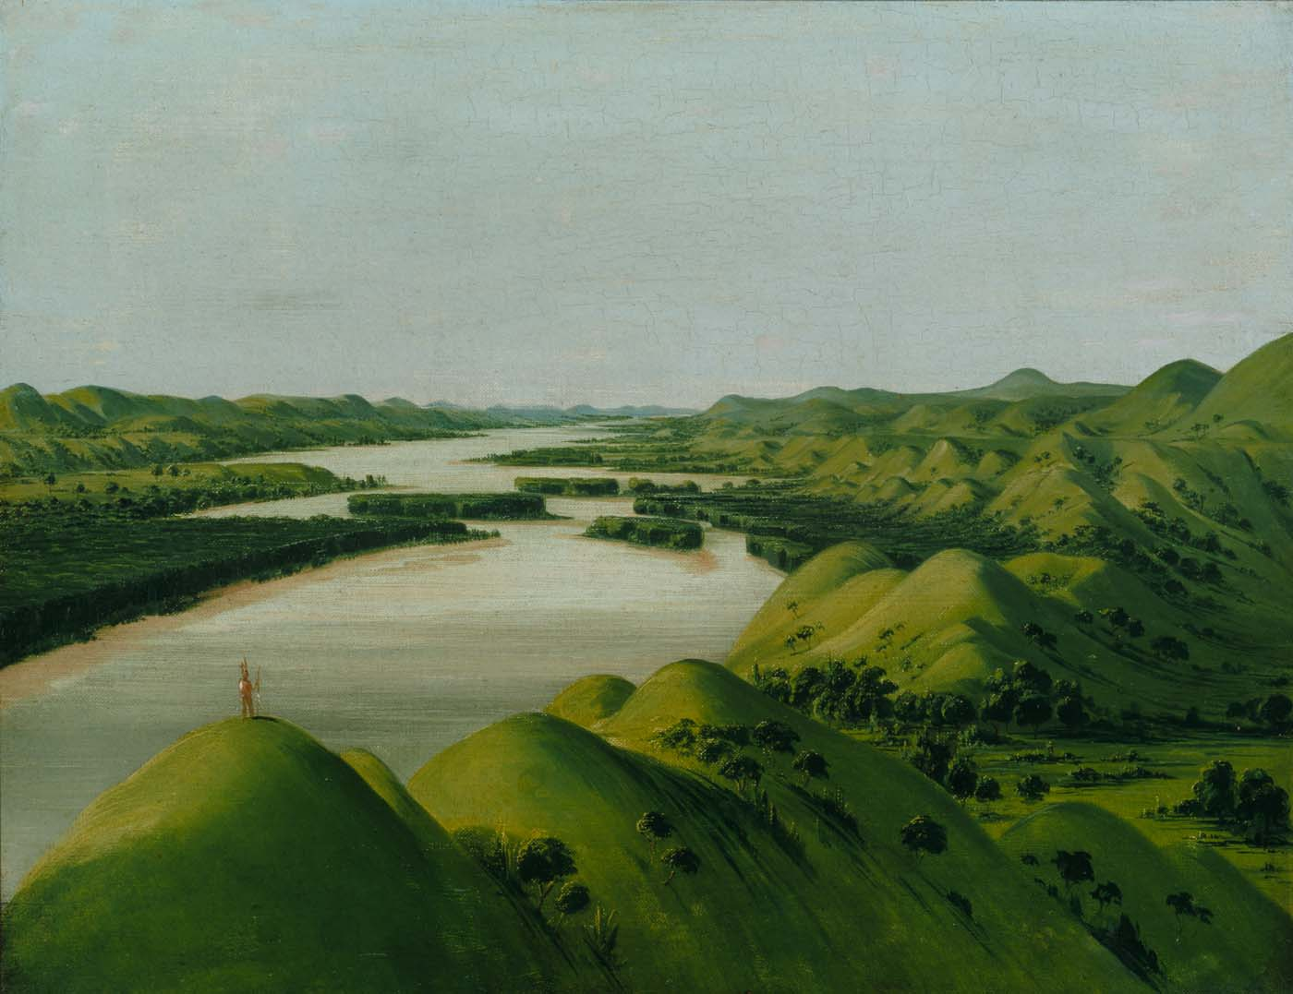
Notes:
River Bluffs, 1320 Miles Above St. Louis
1832 George Catlin

Slide 6
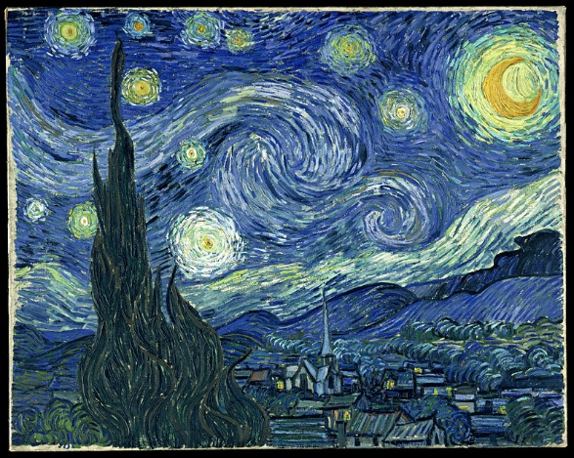
Notes:
Vincent Van Gogh Starry Night 1889

Slide 7
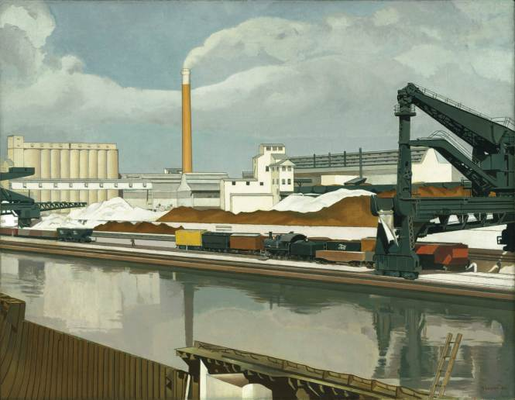
Notes:
Sheeler’s “American Landscape” (1930) adopted the formal conventions of the landscape painting, down to the solitary human form provided to indicate the scale of all else, but, of course, the striking feature of Sheeler’s landscape is the total absence of land. The entire environment has been “mechanized.”

Slide 8
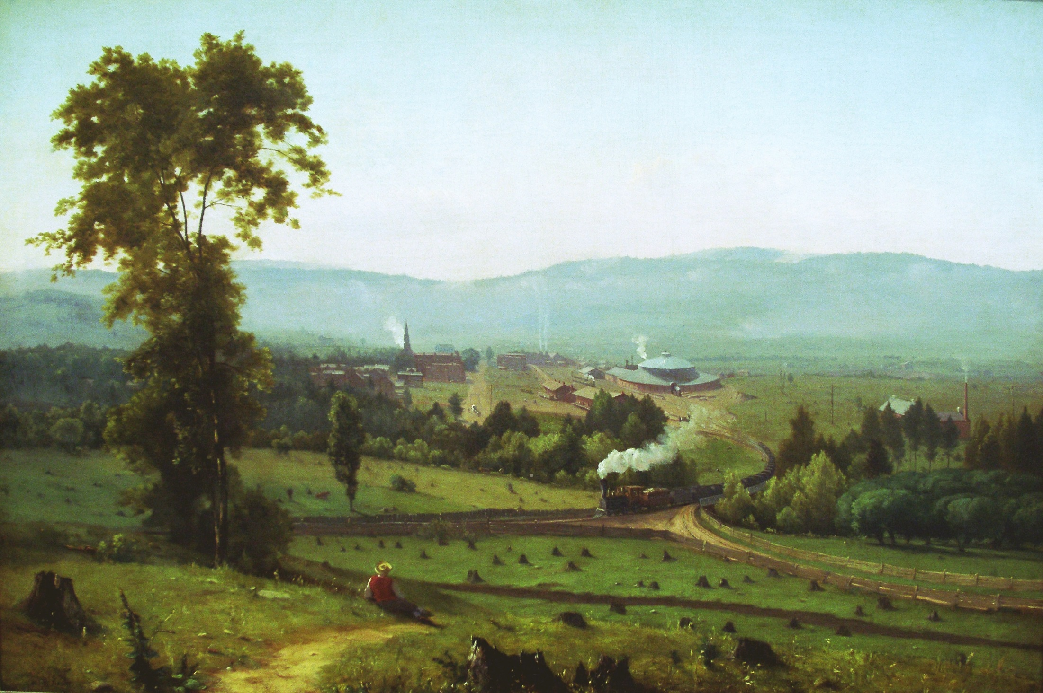
Notes:
In “The Lackawanna Valley” (1855), George Innes depicts a more traditional landscape, but he has incorporated the machine into the scene, both by the presence of the train winding its way toward the foreground and the smoke rising from the mills or factories further in the background

Slide 9
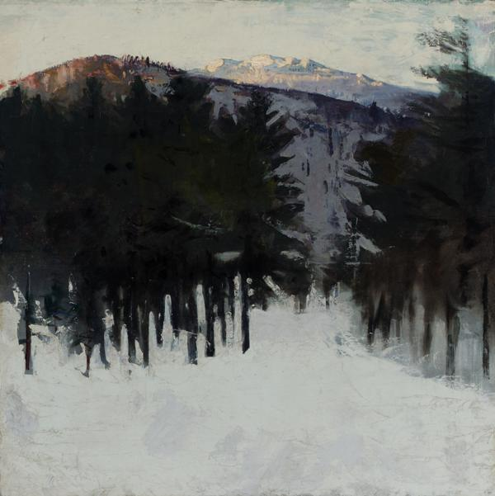
Notes:
Monadnock No. 2; Abbott Handerson Thayer; 1912; oil on canvas

Slide 10
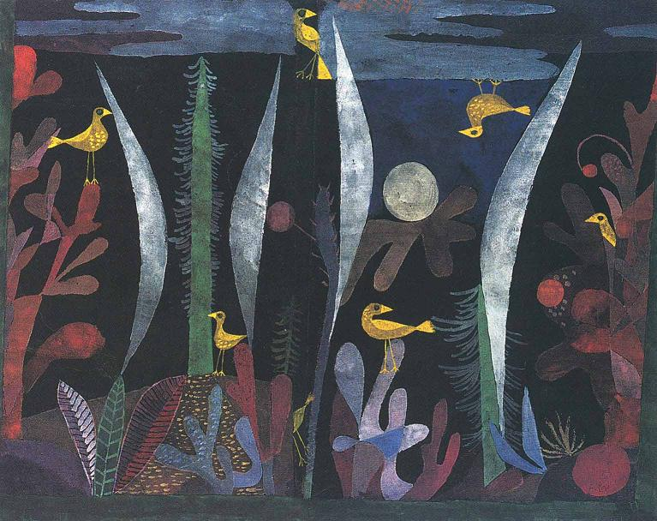
Notes:
Landscape With Yellow Birds
Date unknown
by Paul Klee

Slide 11
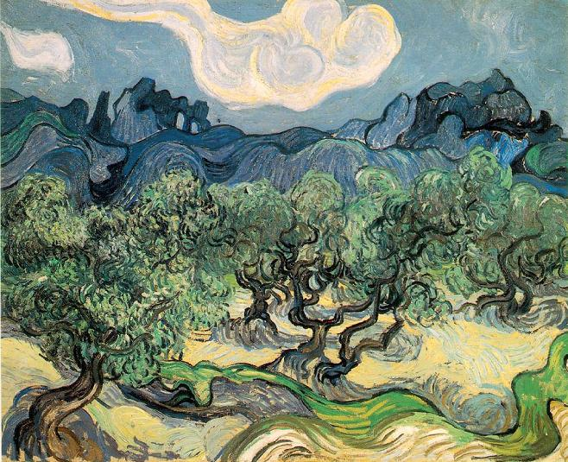
Notes:
Olive Trees
1889
by Vincent van Gogh

Slide 12
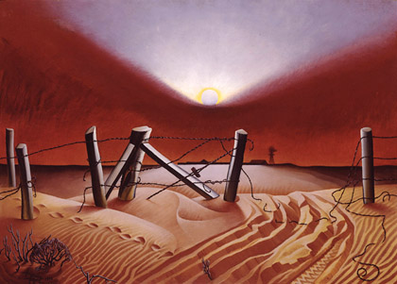
Notes:
Hogue, Alexandre. Dustbowl 1933

Slide 13
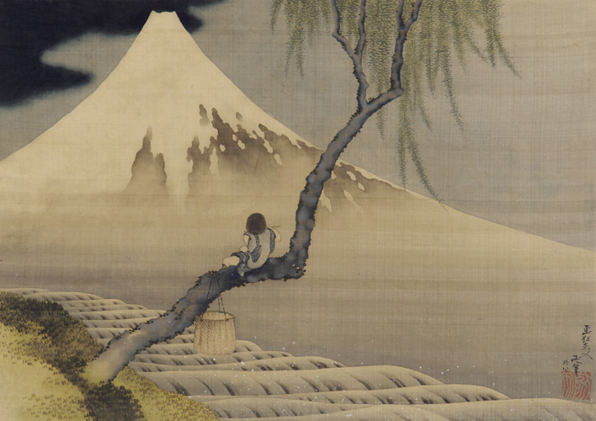
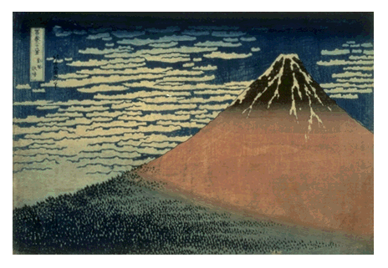
Notes:
Hokusai

Slide 14
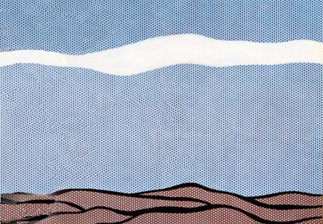
Notes:
Roy Lichenstein, Landscape, 1964 POP ART

