Slide 1
Creating Portraits of Community Helpers
People in Art: Portraits
CCSS RI2 With prompting and support, identify the main topic and retell key details of a text.
THEATRE: 3.1.c Creative Expression and Production: Explore the expressive qualities of a variety of locomotor and non-locomotor movements to create characters . (FREEZE FRAME)
VISUAL ARTS: 3.1.a Creative Expression and Production: Experiment with art media, processes, and techniques and identify ways they can be used to express thoughts and feelings. (PORTRAITS)
Notes:
See: https://www.nationalgalleries.org/play/play-menu/what-is-a-portrait
A portrait is a painting, photograph, sculpture, or other artistic representation of a person, in which the face and its expression is predominant. The intent is to display the likeness, personality, and even the mood of the person. For this reason, in photography a portrait is generally not a snapshot, but a composed image of a person in a still position. A portrait often shows a person looking directly at the painter or photographer, in order to most successfully engage the subject with the viewer.
What is a portrait? According to the dictionary it is a picture of a person, a description. It can be a photograph, a sketch, a sculpture, but a portrait is so much more than that. It is collaboration between the subject and in this case the photographer.
Often a portrait includes inanimate objects that refer to the subject's identity.
Artlex: Portrait - A work of art that represents a specific person, a group of people, or an animal. Portraits usually show what a person looks like as well as revealing something about the subject's personality. Portraits can be made of any sculptural material or in any two-dimensional medium. Portraiture is the field of portrait making and portraits in general.
Portrait is a term that may also refer simply to a vertically oriented rectangle, just as a horizontally oriented one may be said to be oriented the landscape way.

Slide 2
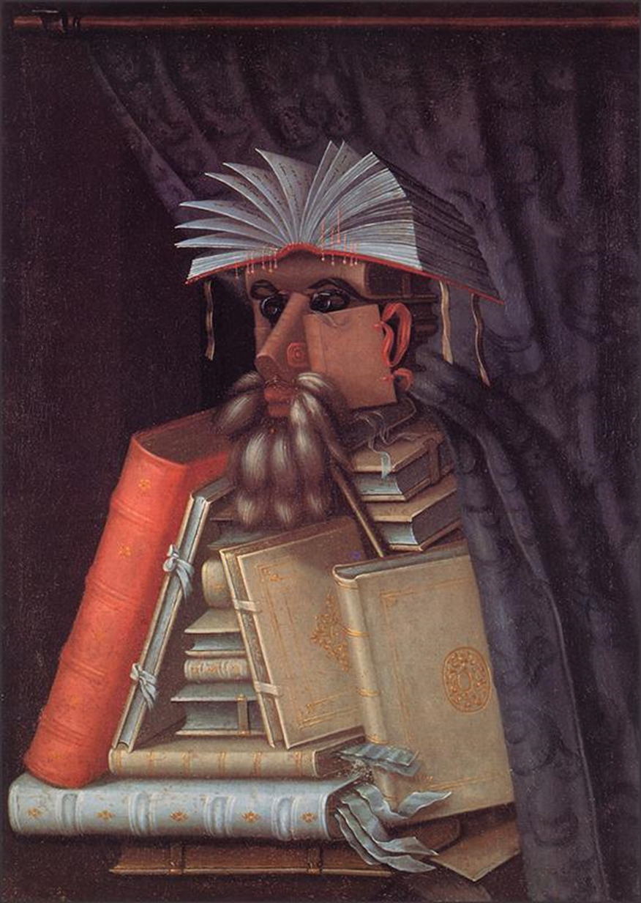
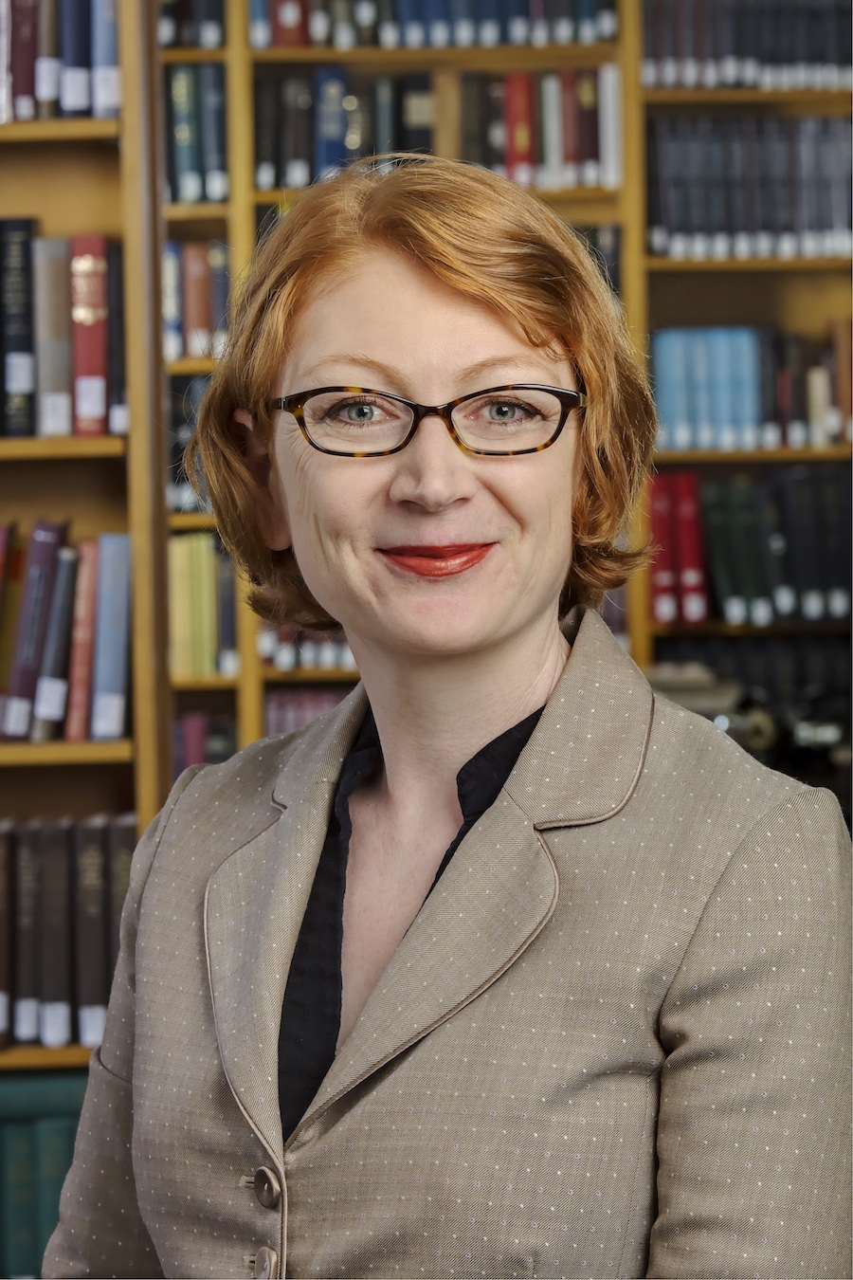
What do you SEE?
THINK?
WONDER?
This is a PORTRAIT: some kind of artwork that shows a person who has posed and is often facing the us.
Notes:
Typical photo/Portraits: Connect to Main Idea and Details (person=main idea; setting/clues=details)
Photograph: Who do you see? Who could this be? How do you know? What is this place? Invite students to share their observations What part of the portrait gives you clues about who this portrait portrays?
2nd Portrait: The Librarian by Giuseppe Archimboldo Discuss how this is a different type of portrait—what details in the painting tell you what this portrait is??

Slide 3
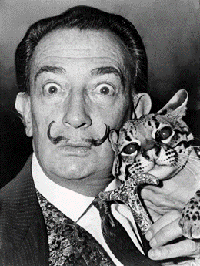
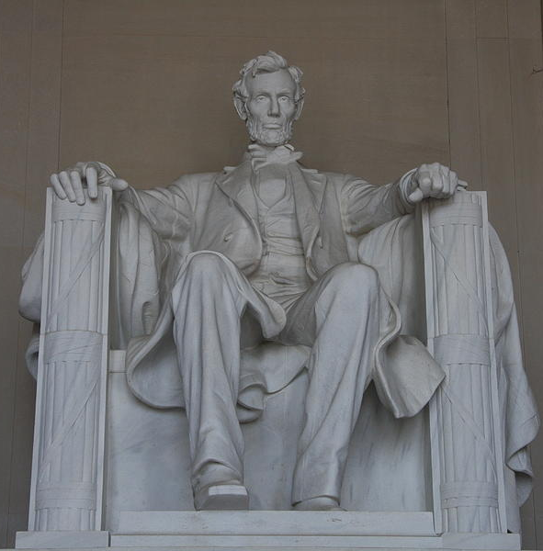
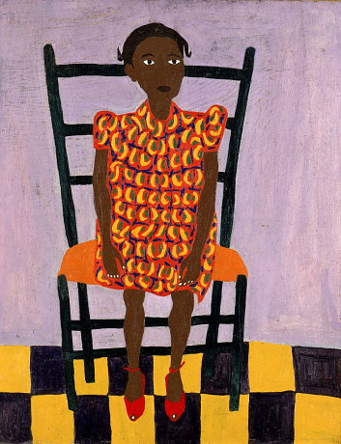
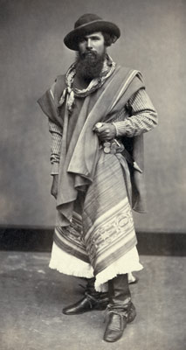
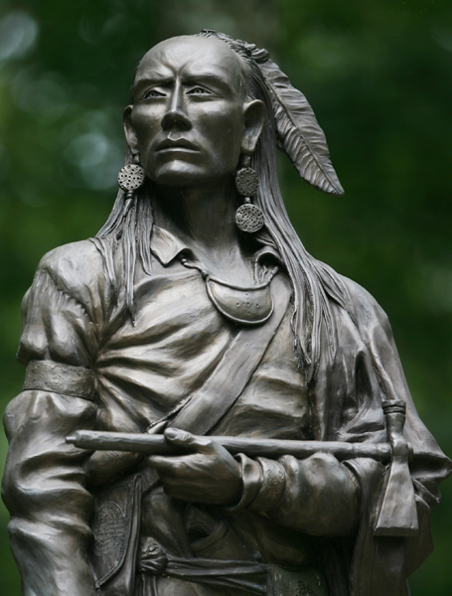
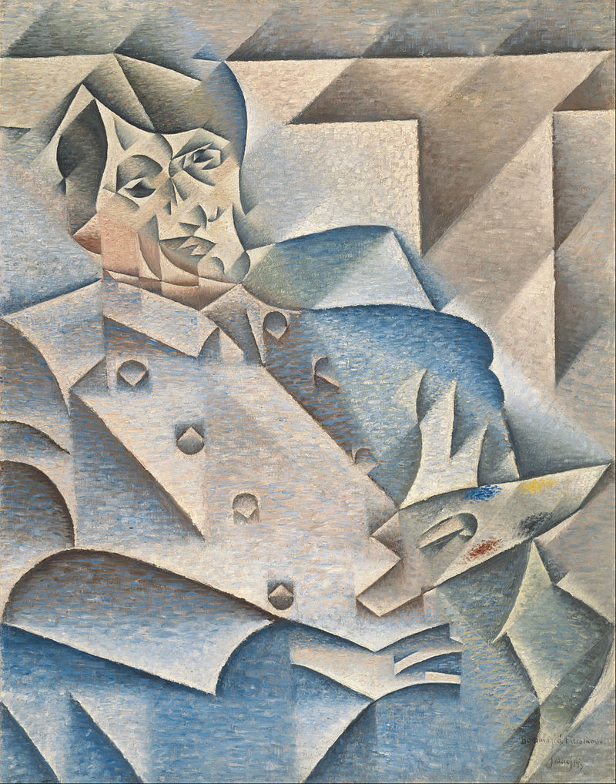
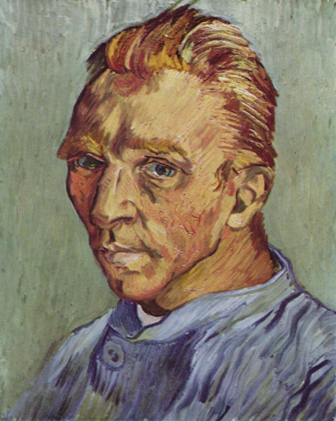
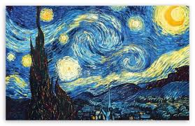
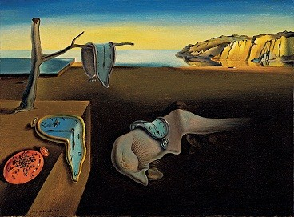
Portraits can be a…
Portraits usually shows what a person looks like
Painting
Photograph
Sculpture
Notes:
Portraits can be:
Head shots
Upper body
Whole body
Paintings: portraits can be painted/drawn in different styles Van Gogh, Picasso (cubism), William H. Johnson
Photographs:
Whole body gaucho from Argentina – point out his clothing which gives clues to his identity
Salvador Dali-- can you tell anything about him by his expression? what the photographer included in the picture?
Sculpture- statue
Tecumseh
A. Lincoln at Lincoln Memoria

Slide 4
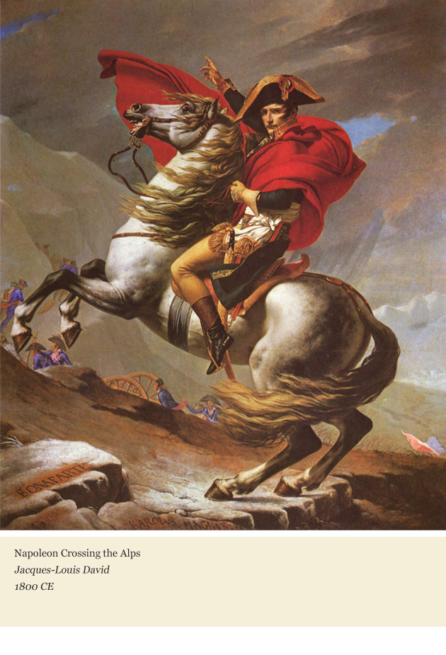
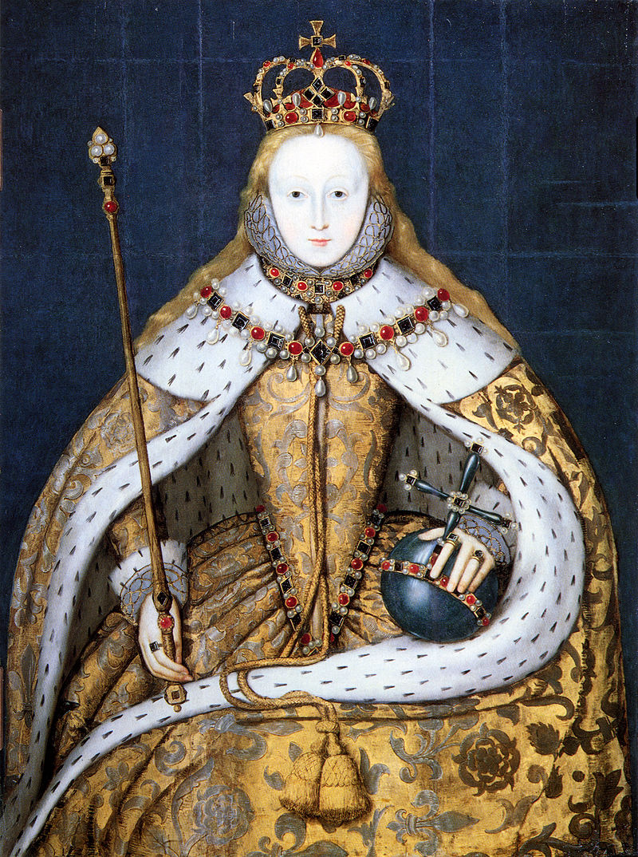
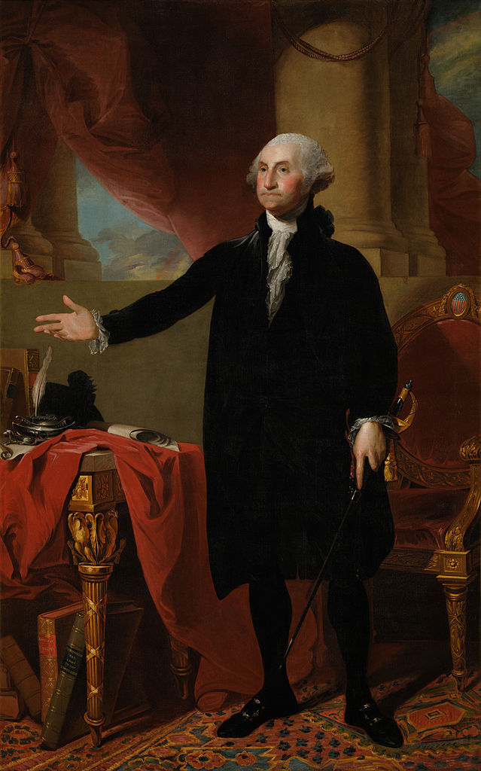
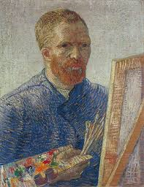
Portraits often include clues about the person
Notes:
What details in the portrait give you clues as to the identity?
Queen Elizabeth 1st
Napoleon do you see soldiers in background
Van Gogh Artist
George Washington

Slide 5

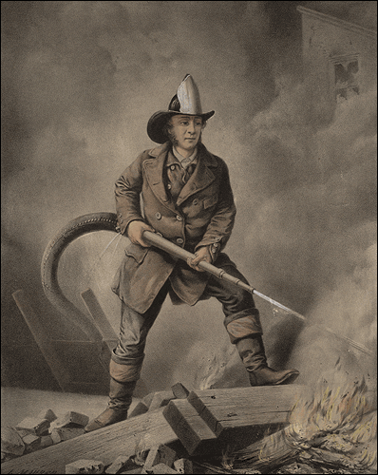
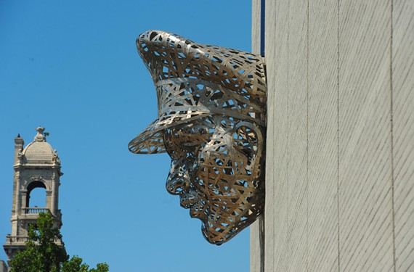
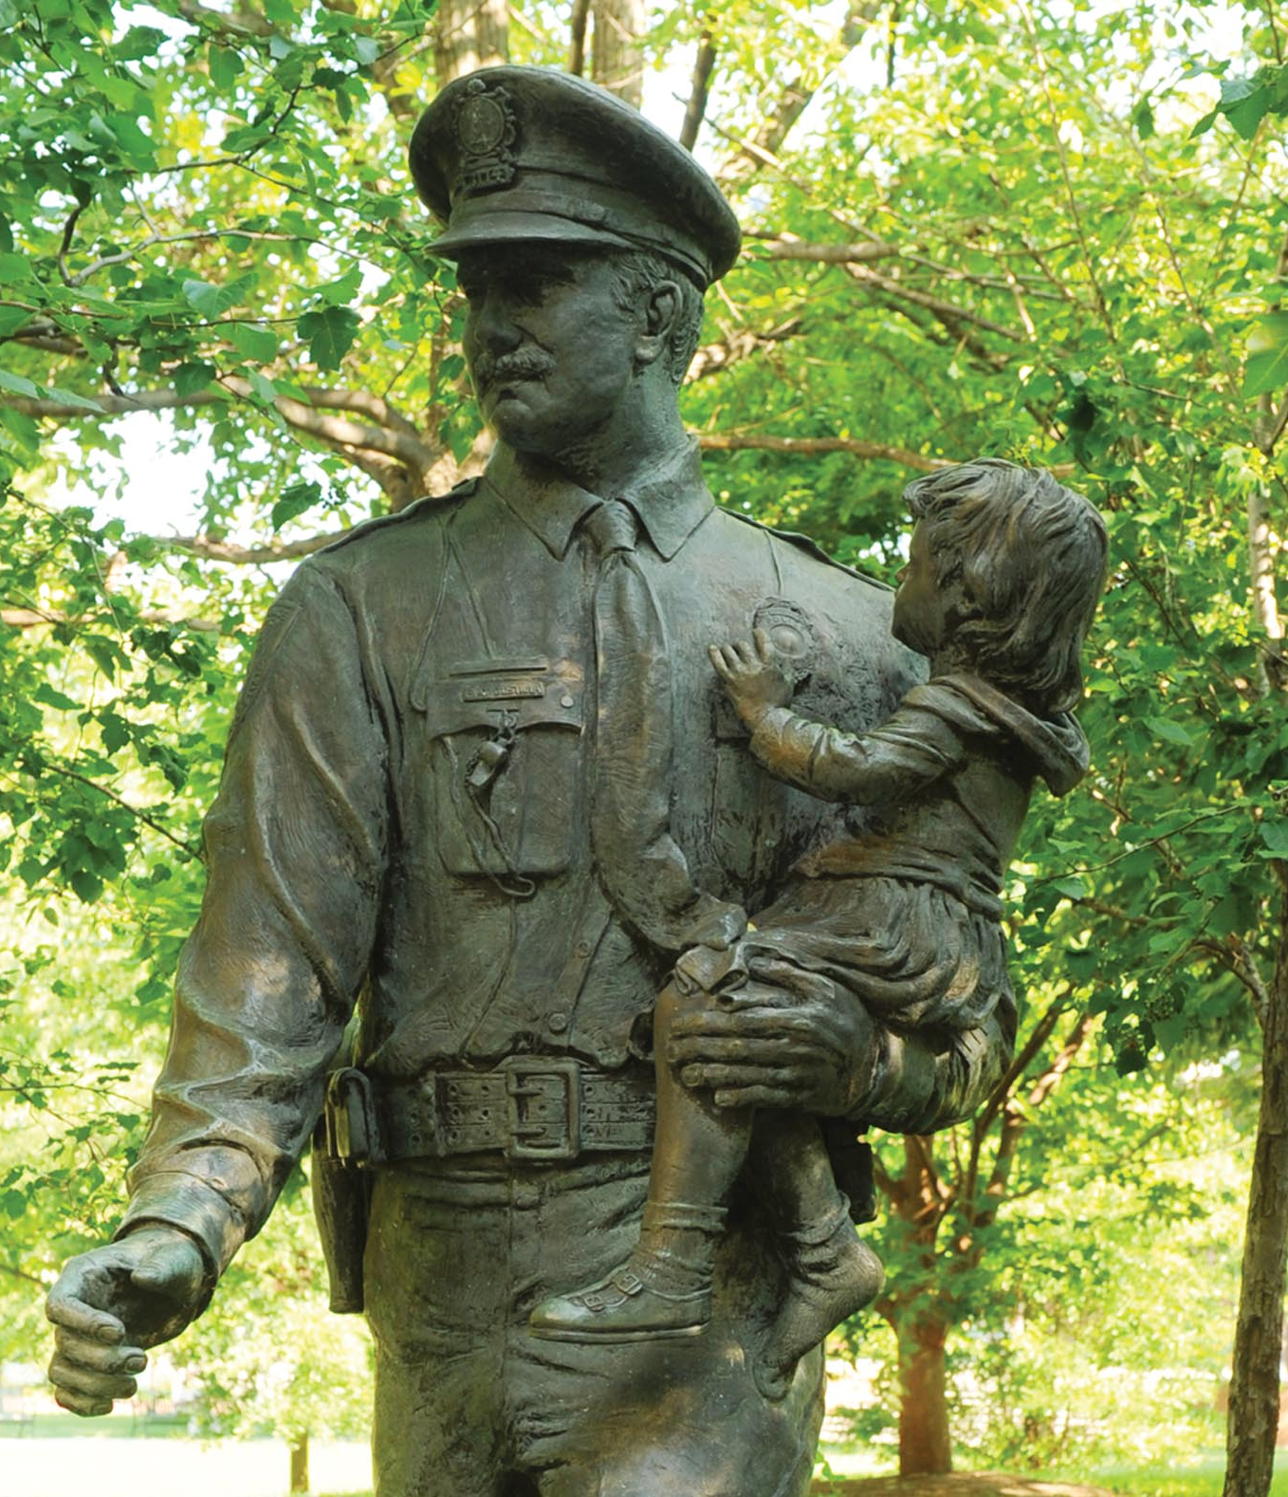
Notes:
How do you know this is a firefighter? What do you see that makes you say that? What are the clues/details included in the painting that give you that information?
What clues on the statue do you

Slide 6
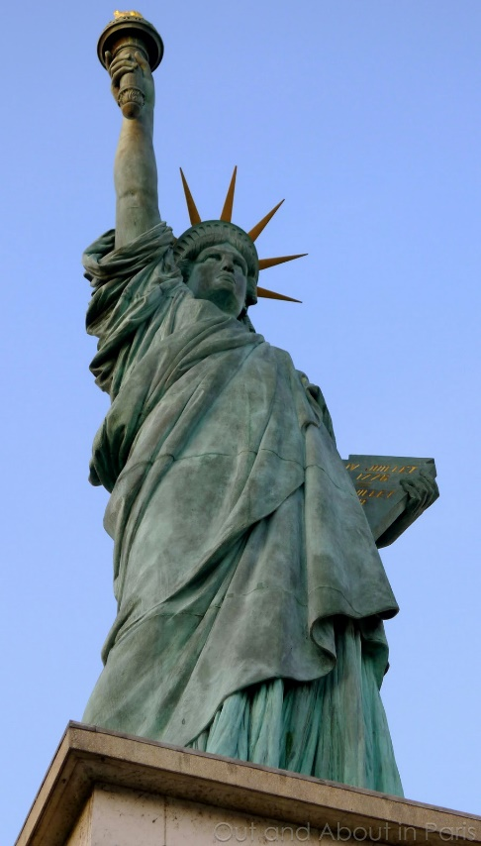
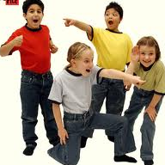
Community Helpers
STATUES
We are going to be actors!
Freeze Frame: Human Statues
Notes:
Can you become a human statue?? An Actor that uses only your face and body to tell the story—provide details?
Option: Have students stand like the Statue of Liberty

Slide 7
Step 1: Personal Space
Find your KINOSPHERE bubble (your personal space with room to move without touching others).
Notes:
Creates a safe personal space in which to experiment with drama or dance.
Guided imagery helps establish the fictional reality.
Facilitates classroom management. “If you bump into someone else’s bubble- it will break and you must sit down to repair it.”
Practice moving around in the personal space, play a few rounds of elimination exercises.

Slide 8
Step 3: FREEZE FRAME/ statues
  FREEZE FRAME: Everyone, independently, strike a SILENT frozen pose for the following scenes (remember—no talking, no props.) Start at a neutral position! Hold your action pose for 3 seconds.
    You are happy
    You are sad
    You are kicking a soccer ball into the goal
    Trying to open a cap of a jar that is stuck
8
Notes:
Introduce concept of neutral position and freezing first– (use word pose)
at count of three move your body in your space. When I say freeze—stop and freeze
Then add scenarios to become human statues
Practice first with facial expression with HAPPY.
Then add body (arms, shoulders) with SAD.
Them add lower body with SOCCER.
Whole body and face with jar
Drama CUES to Use:
Actors, show me you are ready for drama--Hands and laps clear. All eyes focused on the speaker.
When I say go, but not before I say go--Students watch, listen and wait for further instructions.
Places--Students stand in their correct places prepared to begin the drama.
Action--Students begin acting. They move and/or speak as their characters.
Freeze--Students stop whatever they are doing, are silent, and stand still.
Curtain--Indicates the end of the scene or drama. Upon hearing this students are no longer in character.

Slide 9
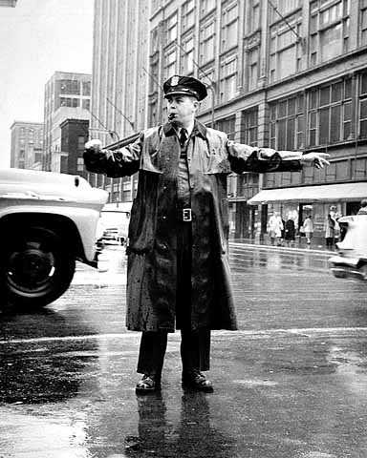
Community Helpers
Human STATUES as portraits
Policeman/woman
Fireman/woman
Teacher
Doctor
Think about..
What does the community helper do?
What things/tools does the community helper use to help others?
Imagine…
What would a statue of the community helper look like?
Create the POSE!
Notes:
Model with policeman –directing traffic, follow with fireman holding hose to put out fire. Then brainstorm what a teacher might be shown doing. Allow for student choice for teacher pose.
For each helper– brainstorm what he/she does—what he/she might use and how this could happen, then 1,2,3 Freeze
Pair students up for Doctor– doctor/patient giving a shot, taking heartbeat, checking the ear with a light, putting on a bandage

Slide 10
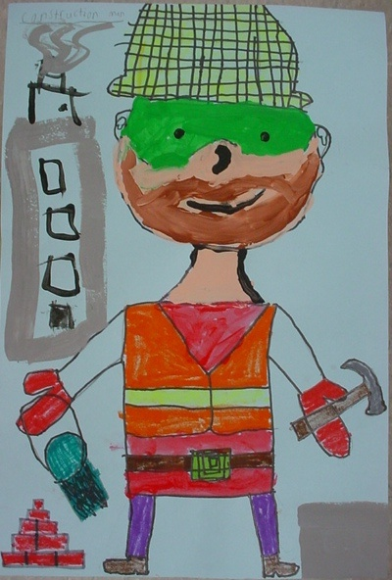
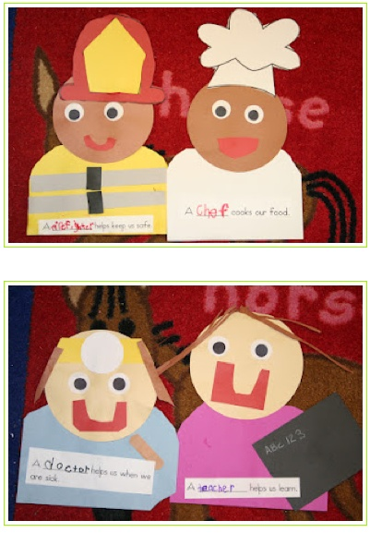
Wrap up
What is a portrait?
What can portraits look like?
What would you include in your artwork if you were drawing or painting a portrait of a community helper and you
Notes:
Portrait has a person as the central element (main idea). A portrait can include many clues to tell what the person is, does, likes.
Students create portraits of a self selected community helper by including things/details that would make the viewer know what helper it is (fireman—hat, hose, boots, fire, smoke, ladder etc.)
Option: talk about doing the portrait in the style of William H. Johnson (see next slide--as in left picture).
Option: It would be fun to create life size portraits of community helpers by tracing themselves on brown paper or create smaller versions that could be superimposed on a map of the community.

Slide 11
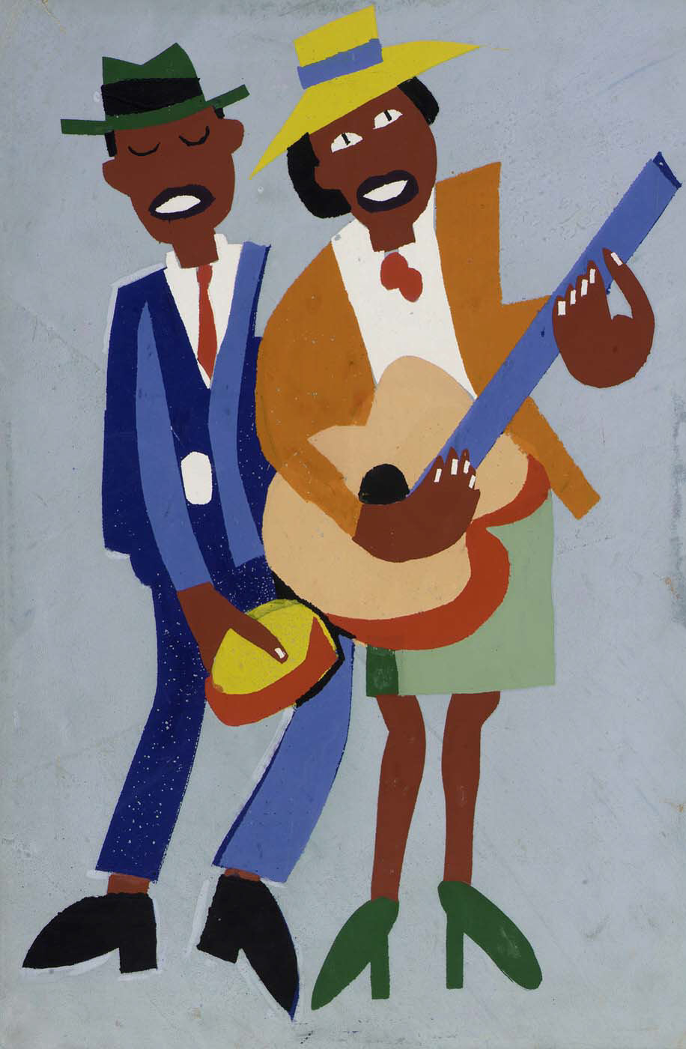
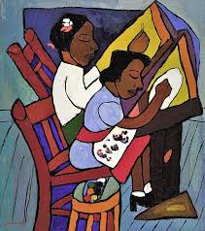

What Colors, Shapes, Lines do you SEE?
Portrait ARTIST:
William H. Johnson
Notes:
By almost any standard, William H. Johnson (1901–1970) can be considered a major American artist. He produced hundreds of works in a virtuosic, eclectic career that spanned several decades as well as several continents. It was not until very recently, however, that his work began to receive the attention it deserves.

