Slide 1
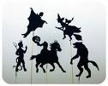
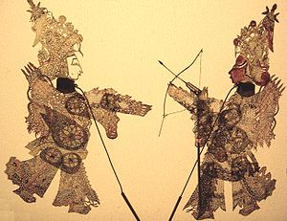
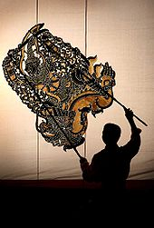
Shadow Puppets: A traditional art in India, Indonesia, China Thailand , Cambodia and Malaysia
http://artsedge.kennedy-center.org/shadowpuppets/shadow_puppets.html

Slide 3
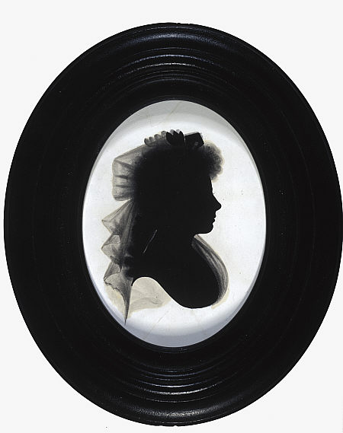
Silhouette=Profile/Side View
A silhouette portrait can be painted, drawn or cut. The traditional method of creating silhouette portraits is to cut them from lightweight black cardboard, and mount them on a pale (usually white) background.
In America, silhouettes were highly popular from about 1790 to 1840. The invention of the camera signaled the end of the silhouette as a widespread form of portraiture
John Miers
Mrs Agnes Maclehose, 'Clarinda', 1759 - 1841.

Slide 4
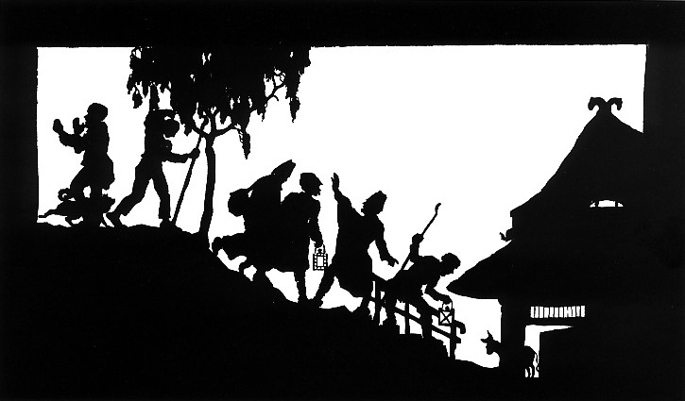
A traditional paper-cut illustration by Wilhelm Gross

Slide 5
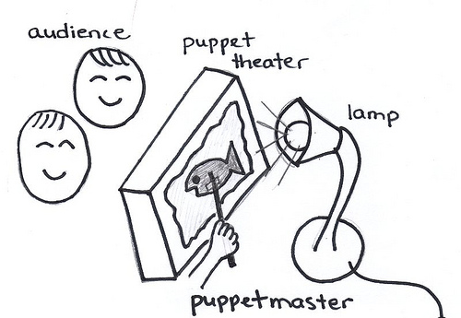
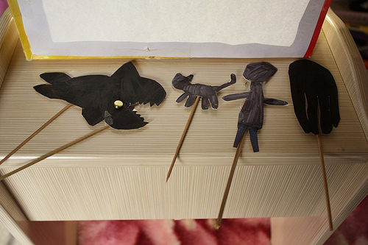
Shadow Puppetry: Silhouette art in theatre format
See a Kindergarten in action:
http://www.schooltube.com/video/490dd2ce3ba44c0b9716/Anansi%20the%20Spider%20Kindergarten%20Puppet%20Theater%202013%20(Revised/Full%20Version)
http://www.schooltube.com/video/e1ce2f42a96245ef9ddb/Zomo%20the%20Rabbit%20Kindergarten%20Puppet%20Theater%202013%20(Revised/Full%20Version)

Slide 6
