Slide 1
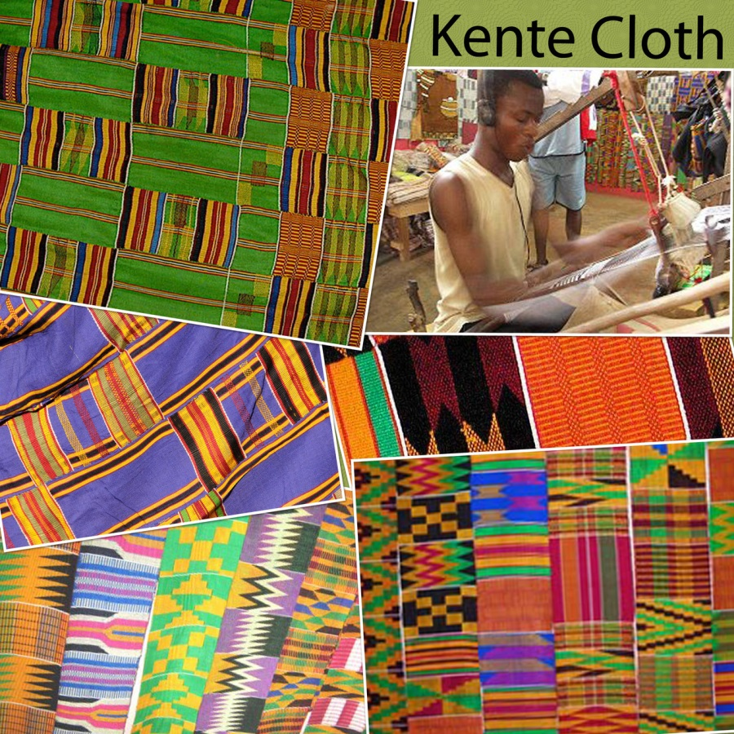
The COLORS and PATTERNS of KENTE cloth
Ghana, Africa
Art Standards:
Discuss and describe the common themes or subject matter of selected artworks from different cultures
Create artworks that explore the uses of color, line, shape, and texture to express ideas and feelings
Art Element/Principal: Pattern

Slide 2
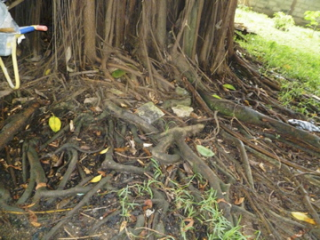
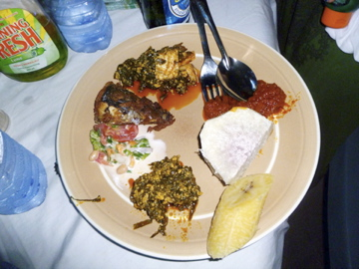
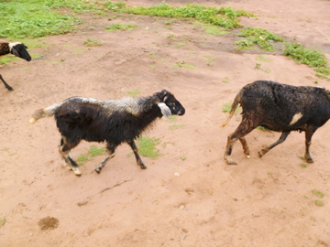
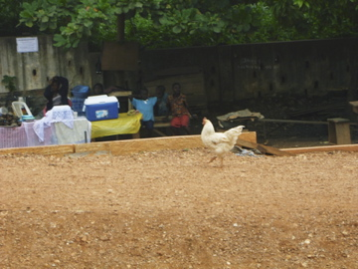
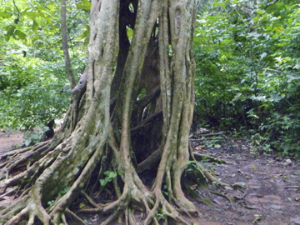
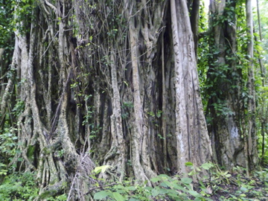
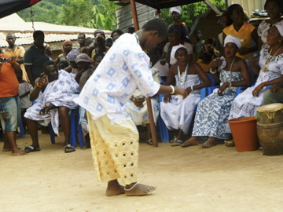
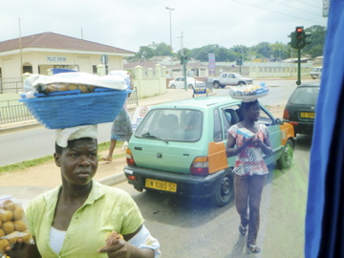
Ghana
West Africa

Slide 3
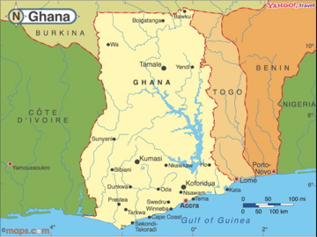
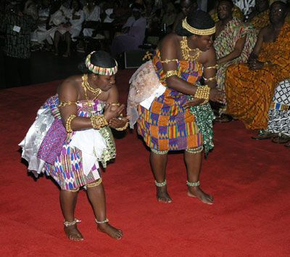
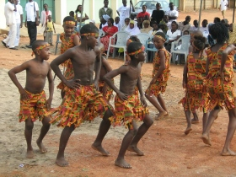
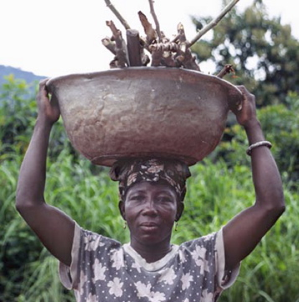
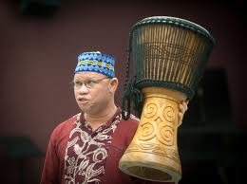
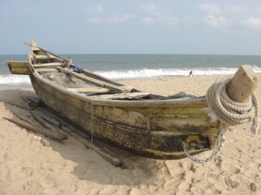
Dancing and music are two forms of art that you can enjoy in Ghana.

Slide 4
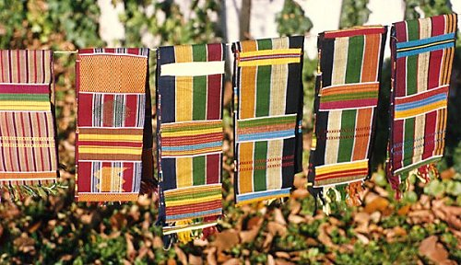
What is the first thing you notice when you look at the picture of Kente?
What colors do you see?
What shapes and patterns do you see?
What do you think Kente Cloth is used for?
How do you think the cloth was made?

Slide 5
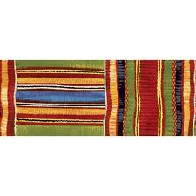
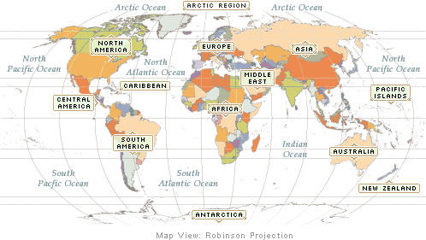
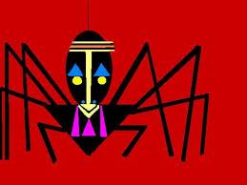
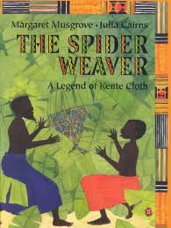
Kente Cloth a traditional fabric that is hand made by the people of Ghana, West Africa
According to Ghanaian traditional stories, Kente cloth was first created when 2 friends watched how a spider wove its web.
By copying the actions of the spiders, they created Kente cloth the same way.

Slide 6
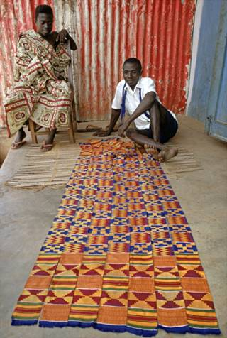
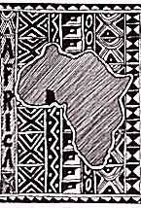
Kente Cloth, Ghana
Weaving done mostly by men in West Africa
Woven in long narrow strips, then sewn together into large fabrics
By age twelve, most boys begin helping their fathers by weaving Kente cloth after school.
Traditionally worn draped across the shoulders

Slide 7
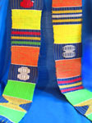
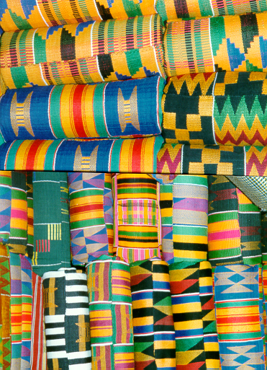
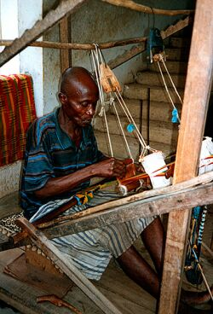
The most well-known type of West African cloth is probably “kente” cloth.
It is woven by Ashanti of Ghana. (highly prestigious silk cloth, made exclusively for the king and his court)

Slide 8
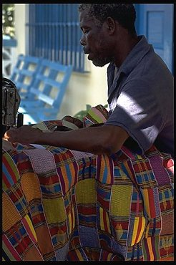
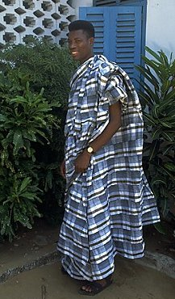
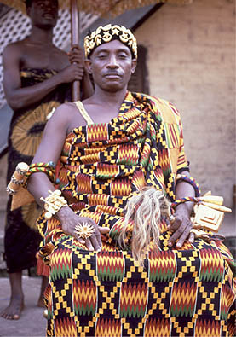
Sewing Kente cloth strips together

Slide 9
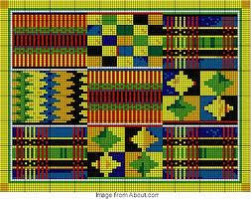
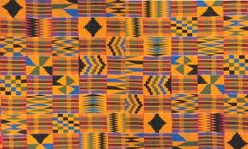
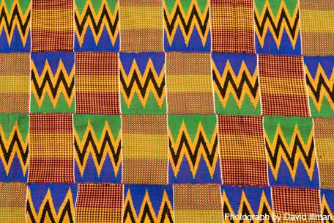
Kente Cloth Patterns & Colors

Slide 10
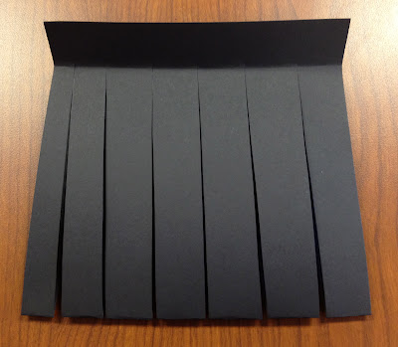
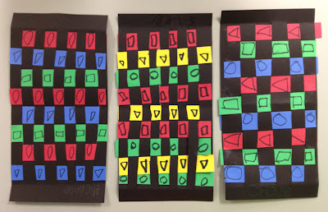
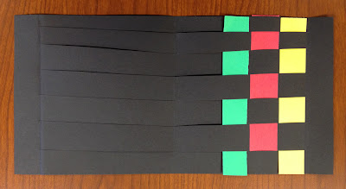
Create KENTE Designs
1. Select one sheet of the black paper. Fold the paper in half (hamburger fold).
2. Fold the open edges down 1 inch. From the folded edge make 1 inch cuts, stopping at the fold.
3. Now, weave your first strip of paper across the black paper, going over and under all the way to the end. Push it up tightly to one end.
4. Continue weaving the rest of your strips revers-ing the under, over.
5. Draw geometric shapes or designs on each color show­ing. Use the same shape or design on all the reds, all the blues, etc. to make a pattern.

