Slide 1
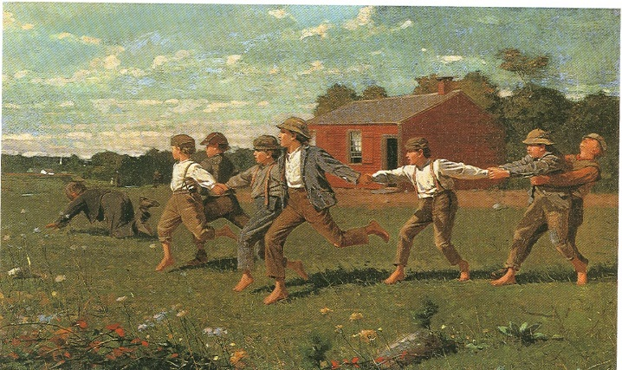
Push-pull art lessons
Exploring colors and texture and FORCE
MD Visual Art Standard: 1.1.a Describe colors, lines, shapes, and textures found in the environment

Slide 2
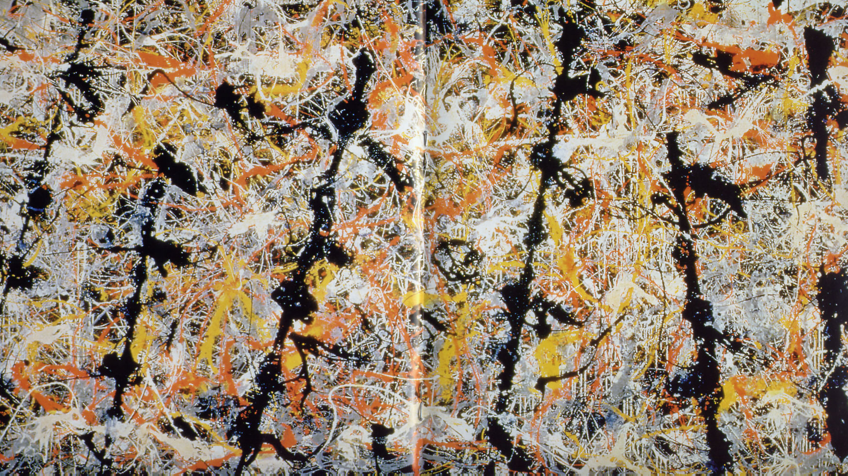
What do you See? Think? Wonder?
Jackson Pollock called his paintings “action” paintings. Rather than paint a landscape or a portrait he wanted to paint ACTION!
Notes:
Jackson Pollock: Blue Poles 1952
https://www.khanacademy.org/partner-content/MoMA/moma-abstract-expressionism/v/moma-painting-technique-Pollock

Slide 3
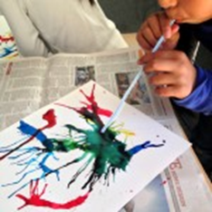
Push Art
Vocabulary
•Science: push force
•Art: primary colors, abstract, representational
Science Curriculum
The way to change how something is moving is by giving it a push or a pull. The size of the change is related to the strength, or the amount of force, of the push or pull.
Art curriculum:
Primary colors mix with each other to produce secondary and tertiary colors.
Materials: all media paper, watercolor inks (), straws, cups, paper plates.
The students used the “push” force to make the watercolor ink move on the paper to produce abstract art (non representational). Use primary colors so students will also see how primary colors mix to produce secondary colors.
There are several ways to make the ink move on the paper. The position of the body is important.
•we can blow parallel to the paper or on top of it and the force is not the same. When we blow parallel to the paper the ink make a path and can go far, depending on the intensity of the blow.
•we can blow above the paper, to get the force hit the paper: we get fine lines going in multiple directions. We can blow with or without a straw and the results are different too.
Group reflection: Looking at all the pieces on the floor, the students talk about the artistic aspects and the scientific aspects of the exercise.

Slide 4
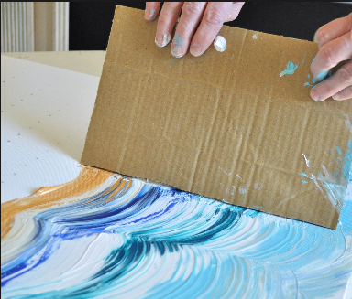
Pull Art:
Students create abstract friction paintings. They create texture with the friction caused by certain materials pulled through the paint.
• Provide students with background information examples about abstract art. Students respond to the art with I see, I Think, I Wonder. See: PowerPoint Vehicles Realism vs. Abstract
• Provide students with a variety of small items with different textures- pieces of sand paper or Styrofoam, toy cars with wheels, string, marbles etc. Provide students with several Styrofoam plates with a thin layer of paint on each.
• Students place the item into a small amount of paint and push or pull the item across the paper leaving a trail of paint and texture and creating an abstract design.

