Slide 1
Ecosystems

Slide 2
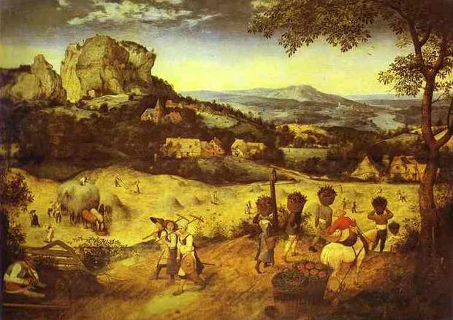
LOOKING 10 x 2
Look at the image quietly for at least 30 seconds. Let your eyes wander.
In one minute, list 10 words or phrases about any aspect of the picture,
Share your words with the class.
Repeat Steps 1 & 2: Look at the image again and try to list 10 more words or phrases to your list.
Notes:
Haymaking
1565
by Pieter Brueghel the Elder

Slide 3
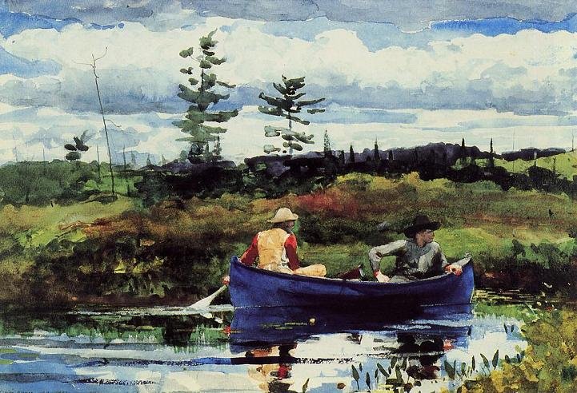
CLAIM Make a claim about the ecosystem. Claim = an explanation or an interpretation of some aspect of the artwork |  | SUPPORT Identify support for your claim Support = Things you see, feel and know that support your claim |  | QUESTION Ask a question related to your claim. Question = What’s left hanging? What isn’t explained, What new reasons does your claim raise?
Notes:
The Adirondack Guide
by Winslow Homer
1889

Slide 4
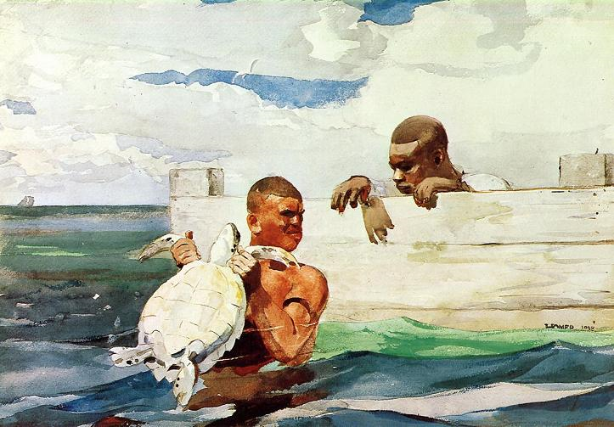
BEGINNING, MIDDLE, END
BEGINNING
If this work is the BEGINNING of a story, what might the beginning of the story be? What might happen next?
MIDDLE
If this work is the MIDDLE of a story, what might have happened before? What might be about to happen?
END
If this work is the END of a story, what might the story be?
Is the turtle part of this ecosystem? Did the boys go out on a mission to find and rescue the turtle?
Think of other scenarios for the picture
Notes:
The Turtle Pond
1898
by Winslow Homer

Slide 5
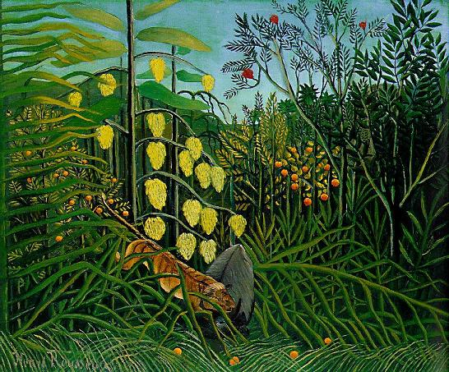
CREATIVE COMPARISONS
What do you see in the artwork? / What do you know about the topic?
2. Compare: Choose a category from your vocabulary list.
3. Imagine: If this topic/artwork was a kind of _____________ (vocabulary word), what would it be?
4. Explain three ways that it compares.
Notes:
The Jungle: Tiger Attacking a Buffalo
1909
by Henri Rousseau

Slide 6
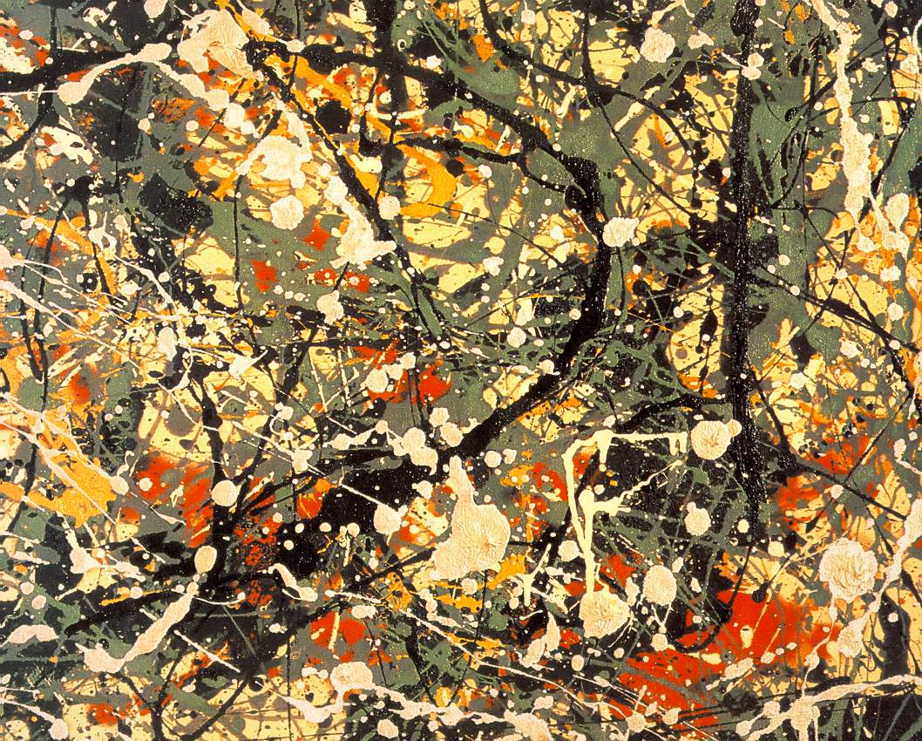
CREATIVE COMPARISONS
If this artwork was a picture of ecosystem which would it be?
What makes you say that?
Notes:
Jackson Pollack

Slide 7
I See, I Think, I Wonder!
What’s going on in this artwork?
What MAKES YOU SAY THAT?
Notes:
Alexis Rockman

Slide 8
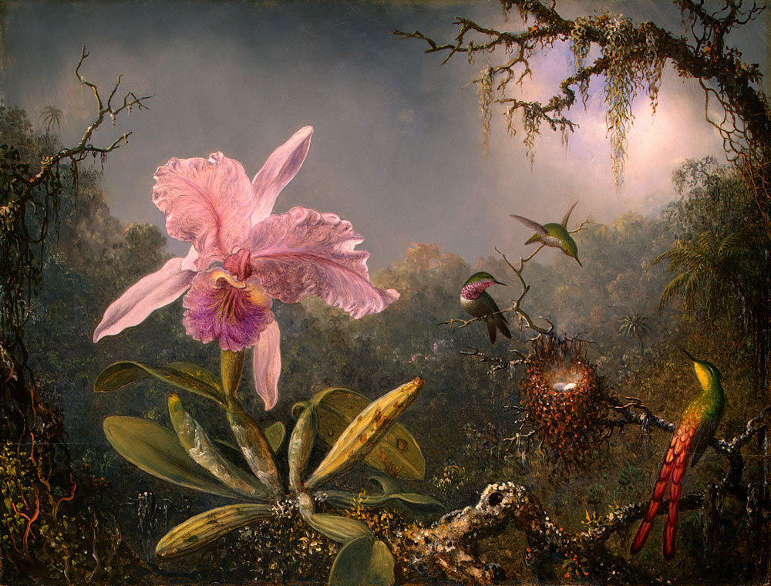
Notes:
Martin Heade Orchid

Slide 9
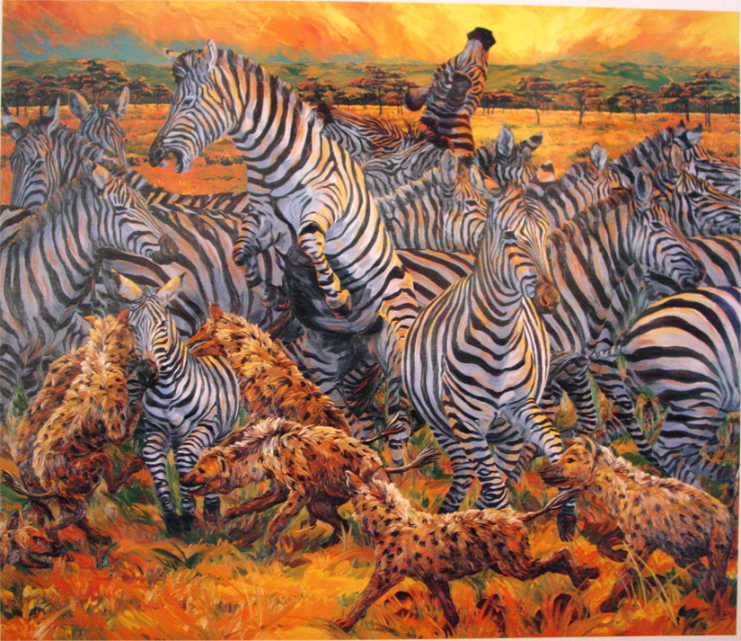
Notes:
Miller, Zebras and Hyenas

Slide 10
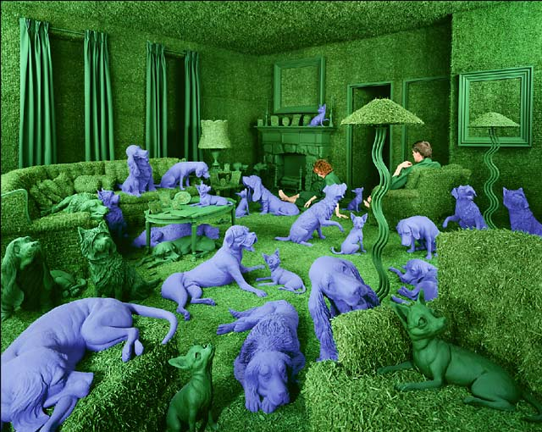
Notes:
Skoglund, The Green House

Slide 11
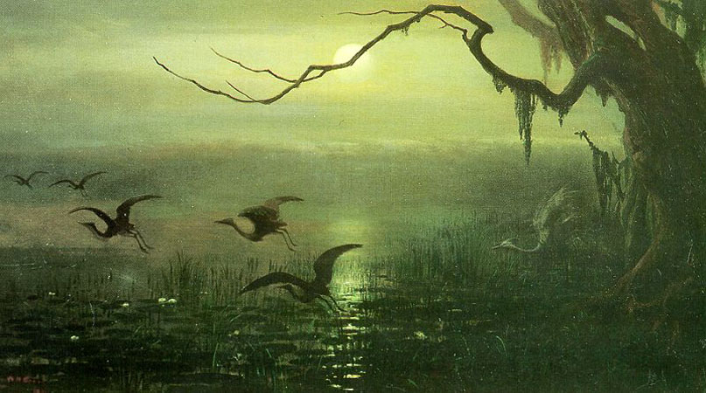
Notes:
Beard, Phantom Crane

Slide 12
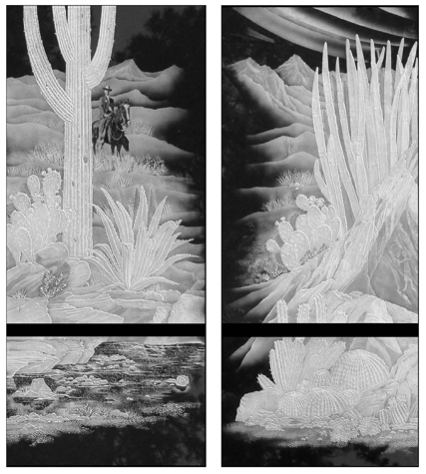
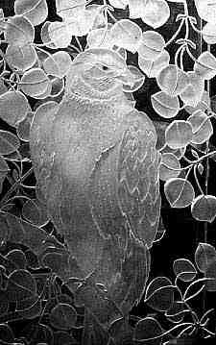
Notes:
Kathy Bradford, Desert Reflections

Slide 13
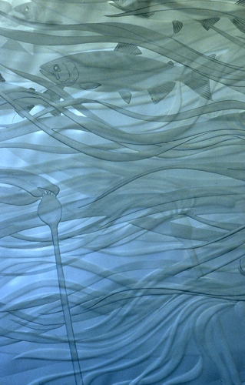
Notes:
Kathy Bradford, Cruising Through (detail)

Slide 14
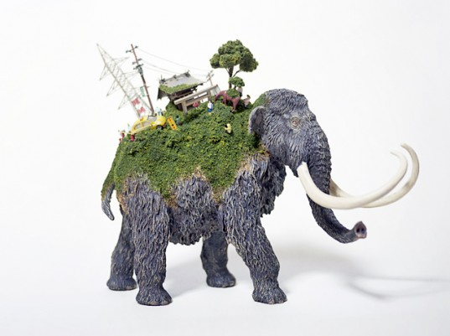
Notes:
Ecosystems in Art: Japanese artist Maico Akiba crafts tiny ecosystems on the backs of tortoises, gorillas and polar bears. Simply called ‘Sekai’ World. She uses Gorillas, tortoises, polar bears and even an armadillo transport tiny forests, houses and people. The figures are open to interpretation, although they could represent migrating animals looking for a better life while having to put up with human ‘progress’ on their backs. Akiba’s Sekai sculptures are also available in even tinier versions designed to be used as cell phone straps.

Slide 15
Notes:
Alexis Rockman

