Slide 1
What Makes You Say That? Discussion ideas!
Think of the main idea….
What is going to happen in the picture?
What will happen at the end?
Why do you think that?

Slide 2
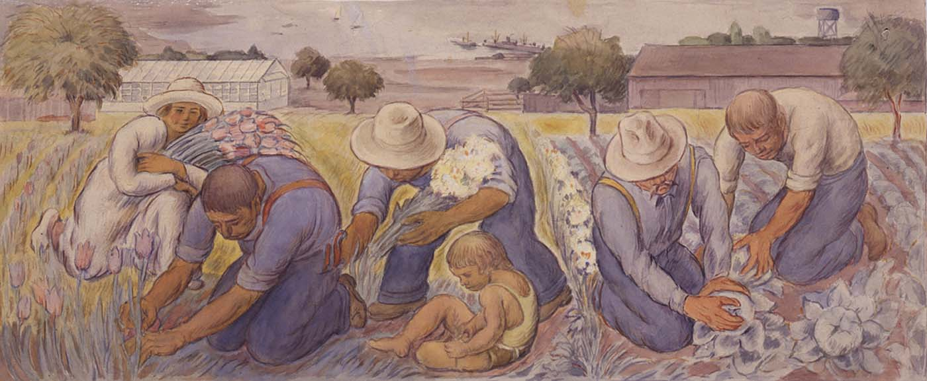
Agriculture in Art
Notes:
(Flower and Vegetable Farming, study for mural)
n.d.Jose Moya del Pino Born: Priego, Spain 1891

Slide 3
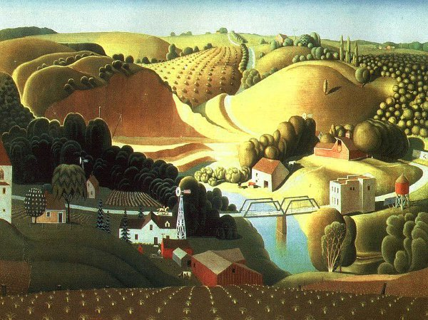
Notes:
Wood, Grant_Stone City, Iowa

Slide 4
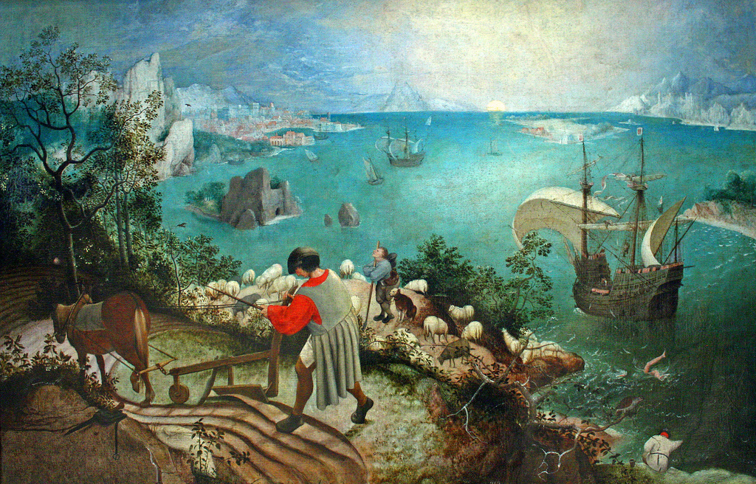
Notes:
Brueghel, Pieter the Elder_Icarus_1555

Slide 5
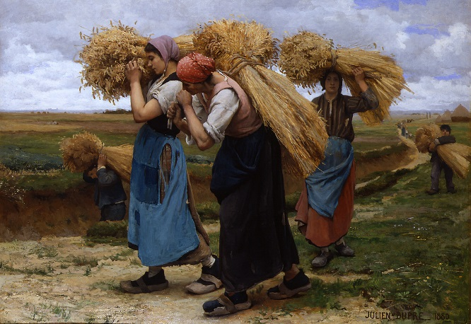
Notes:
Dupre, Julien_ The Gleaners_1880

Slide 6
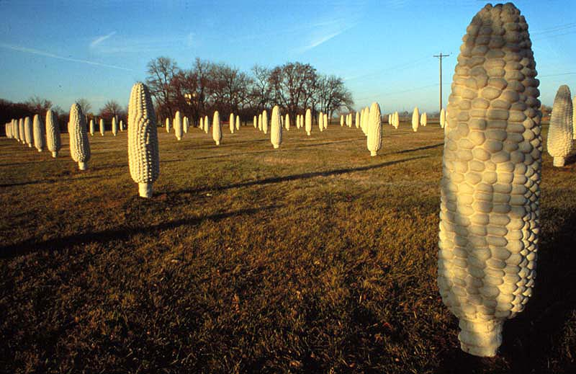
Notes:
Cochran, Malcolm_ Field of Corn_ 1994

Slide 7
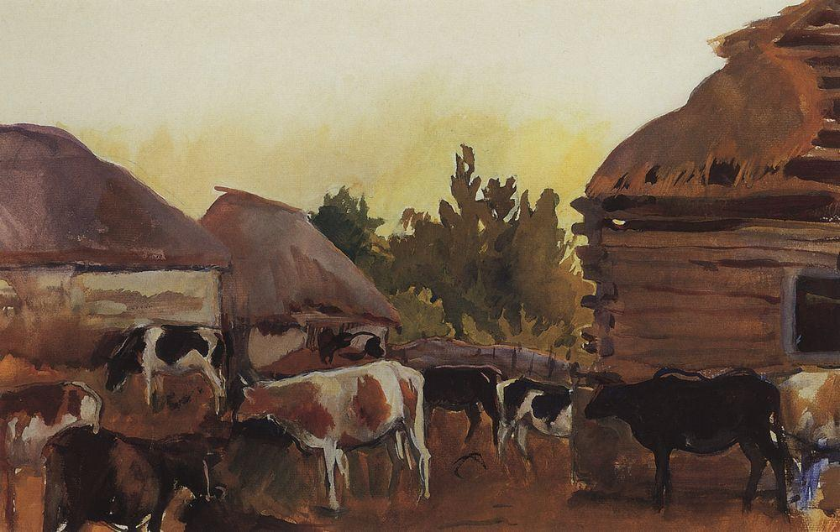
Notes:
Animal Farm in the village Neskuchnoye
Artist: Zinaida Serebriakova
Completion Date: c.1910

Slide 8
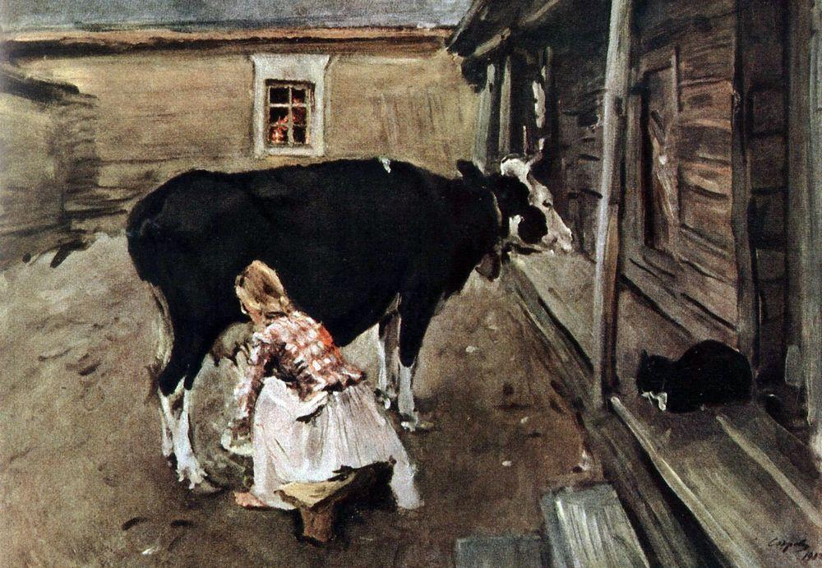
Notes:
Farm Yard In Finland: Artist: Valentin Serov
Completion Date: 1902

Slide 9
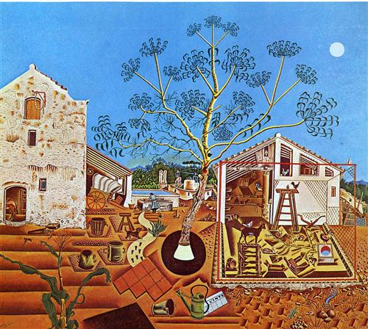
Notes:
Miro, Joan_ The Farm_1921

Slide 10
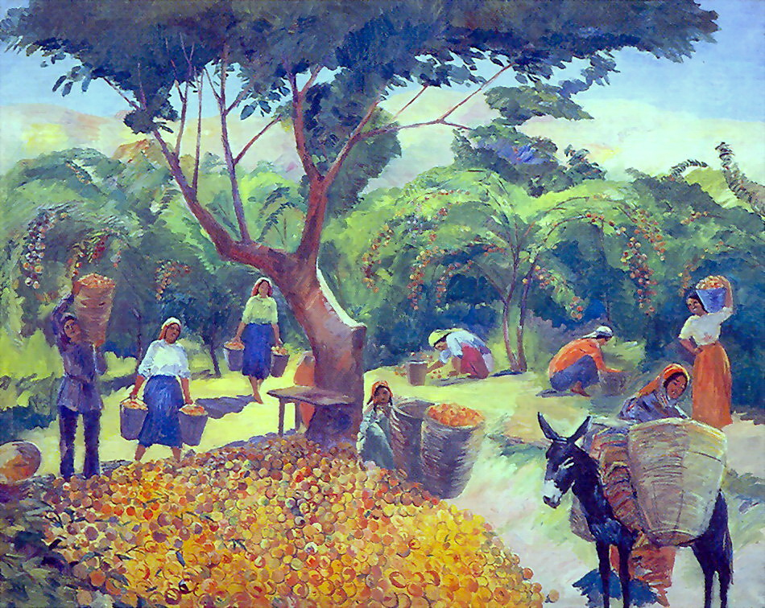
Notes:
Gathering peaches in the collective farm in Armenia Artist: Martiros Saryan
Completion Date: 1938

Slide 11
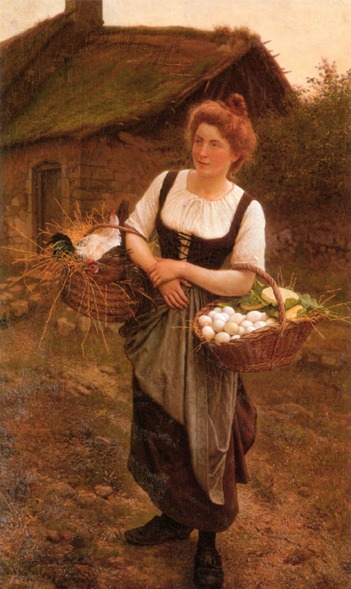
Notes:
The Farm Girl: Artist: Gustave Boulanger

Slide 12
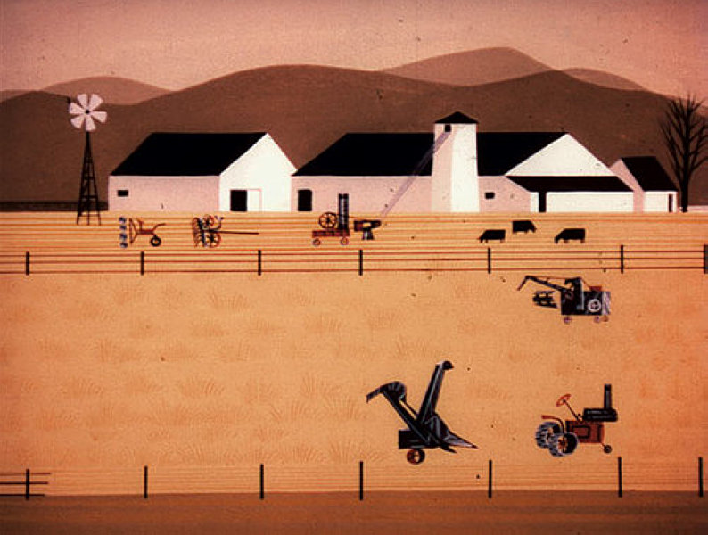
Notes:
Rhapsody of Steele: Artist: Eyvind Earle
Completion Date: 1959

