Slide 1
See, Wonder, Think!
Look at a piece of art for 30 seconds
List 10 words or phrases about any aspect of what you see.
Think of the five senses
Repeat with other pictures

Slide 2
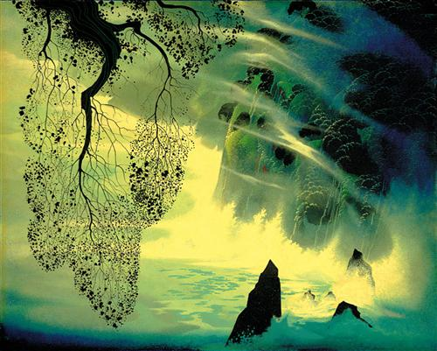
Weather
What do You SEE?

Slide 3
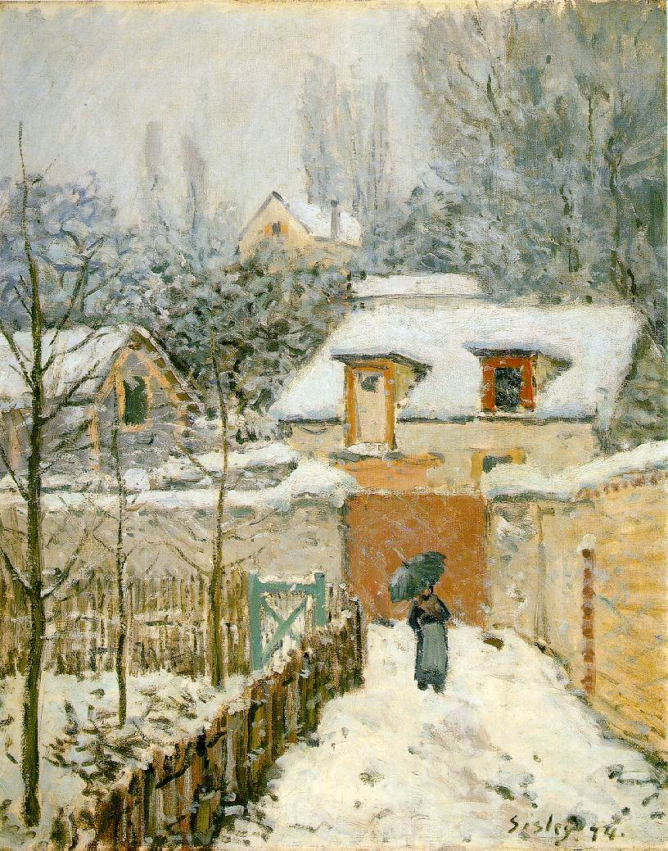
What do feel?
What do you hear?
Notes:
Alfred Sisley Snow al Louveciennes

Slide 4
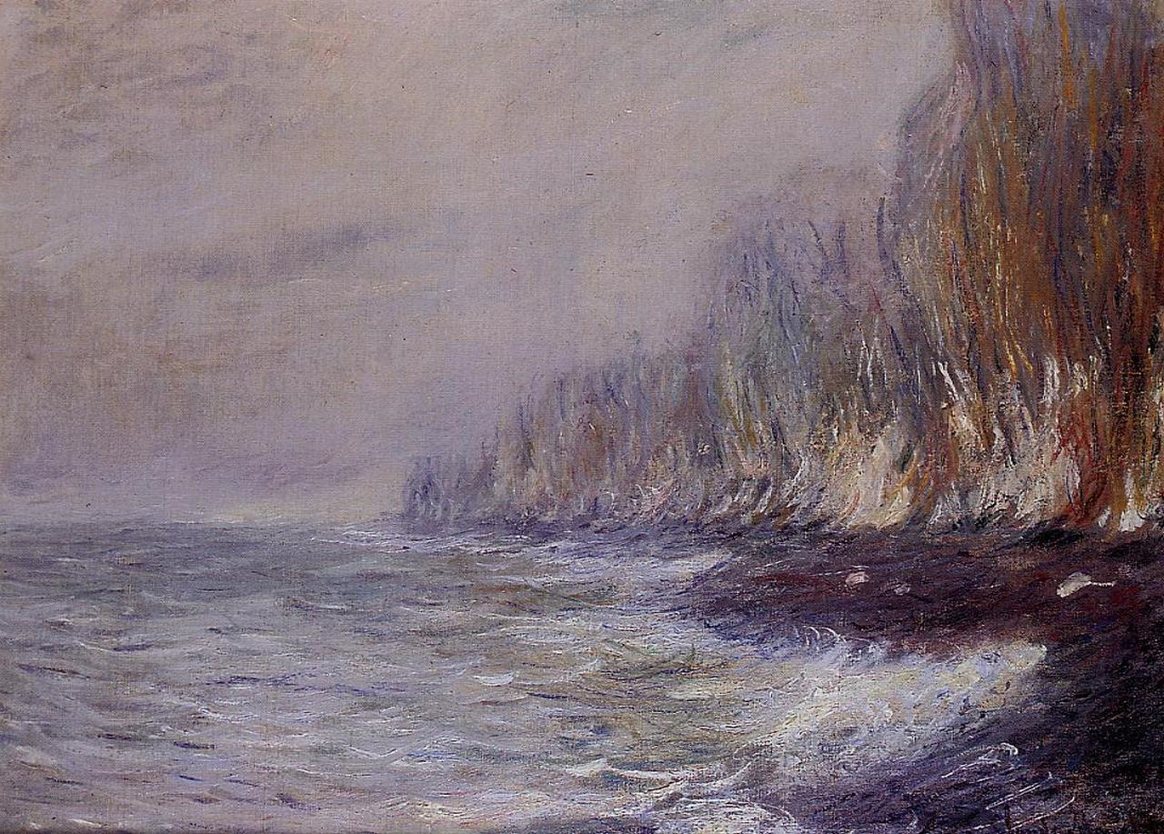
What do you see?
If you were in the painting, what would you taste?
Notes:
Claude Monet: The Effects of Fog on Dieppe_1882

Slide 5
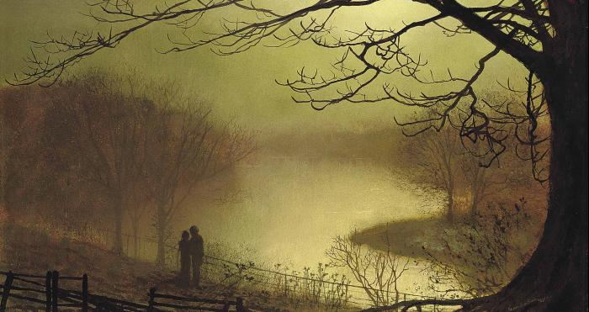
Notes:
JA Grimshaw: Roundhay Lake

Slide 6
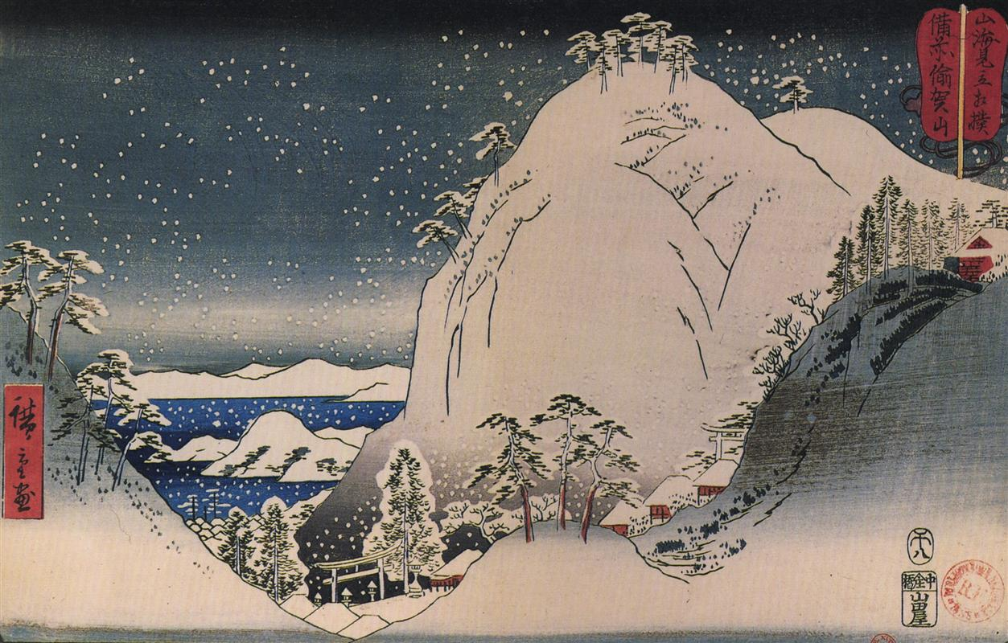
Notes:
Hiroshige: Shrines in the Snowy Mountains

Slide 7
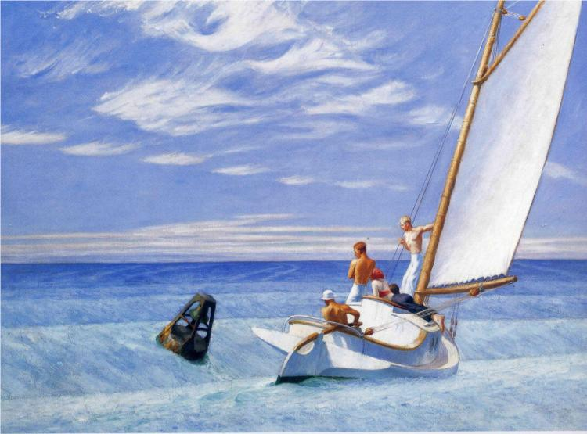
Notes:
Hopper, Edward: Ground Swell

Slide 8
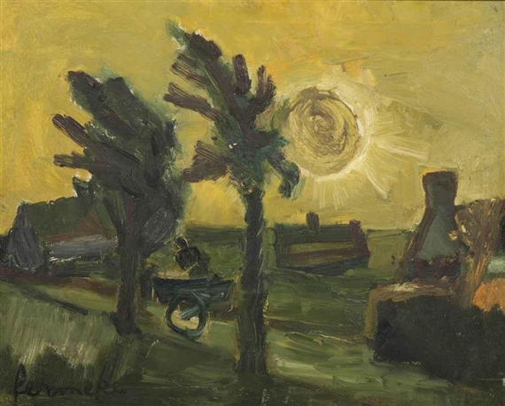
Notes:
Permeke, Constant: Farm hands on a sunny landscape

Slide 9
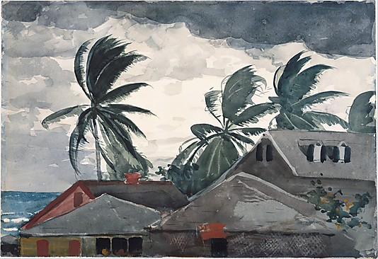
Notes:
Hurricane, Bahamas
Winslow Homer (American, Boston, Massachusetts 1836–1910 Prouts Neck, Maine)
Date: 1898 Medium: Watercolor and graphite on off-white wove paper

Slide 10
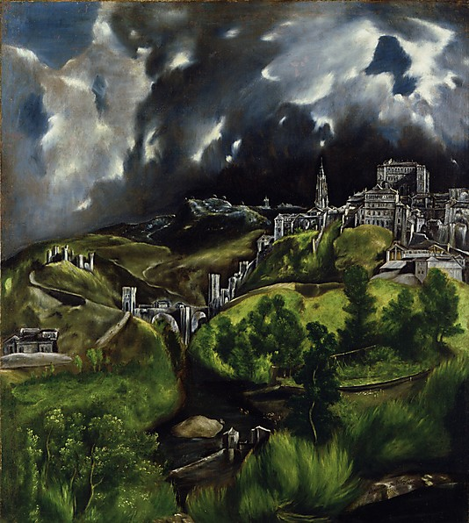
Notes:
El Greco (Domenikos Theotokopoulos) (Greek, Iráklion (Candia) 1540/41–1614 Toledo)
Medium: Oil on canvas

Slide 11
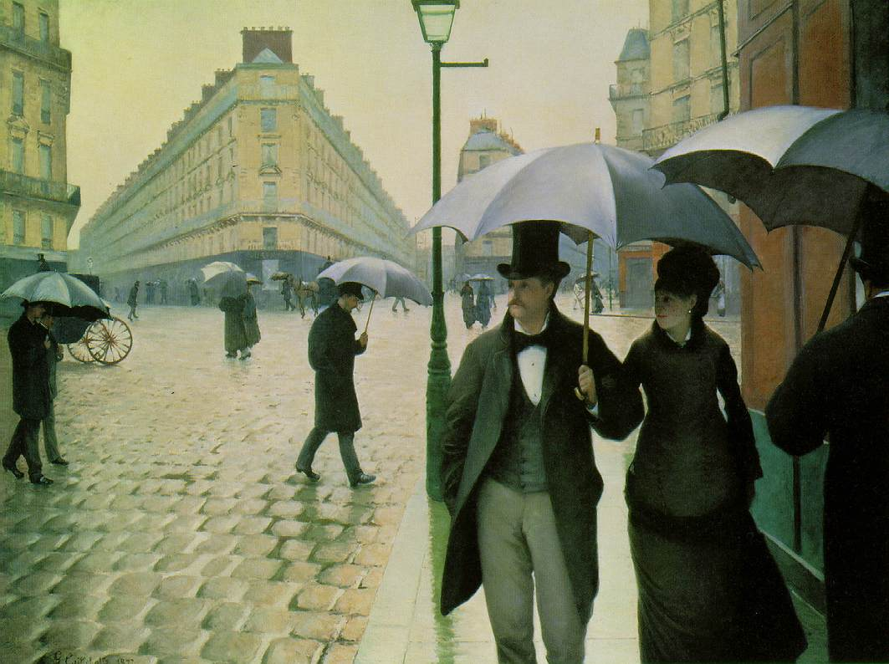
Notes:
Calliebotte, Gustave Rue de Paris, temps de pluie; Intersection de la Rue de Turin et de la Rue de Moscou 1877 (100 Kb); Paris: A Rainy Daydepicts an area of the Batignolles quarter. Oil on canvas,

Slide 12
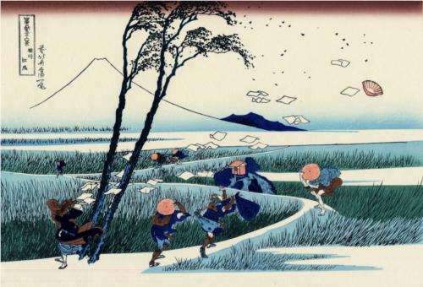
Notes:
Ejiri in the Suruga province
Artist:Katsushika Hokusai
Completion Date: c.1832
Style:Ukiyo-e
Genre:landscape

Slide 13
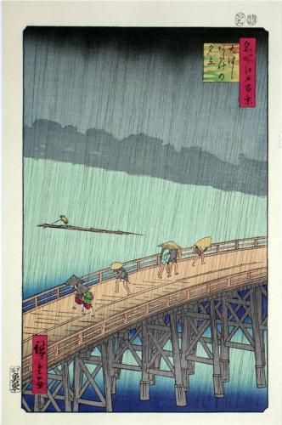
Notes:
Hiroshige: Sudden Shower over Shin-Ohashi Bridge at Atake

Slide 14
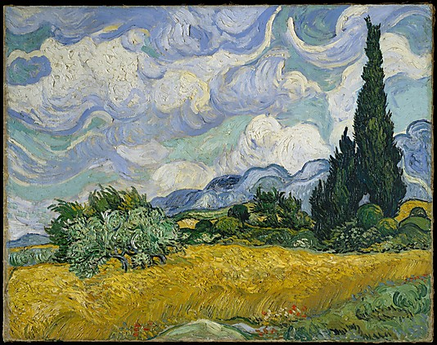
Notes:
Wind
Wheat Field with Cypresses
Vincent van Gogh (Dutch, Zundert 1853–1890 Auvers-sur-Oise)
Date: 1889 Medium: Oil on canvas

Slide 15
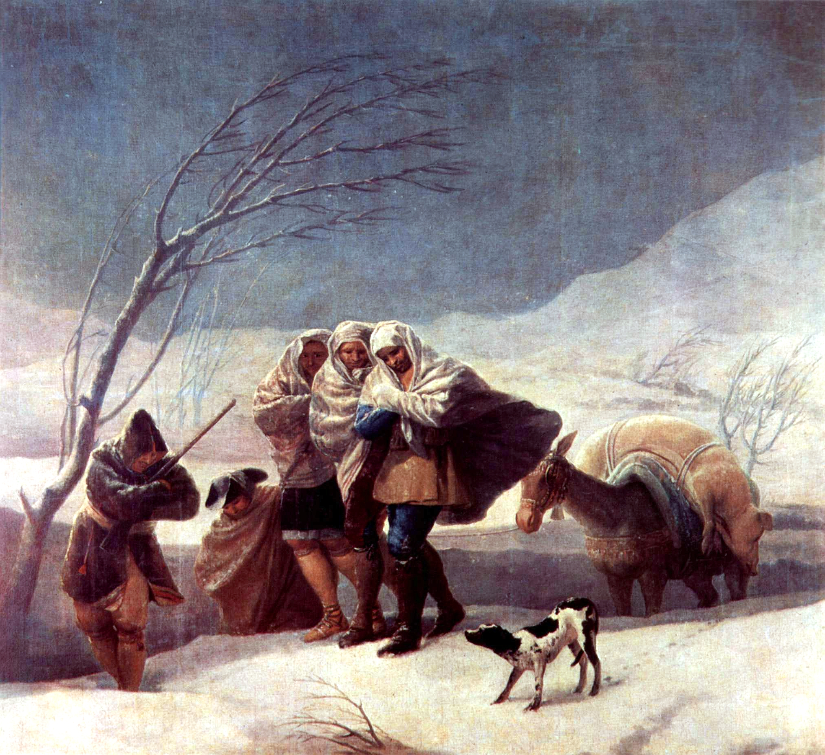
Notes:
Goya_The Snowstorm_1787

