Slide 1
Then and Now
Changes in our communities

Slide 2
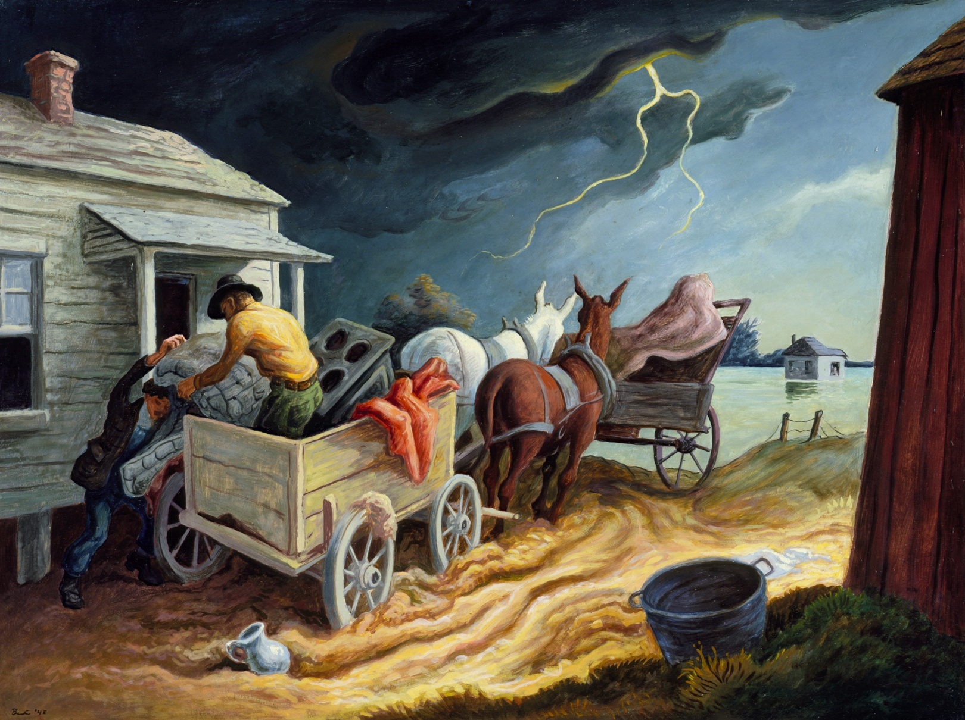
Notes:
Curry

Slide 3
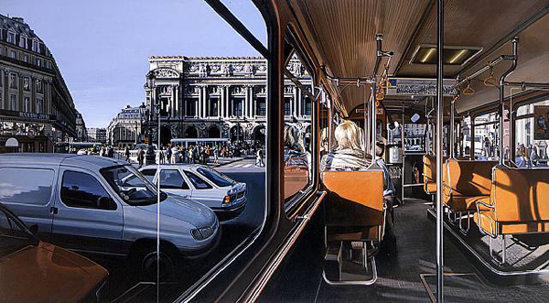
Notes:
Richard Estes: Paris Opera House
(ultra realism)

Slide 4
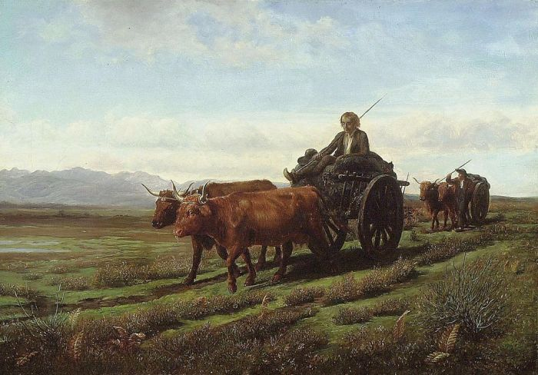
Notes:
Rosa Bonheur: Going to Market

Slide 5
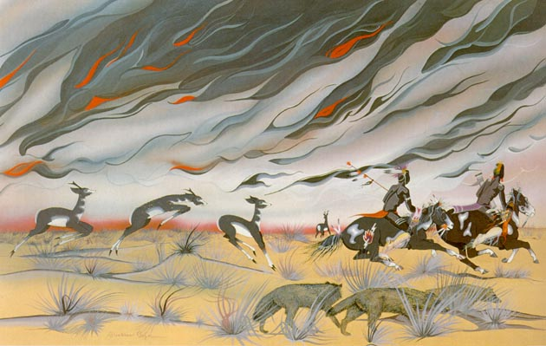

Slide 6
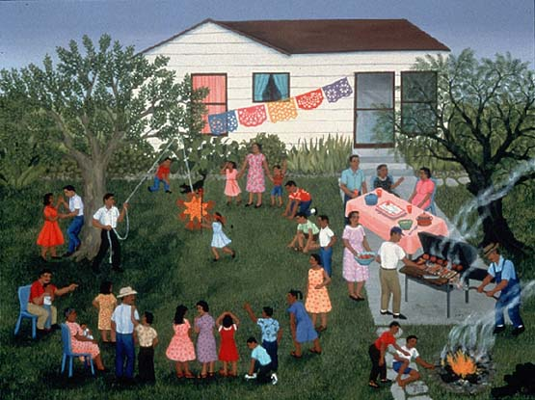
Notes:
Garza, Carmen Lopez Barbacoa para Cumpleañeros, 1993

Slide 7
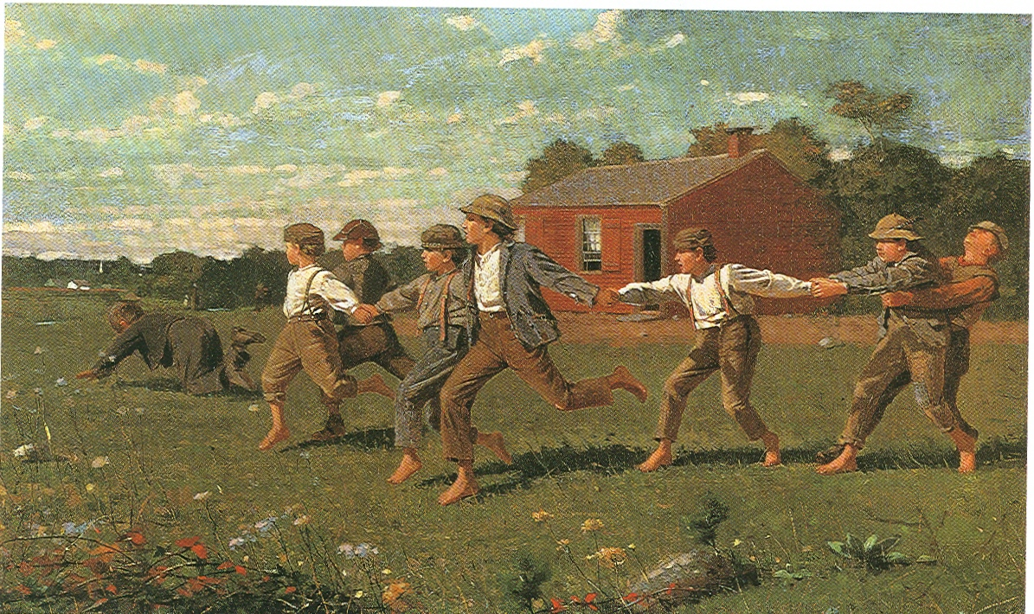
Notes:
Winslow Homer SNAP THE WHIP

Slide 8
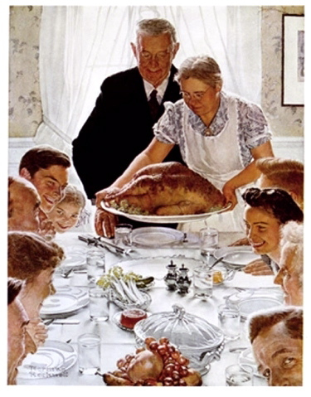
Notes:
Norman Rockwell Thanksgiving

Slide 9
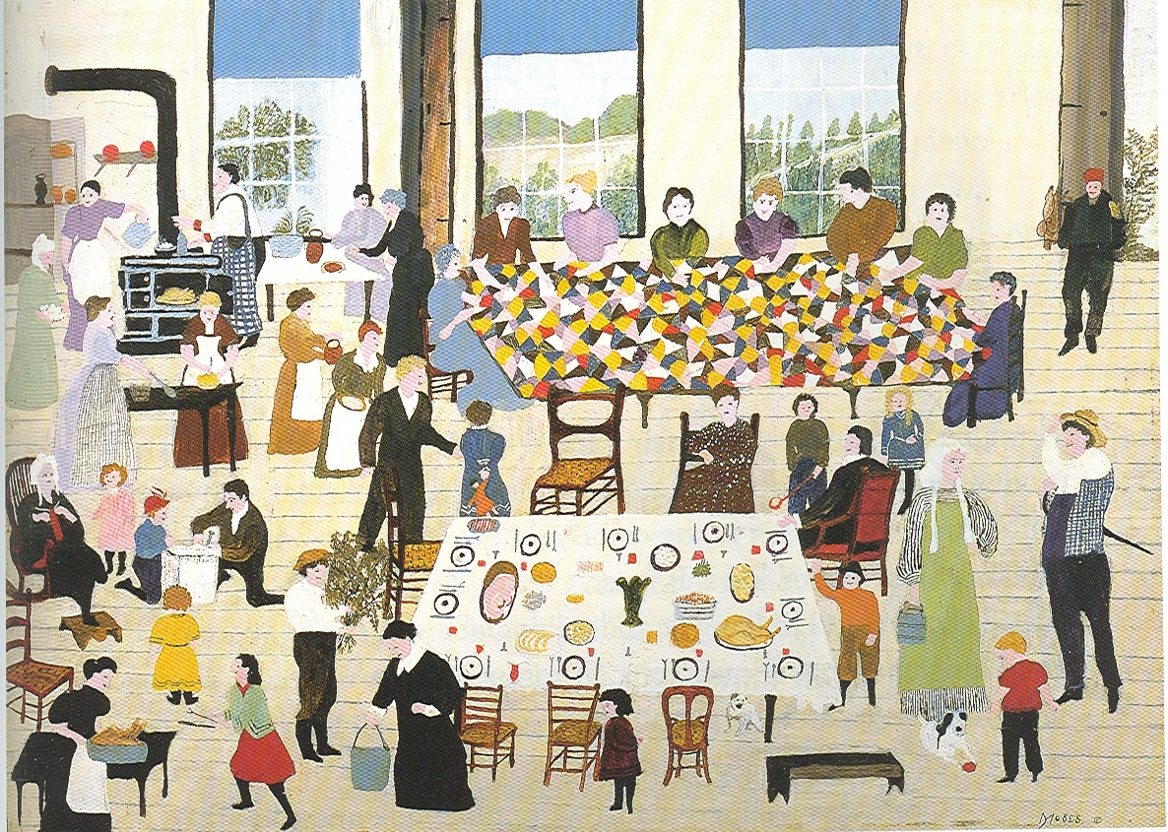
Notes:
Grandma Moses Quilting Bee

Slide 10
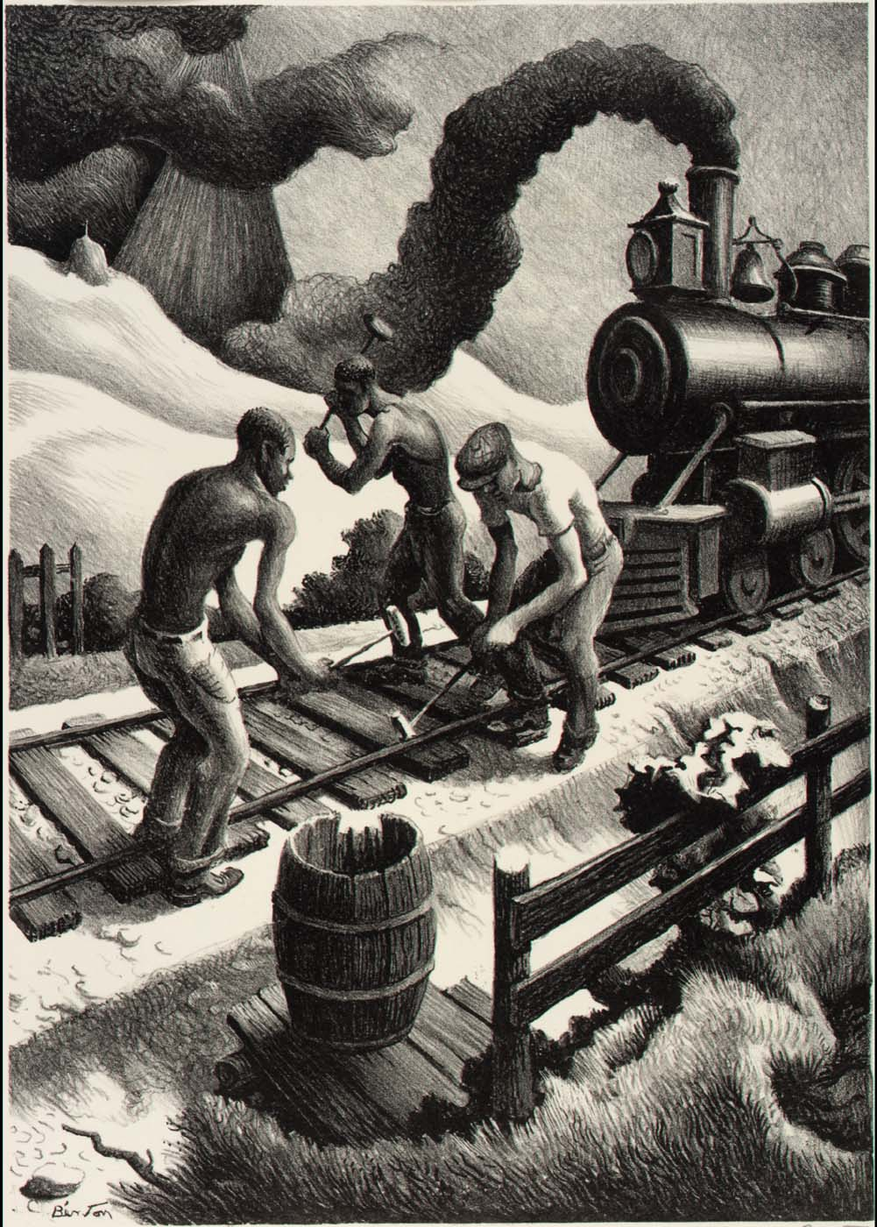
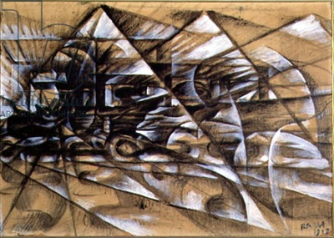

Slide 11
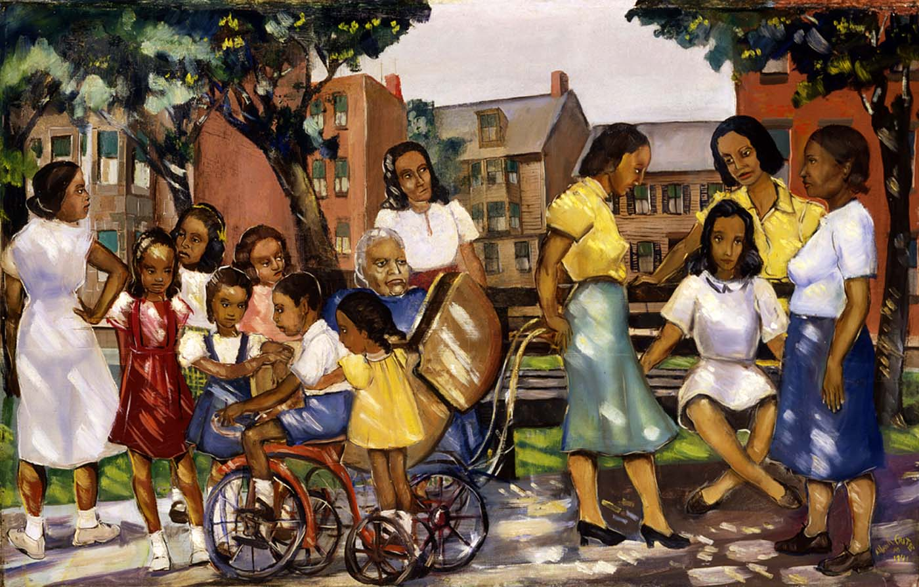
Notes:
Alan Crite Sunlight and Shadow 1941

Slide 12
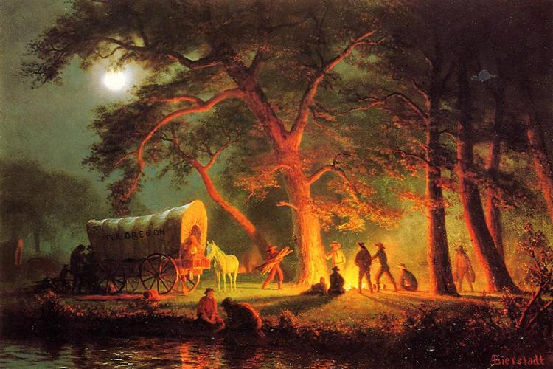
Notes:
Bierstadt: The Oregon Trail

Slide 13
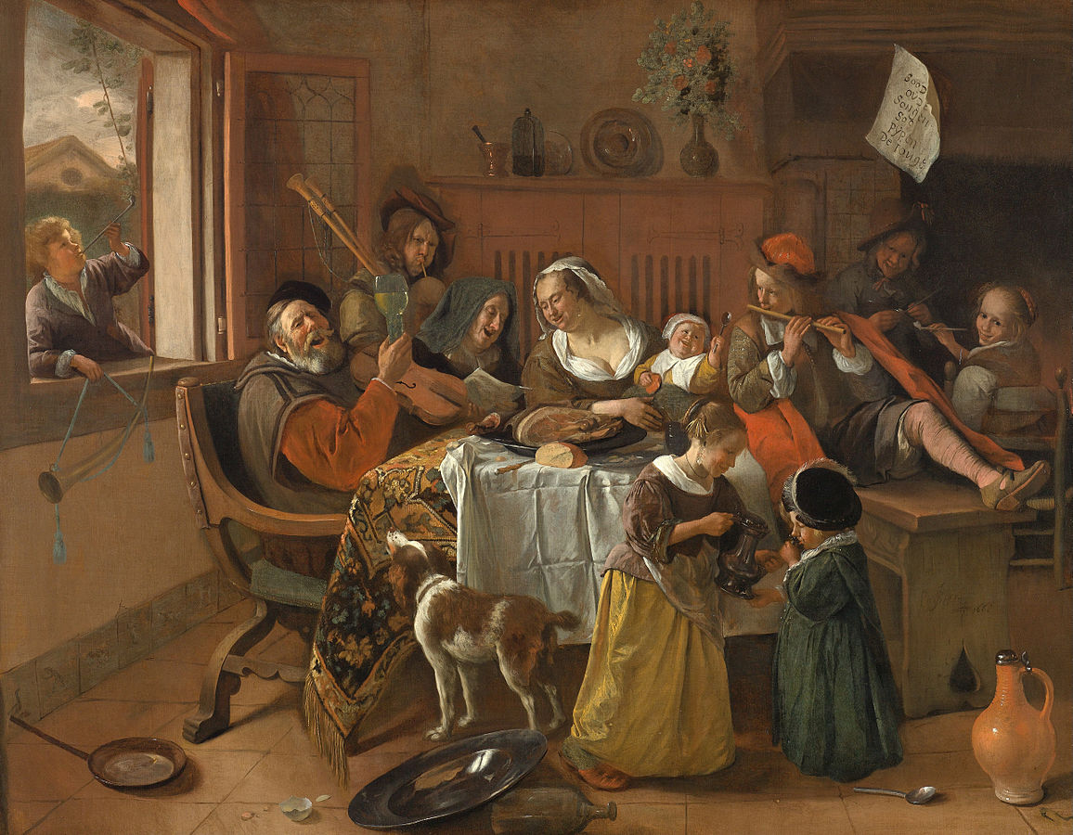
Notes:
Steen: The Merry Family

Slide 14
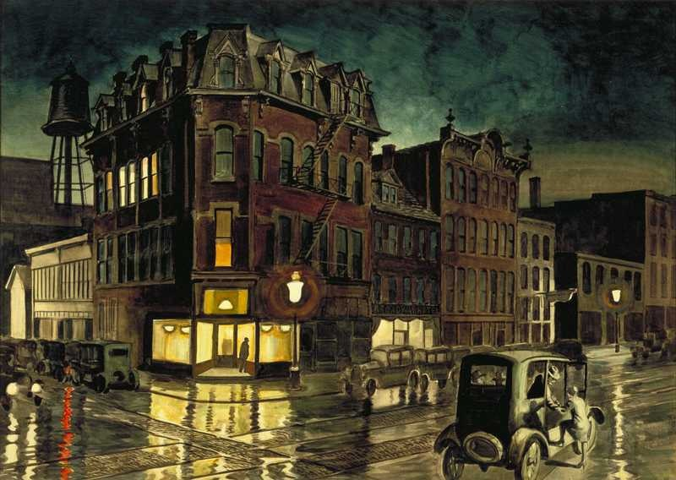

Slide 15
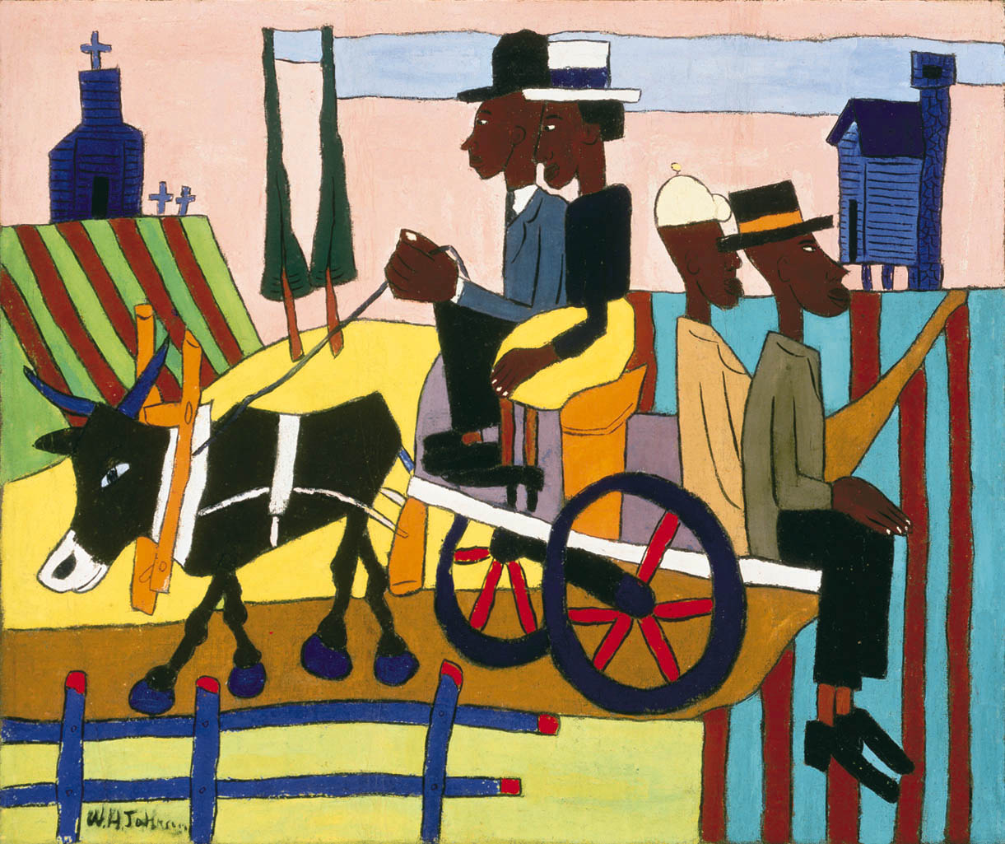
Notes:
William H. Johnson: Going to Church

Slide 16
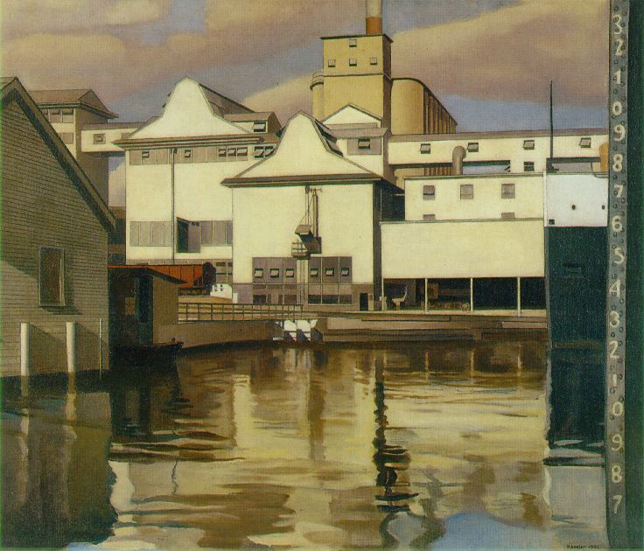
Notes:
Sheeler: River Rouge Plant

Slide 17
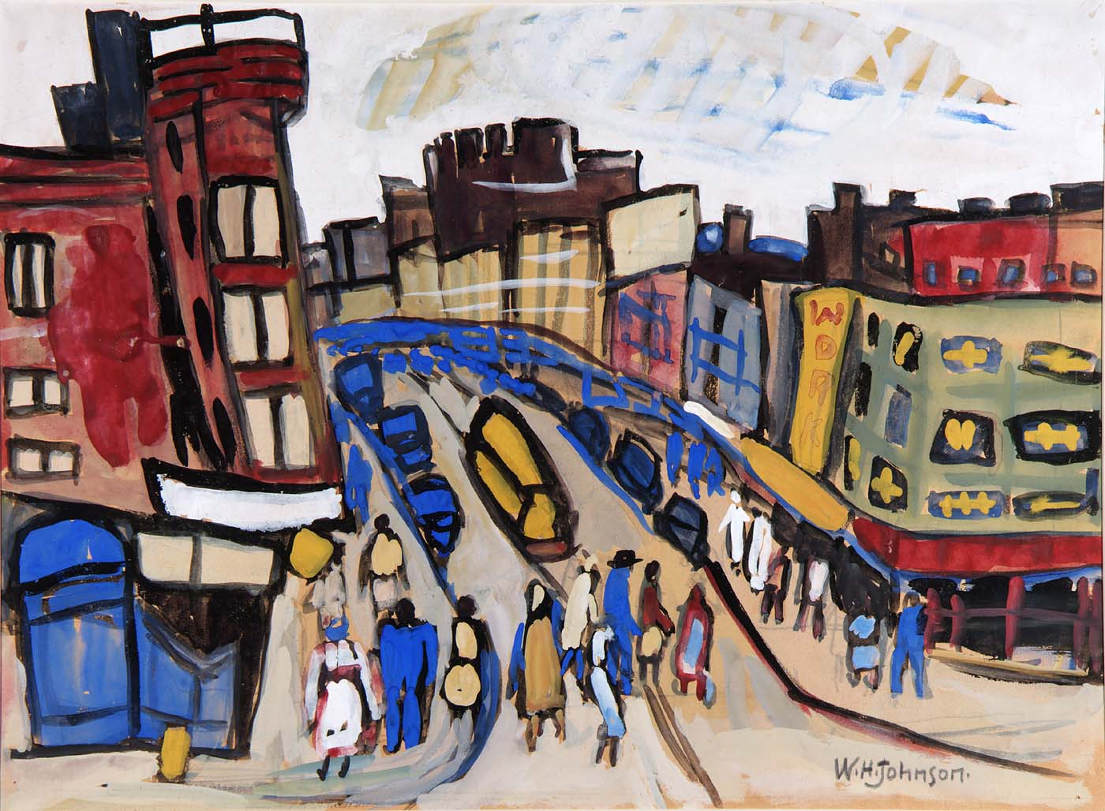
Notes:
William H. Johnson: Harlem Street

Slide 18
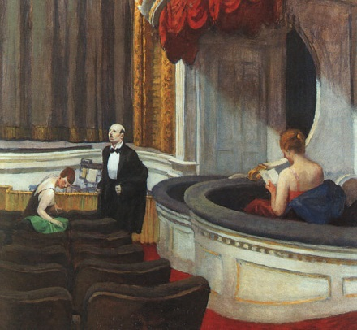
Notes:
Hopper: Two on the Aisle

Slide 19
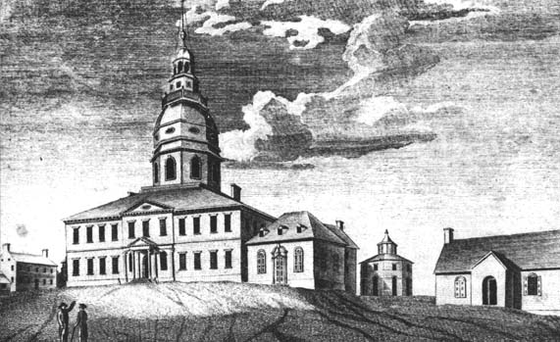
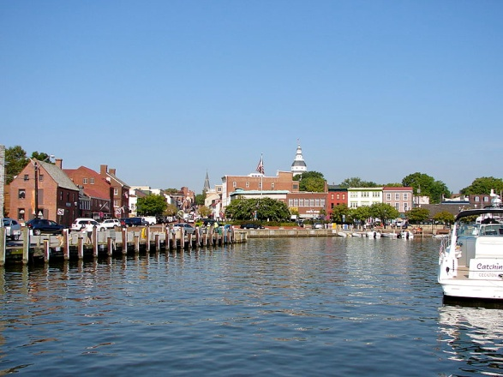
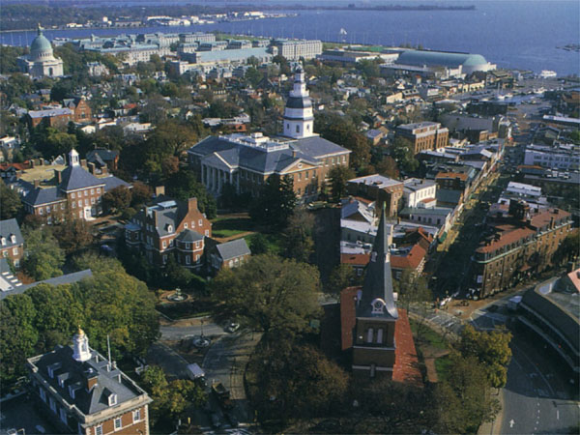
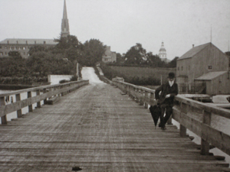
Notes:
Annapolis

