Slide 1
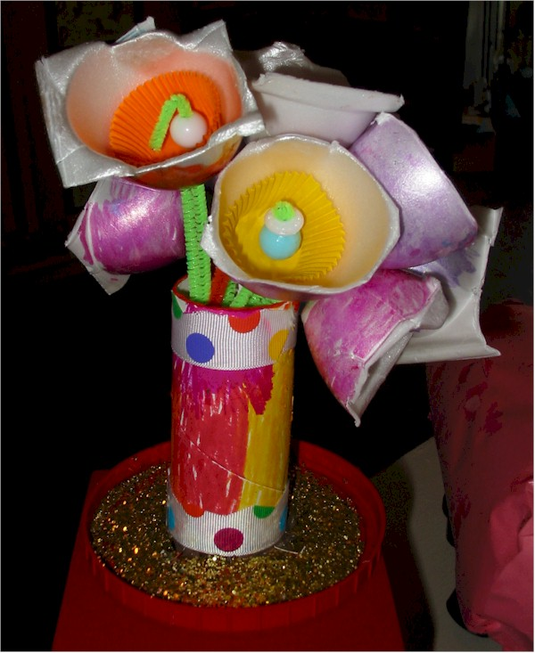
Art: Recycled/Found Materials
Visual Arts Standard:
3.1.a Experiment with art media, processes, and techniques to generate and express personal meaning.

Slide 2
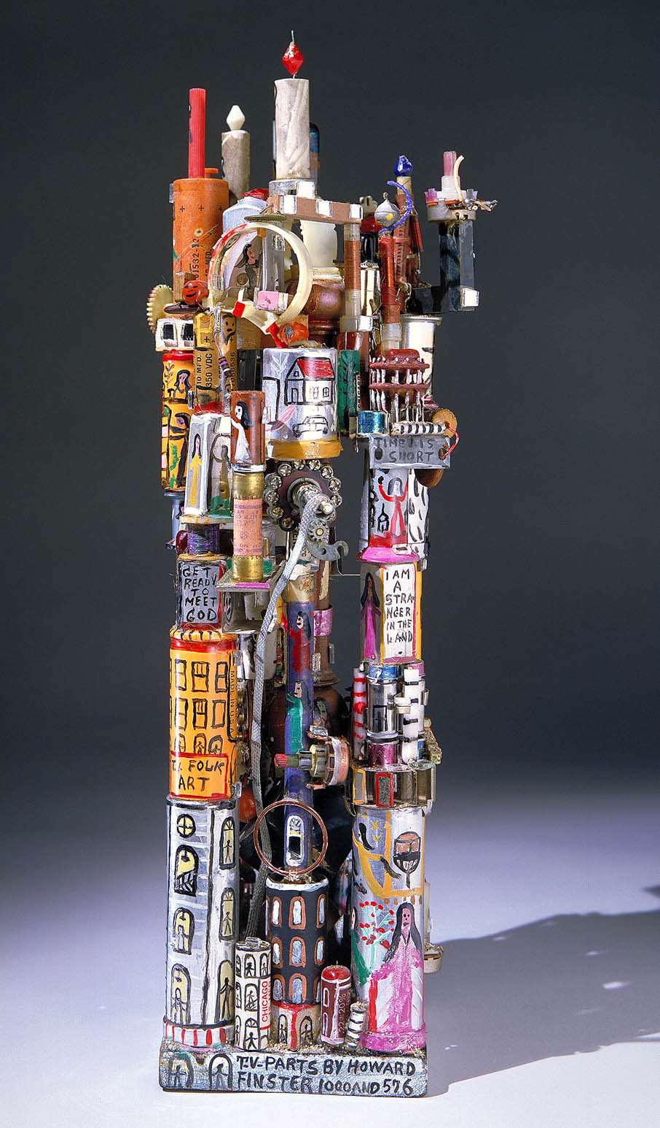
Notes:
http://americanart.si.edu/images/1986/1986.65.245_1a.jpg
THE MODEL OF SUPER POWER PLAINT (FOLK ART MADE FROM OLD T.V. PARTS)
1979 Howard Finster, born Valley Head, AL 1916-died Rome, GA 2001 assembled and painted electronic television parts, painted metal, painted stic, glitter, mirror glass, wood, cardboard, and ceramic

Slide 3
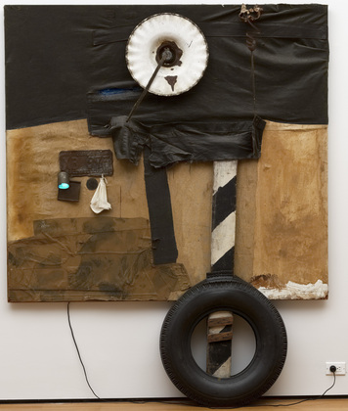
Notes:
Museum of Modern Art First Landing Jump
Robert Rauschenberg (American, 1925–2008)
1961. Cloth, metal, leather, electric fixture, cable, and oil paint on composition board, with automobile tire and wood plank, 7' 5 1/8" x 6' x 8 7/8" (226.3 x 182.8 x 22.5 cm).

Slide 4
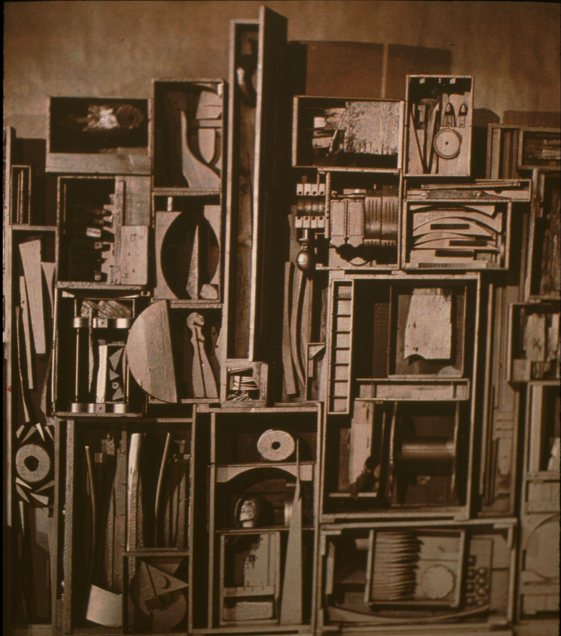
Notes:
Louise Nevelson. Moon Garden Plus One. 1960 -working with discarded objects

Slide 5
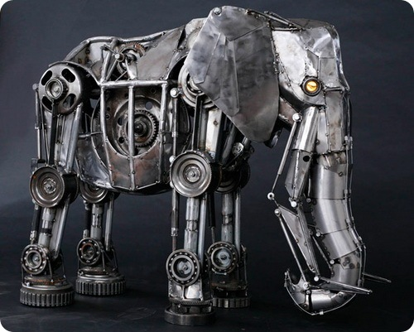

Slide 6
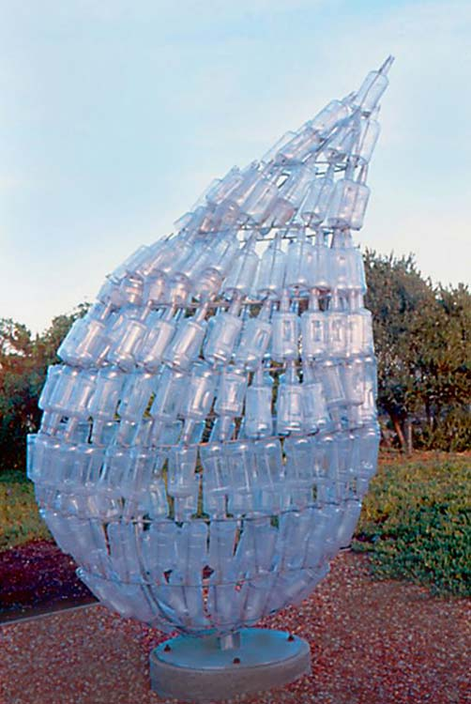
Notes:
Marta Thomas_Earth’s Tear Recycled bottles

Slide 7
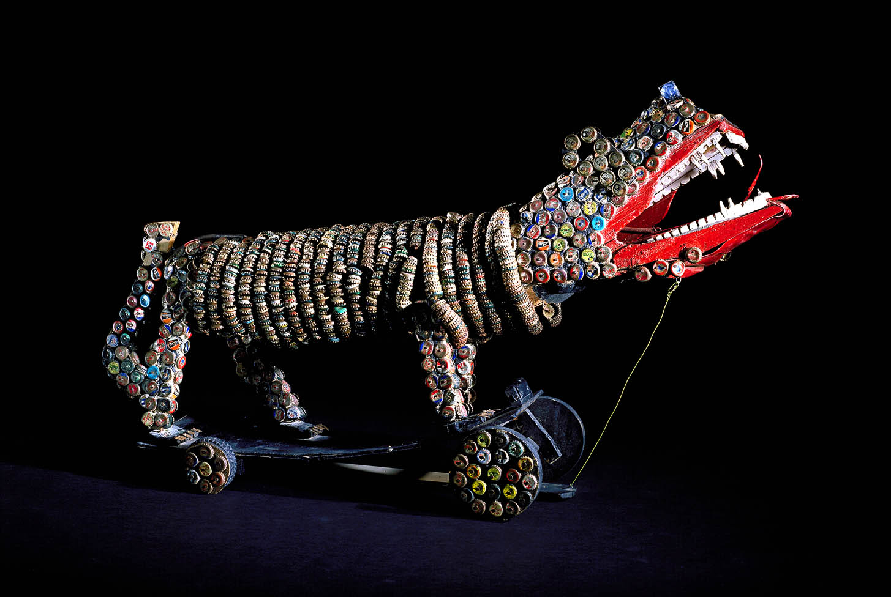
Notes:
Bottlecap Lion
completed after 1966 Unidentified carved and painted assemblage, bottlecaps, flashcube, fiberboard, and plastic

