Slide 1
Animals Make Changes
Anne Arundel County Public Schools
Theme 3 Unit 1 Question 3

Slide 2
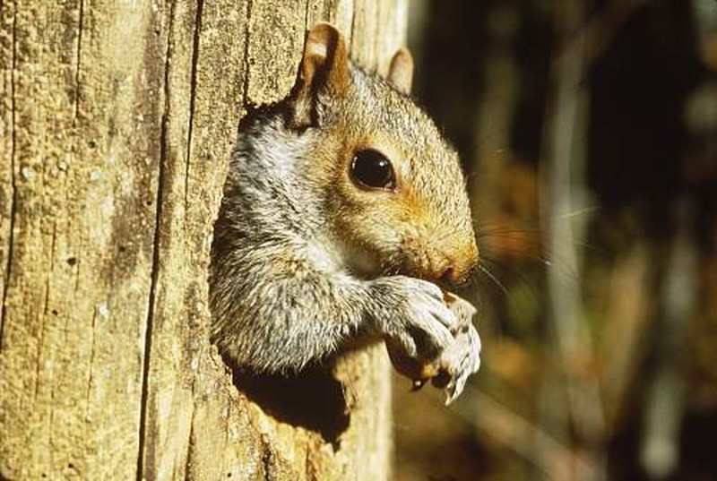
How did the squirrel change the environment to meet its needs?
Hole
Squirrel
Tree
Claws

Slide 3
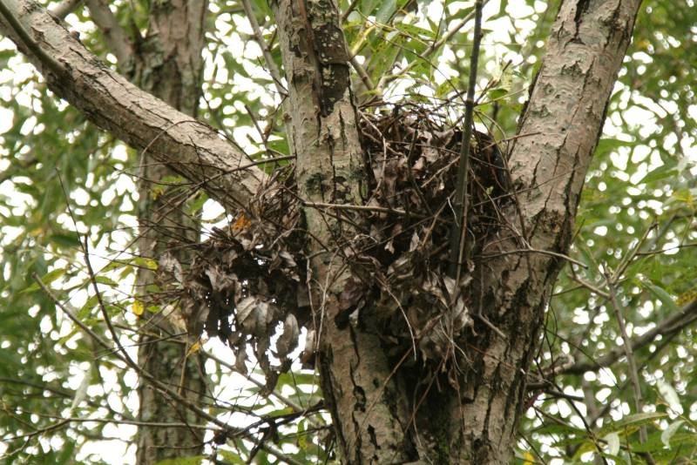
How did the squirrel change the environment to meet its needs?
Sticks
Tree
Leaves
Nest

Slide 4
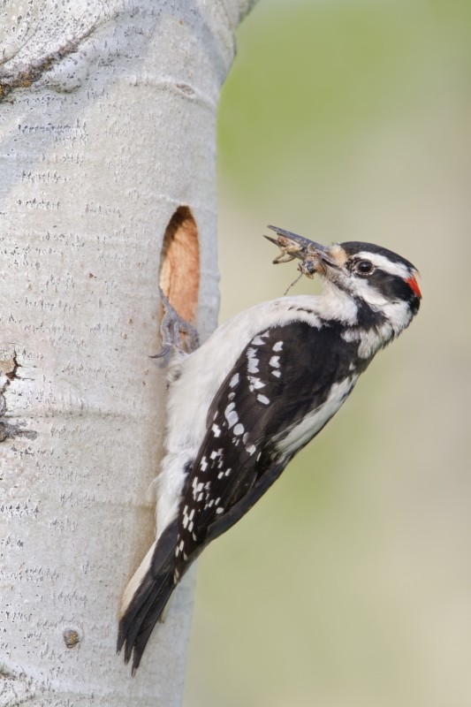
How did the woodpecker change the environment to meet its needs?
Hole
Beak
Tree
Woodpecker

Slide 5
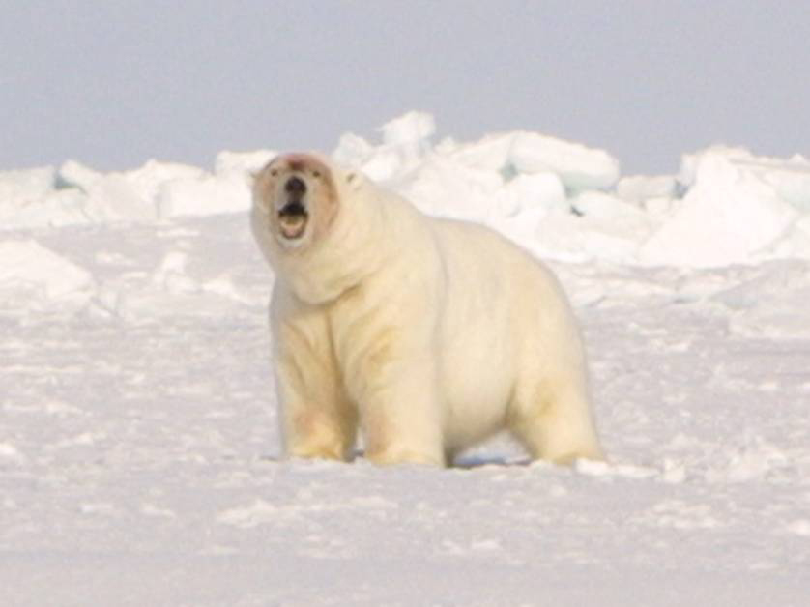
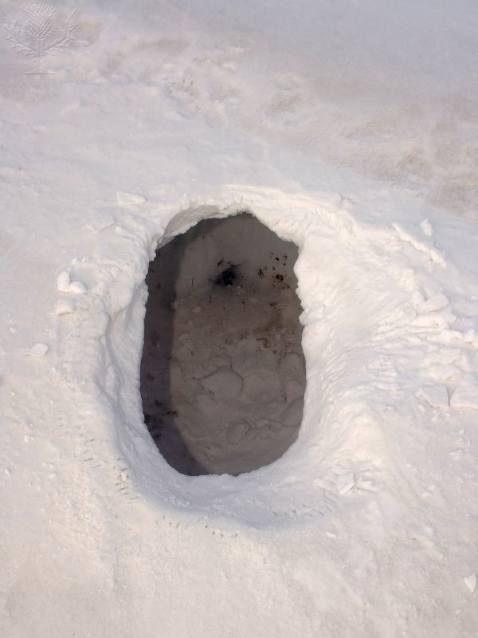
Polar Bear
How did the polar bear change the environment to meet its needs?
Hole
Snow

Slide 6
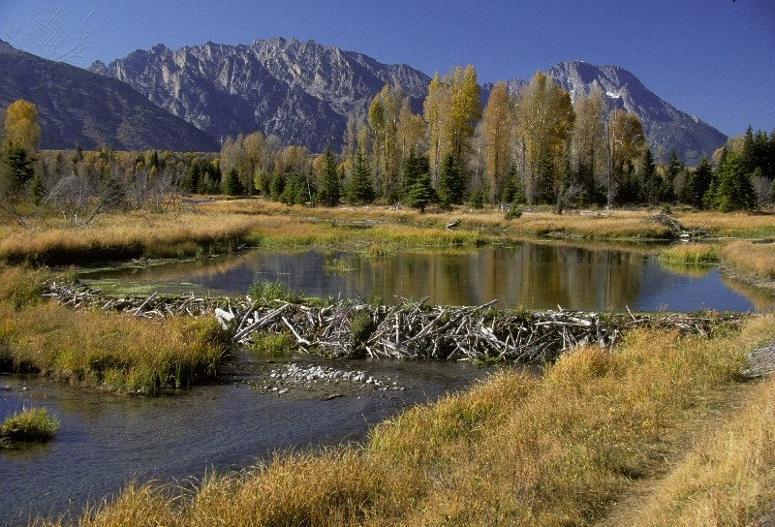
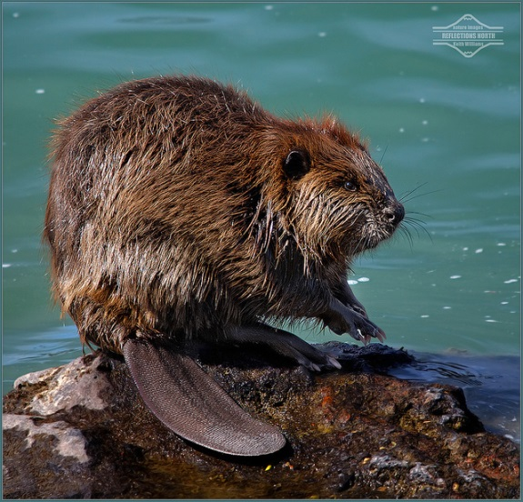
Teeth
How did the beaver change the environment to meet its needs?
Beaver
Logs
Twigs
Grass
Mud
Rocks
Claws
Dam
River

Slide 7
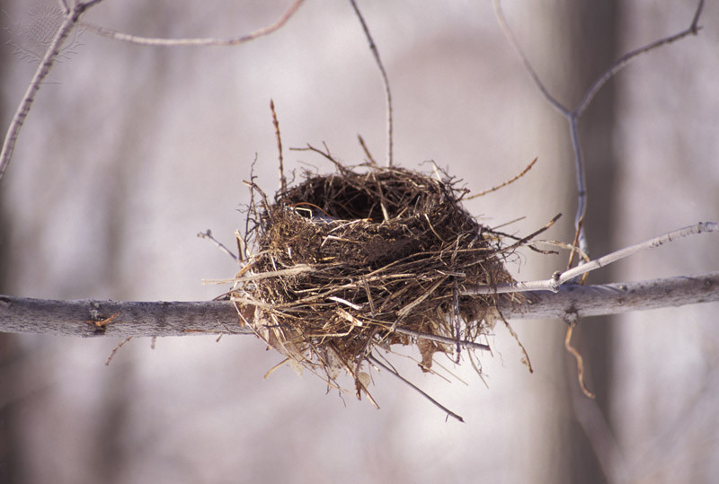
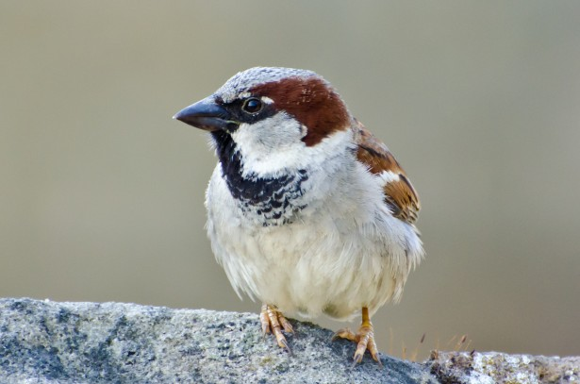
How did the bird change the environment to meet its needs?
Twigs
Grass
Mud
Nest
Beak
Branch
Bird

Slide 8
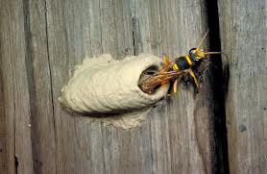
How did the wasp change the environment to meet its needs?
Mud
Clay
Wasp
Mouth
Nest

