Slide 1
MOTION & Art: Kinetic Art
Art/Sculpture that Moves from
Wind, Water, Electricity or Human Touch
Notes:
Kinetic art is art from any medium that contains movement perceivable by the viewer or depends on motion for its effect. Kinetic art explores how things look when they move. Most Kinetic art pieces are sculptured works, made up of parts designed to be set in motion by an internal mechanism or an external stimulus, by a motor, water, wind or even a button pushed by the viewer.

Slide 2
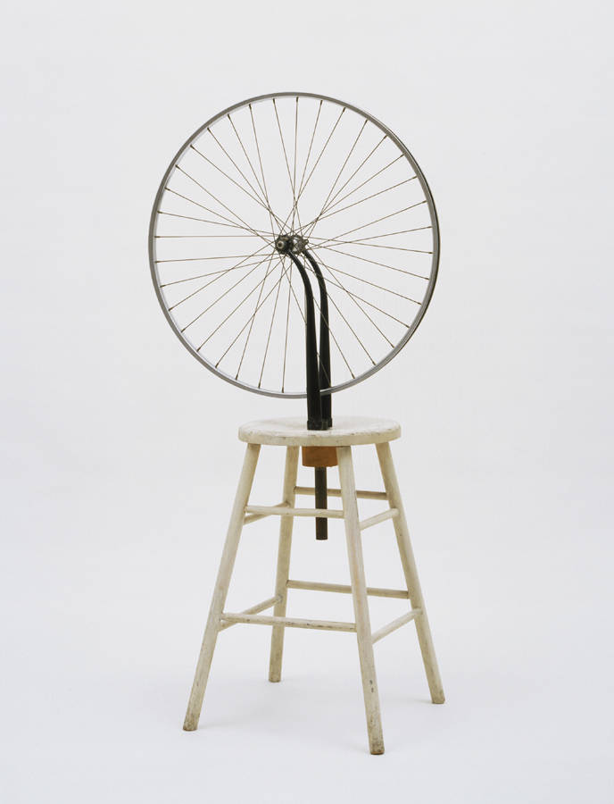
Notes:
Marcel Duchamp’s Bicycle Wheel (1913). It was seen as the first work of kinetic art because the wheel affixed to the stool could be spun.

Slide 3
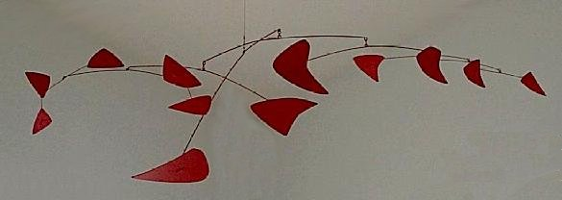
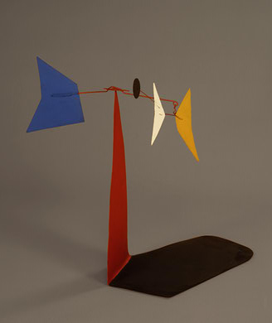
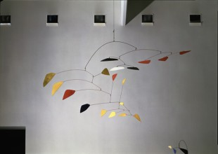
Notes:
A mobile is a type of kinetic sculpture constructed to take advantage of the principle of equilibrium.
http://www.npg.si.edu/exhibit/calder/index.html
Alexander Calder, "Red Mobile", 1956. Painted sheet metal and metal rods, Montreal Museum of Fine Arts.
“Mobile on Two Planes: (bottom left)

Slide 4
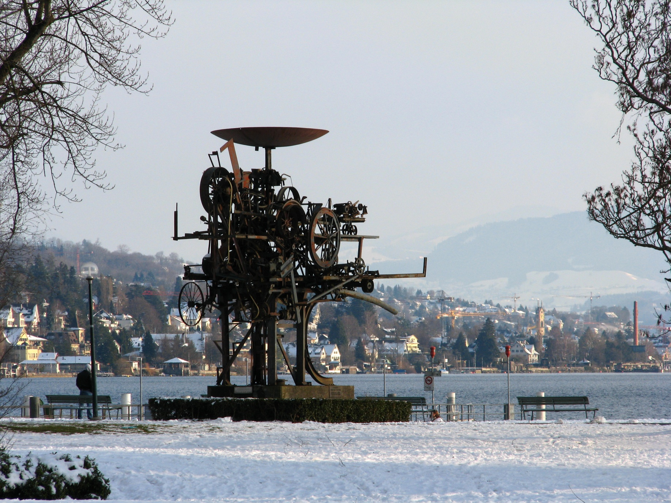
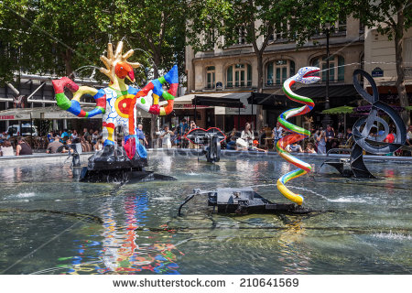
Notes:
Jean Tinguely's fountain Heureka in Zürich-Seefeld (Zürichhorn)
Insert: Stravinsky Fountain, Pompidou Museum, Paris.

Slide 5
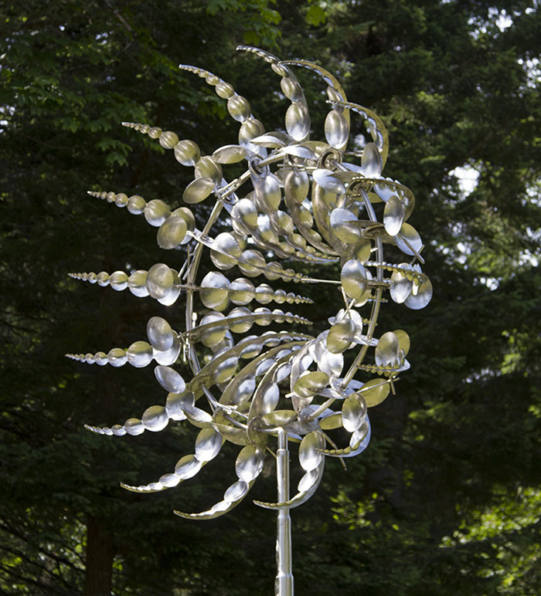
https://www.youtube.com/watch?v=RJu5i1SMaiw
Octo
by Anthony Howe

Slide 6
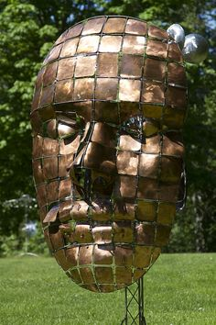
https://www.youtube.com/watch?v=J0__9BVFX0I
About
Face
by Anthony Howe

Slide 7
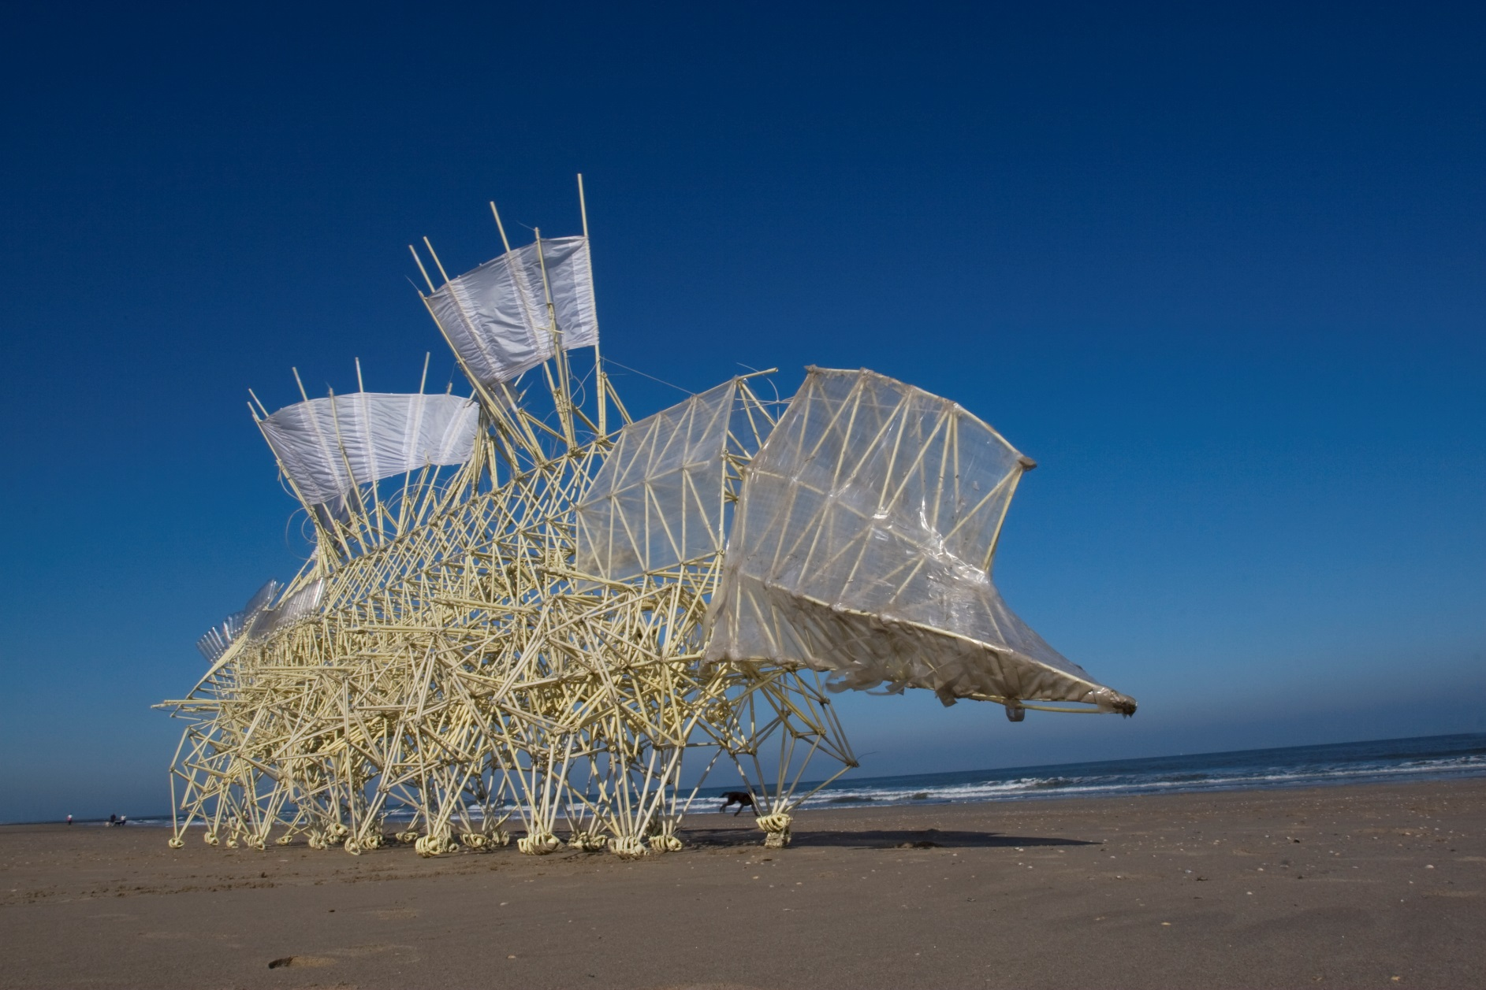
https://www.youtube.com/watch?v=azy-c6QXUCw
Standbeest
By Theo Jensen

Slide 8
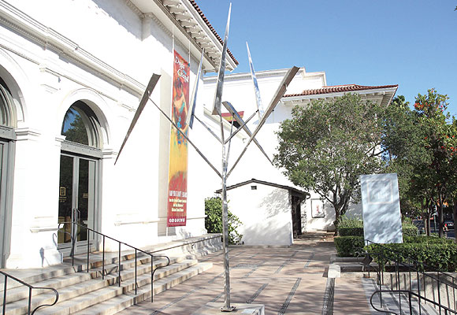
Six
Random
Lines
Excentric
III
George Rickey

