Slide 1
Stormy Weather

Slide 2
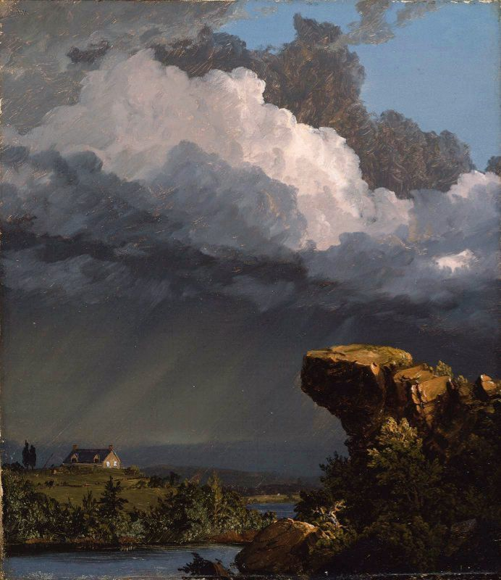
LOOKING 10 x 2
Look at the image quietly for at least 30 seconds. Let your eyes wander.
In one minute, list 10 words or phrases about any aspect of the picture,
Share your words with the class.
Repeat Steps 1 & 2: Look at the image again and try to list 10 more words or phrases to your list.
Notes:
A Passing Storm
1849
by Frederic Church

Slide 3
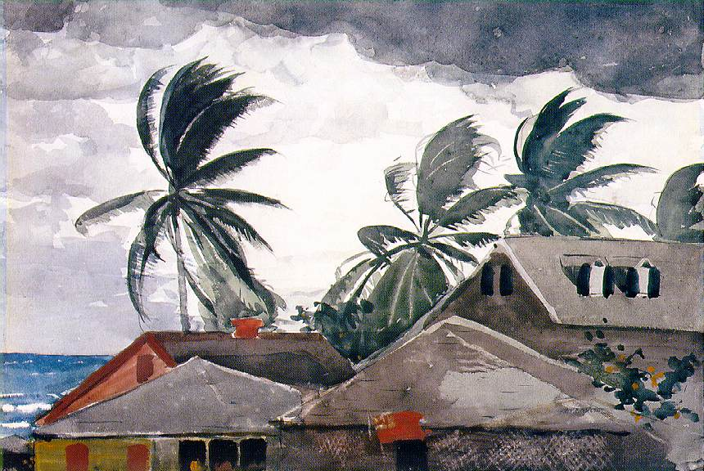
CLAIM Make a claim about the weather. Claim = an explanation or an interpretation of some aspect of the artwork |  | SUPPORT Identify support for your claim Support = Things you see, feel and know that support your claim |  | QUESTION Ask a question related to your claim. Question = What’s left hanging? What isn’t explained, What new reasons does your claim raise?
Notes:
Hurricane, Bahamas
1899
by Winslow Homer

Slide 4
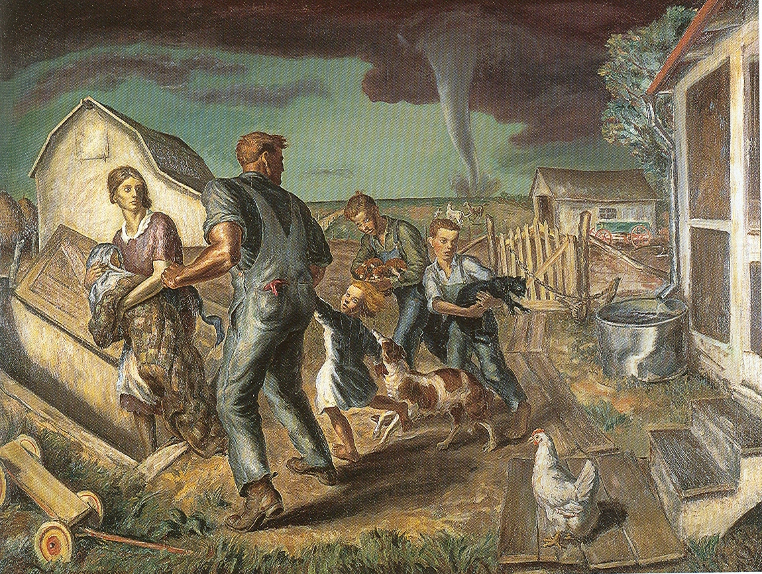
Artful
Thinking
CLAIM Make a claim about the weather. Claim = an explanation or an interpretation of some aspect of the artwork |  | SUPPORT Identify support for your claim Support = Things you see, feel and know that support your claim |  | QUESTION Ask a question related to your claim. Question = What’s left hanging? What isn’t explained, What new reasons does your claim raise?
Notes:
Curry John Stewart
Tornado Over Kansas
1929

Slide 5
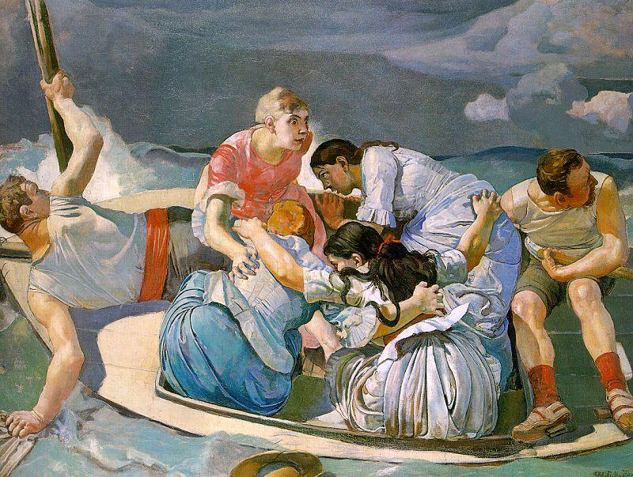
Is this painting the
Beginning
Middle
or
Ending of the story?
Notes:
Surprised by the Storm
1887
by Ferdinand Hodler
Gr. 5 Weather, hurricanes

Slide 6
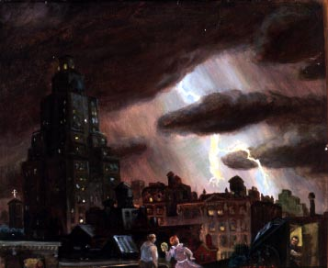
Notes:
C. Bell Electric Storm

Slide 7
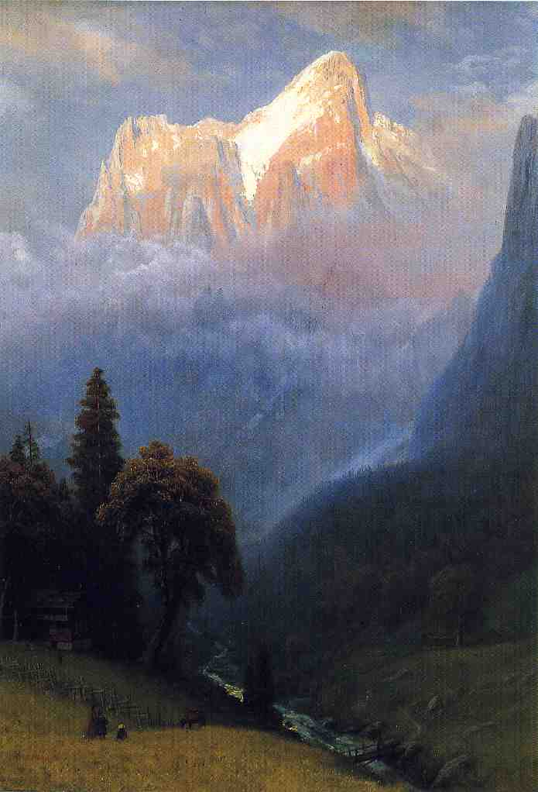
Notes:
Storm Among the Alps
1856
by Albert Bierstadt

Slide 8
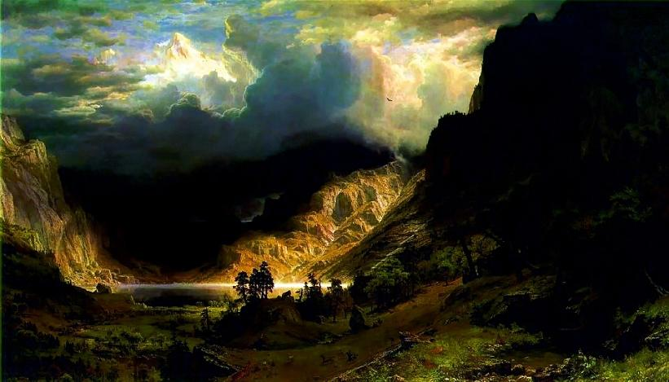
Notes:
Storm in the Rocky Mountains
1866
by Albert Bierstadt

Slide 9
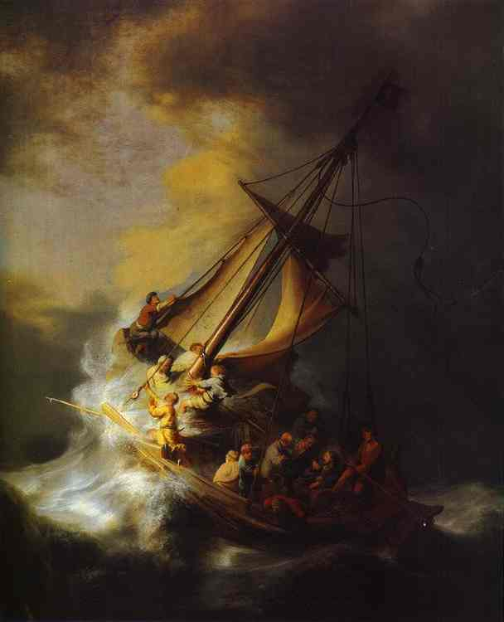
Notes:
Storm on the Lake of Galilee
1633
by Rembrandt

Slide 10
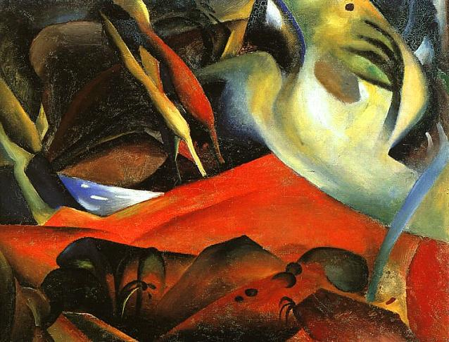
Notes:
The Storm
1911
by August Macke

Slide 11
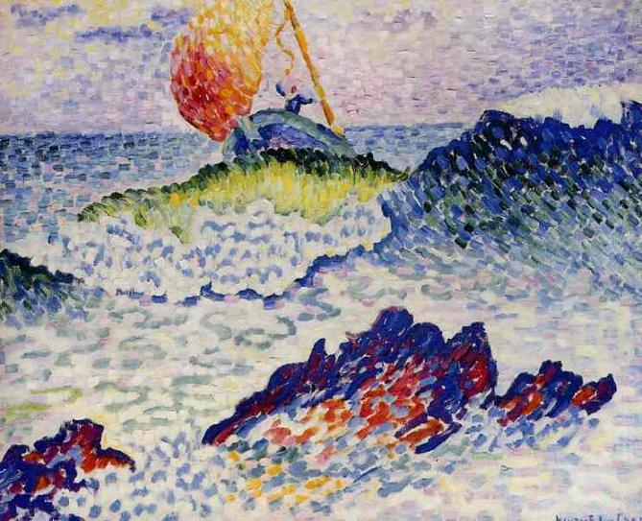
Notes:
The Shipwreck
1907
by Henri-Edmond Cross

Slide 12
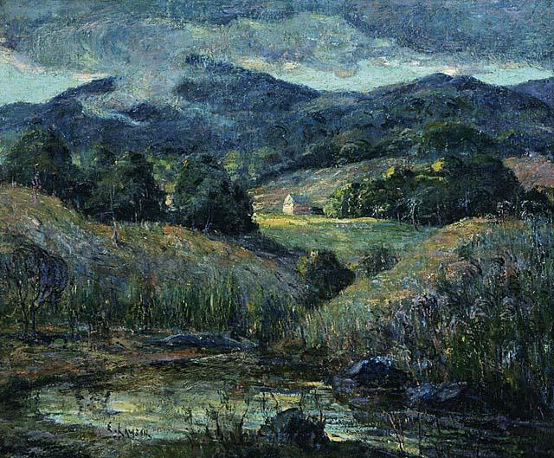
Notes:
Approaching Storm
1919
by Ernest Lawson

Slide 13
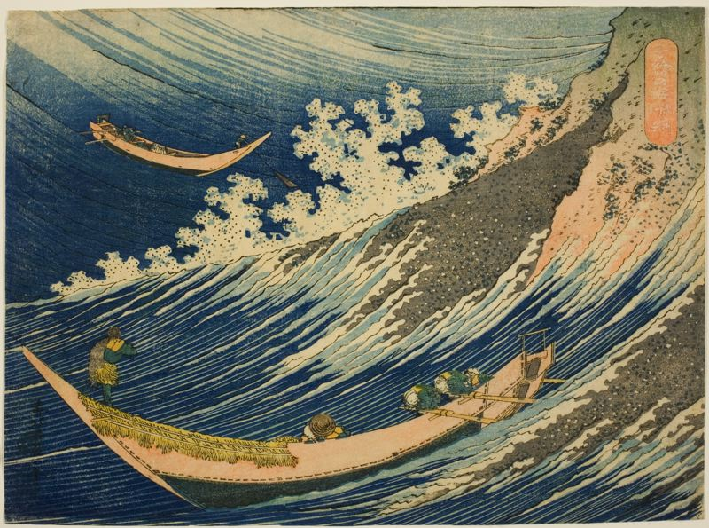
Notes:
Fishing boats at Choshi in Shimosa
Date unknown
by Katsushika Hokusai

Slide 14
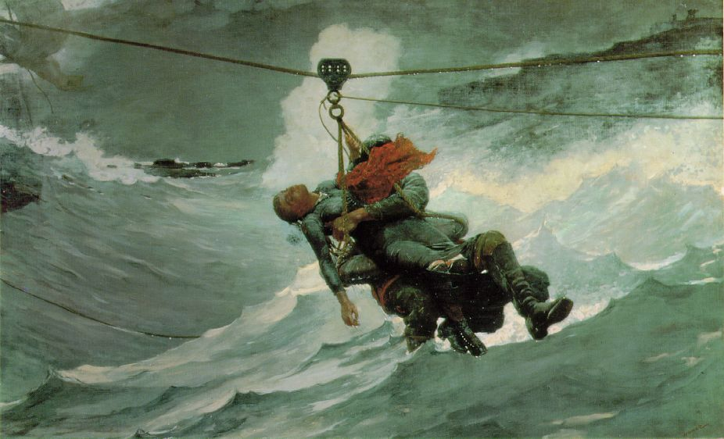
Notes:
The Life Line
1884
by Winslow Homer

Slide 15
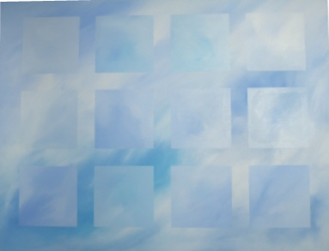
Here is another artist’s painting of the sky.
What title would you choose for this painting?
Why do you think your title is a good one for this artwork?

Slide 16
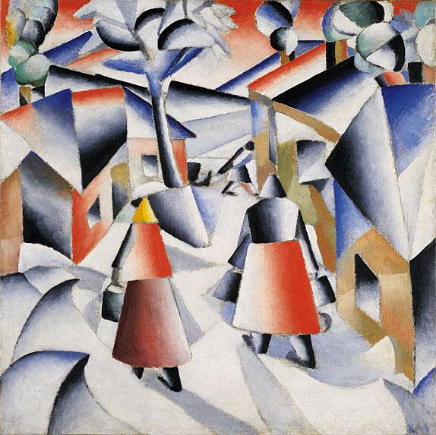
Notes:
Morning in the Village after Snowstorm
1912
by Kasimir Malevich

Slide 17
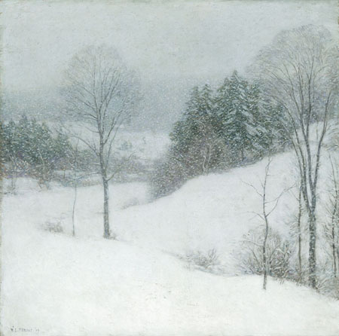
Notes:
The White Veil
1909
by Willard Metcalf

