Slide 1
Miss Alaineus
EduCreations Character Conflict Mini Project

Slide 2
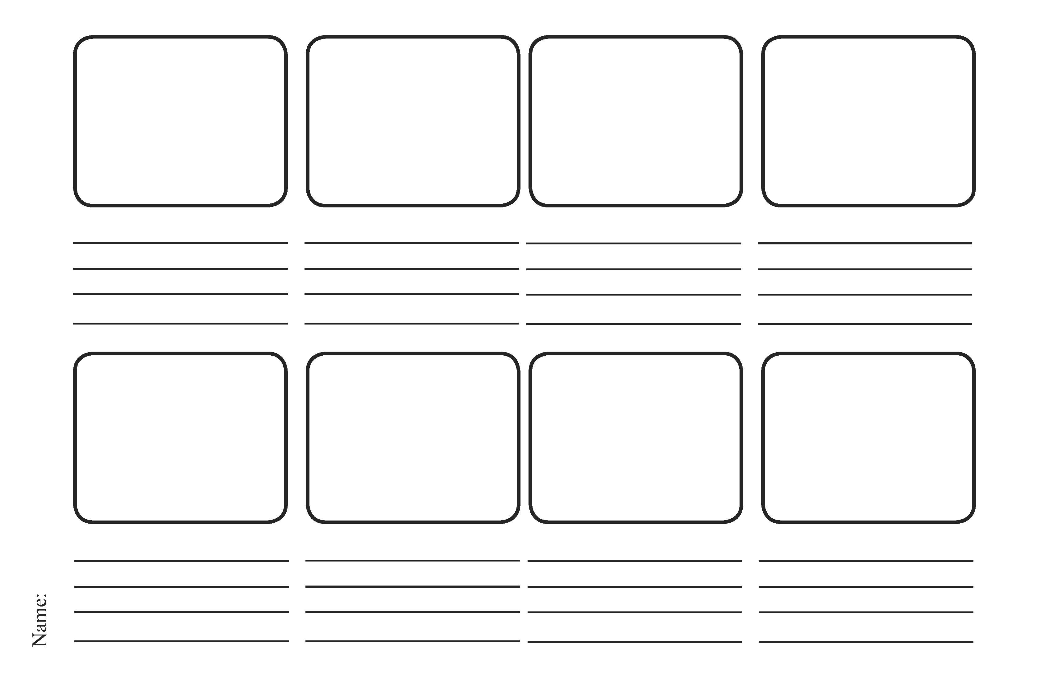
Use the story board above to summarize the main events of the story.

Slide 3
Character Conflict
Now that your story board is complete, consider the character conflict that appeared in the story.
Character Conflict can happen in several different ways:
1) Character vs. The World (with society)
2) Character vs. Character (another person in the story)
3) Character vs. Self (internal conflict)
In each of the main events you listed on the previous page, consider which type of conflict the main character was experiencing.
On the next page, create a new story board where you’ve included the character’s conflicts and how they affect the plot of the story.

Slide 6
EduCreations
Open up the iPad app – EduCreations to create your story board.
Follow the below steps in order:
1) Draw the story scenes on all the pages
2) Once you have the entire story laid out in picture form…
3) Write down exactly what you want to describe in each of the story frames.
4) Once you have double checked your writing and not missed any important information about the main character’s conflicts and main events…
5) Hit the record button to begin recording. Click on the pages as you are ready. Once you begin recording you may NOT edit it!
Find a quiet spot in the room to record. All other background noises will be picked up.

