Slide 1
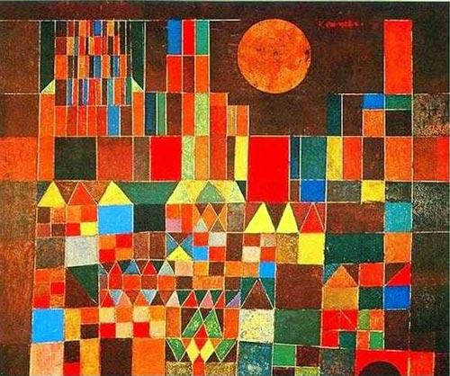
LOOKING 10 x 2
Look at the image quietly for at least 30 seconds. Let your eyes wander.
In one minute, list 10 words or phrases about any aspect of the picture. Include the math that you see.
Share your words with the class.
Repeat Steps 1 & 2: Look at the image again and try to list 10 math words or phrases to describe the painting.

Slide 2
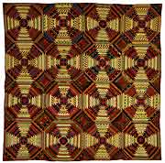
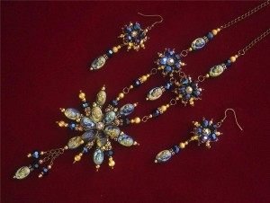
attern
Repetition of an any element of art (i.e., shapes, lines, or colors) to achieve decoration or ornamentation. Also called a motif, in a design

Slide 3
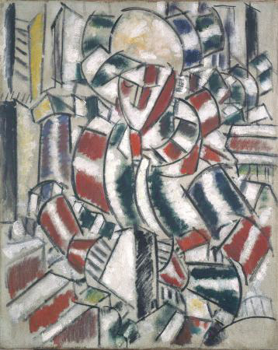
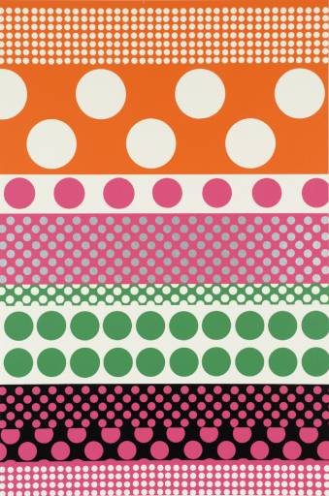
Leger, Fernand
Woman in Red and Green
1914
Sir Eduardo Paolozzi (English, 1924-2005), from "Moonstrips Empire News", [no title], 1967

Slide 4
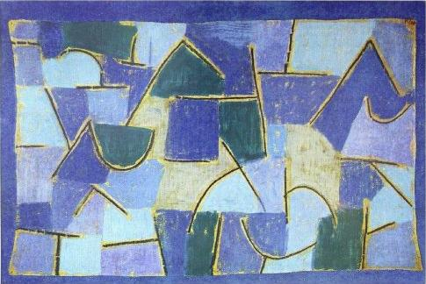
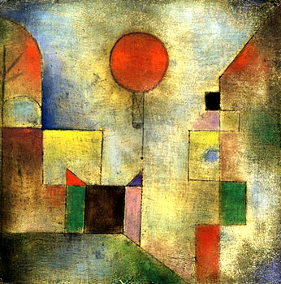
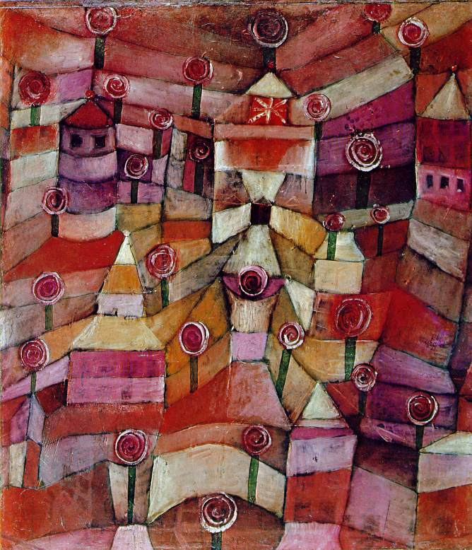
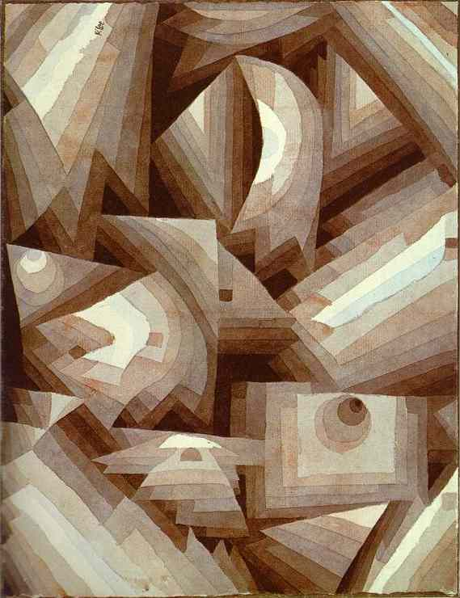
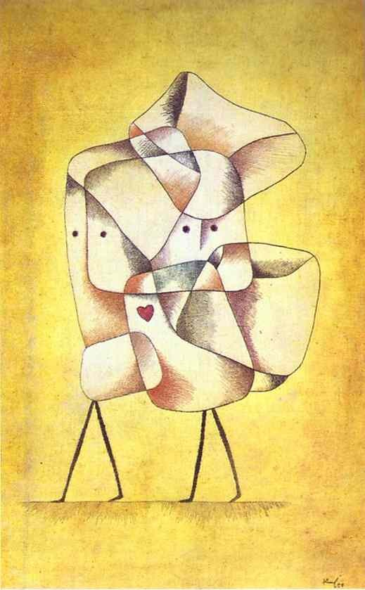
Baloon, 1932
The Rose Garden, 1920
Blaue Nacht, 1937
Paul Klee was a famous Swiss-German artist known for the fine lines, pattern and playful geometry in his childlike watercolors and illustrations that incorporated repeated colors and shapes.
Notes:
Visual Music - Paul Klee This rich quilt of pattern and color is a 1922 painting by the German-Swiss artist Paul Klee, a master of the playful and inventive, an artist who sometimes used materials in unconventional ways. He is best known for compositions that appeal to the eye with a light-hearted use of color and line Klee was a talented violinist, married to a pianist, and like his contemporary Kandinsky, created work that evokes the harmonies of music through color, line, and form. It is a sad comment on the times he lived through that even his work, innocent as it appears, was given the label of 'degenerate' by the Nazis. He taught at the celebrated Bauhaus school in Germany until he was forced into exile. As you would expect, his late work is darker and can contain a deeper sense of the malevolent.

Slide 5
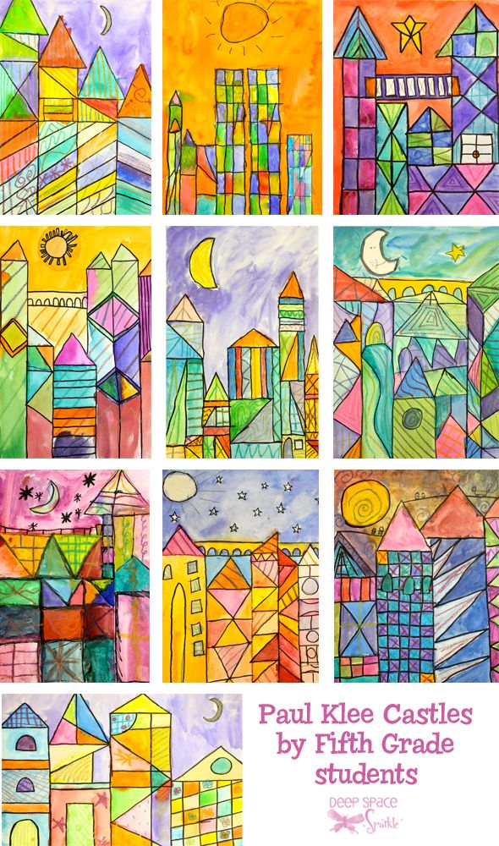
City-Scapes a la Klee
Create cityscapes in the style of Paul Klee. Use rulers to draw building shapes and then create lines patterns inside each building to represent a multiplication sentence.
1.
Use your ruler to draw tall buildings in a city scape.
2.
On each building include an array using windows, shapes, colors or items in/on the building or items in the sky.
3.
Add color to your buildings to create additional patterns in the Paul Klee style with oil pastel crayons.
4.
Complete a chart describing your art using multiplication sentences.
5.
Sign and title your artwork.
Take a gallery walk of your classmates work and try to discover the sentence they wrote.
Notes:
use a ruler to create straight lines *create a cityscape *on each building include an array (using windows, shapes, colors or items in/on the building) *add extra details like stars or snowflakes in an array *complete the chart describing the art using multiplication sentences
Students completed two charts - one with answers and one without - so that people could find the correct object and then check their answers on the second page.

Slide 6
