Slide 1
Designing your dream bedroom
Using the Chrome App “Build with Chrome” your goal is to design your bedroom using your knowledge of area and volume.

Slide 4
Specifications
As you are building your dream bedroom, you are limited on space and therefore the furniture in your bedroom has to follow the below specifications.
You are allowed to build composite figures (2+ right rectangular prisms combined)
Your RED bed has to have a volume between 48 – 56 units³
Your ORANGE nightstand has to have a volume between 20 – 32 units³
Your YELLOW dresser has to have a volume between 32 - 44 units³
Your GREEN area rug has to have a volume between 12 – 20 units³
*Using only the $\frac{1}{2}$ height Legos
You may choose 1 other BLUE item to build in your bedroom. It’s volume has to be between 16 - 28units³

Slide 5
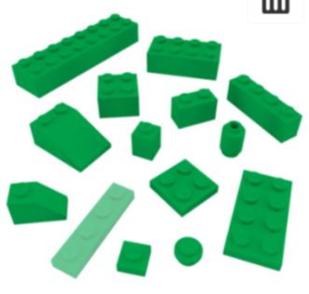
Building Tools
This lego has a volume of 2 x 4 x 1 units³
Look for the “TIPS” section at the bottom of your screen!
This lego has a volume of 2 x 8 x 1 units³
This lego has a volume of 2 x 2 x 1 units³
This lego has a volume of 1 x 4 x 1 units³
This lego has a volume of 1 x 1 x 1 units³
Don’t use!
Don’t use!
Don’t use!
This lego has a volume of 1 x 2 x 1 units³
This lego has a volume of 2 x 2 x $\frac{1}{2}$ units³
Don’t use!
This lego has a volume of 2 x 4 x $\frac{1}{2}$ units³
This lego has a volume of 1 x 4 x $\frac{1}{2}$ units³
This lego has a volume of 1 x 1 x $\frac{1}{2}$ units³

Slide 6
My Dream Bedroom!
Add your screen shot of your room you built in “Build with Chrome” to the left.
In this box, fill in the missing information below.
Red Bed: _____ units³
Orange Nightstand: _____ units³
Yellow Dresser: _____ units³
Green Area Rug: _____ units³
Blue (student choice): _____ units³

Slide 7
 | 4 | 3 | 2 | 1
Creativity | The design of your bedroom contains creative details and is very organized. You have really used your imagination. | The design of your bedroom contains a few creative details and is organized. You have used your imagination. | The design of your bedroom contains a few creative details and is somewhat organized. You have tried to use your imagination. | The design of your bedroom contains little evidence of creativity. You did not use much imagination.
Volume | All volume components are accurate to the assignment’s directions. | The majority of the volume components are accurate to the assignment‘s directions. | Some of the volume components are accurate to the assignment's directions. | A few to none of the volume components are accurate to the assignment’s directions.
Calculations | All calculations are correct. | The majority of calculations are correct. | Some of the calculations are correct. | A few to none of the calculations are correct.
Dream Bedroom Rubric

Slide 8
EXTENSION
Each item that you have built in your bedroom costs $1.12 per cubic unit.
What is the total cost of your bedroom?
Show your work below.
Now that you have designed your room, you need to figure out the cost of designing your bedroom.

