Slide 1
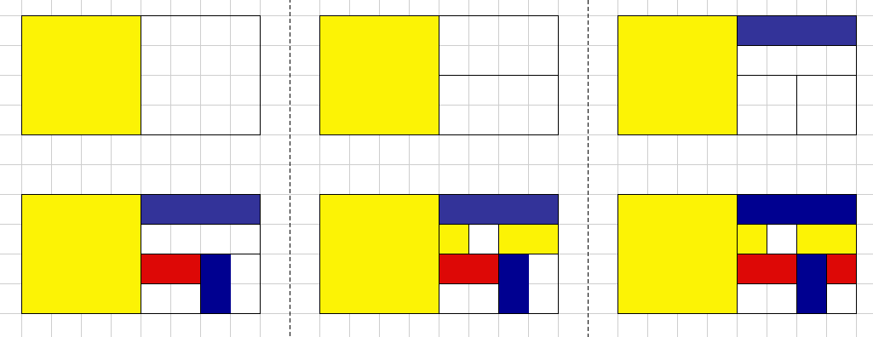
It’s YOUR TURN
You will create a Mondrian style artwork to demonstrate equivalent FRACTIONS. Select three colors to use in your artwork.
2. Draw a line to divide your rectangle in half.
3. Pick either or both of the new rectangles and repeat the process.
You can do the same with each rectangle that your create
4.Decide on a color scheme. Fill in your design with your three color choices but be sure and leave some white
5. Add black lines to outline your colors, like Mondrian did.
P
P
P
Secondary colors are formed by mixing primary colors.

Slide 2
BUT
Make it your
unique design following the steps!

