Slide 1
Composition No. II, with Red and Blue
Piet Mondrian (Dutch, 1872–1944)
CLAIM Make a claim about the math you see in Mondiran’s artwork. Claim = an explanation or an interpretation of some aspect of the artwork |  | SUPPORT Identify support for your claim Support = Things you see, feel and know that support your claim |  | QUESTION Ask a question related to your claim. Question = What’s left hanging? What isn’t explained, What new reasons does your claim raise?
Notes:
What is an artist?” And, "What does an artist do?” The objective is for the students to be led to their own realization that original, and sometimes strange, ideas come from the artist’s imagination. Typical responses from the students were that artists "make things," and artists sing, write stories, paint, draw, build, dance, compose music, etc. One
student responded that special artists also invent things. Lead the students to conclude that all artists have to learn to use skills to make their art better. Another important is that if an idea doesn't work right or doesn't sound right or doesn't look right, it is not necessarily a bad idea. If our ideas are not to our satisfaction, we may need to work hard to make them better. Sometimes we are more artists, and sometimes we are more
scientists or mathematicians. Non-representational painter, Piet Mondrian’s art evolved over his lifetime into his own unique style, which he coined “neo-plasticism.” This art was not based on outside artistic influences or on typical techniques, but was instead Mondrian’s interpretation of his deeply felt philosophical beliefs

Slide 2
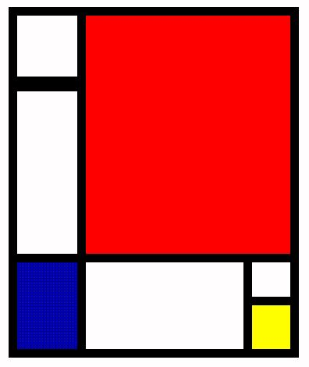
What
Colors
Shapes
Lines
do you see?
Choose a kind of color, shape, or line that you listed. * How does it contribute to the artwork overall? (How does it help the artwork “work?”) Consider: • How does it contribute to how the artwork feels? • How does it contribute to the mood of the artwork? • How does it contribute to how the artwork looks? • How does it contribute to the story the artwork tells? • How does it contribute to the ideas in the artwork?

Slide 3
Known as "the father of geometric abstraction," Piet Mondrian (1877-1944) was a central figure in the revolution of Modern Art in the early 20th century.
Notes:
Geometric abstraction is a form of abstract art based on the use of geometric forms
Abstract art has also historically been likened to music in its ability to convey emotional or expressive feelings and ideas without relying on something objective.

Slide 4
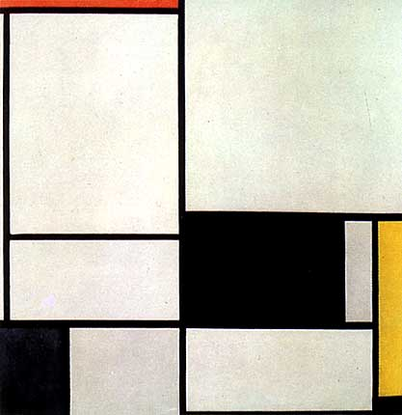
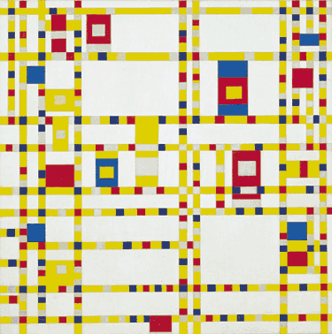
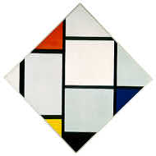
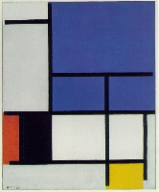
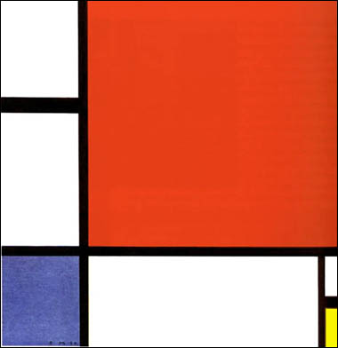
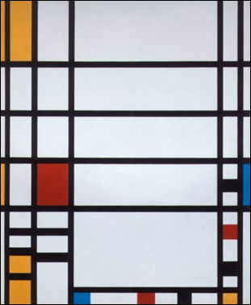
Art focused on
PRIMARY COLORS
Strong fields of color dominated his paintings, separated by thick black lines and sections of pure white
Notes:
Piet Mondrian-(1872-1944) Pieter Cornelis “Piet” Mondriaan, was a Dutch painter and a follower of the Bauhaus. HE was also an important contributor to the De Stijl art movement and group, which was founded by Theo van Doesburg. He evolved a non-representational form which he termed Neo-Plasticism. This consisted of white ground, upon which was painted a grid of vertical and horizontal black lines and the three primary colors.
Mondrian’s paintings are not composed of perfectly flat planes of color, as one might expect. Brush strokes are evident throughout, although they are subtle, and the artist appears to have used different techniques for the various elements.The black lines are the flattest elements, with the least amount of depth. The colored forms have the most obvious brush strokes, all running in one direction. Most interesting, however, are the white forms, which clearly have been painted in layers, using brush strokes running in different directions. This generates a greater sense of depth in the white forms, as though they are overwhelming the lines and the colors, which indeed they were, as Mondrian’s paintings of this period came to be increasingly dominated by white space.His art and theory influenced the Bauhaus movement and the development of the International style in architecture. In 1940 he settled in New York City.

Slide 5
Mondrian & Line
LINE was an important element of Mondrian’s Art
Lines can divide, connect and define a composition
A line can vary in width, direction, and length.
Lines often define the edges of a form on in this case is one-dimensional-length, not thickness.
Lines lead your eye around the composition.
Lines can be
horizontal, vertical, diagonal,
straight, curved or zigzag,
thick or thin, broken or continuous,
contoured, and
actual or implied.

Slide 6
How did Mondrian use fractions in his artwork?
What tools do you think he used to make the art?
Composition No. II, with Red and Blue
Piet Mondrian (Dutch, 1872–1944)
CLAIM Make a claim about a fraction you see in this artwork. |  | SUPPORT Identify support for your claim |  | QUESTION Ask a question related to your claim.
Notes:
How many implied lines are there on this artwork? How does that help us see the fractions? What would it look like if all the implied lines were drawn in? How could we divide the space to show 1/3 in the color red?
How could we divide the space to show 1/2 in the color yellow?

Slide 7
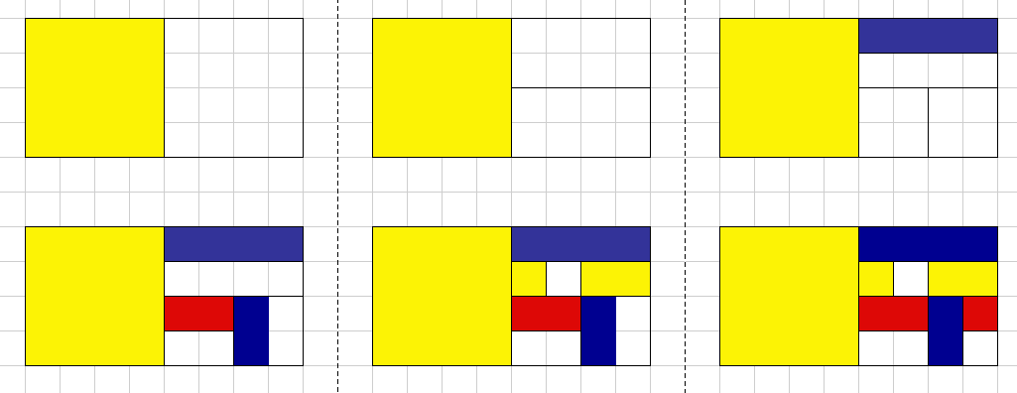
It’s YOUR TURN
You will create a Mondrian style artwork to demonstrate equivalent FRACTIONS. Select three colors to use in your artwork.
2. Draw a line to divide your rectangle in half.
3. Pick either or both of the new rectangles and repeat the process.
You can do the same with each rectangle that your create
4.Decide on a color scheme. Fill in your design with your three color choices but be sure and leave some white
5. Add black lines to outline your colors, like Mondrian did.
P
P
P
Secondary colors are formed by mixing primary colors.
Notes:
RESOURCE: http://www.teachmaths-inthinking.co.uk/activities/the-art-of-fractions.htm

