Slide 1
Mindy’s Vegetable Stand
has 213 red tomatoes and
323 green tomatoes. Does
she have more than or less than 500 tomatoes?
Double click to type

Slide 2
Sue’s Sewing Store has 185 large buttons and 201 small buttons. DoesSue’s shop have more than or less than 300 buttons?
Double click to type

Slide 3
Rob’s Art Shop has 328 watercolor paints and 215 oil paints. Does Rob’s shop have more than or less than 600 paints?
Double click to type

Slide 4
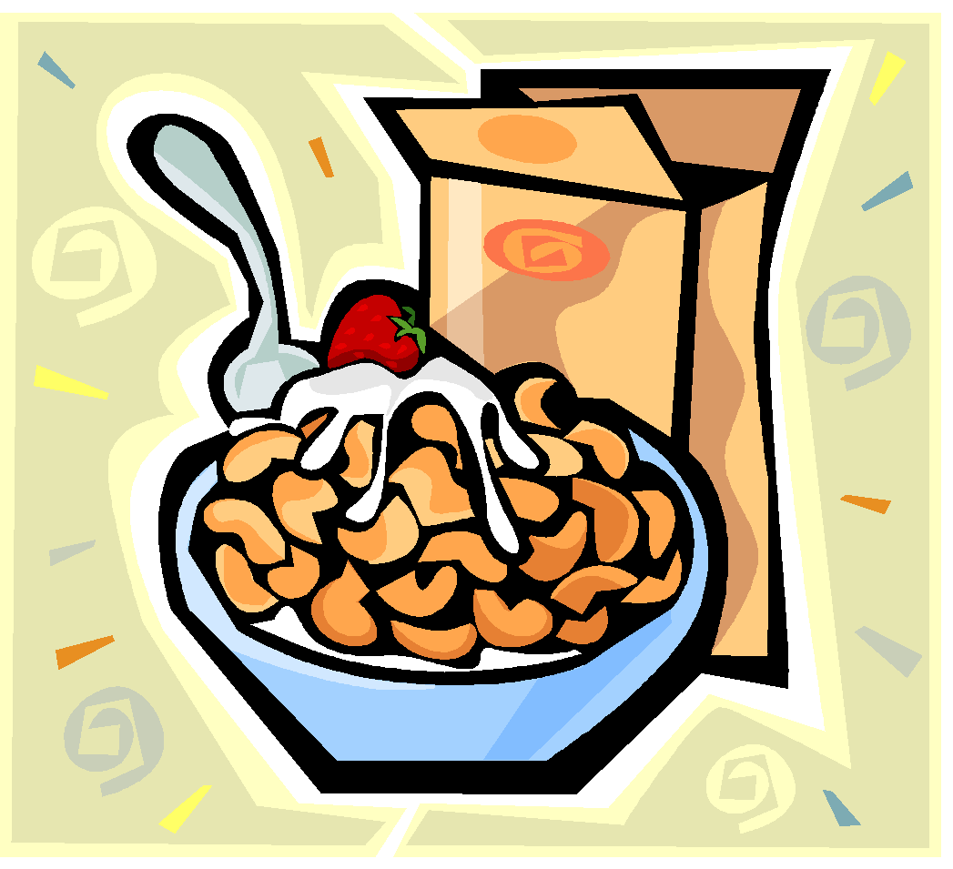
Ms. Walsh’s Health Food Bar has 425 boxes of hot cereal and some boxes of cold cereal. In all, there are about 500 boxes of cereal. How
many boxes of cold cereal are there?
Double click to type

Slide 5
Mrs. Pinky sails 256 miles on
her boat to an island. Then
she sails 139 miles to another
island. About how many miles
does she sail in all?
Double click to type

Slide 6
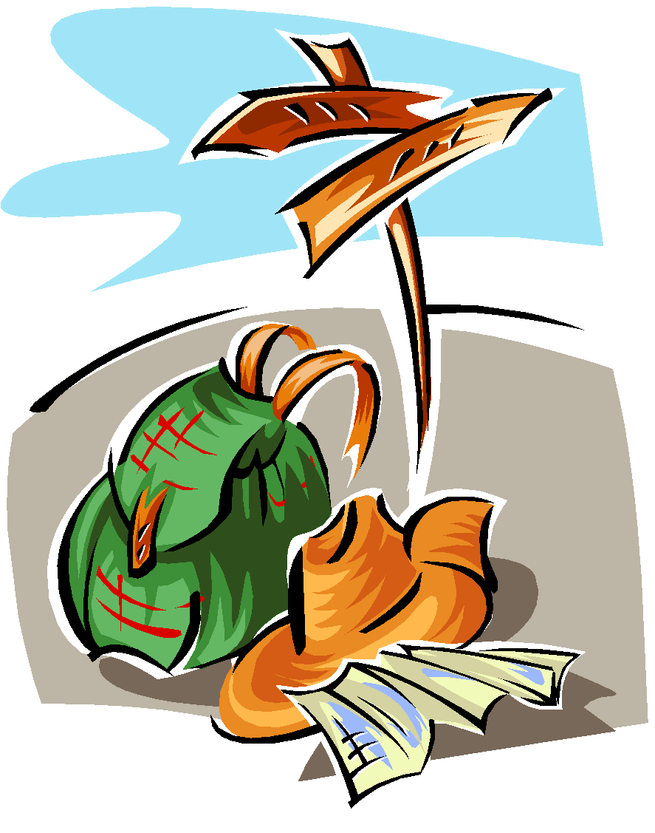
Mr. DeLuca hikes 192 miles in one week. Then he hikes 173 miles the next week. About how many miles does Mr. DeLuca hike in two weeks?
Double click to type

