Slide 1
Bar Model Comparison Problems
2T1U4Q12
Modified by Darren Towers | Hilltop Elem.
August 2017

Slide 2
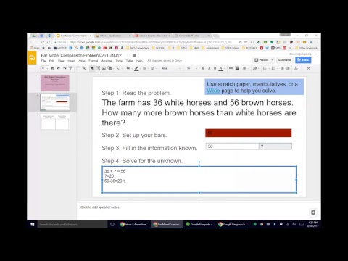
Double-click to watch this video.

Slide 3
Step 1: Read the problem.
The farm has 36 white horses and 56 brown horses.
How many more brown horses than white horses are there?
Use scratch paper, manipulatives, or a Wixie page to help you solve.
Step 2: Set up your bars.
Step 3: Fill in the information known.
Step 4: Solve for the unknown.
56
36
?
36 + ? = 56
?=20
56-36=20

Slide 4
Practice Making and Labeling Bars
Practice Writing Equations

Slide 5
Step 1: Read the problem.
76 students went on a field trip on Monday. 57 students went on a field trip on Tuesday. How many fewer students went on the field trip on Tuesday?
Use scratch paper, manipulatives, or a Wixie page to help you solve.
Step 2: Set up your bars.
Step 3: Fill in the information known.
Step 4: Solve for the unknown.

Slide 6
Step 1: Read the problem.
Jim has $48 in his wallet. His sister has $76 in her wallet. How much more does Jim's sister have in her wallet than Jim?
Use scratch paper, manipulatives, or a Wixie page to help you solve.
Step 2: Set up your bars.
Step 3: Fill in the information known.
Step 4: Solve for the unknown.

Slide 7
Step 1: Read the problem.
Bob drove 73 miles on Monday and 42 miles on Tuesday. How many fewer miles did Bob drive on Tuesday than on Monday?
Use scratch paper, manipulatives, or a Wixie page to help you solve.
Step 2: Set up your bars.
Step 3: Fill in the information known.
Step 4: Solve for the unknown.

Slide 8
Step 1: Read the problem.
The library has 64 nonfiction books and 58 fiction books about the holidays. How many more nonfiction books does the library have than fiction books?
Use scratch paper, manipulatives, or a Wixie page to help you solve.
Step 2: Set up your bars.
Step 3: Fill in the information known.
Step 4: Solve for the unknown.

