Slide 1
Feeding Time
Modeling Repeated Addition
Modified by Darren Towers | Hilltop Elem.
August 2017

Slide 2
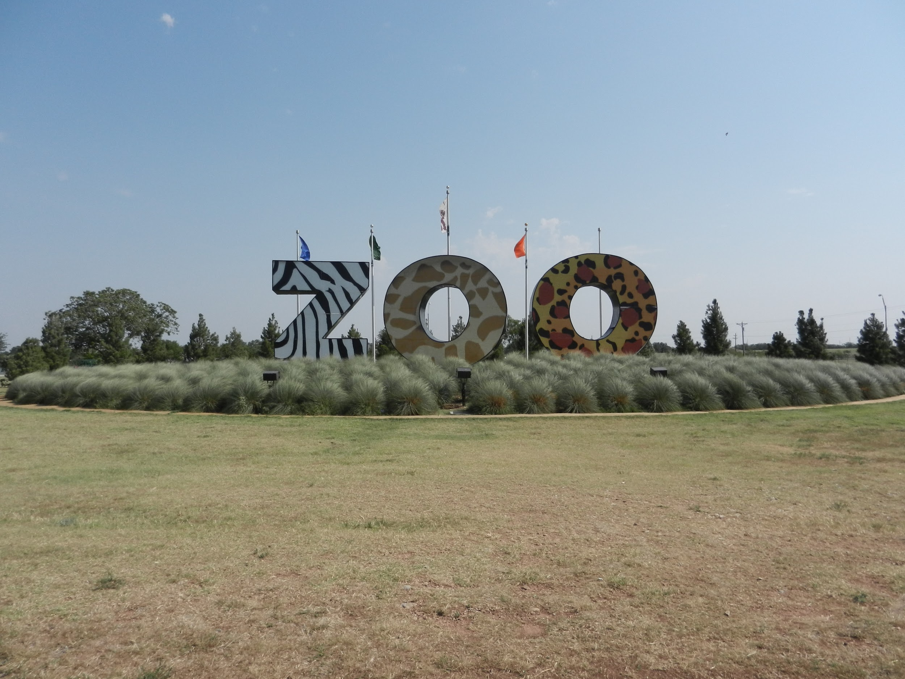
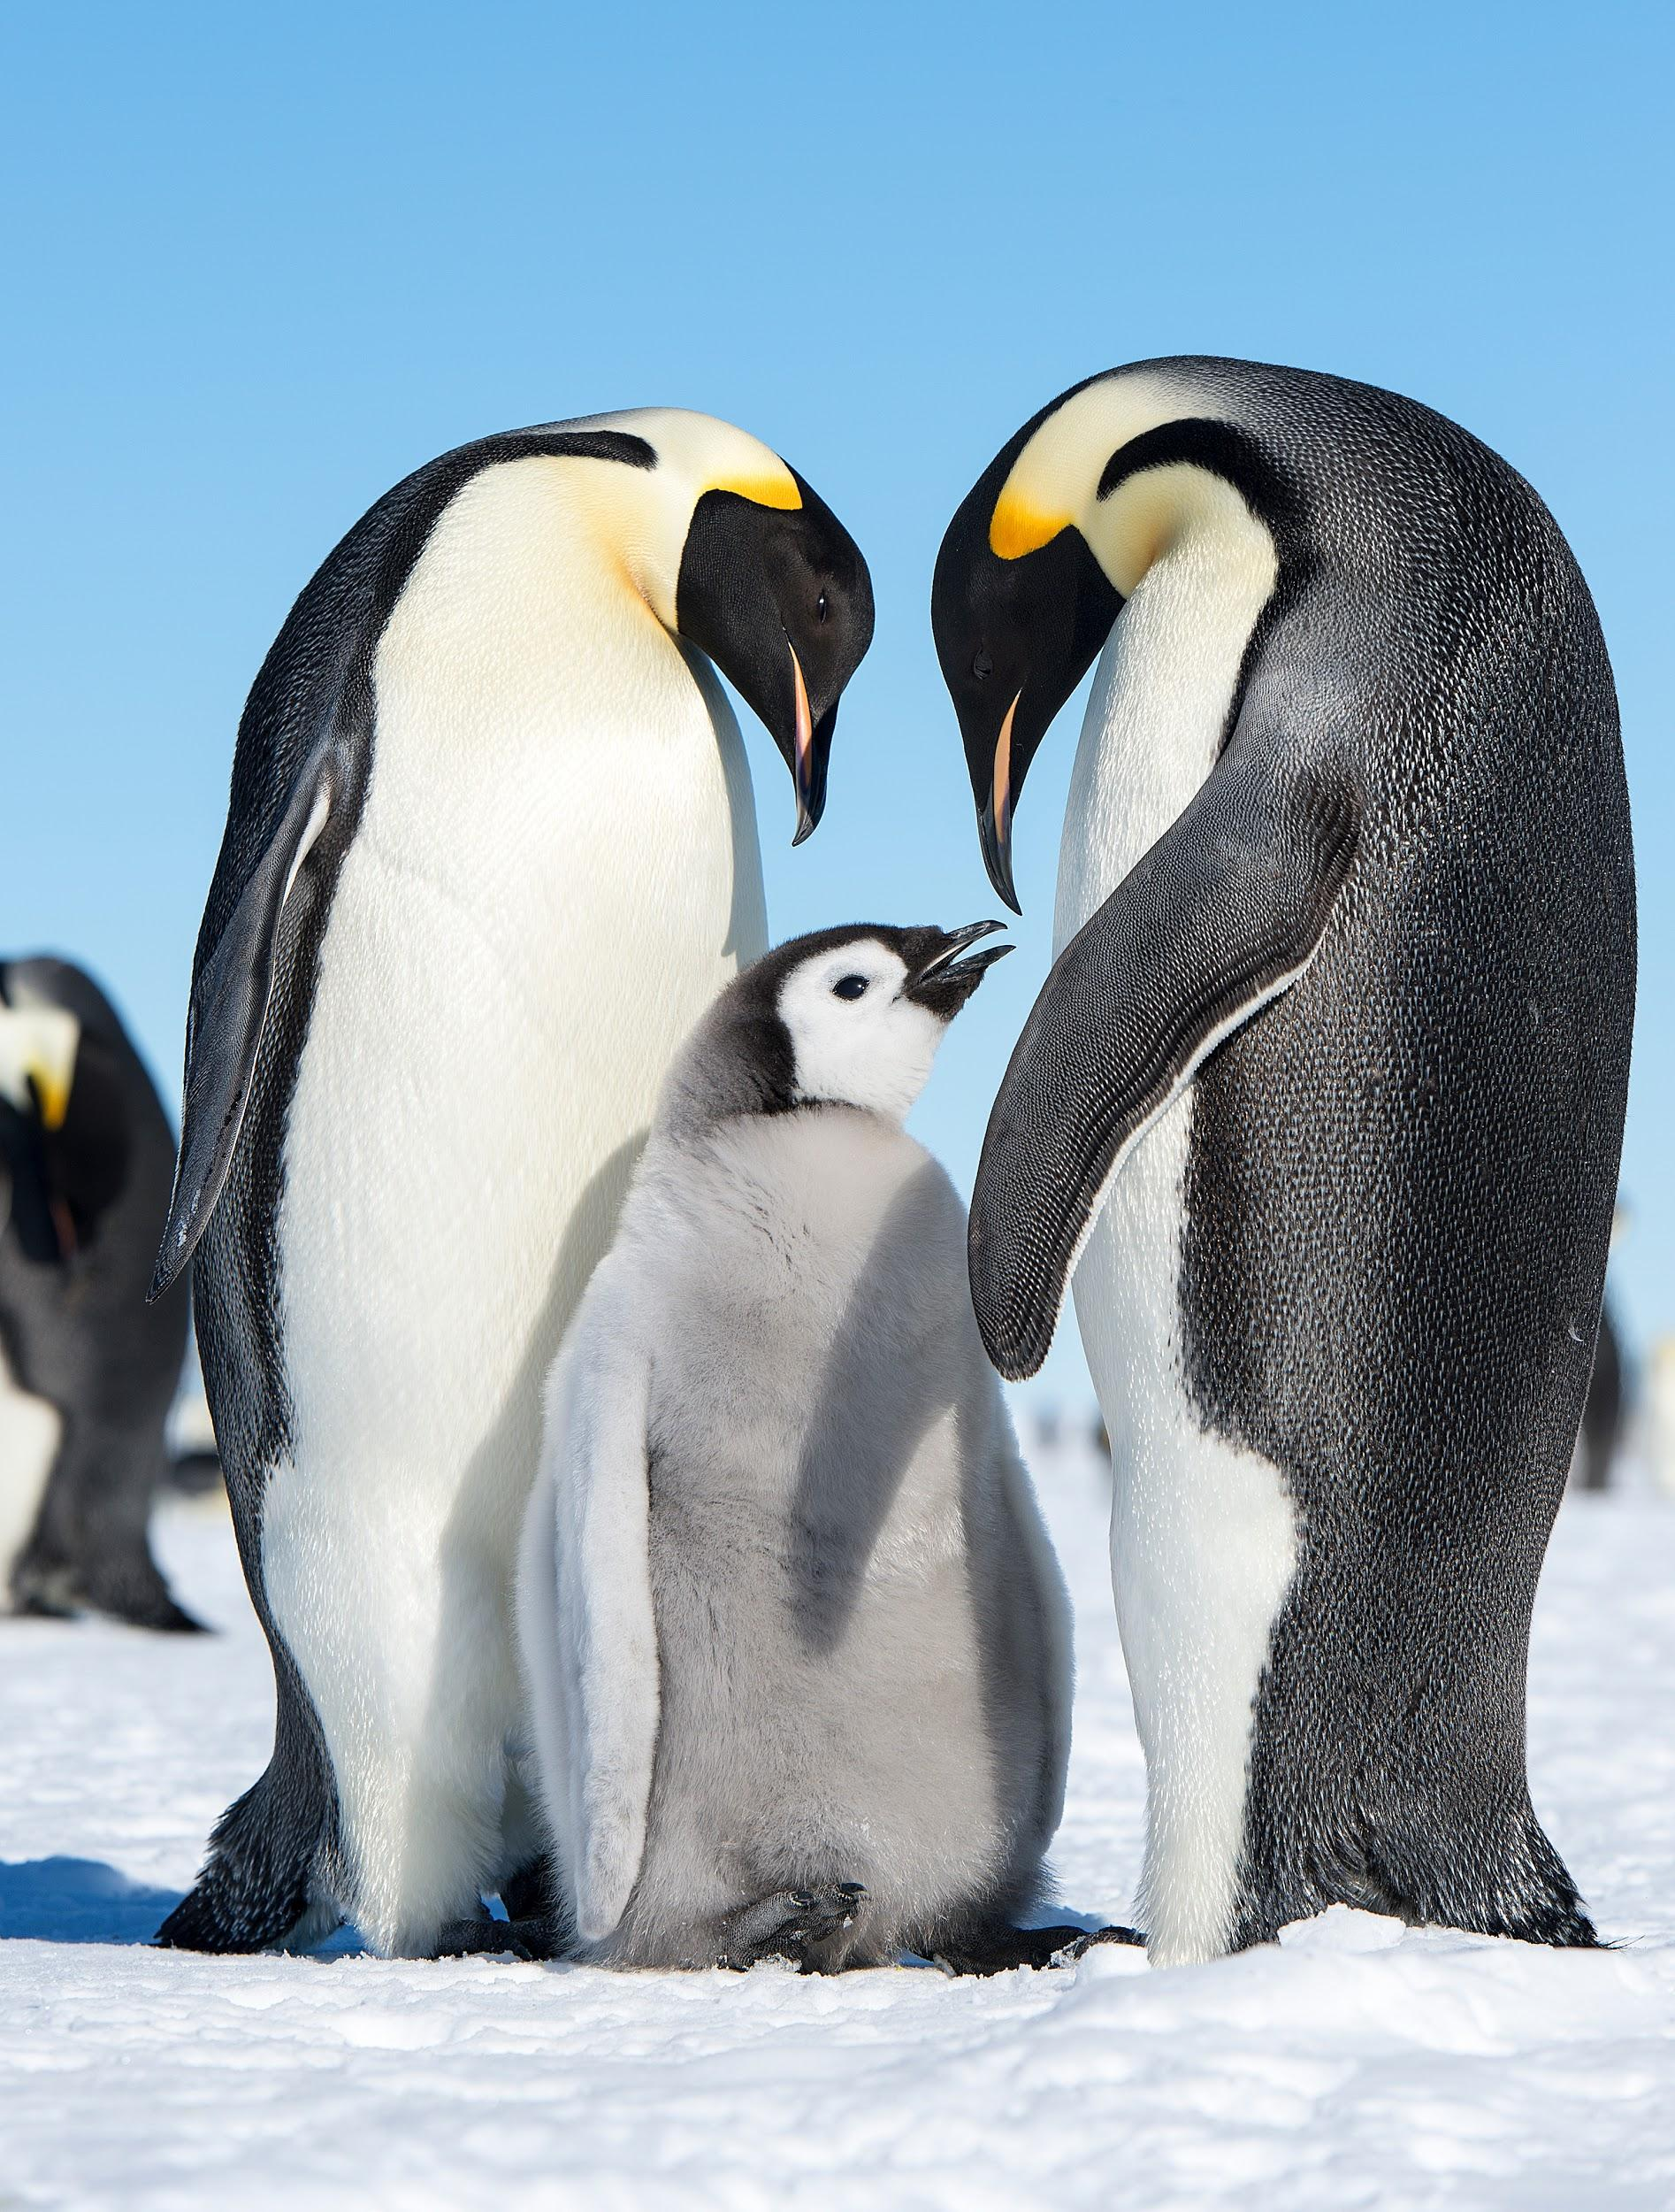
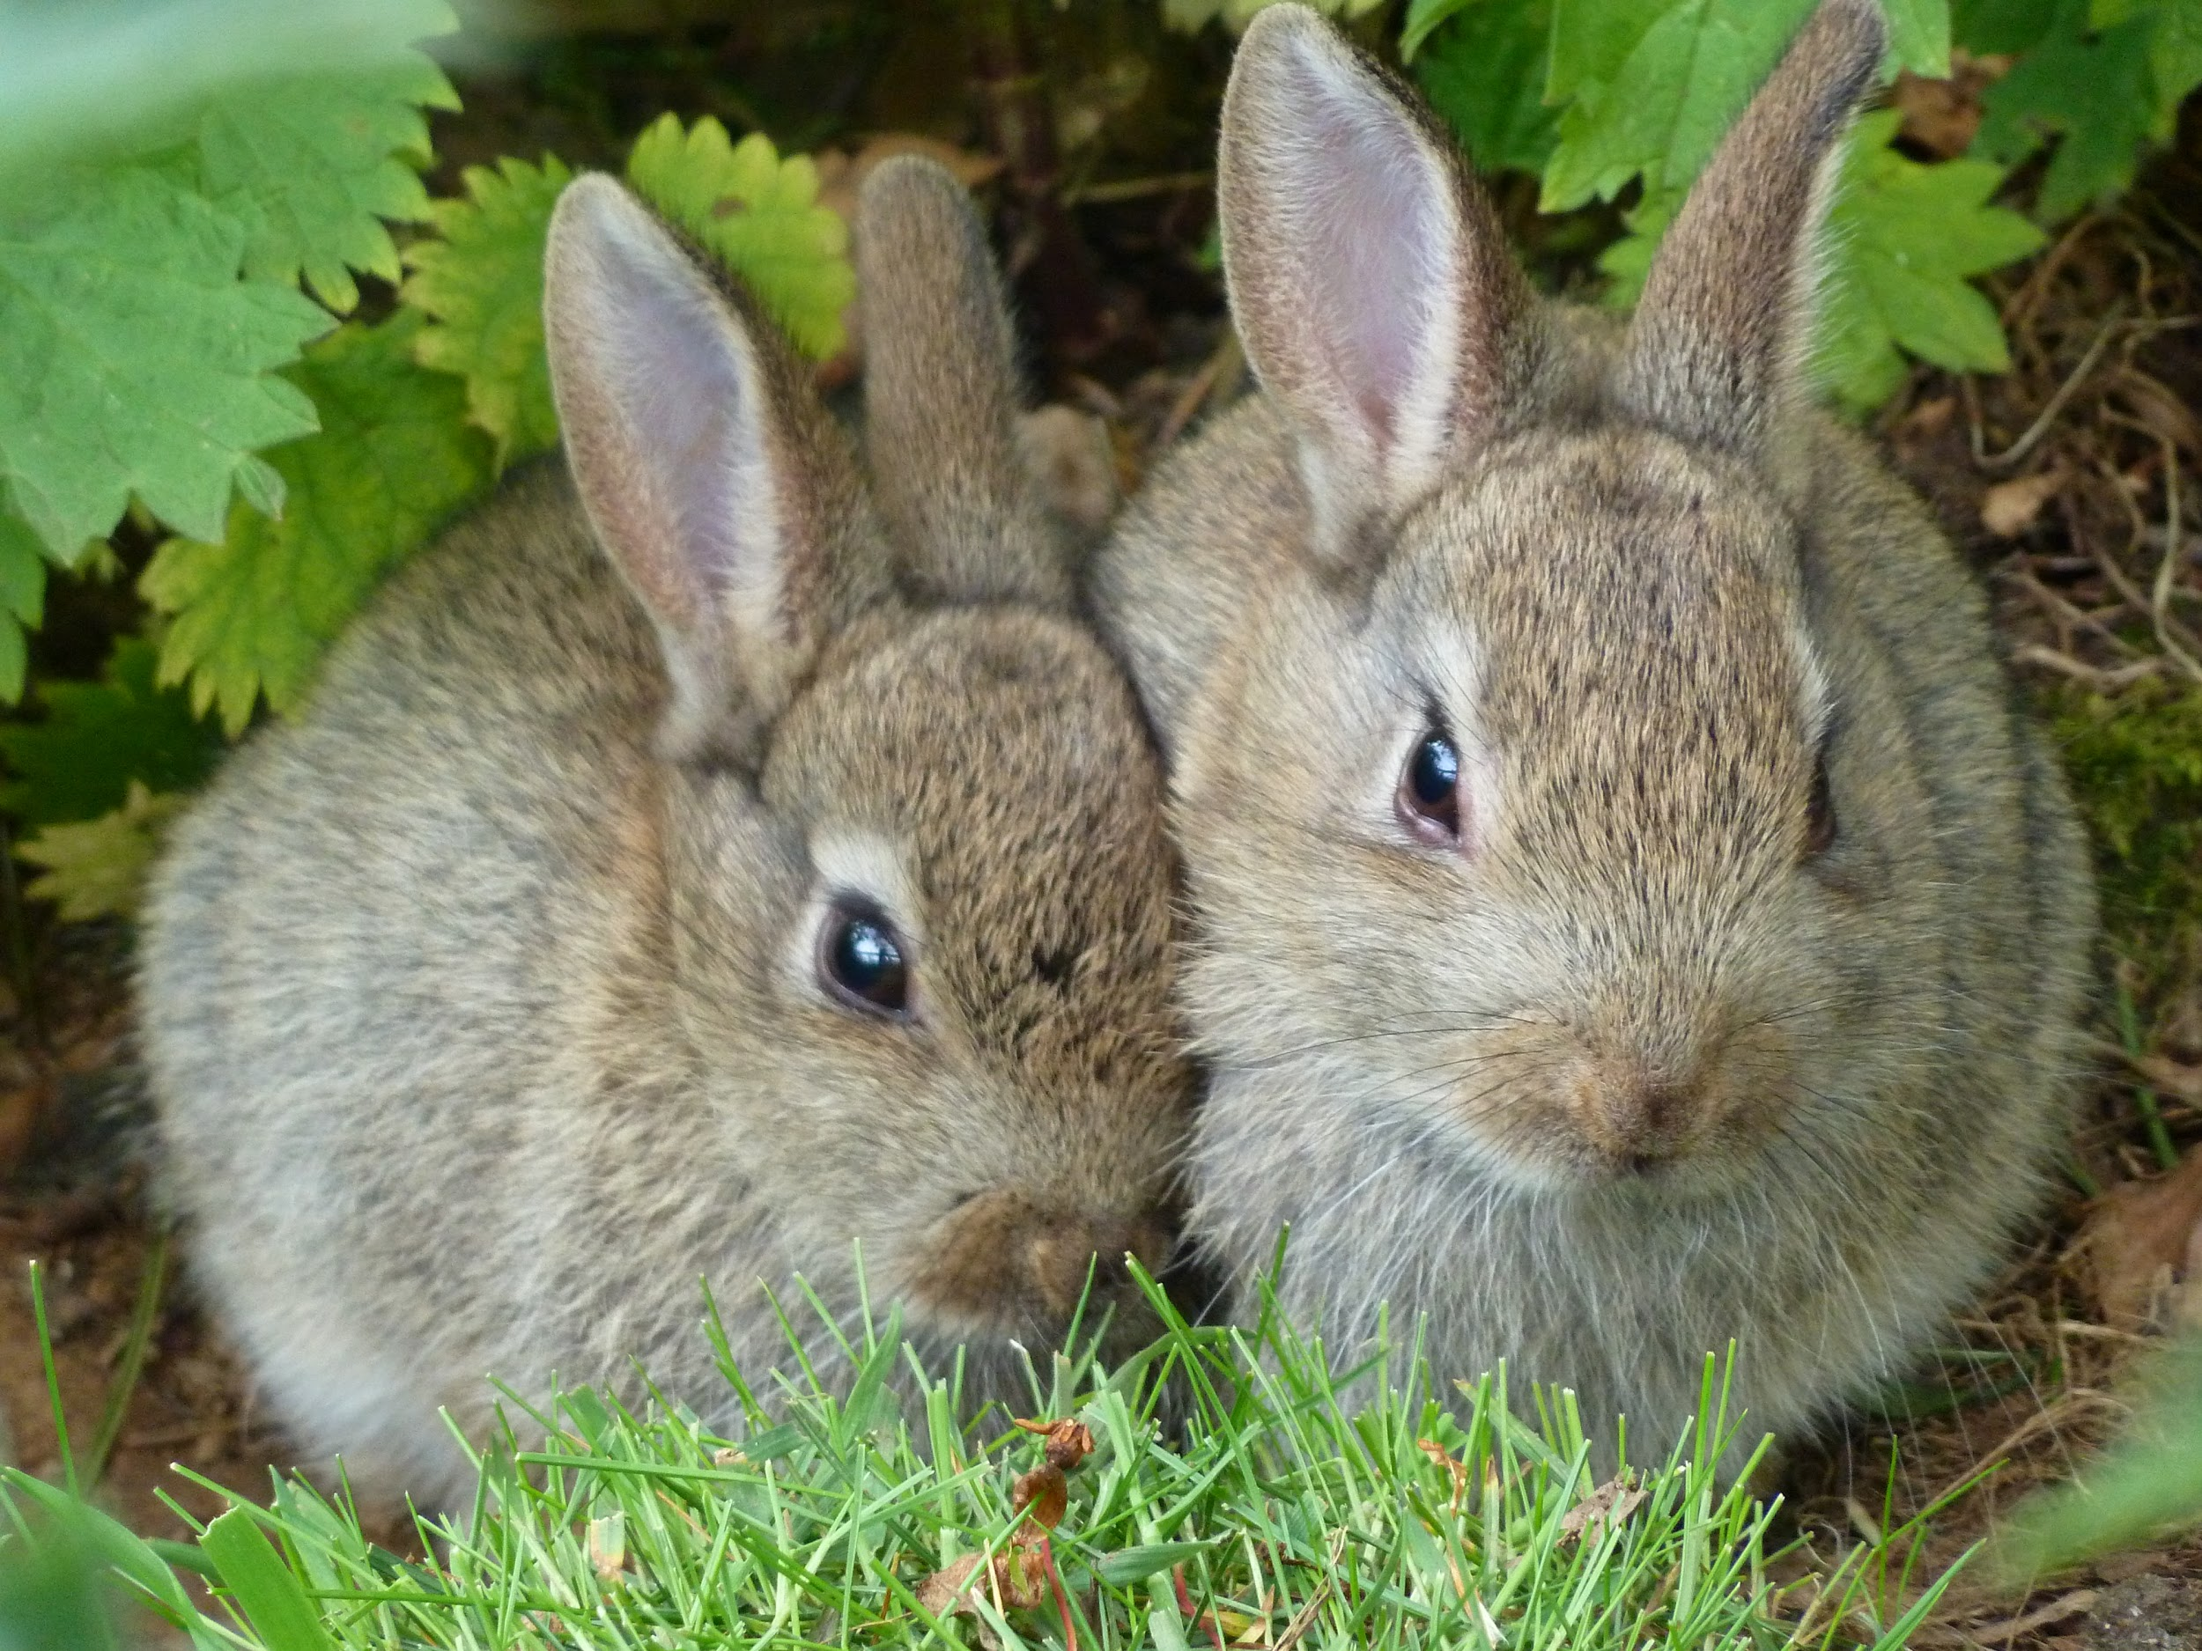
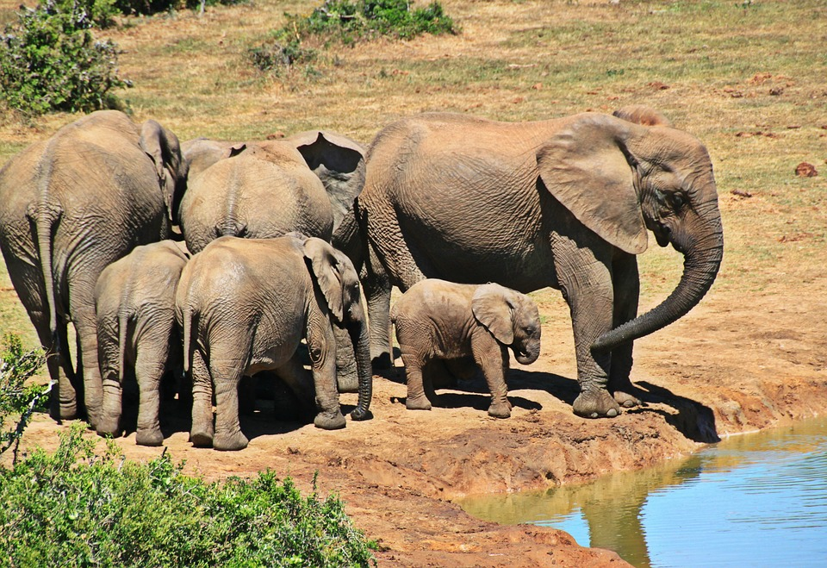
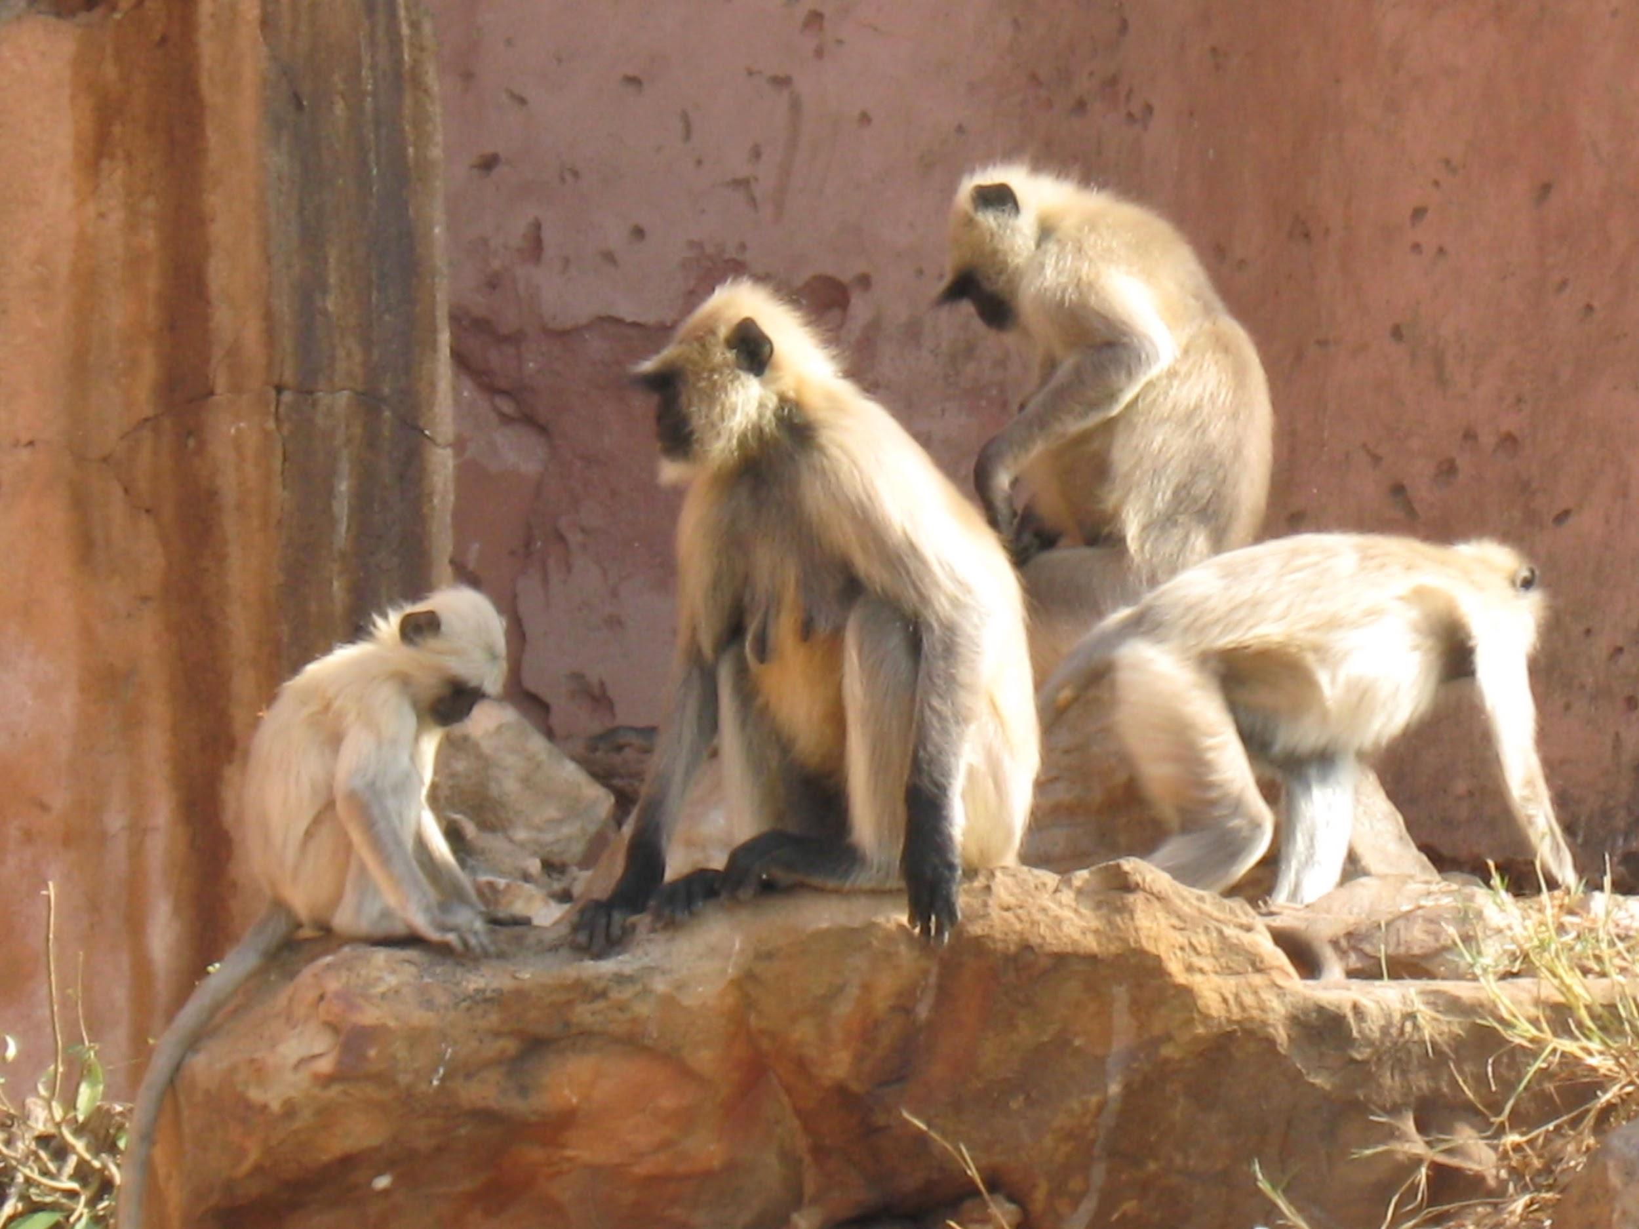
It's feeding time at the zoo.
It is our job to find out how much food we need to have to feed each animal family for 5 days.

Slide 3
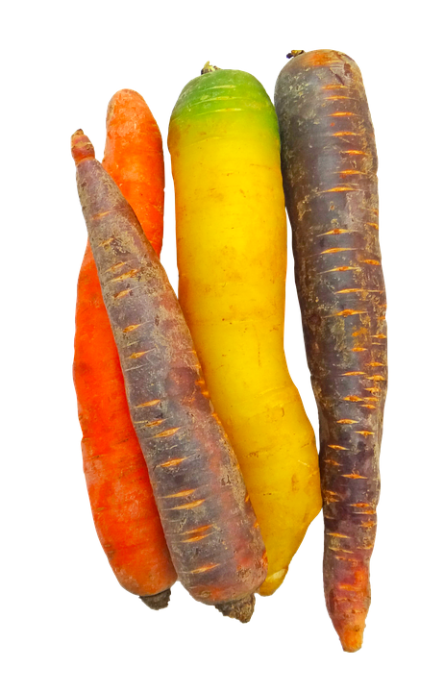
Each rabbit family gets 4 carrots a day.
How many carrots will they need for 5 days?
Day 1
Day 2
Day 3
Day 4
Day 5
Each family gets ___ for the week (double click):
Repeated Addition Equation (double click):

Slide 4
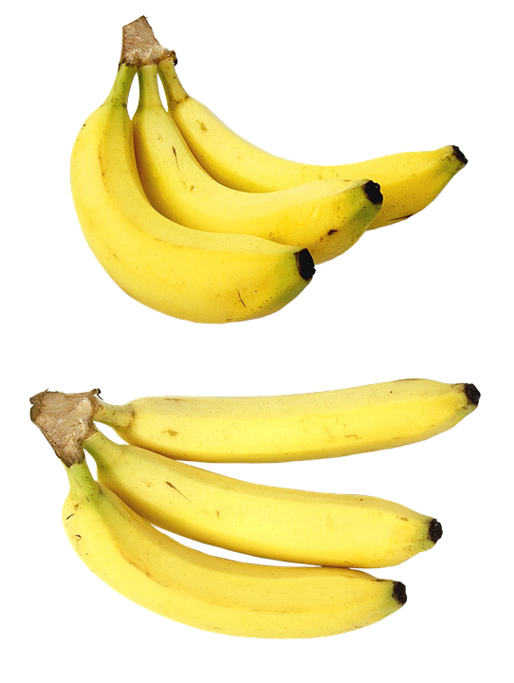
Each monkey family needs 6 bananas a day.
How many bananas will we need to feed the monkeys for 5 days?
Day 1
Day 2
Day 3
Day 4
Day 5
Each family gets ___ for the week (double click):
Repeated Addition Equation (double click):

Slide 5
Each elephant family needs 3 bags of peanuts a day. How many bags of peanuts will the elephant family need for 5 days?
Day 1
Day 2
Day 3
Day 4
Day 5
PEANUTS
PEANUTS
PEANUTS
PEANUTS
PEANUTS
PEANUTS
PEANUTS
PEANUTS
PEANUTS
PEANUTS
PEANUTS
PEANUTS
PEANUTS
PEANUTS
PEANUTS
PEANUTS
PEANUTS
PEANUTS
PEANUTS
PEANUTS
PEANUTS
PEANUTS
PEANUTS
PEANUTS
PEANUTS
PEANUTS
PEANUTS
PEANUTS
PEANUTS
PEANUTS
PEANUTS
PEANUTS
PEANUTS
PEANUTS
PEANUTS
PEANUTS
PEANUTS
PEANUTS
PEANUTS
PEANUTS
PEANUTS
PEANUTS
PEANUTS
PEANUTS
PEANUTS
PEANUTS
PEANUTS
PEANUTS
PEANUTS
PEANUTS
PEANUTS
PEANUTS
PEANUTS
PEANUTS
PEANUTS
PEANUTS
PEANUTS
Each family gets ___ for the week (double click):
Repeated Addition Equation (double click):

Slide 6
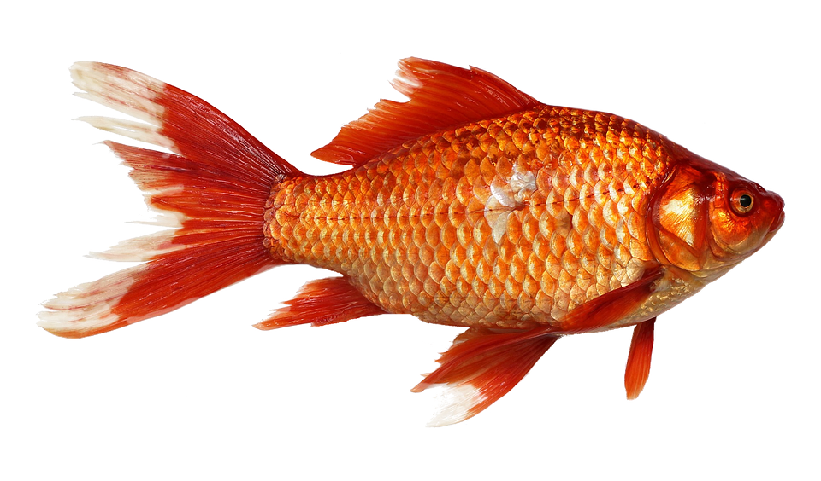
Each penguin family needs 5 fish a day.
How many fish will they need for 5 days?
Day 1
Day 2
Day 3
Day 4
Day 5
Each family gets ___ for the week (double click):
Repeated Addition Equation (double click):

Slide 7
All Done?
Let your teacher know your are finished.
Then, here is a video and practice from Khan Academy.

