Slide 1
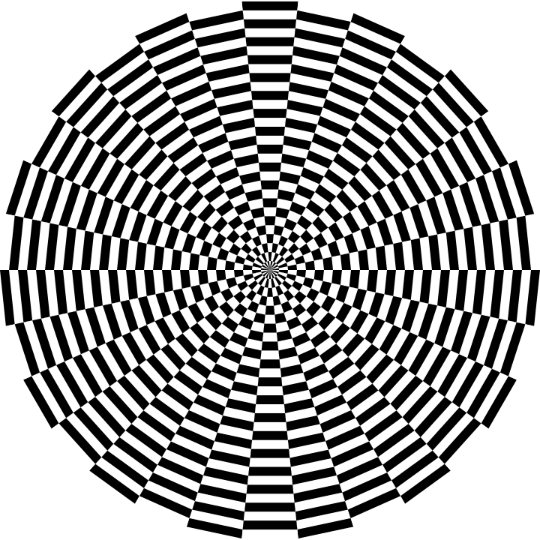
Geometry in Art/Art in Geometry
Select an artwork to view.
Use one of the Artful Thinking Routines for each artwork:
Colors Shapes Lines (example on Slide 2)
Claim, Support, Question (example on Slide 3)

Slide 2
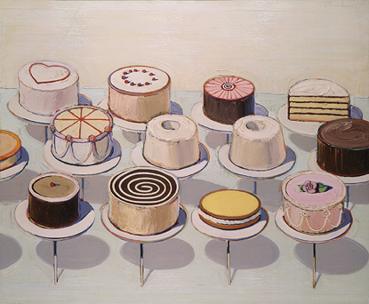
COLORS What colors do you see? Describe them. | SHAPES What kinds of shapes do you see? Describe them. | LINES What kinds of lines do you see? Describe them.

Slide 3
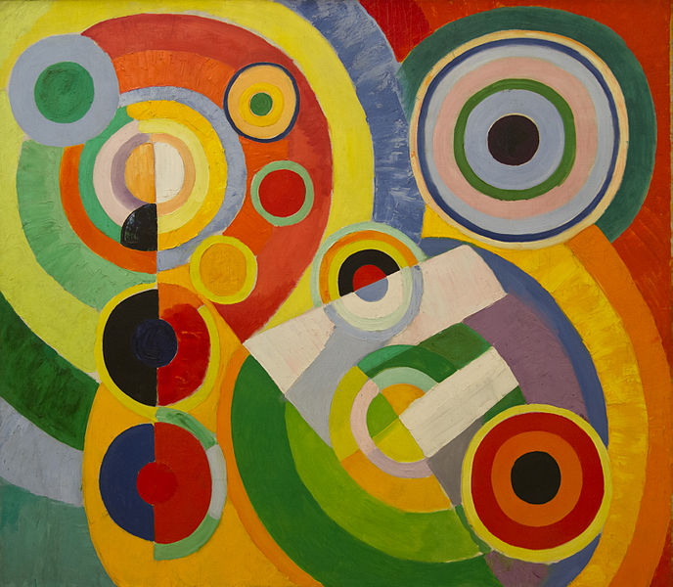
CLAIM Make a claim about the geometry in the artwork. Claim = an explanation or an interpretation of some aspect of the artwork |  | SUPPORT Identify support for your claim Support = Things you see, feel and know that support your claim |  | QUESTION Ask a question related to your claim. Question = What’s left hanging? What isn’t explained, What new reasons does your claim raise?
Notes:
Circular forms
by Robert Delaunay
1930

Slide 4
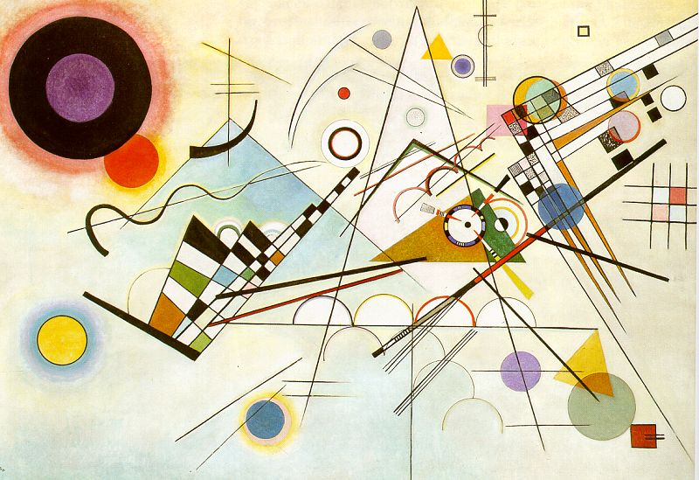
Notes:
Kandinsky, W. Composition VIII, 1923, oil on canvas, Solomon R. Guggenheim Museum, New York. 107KB

Slide 5
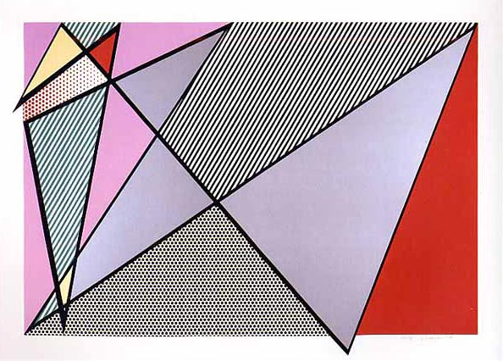
Notes:
Imperfect 224
by Roy Lichtenstein, Pop Artist
1988

Slide 6
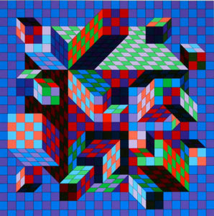
Notes:
Untitled 2
by Victor Vasarely
1975

Slide 7
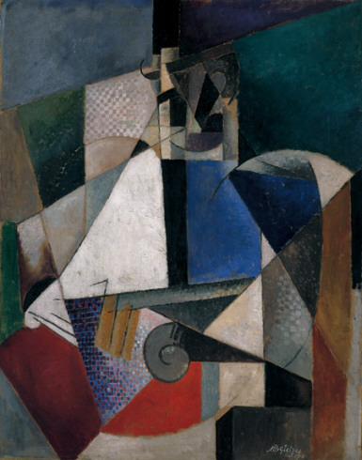
Portrait of an Army Doctor
by Robert Delaunay
1914
Notes:
Portrait of an Army Doctor
by Robert Delaunay
1914
The 1911 Salon des Indépendants—in which Robert Delaunay, Albert Gleizes, Jean Metzinger, and others presented paintings in an idiom that Guillaume Apollinaire would later term “Cubist”—was met with derision by critics and public alike. In an effort to deflect the outcry that followed, Gleizes and Metzinger published Du Cubisme in 1912. This important early treatise on Cubism stressed a conceptual approach to the translation of objects into the plastic realm, one in which surface appearances are sacrificed to the processes of thought.
Unlike Georges Braque and Pablo Picasso, who historically have been promoted as the main arbiters of Cubism, Gleizes abandoned Cubism’s first, analytic phase and strove to create a synthetic art, one incorporating the social values that had preoccupied him since the days of the Abbaye de Créteil, a utopian community of artists and writers he helped establish in 1906. In rejecting what he perceived as Picasso’s and Braque’s “Impressionism of form” and dissection of the subject, Gleizes embraced a style that attempted to capture the subject in its absolute order and truth. With its broad, overlapping planes of brilliant color, Portrait of an Army Doctor embodies the second synthetic phase of Cubism.
This painting dates from 1914–15, during which time Gleizes served a second stint in the military. While Gleizes was stationed in Toul, his commanding officer—an admirer of his work—made arrangements so that Gleizes could continue to paint while fulfilling his military obligation. That at least eight studies for the painting survive is no surprise, given that Gleizes’s artistic inclinations were accommodated by the regimental surgeon, in whose home he painted. With ample opportunity to observe and study his subject, Gleizes worked through these studies to resolve the compositional harmony of the painting, inflecting an otherwise staid genre with a circular rhythm. Gleizes experienced increasing frustration toward the end of the 1910s as the avant-garde embraced Dada, an anarchic enterprise that ran counter to his quest for social values in art. He began to focus increasingly on the compositional harmonies of his subjects—evident early on in works such as Portrait of an Army Doctor—in the belief that rhythmic harmonies were more universal and hence superior to subjective responses. In the early 1930s, together with Jean Arp, Delaunay, Jean Hélion, and others, he founded the Abstraction-Création group in order to advance pure abstraction. Tellingly, his works from the 1930s on promote plastic values to the exclusion of discernible subject matter, resulting in lyric explorations of pure form and color.

Slide 8
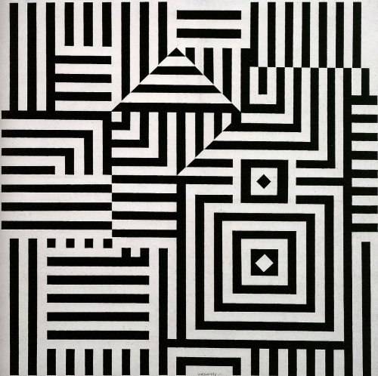
Notes:
Victor Vaserly Riu Kiu C, 1960

Slide 9
Notes:
Homage to the Square: Soft Spoken, 1969 Josef Albers (American, born Germany, 1888–1976)

Slide 10
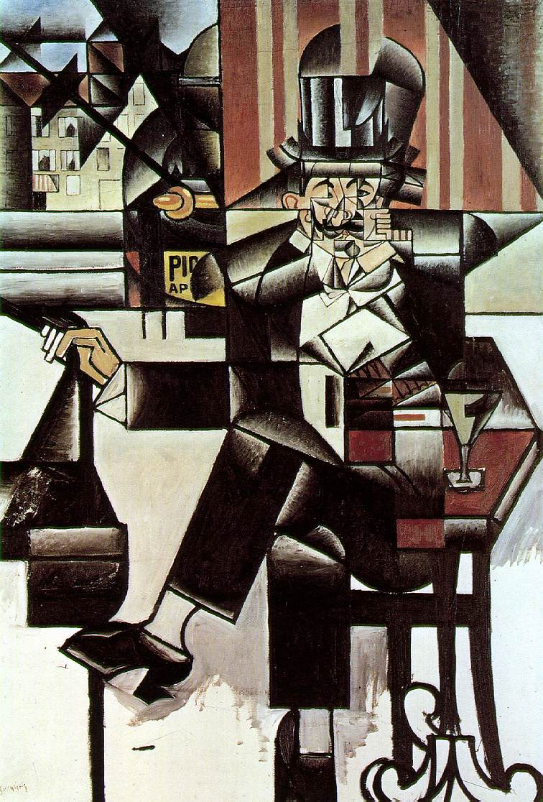
Gris, Juan. Man in the Cafe
1912; Oil on canvas, 128.2 x 88 cm; Philadelphia Museum of Art
Notes:
Gris, Juan. Man in the Cafe 1912; Oil on canvas, 128.2 x 88 cm; Philadelphia Museum of Art

Slide 11
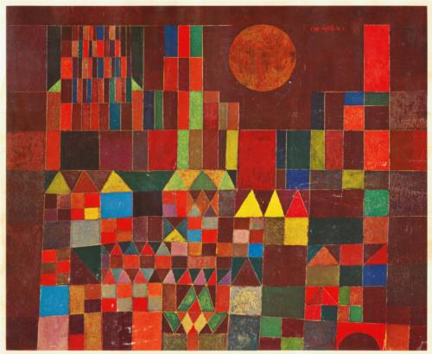
Paul Klee Castles
Notes:
Paul Klee Castles

Slide 12
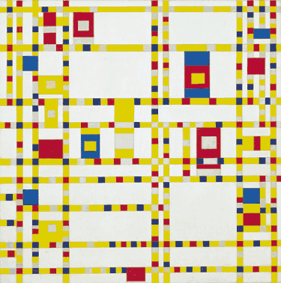
Mondrian, Piet. Broadway Boogie Woogie, 1942-43

Slide 13
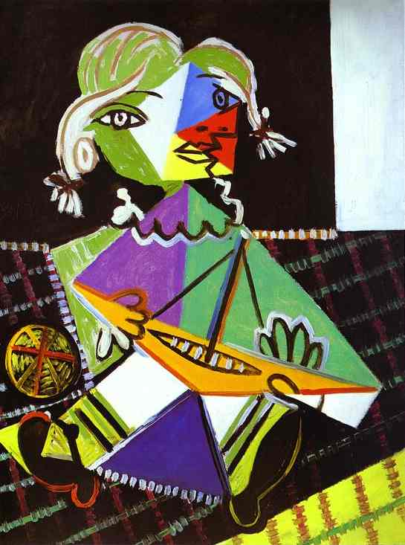
Picasso, Pablo. Girl With a Boat, 1938.

