Slide 1
friends
Art Collection

Slide 2
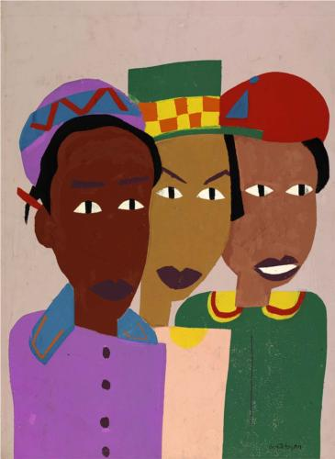
Notes:
William H Johnson Three Friends

Slide 3
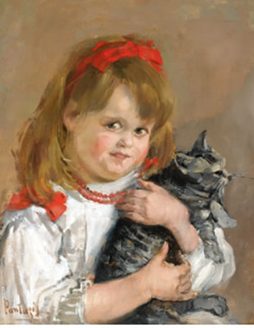
Notes:
Best Friends Forever
Artist: Pericles Pantazis
Style: Impressionism
Genre: portrait

Slide 4
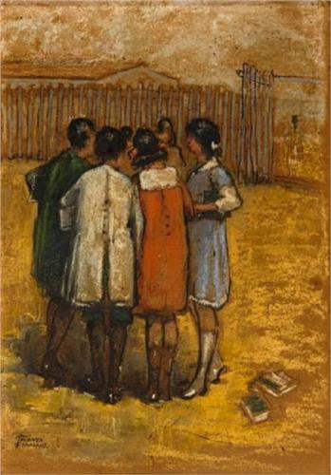
Notes:
Friends
Artist: Theophrastos Triantafyllidis
Style: Post-Impressionism
Genre: genre painting

Slide 5
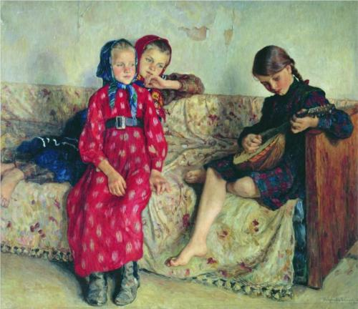
Notes:
Country Friends
Artist: Nikolay Bogdanov-Belsky
Completion Date: 1912
Style: Realism
Genre: portrait

Slide 6
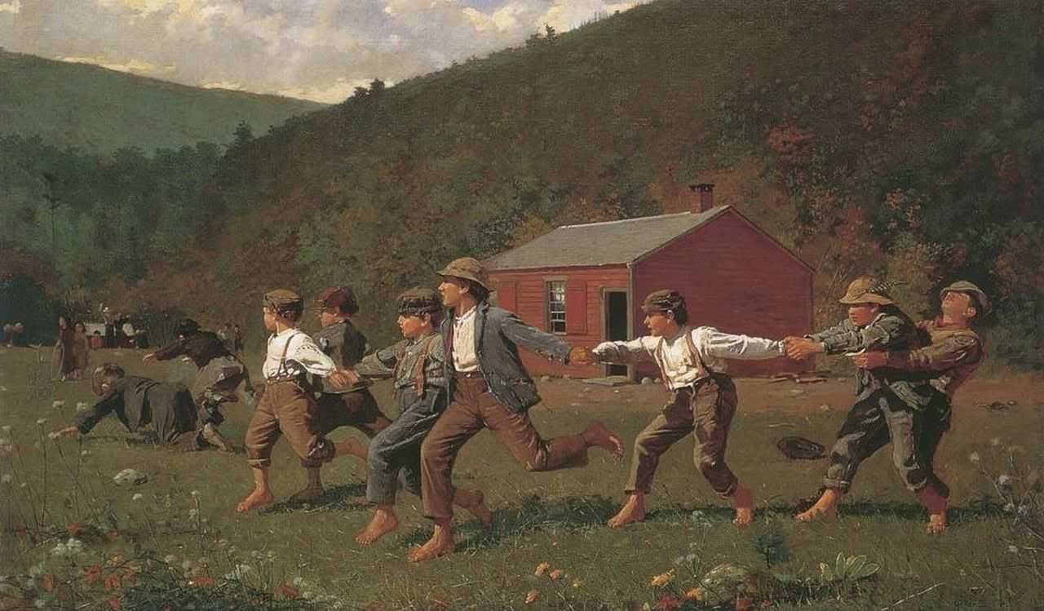
Notes:
Winslow Homer
Snap the Whip

Slide 7
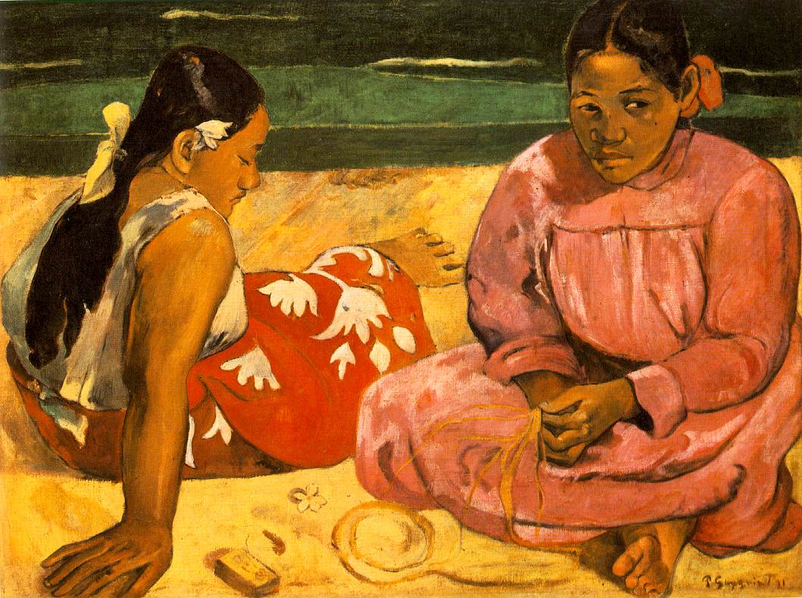
Notes:
Gauguin

Slide 8
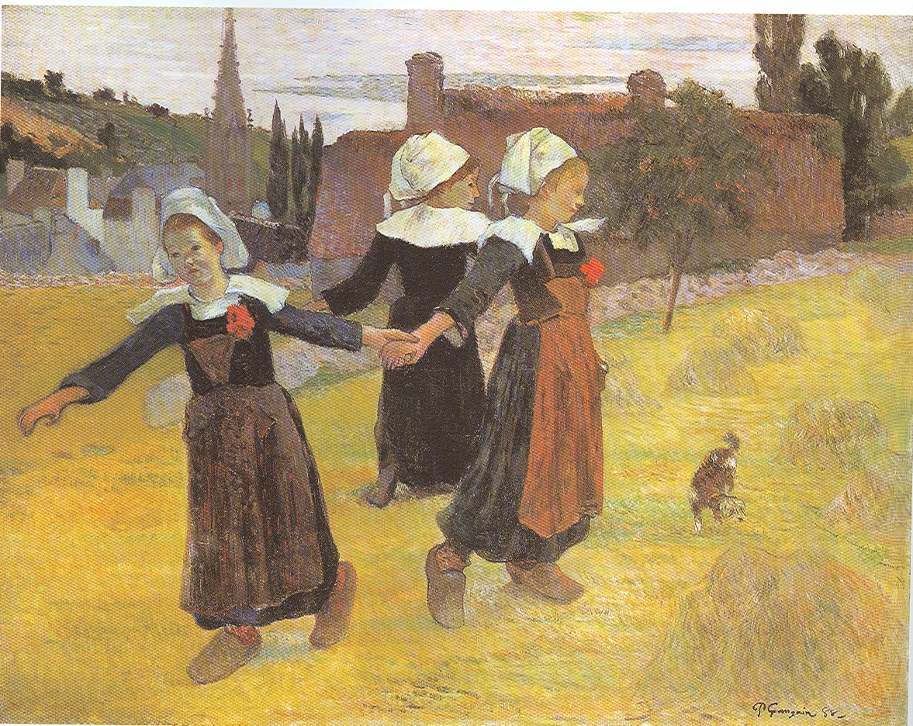
Notes:
Breton Girls Gaugain

Slide 9
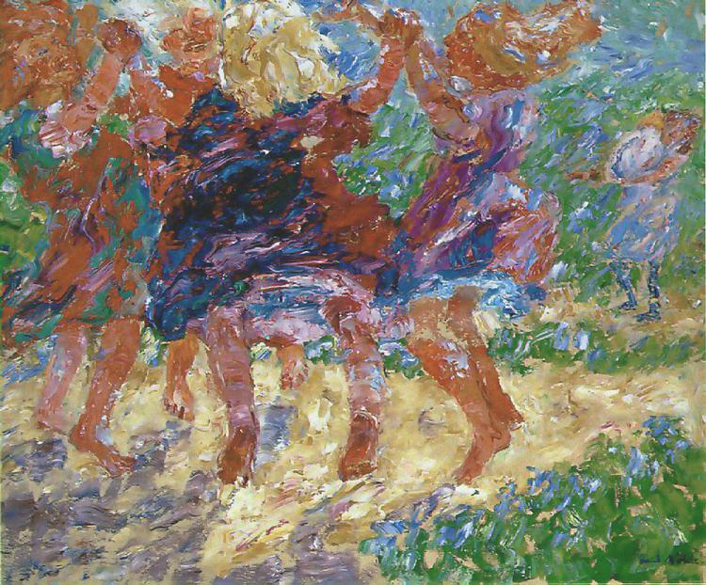
Notes:
Nolde Dancing Childre

Slide 10
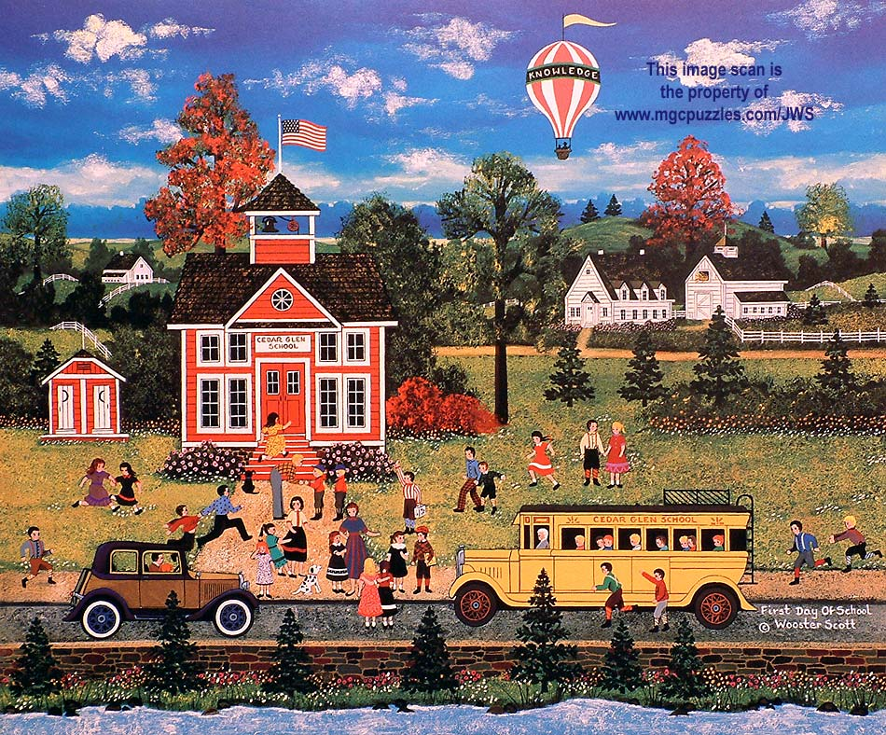
Notes:
Wooster Scott First Day of School

Slide 11
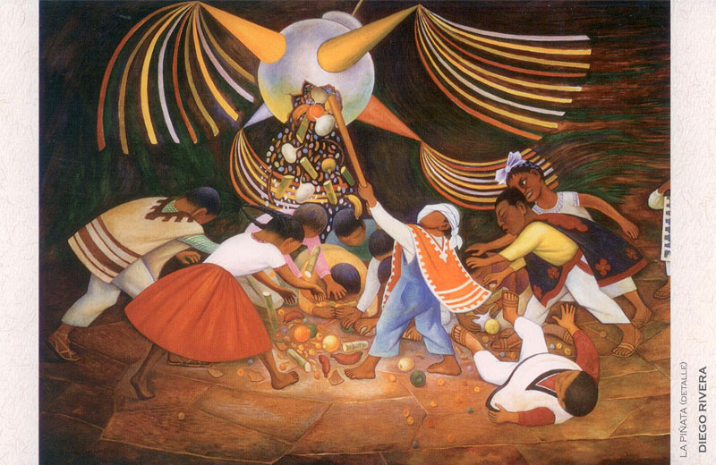
Notes:
Diego rivera Pinata

Slide 12
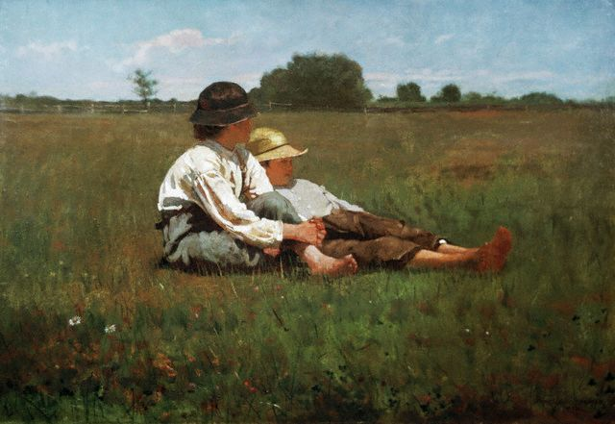
Notes:
Winslow homer

Slide 13
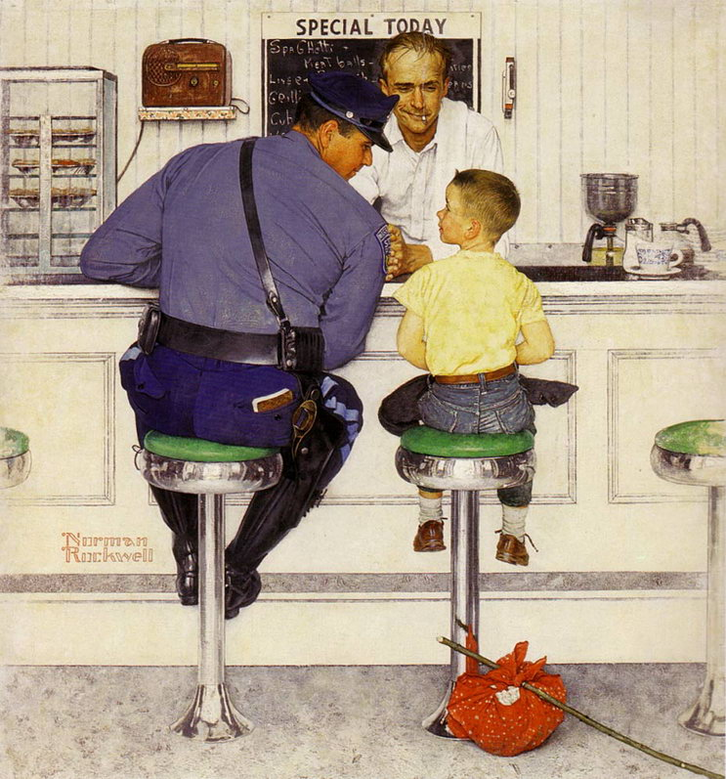
Notes:
Norman Rockwell

