Slide 1
Landforms

Slide 2
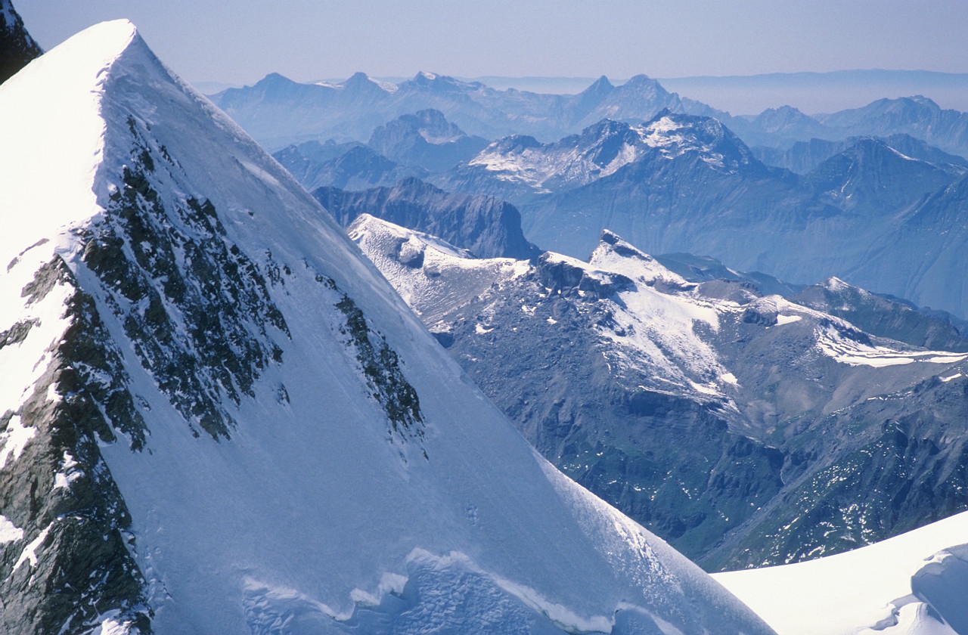
Mountains
Notes:
Photo credit:
Microsoft. (Designer). (2010). Clip art [Web Graphic]. Retrieved from http://office.microsoft.com/en-us/images/

Slide 3
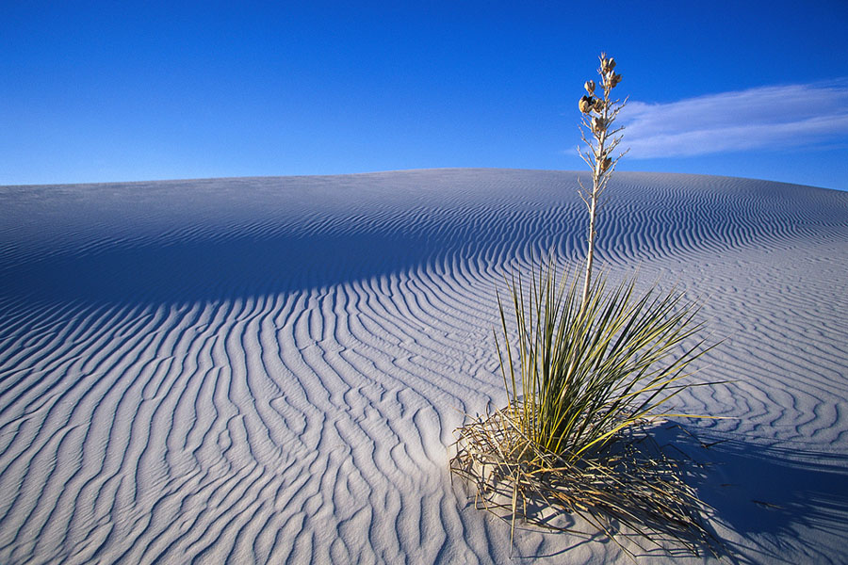
Desert
Notes:
Photo credit:
Microsoft. (Designer). (2010). Clip art [Web Graphic]. Retrieved from http://office.microsoft.com/en-us/images/

Slide 4
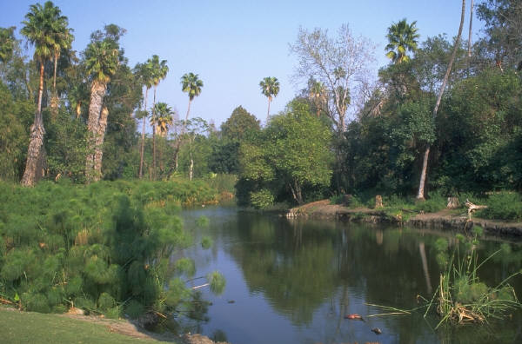
Wetlands
Notes:
Photo credit:
Microsoft. (Designer). (2010). Clip art [Web Graphic]. Retrieved from http://office.microsoft.com/en-us/images/

Slide 5

Plains
Notes:
Photo credit:
Microsoft. (Designer). (2010). Clip art [Web Graphic]. Retrieved from http://office.microsoft.com/en-us/images/

Slide 6
Modifications

Slide 7
Terracing – Mountains
Notes:
Photo credit:
Microsoft. (Designer). (2010). Clip art [Web Graphic]. Retrieved from http://office.microsoft.com/en-us/images/

Slide 8
Water pipeline/pump – Deserts
Notes:
Photo credit (all):
Microsoft. (Designer). (2010). Clip art [Web Graphic]. Retrieved from http://office.microsoft.com/en-us/images/

Slide 9
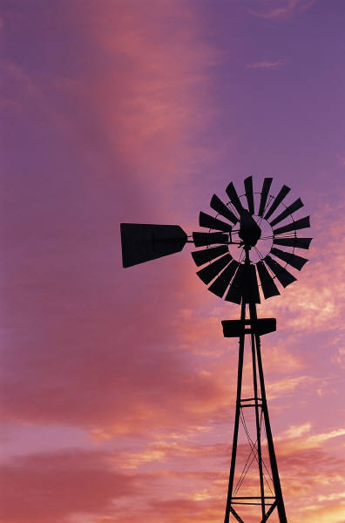
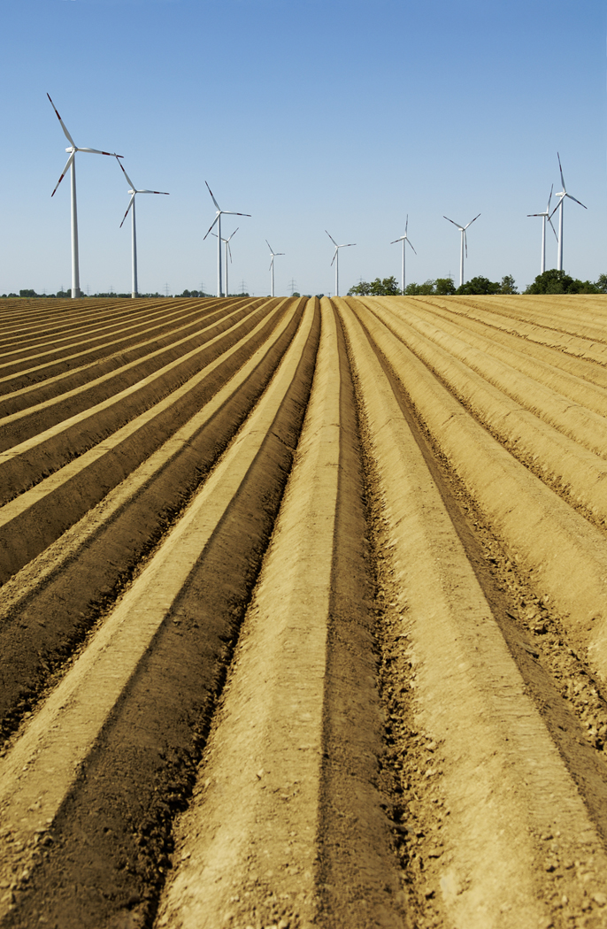
Windmill or plow – Plains
Notes:
Photo credit (all):
Microsoft. (Designer). (2010). Clip art [Web Graphic]. Retrieved from http://office.microsoft.com/en-us/images/

Slide 10
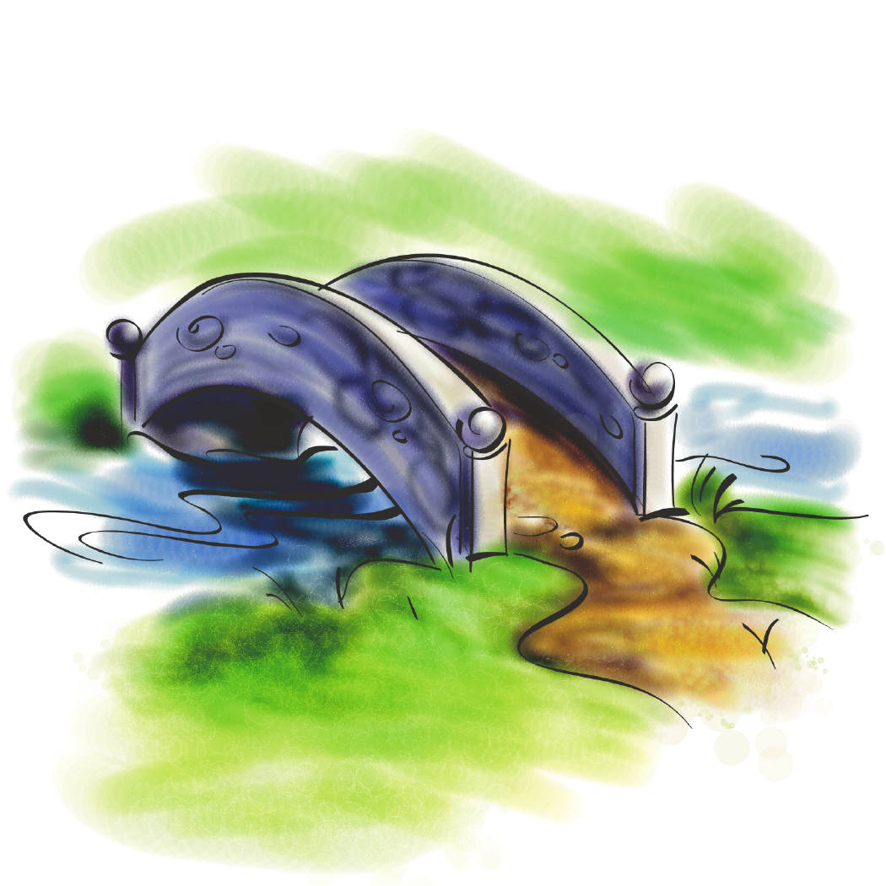
Bridge over Wetlands
Notes:
Photo credit:
Microsoft. (Designer). (2010). Clip art [Web Graphic]. Retrieved from http://office.microsoft.com/en-us/images/

