Slide 1
Urban, Suburban, and Rural
Kelly Hong

Slide 2
Teacher Notes
Objective: The student understands how physical characteristics of places and regions affect people's activities and settlement patterns. The student is expected to: identify the characteristics of different communities, including urban, suburban, and rural, and how they affect activities and settlement patterns.
Use the graphic organizer on slide 8 for this lesson.
Identify the type of community on each slide (urban, suburban, or rural) and it’s physical and human characteristics.
Brainpop Jr Has a great video that introduces Urban, Suburban, and Rural. The website also has other good resources for the subject. You can sign up for a free trial if you are not a member.

Slide 3
Types of communities
Urban: a community where the building, stores, cars and people live close together.
Rural: a community that is very spread out and has a lot of land for farms.
Suburban: a community near a city, where the buildings and people are more spread out than a city.
Notes:
Vocabulary Resource: http://www.brainpopjr.com/socialstudies/communities/ruralsuburbanandurban/wordwall/

Slide 4
Urban, Suburban, or Rural?
On the next slides use the graphic organizer to identify the types of community and their physical and human characteristics.
Physical Characteristics: buildings, geography, landscaping, etc.
Human Characteristics: jobs, attire, recreation, etc.

Slide 5
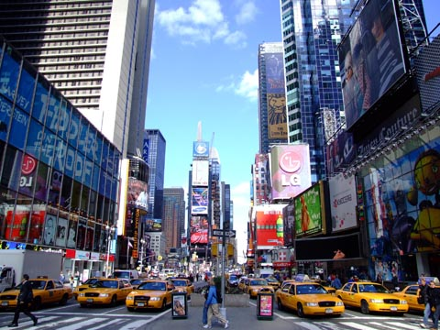
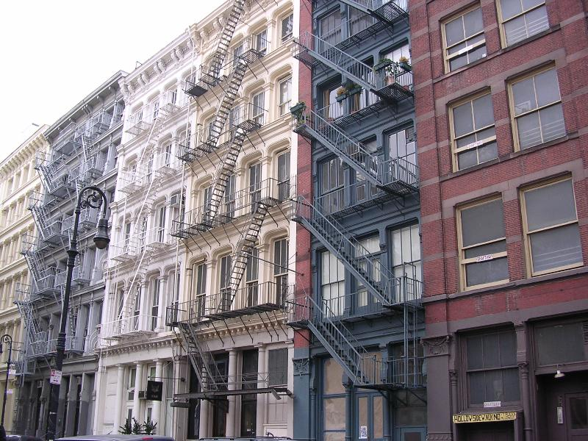

1
Notes:
Pictures:
http://www.traveltowork.net/2011/09/christmas-in-new-york/
http://new-to-newyork.com/how-to/find-an-apartment/
http://bungaraya-humancapital.com/services.php

Slide 6
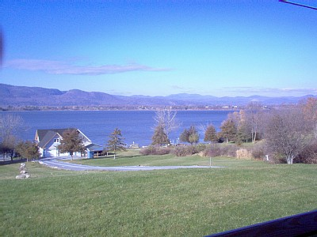
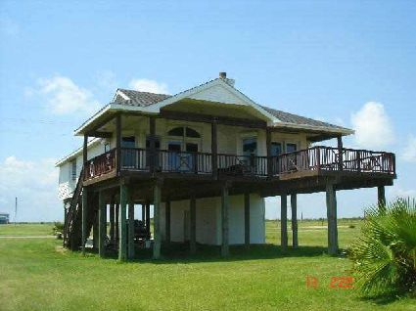
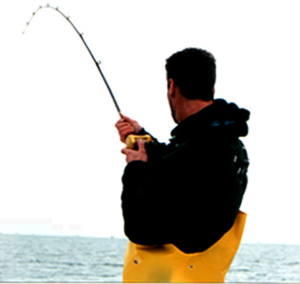
2
Notes:
Stilts incase of flooding and steep roof for rain.
Pictures:
http://www.trails.com/rentals/property.aspx?vacation=0106368_Bridport_VT
http://www.sellinggalveston.com/index.php?n=4&article_id=50
http://topnews.in/fisherman-rescued-alive-after-30-hours-water-223008

Slide 7
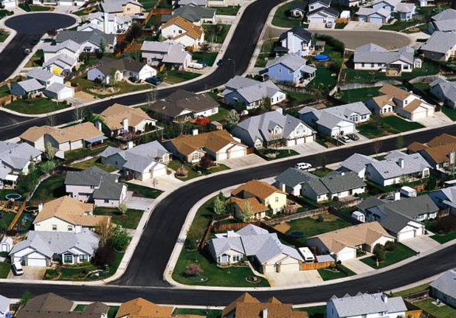
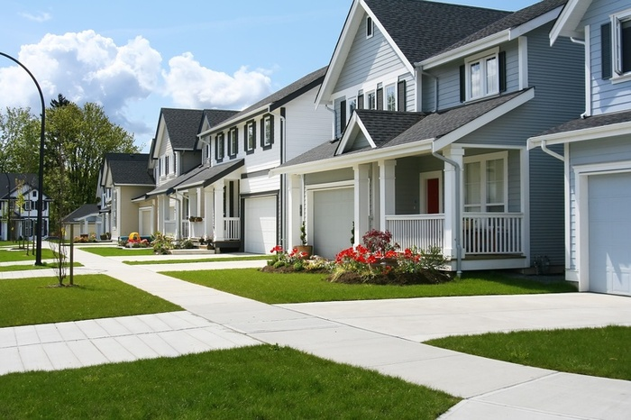

3
Notes:
Pictures:
http://www.aiasb.com/viewpointVideos.cfm
http://www.energreenovation.com/tag/green-building-concept
http://www.cgcoc.org/pcit.php

Slide 8
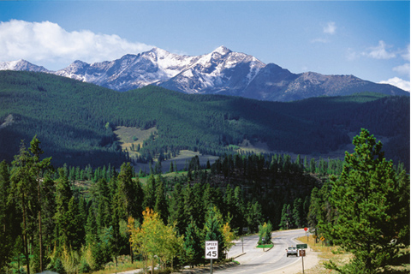
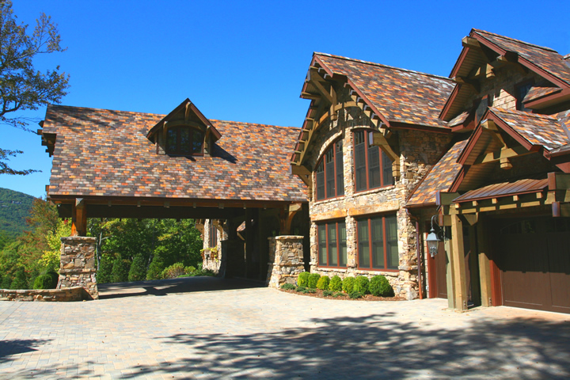
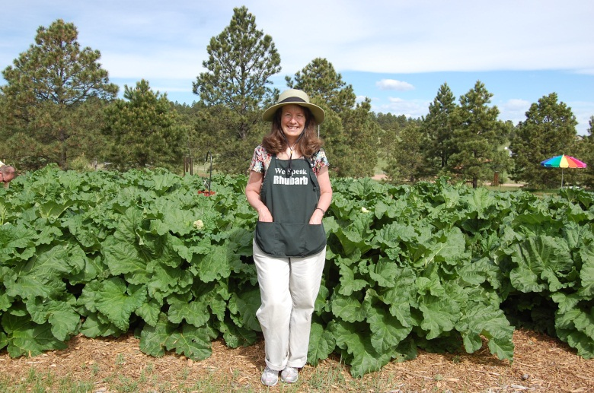
4
Notes:
Steep roof for snow.
Pictures:
http://stayinkeystone.com/
http://www.homearchitects.com/lake-toxaway-architects
http://www.google.com/imgres?imgurl=http://urbanhomesteader.files.wordpress.com/2010/06/dsc_1546.jpg&imgrefurl=http://www.happysimpleliving.com/2010/06/21/a-visit-to-an-organic-rhubarb-farm/&h=1496&w=2256&sz=928&tbnid=Oaml0h6f585kKM&tbnh=183&tbnw=276&zoom=1&usg=__ahpHGZ07-NYx1BhIfGa4vS0HPv0=&hl=en&sa=X&ei=fyvcT7W-NKGs2gWR2pnRDQ&ved=0CDoQ8g0

Slide 9
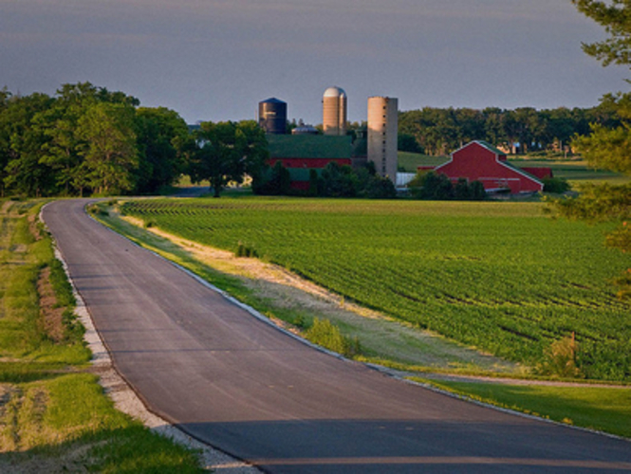
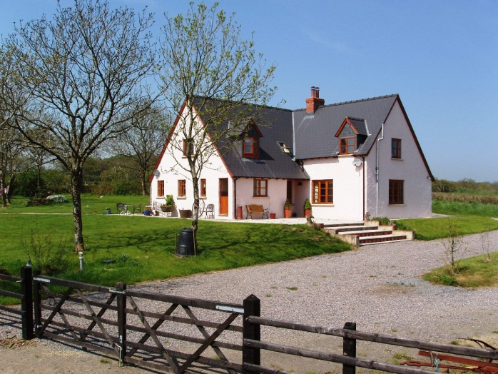
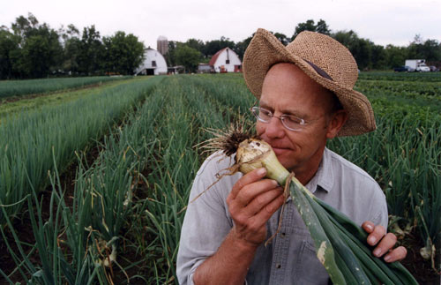
5
Notes:
Pictures:
http://timjohnson.house.gov/AboutTim/CaucusMembership.htm
http://www.furzehillfarm.com/
http://www.pbs.org/independentlens/realdirt/

Slide 10
Human and Physical Characteristics of a Community
 | Community Type | Physical Characteristics | Human Characteristics
1
2
3
4
5
Download and print copy here: https://docs.google.com/document/d/1skd8xh6cNYpfZGmWp6rbQhcWhBYPB7tUn6xJlkURJCI/edit

