Slide 1
Lesson Objectives:
MSDE 3.A.1b Construct and interpret maps by using elements such as title, compass rose, simple grid system, and scale
CCSS ELA RI 3.7 Use information gained from illustrations (e.g. maps, photographs) and the words in a text to demonstrate understanding of the text (e.g. where, when, why, and how key events occur)

Slide 2
Reading Maps
3rd Grade Earth/Space Science
Objectives:
Students will be able to identify elements of a map
Students will be able to know what makes a good map

Slide 3
Review
Maps are very useful to us.
They show us what places look like and give us an idea of where we are.
Think about a time when you used a map.

Slide 4
Elements of a Map
A good map includes all the elements: border, grid, key, title, orientation, author, date, and scale.
We can remember this by taking the letters and
making a sentence to remember it:
Big Green Kissing TOADS.
If you look closely, you will see that all of the capital letters in this sentence start with the same letter as one of the elements. Practice remembering this on the next page.

Slide 5
Big
Green
Kissing
T
O
A
D
S
Take a guess at what each capital letter represents
and then click on it to check
your answer!
Remember: The capital letter is the same letter that
each element starts with.

Slide 6
B
stands for:
Border
A border is the images or lines that surround the
outside of a map. The border on this page
is an example.

Slide 7
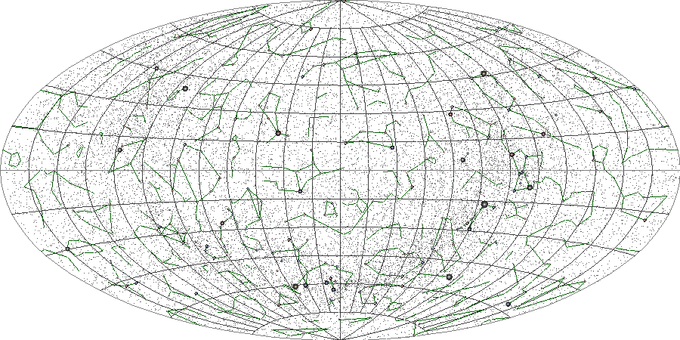
Grid
G is for:
The horizontal and vertical lines above make up the grid of the map.
It helps keep the map organized.

Slide 8
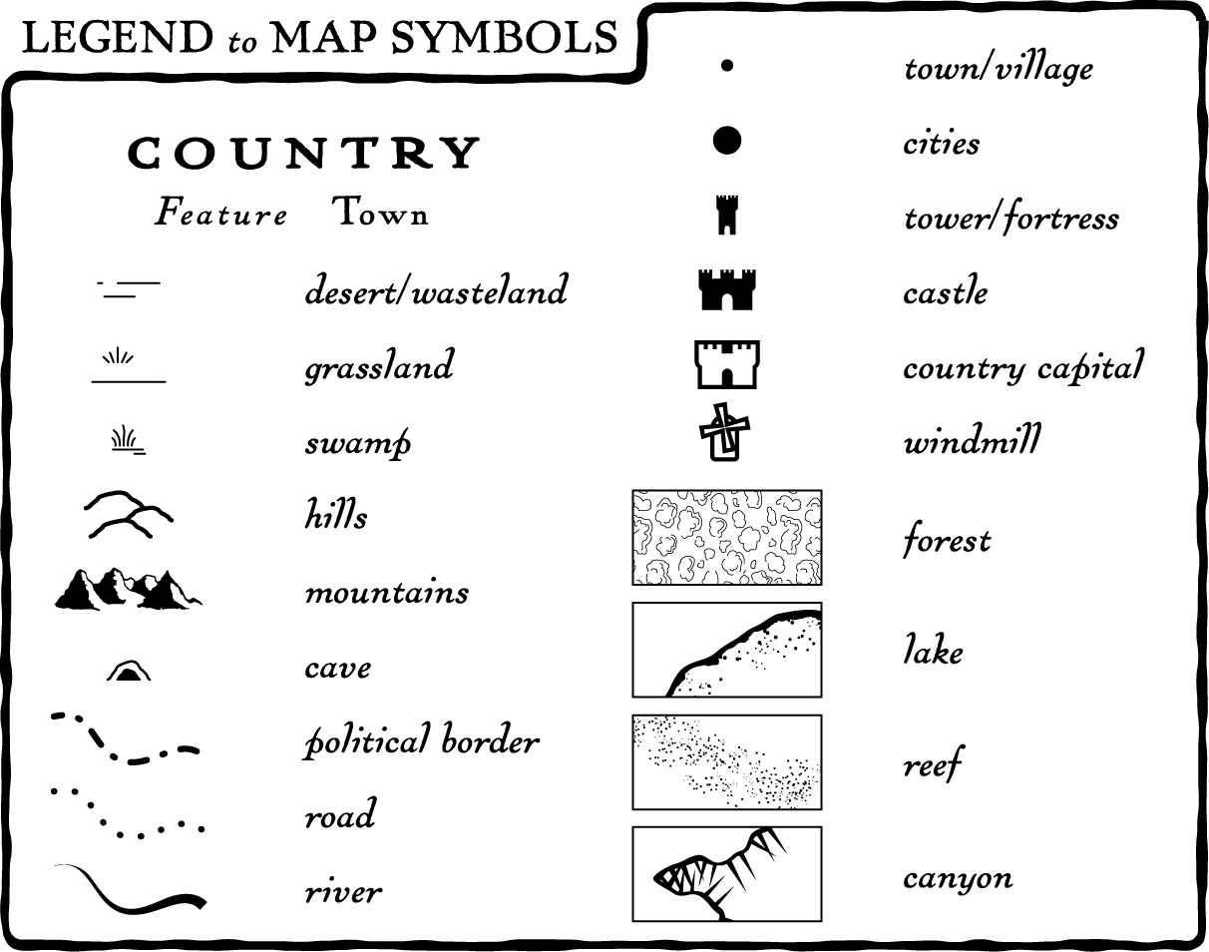
K is for: Key
Keys help us know what each symbol on the map stands for.
This is one example.

Slide 9
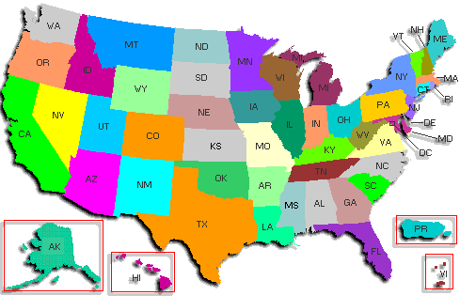
T is for: Title
The title of a map is simply it’s name. For example,
the title of this map could be:
The United States of America

Slide 10
O is for: Orientation
The orientation on a map helps us know the direction of
a certain area compared to another.

Slide 11
A is for: Author!
Just like books, maps must also have an author.

Slide 12
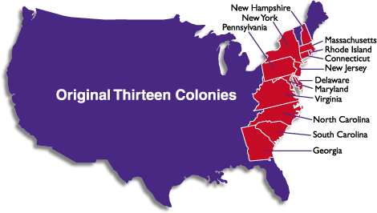
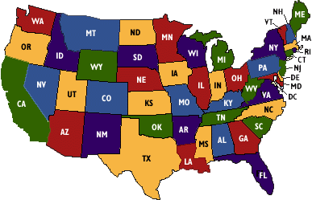
D is for: Date
Maps can change, that is why it is important to include the date the
map was made. For example, look at what the United States looked like
before all of the other states joined.

Slide 13
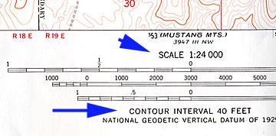
S is for: Scale
Scales tell us how to compare the size of
the map to the real-life size so that it
fits on the page but we can still tell
how big it really is.

Slide 14
Assessment
Answer the following questions by answering True or False
The title does not always have to be displayed on a “good map”
Orientation helps you with direction.
Scale tells us about the size of the map.
All of the map elements are needed to map a good map.

