Slide 1
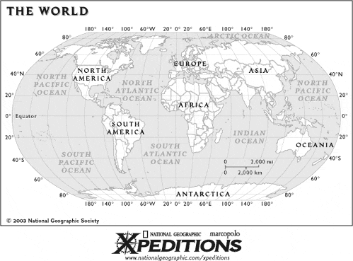

Slide 2
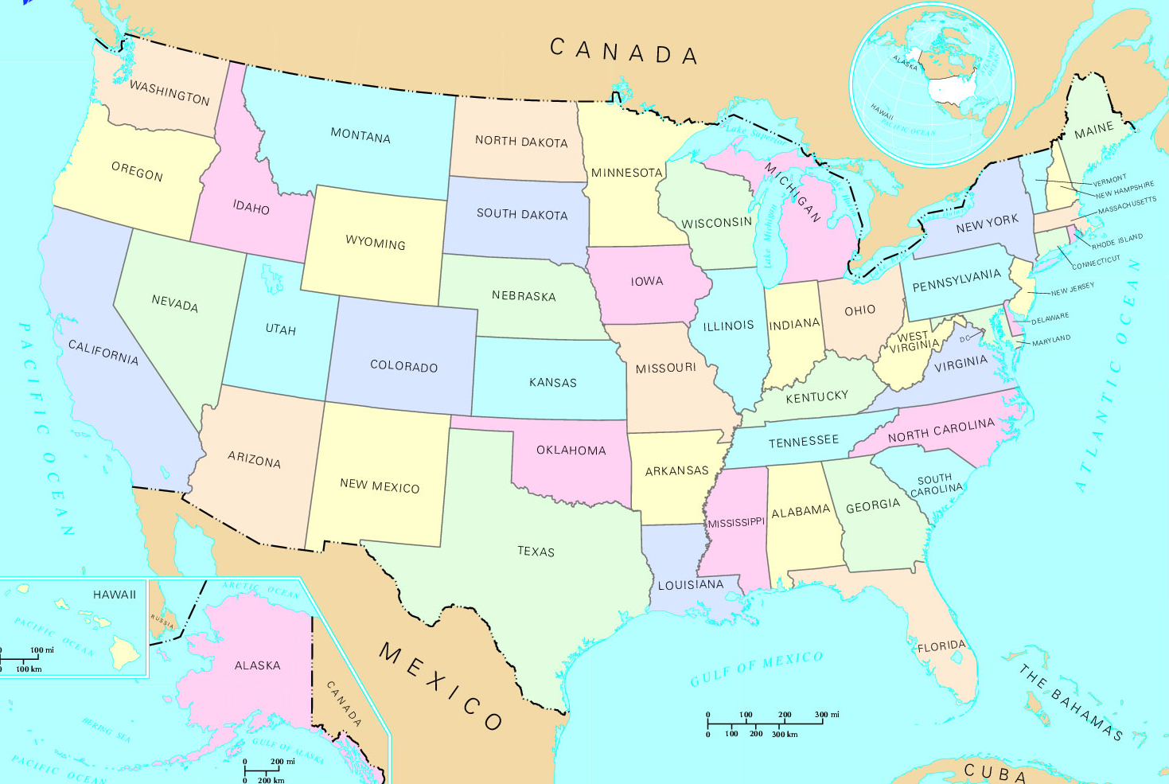
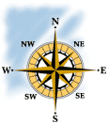
Where is Maryland?

Slide 3
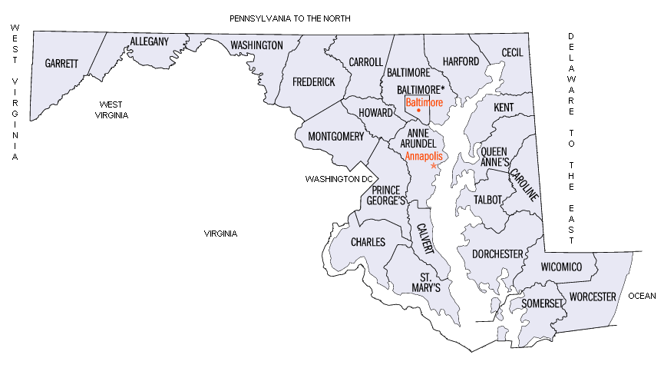
Describe Anne Arundel County’s location using cardinal directions.
Describe where Baltimore County is compared to Anne Arundel.
Describe Talbot County’s location compared to Anne Arundel.

