Slide 1
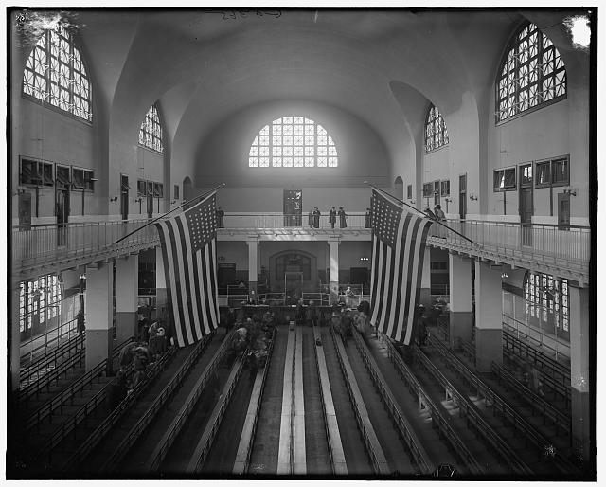
Coming to America
The Immigrant’s Experience

Slide 2
Coming to America
Before landing:
A doctor comes aboard ship to check for contagious diseases such as cholera. If any are found the entire ship may be denied entry even to Ellis Island.

Slide 3
Coming to America
Arrival:
General Inspection: Looking for any disease or deformity.
Inspection of the Eyes:
Inspection by a Matron: all women are eyed “sharply” for doubtful character.

Slide 4
Coming to America
Questions:
What is your name?
How old are you?
Where did you live before coming here?
Who paid your passage?
Where are you going?
Have you a ticket?
What is your business?
How much money do you have?
Can you read and write?
Were you ever in a prison or an almshouse?
Are you an anarchist or polygamist?
Are you under a labor contract?
Who is here to meet you?

Slide 5
Coming to America
Aliens or Americans?—Codes
F.I. (Further Investigation)
S.I. (Special Investigation)
T.D. (Temporarily Detained)
L.P.C (Likely to be a Public Charge)
E (Excluded)
D (Deported)
O.K. (All Right)

Slide 6
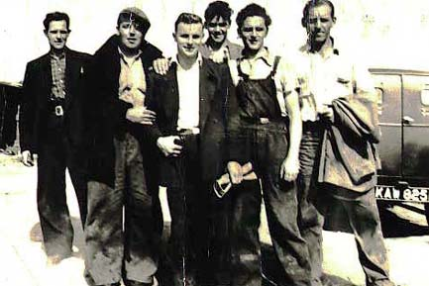
Coming to America
Five Irishmen: John O’Henessy, Pat O’Leary, Michael O’Brien, Dennis Maloney and Michael Mahoney.
They have all come from the county of Cork. One or two of them can read and write a little. They all admit their tickets were paid for by a friend. 2

Slide 7
Coming to America
None of them have much money, perhaps a shilling or two. Fearing they will be rejected because of lack of money, their leader pulls out a paper showing that they all have work, that, in fact, they have come under a labor contract.

Slide 8
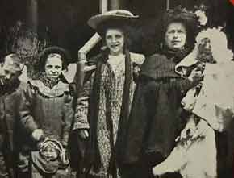
Coming to America
Swedish Family—Mr. & Mrs. Johannsen and their five children.
They have $200. All speak English. Mr. Johannsen expects to get work with friends in Worcester, Mass.

Slide 9
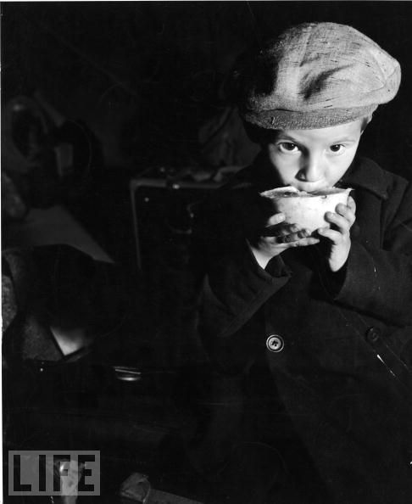
Coming to America
English Boy—Timothy Donalds
He is thirteen years old and has come to live with his uncle in San Antonio, Texas.
He had $200 but it was stolen from him in steerage when he as seasick. He has $1.37 left.

Slide 10
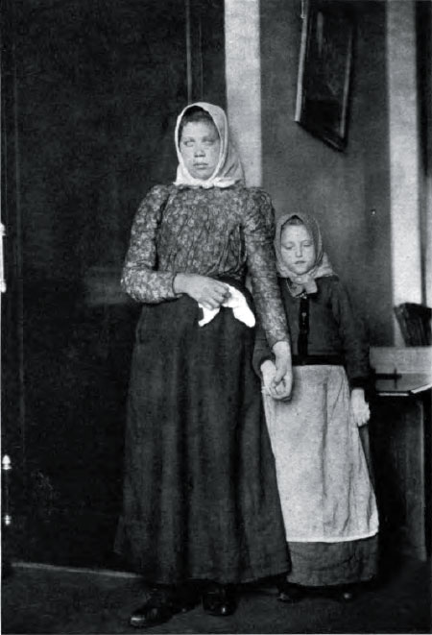
Coming to America
Dutch girl—Katrina Homberg
She has no money and has come to be married. Her fiancée, Jan lives near New York, but she has lost his address. She knows it starts with an “O”. She thinks its Omaha or maybe Oklahoma or maybe Oakland.
1

Slide 11
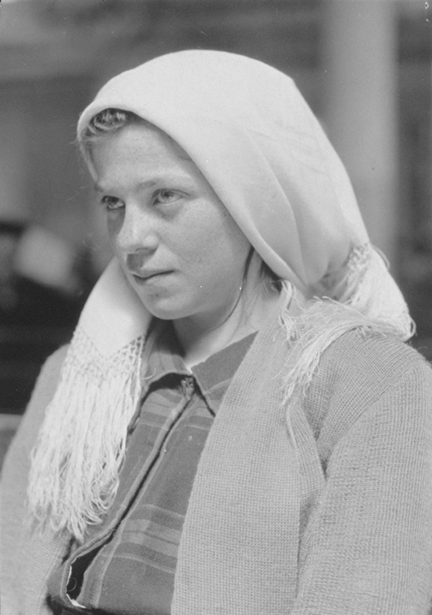
Coming to America
German Girl—Gretchen Stiglitz
She answers all but the money question satisfactorily. She has only five dollars but has come over to be married. The young man she expects to meet her has not arrived yet.

Slide 12
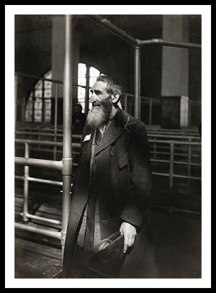
Coming to America
A Russian Jew—Isaac Jacobson
He expects to stay in New York. His son paid for his ticket. He insists that he can earn his own living, but he looks very old and feeble.
3

Slide 13
Coming to America
He is told he looks weak and is asked if he is ill.
He replies that when he has eaten he will be strong again.
Are you hungry? He is asked.
I have not eaten in eight days.
2

Slide 14
Coming to America
Down in the bottom of the ship they gave us food that was unclean and my religion will not let me eat it.
“When I have eaten I shall be strong,” he insists.
1

Slide 15
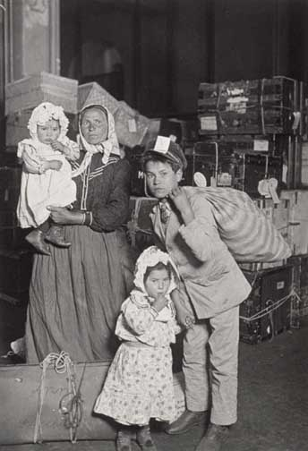
Coming to America
Italian Family—Carmelita Orrificio and eight children.
They come from southern Italy. Their 67 year old grandmother is with them. Each child is carrying a box or bundle. They are expecting their father to meet them. She can produce only ten cents in cash. 4

Slide 16
Coming to America
Italian Family—Carmelita Orrificio and eight children.
One child seems to have eye trouble and another has a limp. It is a long wait. If father does not come we must all go back to Italy.
3

Slide 17
Coming to America
Every week mother get a letter telling how much father saved. Father can’t write himself but knows a boy who can. At last a letter come with money to buy tickets for all of us.
Coming over we were very much seasick. 2

Slide 18
Coming to America
We were much afraid when the inspector looked at the baby’s eyes. What if he has to go back? Mother would have to go with him and then what would happen to us?
1

Slide 19
Coming to America
Hungarian Family—Mrs. Bulenski and her two daughters
None of them can read or write or speak much English. One child has trouble with her eyes. The mother has six dollars. She expects her husband to meet her. He is a farmer in Pennsylvania but she doesn’t know where.

Slide 20
Coming to America
Five Irish Men:
O.K. ? Deported?

Slide 21
Coming to America
Inspection:
Five Irish Men:
Because they were admitted under a labor contract, they are excluded from America and must wait for the steamer that brought them to Ellis Island to return them to Ireland.

Slide 22
Coming to America
English Boy:
O.K. ? Deported?

Slide 23
Coming to America
Inspection:
English Boy
A telegram arrives from his uncle including money for his passage to Texas and he is marked O.K.

Slide 24
Coming to America
Swedish Family
O.K. ? Deported?

Slide 25
Coming to America
They are marked O.K., helped to the train station where they change money and buy their tickets.

Slide 26
Coming to America
Dutch Girl:
O.K. ? Deported?

Slide 27
Coming to America
Inspection:
Dutch Girl—Katrina Homberg
Several telegrams are sent but Jan can not be located so Katrina must be deported.

Slide 28
Coming to America
German Girl:
O.K. ? Deported?

Slide 29
Coming to America
Inspection:
German Girl—Gretchen Stieglitz:
When her fiancee, Hans Leiter, arrives, she must marry him on Ellis Island since they will not allow a young, unmarried girl to go alone and friendless to New York.

Slide 30
Coming to America
Russian Jew:
O.K. ? Deported?

Slide 31
Coming to America
Inspection:
Russian Jew—Isaac Jacobson
He is sent to the dining room for a square meal and allowed to go with his son.

Slide 32
Coming to America
Italian Family:
O.K. ? Deported?

Slide 33
Coming to America
Inspection:
Italian Family
After a long wait, an officer comes to the door. Their father has come but one of the children is missing and they can’t leave without him. Finally he is found and they all embrace and leave.

Slide 34
Coming to America
Hungarian Family:
O.K. ? Deported?

Slide 35
Coming to America
Inspection:
Hungarian Family
They look up eagerly each time the door opens. An officer comes and tells them their father has not arrived and they must go back. Protesting and in tears, they are deported.

