Slide 1
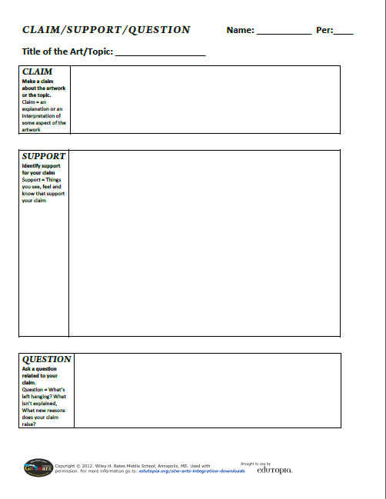
Directions:
Use the artful thinking routine: Claim/Support/Question with the Topic: “Early Government” as you view the following images to answer the question:
How did 17th century English Settlers influence the early government?

Slide 2
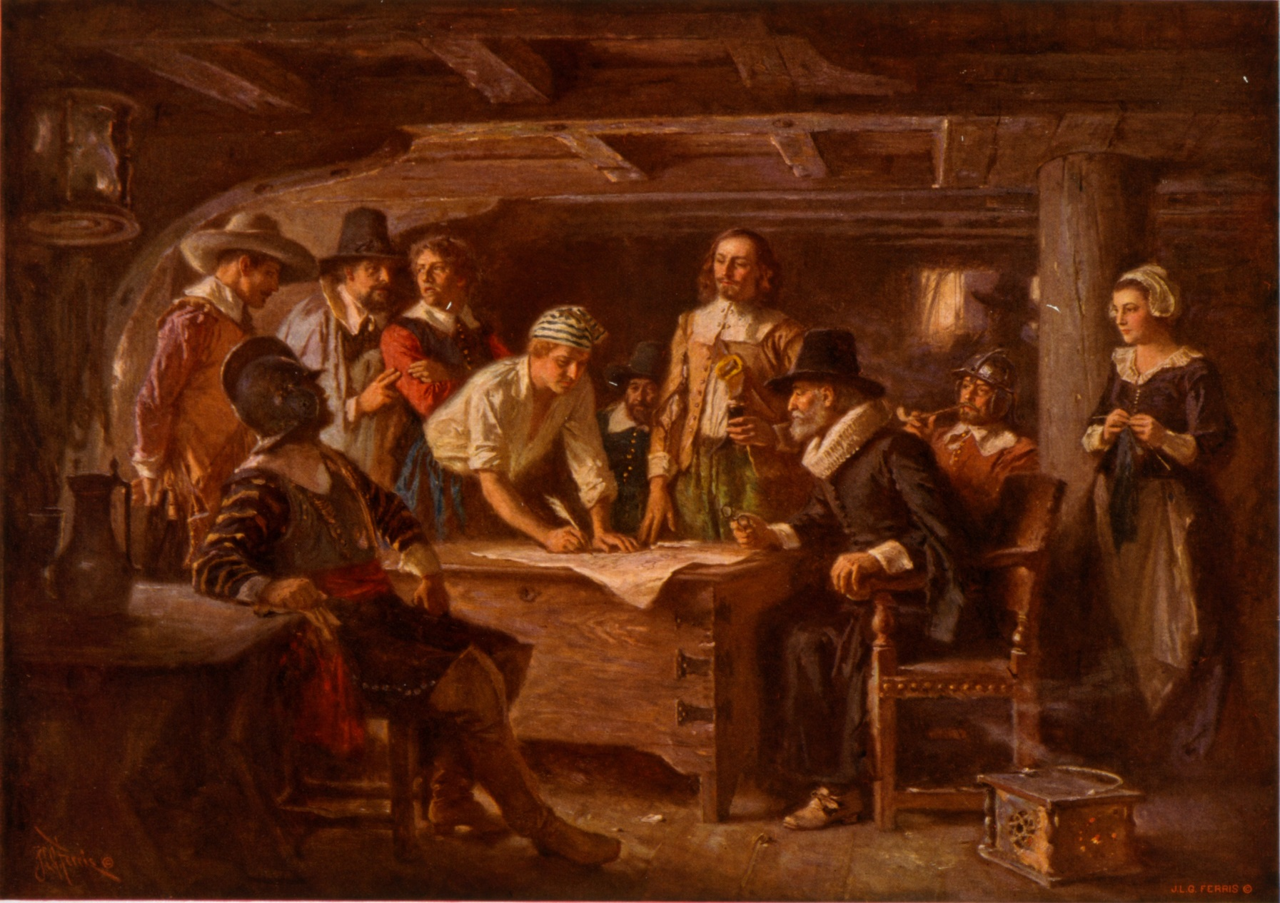
Source: http://billofrightsinstitute.org/wp-content/uploads/2011/12/AP_Documents_Mayflower.jpg

Slide 3
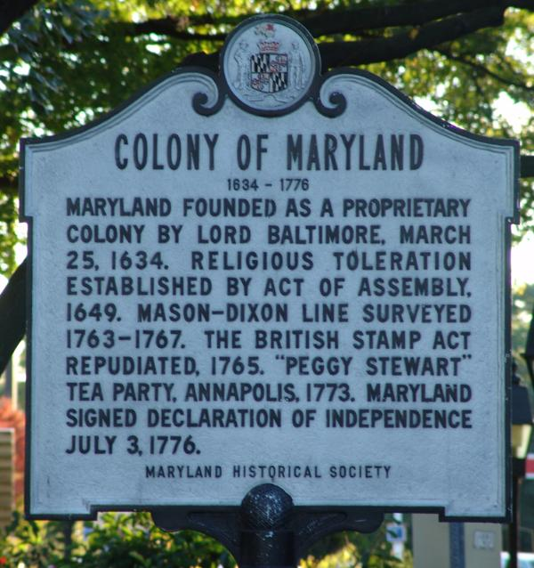
Source: http://img.groundspeak.com/waymarking/25706989-b35c-429d-a662-8177b3c3559e.jpg

Slide 4
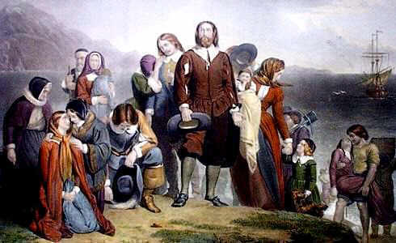
Source: http://www.landofthebrave.info/images/puritans.jpg

Slide 5
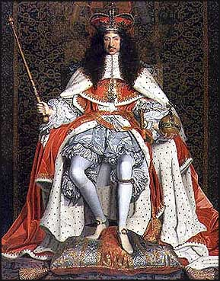
Source: http://www.luminarium.org/encyclopedia/charles2.jpg

Slide 6
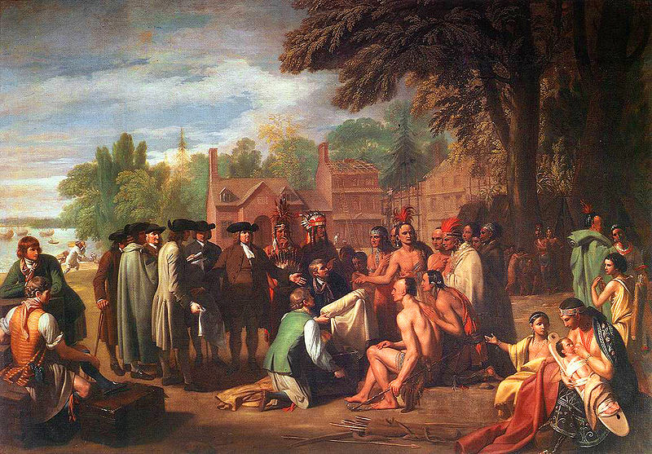
Source: http://faculty.uml.edu/bmarshall/williampennstreatywtihtheindians.jpg

Slide 7
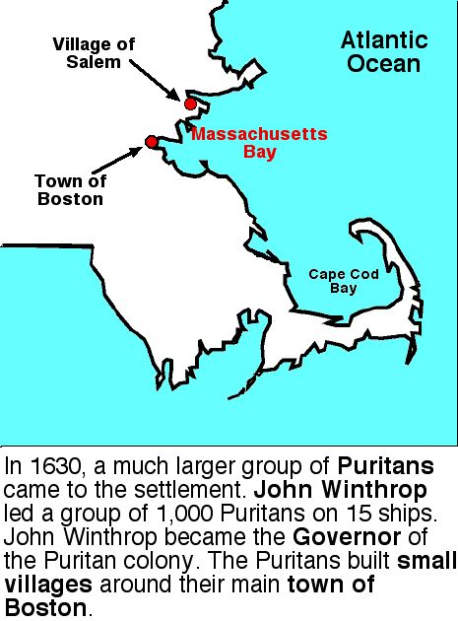
Source: http://www.watertown.k12.ma.us/cunniff/americanhistorycentral/Graphic_Images/05_Europeans_Settle_N_Am/07_Massachusetts_Bay_Colony/MassBay_Plymouth_Boston4.jpg

