Slide 1
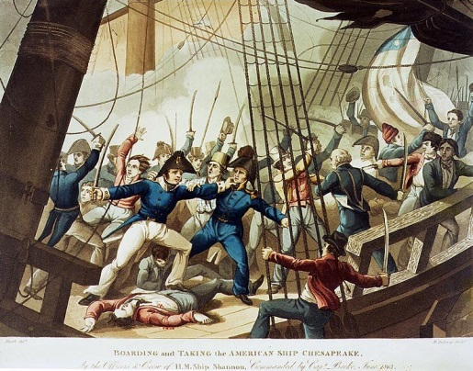
What’s going on?
What makes you say that?

