Slide 1
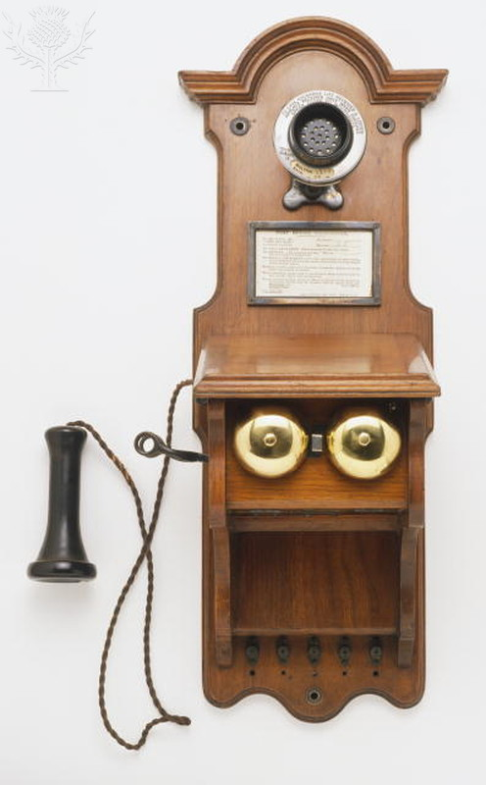
Dorling Kindersley/ Dorlng Kindersley / Universal Images Group /Rights Managed / For Education Use Only

Slide 2
Dorling Kindersley/ Dorlng Kindersley / Universal Images Group /Rights Managed / For Education Use Only

Slide 3
Peter Anderson / Dorlng Kindersley / Universal Images Group /Rights Managed / For Education Use Only

Slide 4
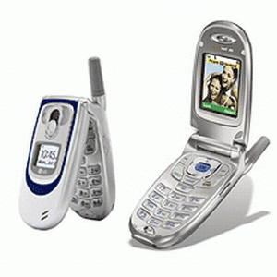
https://www.urmc.rochester.edu / Rights Managed / For Education Use Only

Slide 5
http://www.riskmanagementmonitor.com/ Rights Managed / For Education Use Only

Slide 6
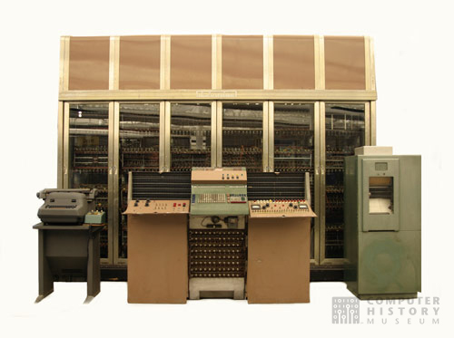
Computer History Museum / Rights Managed / For Education Use Only

Slide 7
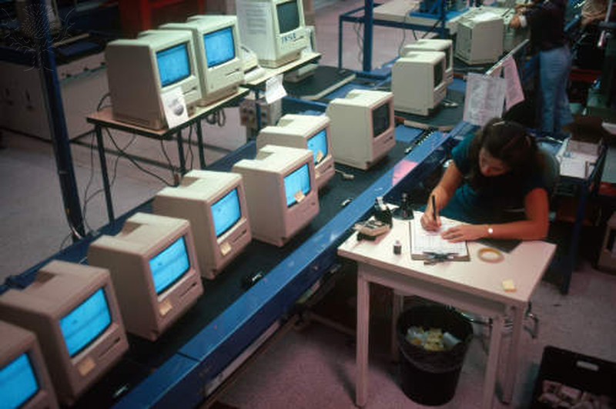
Hank Morgan / Photo Researchers / Universal Images Group /Rights Managed / For Education Use Only

Slide 8
JERRY MASON/SCIENCE PHOTO LIBRARY / Universal Images Group /Rights Managed / For Education Use Only

Slide 9
GIPhotoStock / Photo Researchers / Universal Images Group / Rights Managed / For Education Use Only

Slide 10
Oleksiy Maksymenko / All Canada Photo / Universal Images Group / Rights Managed / For Education Use Only

Slide 11
Andersen Ross / Blend / Learning Pictures / Universal Images Group / Rights Managed / For Education Use Only

Slide 12
Justin Sullivan / Getty Images News / Getty Images / Universal Images Group / Rights Managed / For Education Use Only

