Slide 1
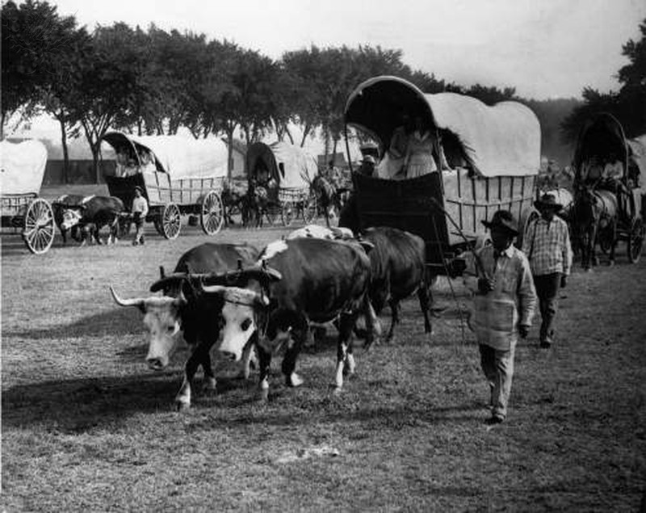
Photo Researchers / Photo Researchers / Universal Images Group Rights Managed/ For Education Use Only

Slide 2
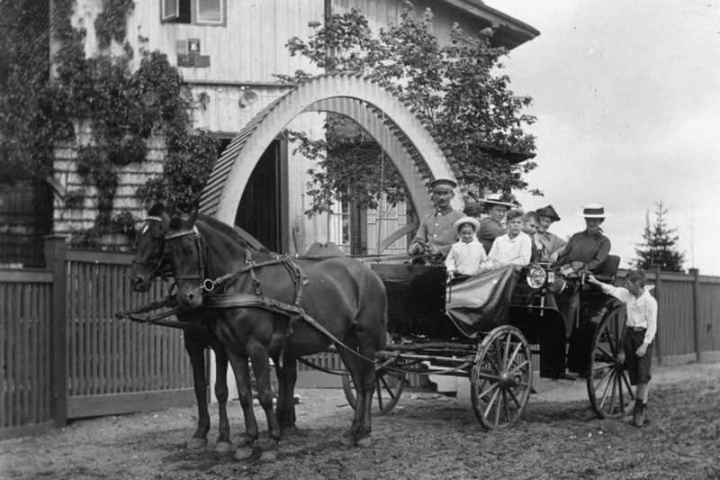
akg-images / Universal Images Group Rights Managed/ For Education Use Only

Slide 3
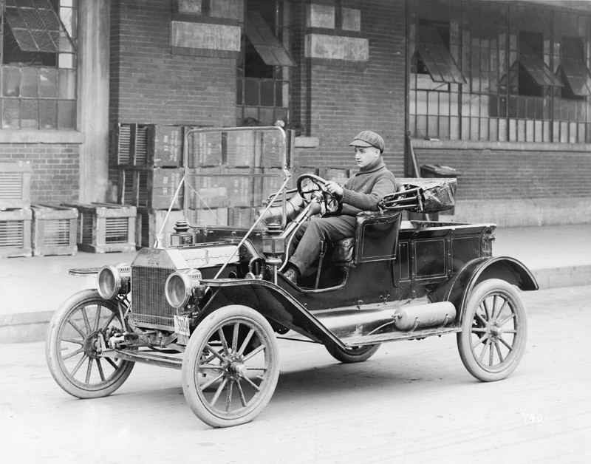
Three Lions / Hulton Archive / Getty Images / Universal Images Group Rights Managed/ For Education Use Only

Slide 4
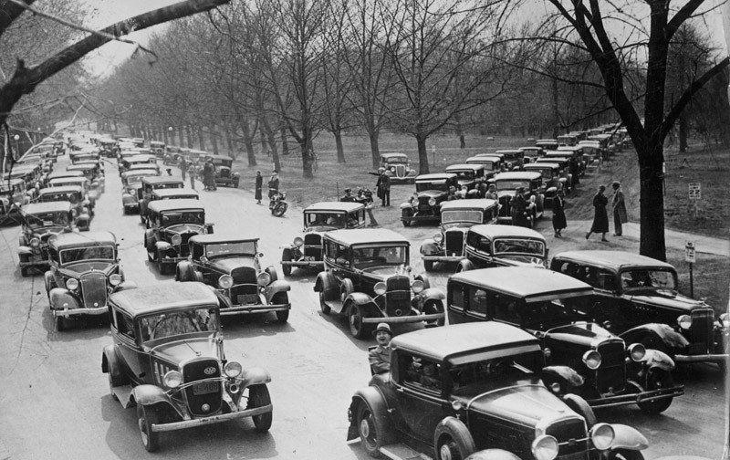
Three Lions / Hulton Archive / Getty Images / Universal Images Group Rights Managed/ For Education Use Only

Slide 5
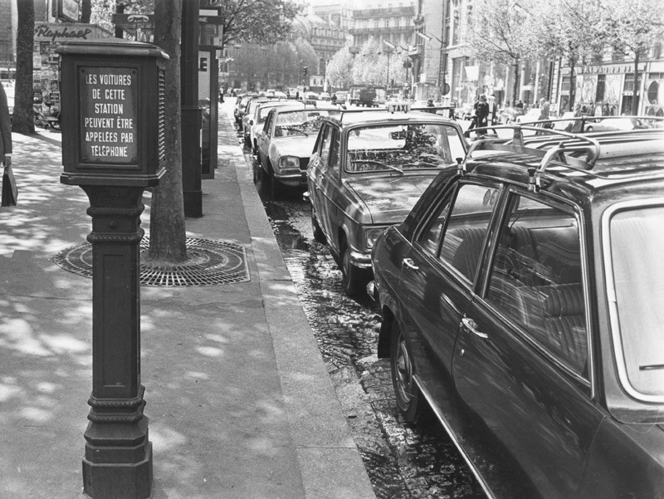
Keystone / Hulton Archive / Getty Images / Universal Images Group Rights Managed/ For Education Use Only

Slide 6
Tom Kelley Archive / Retrofile Creative / Getty Images / Universal Images Group Rights Managed/ For Education Use Only

Slide 7
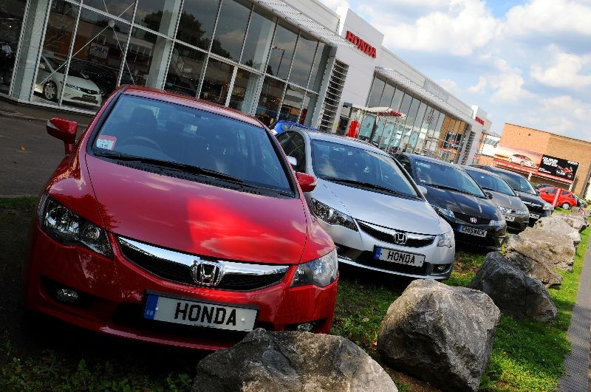
Fiona Hanson / PA Archive / Press Association Images / Universal Images Group / Rights Managed / For Education Use Only

Slide 8
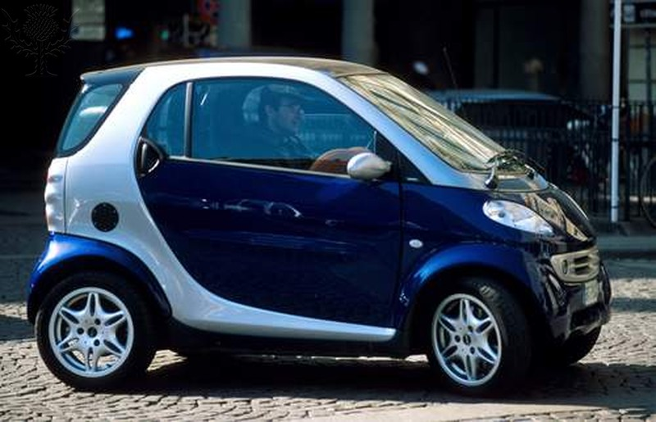
David R. Frazier / Photo Researchers / Universal Images Group / Rights Managed / For Education Use Only

Slide 9
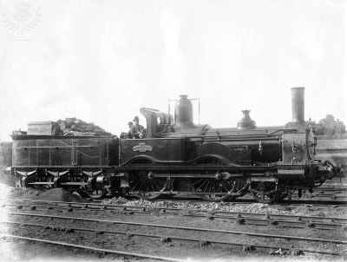
Universal History Archive/Universal Images Group / Rights Managed/ For Educational Use Only

Slide 10
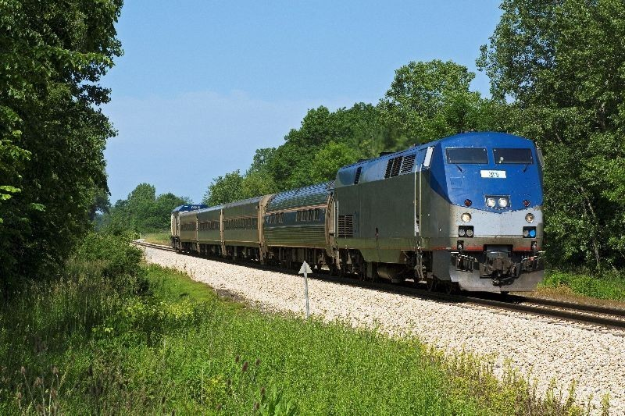
Superstock / Universal Images Group / Rights Managed/ For Education Use Only

Slide 11
David R. Frazier Photolibrary, Inc. / Photo Researchers / Universal Images Group/ Rights Managed/ For Education Use Only

Slide 12
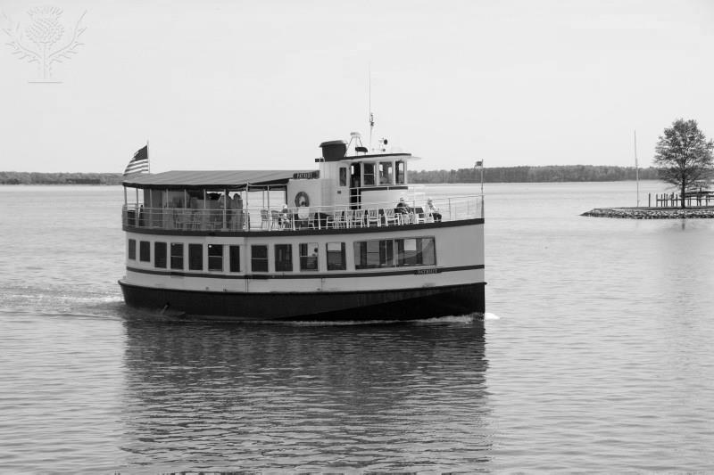
Robert Harding Productions / Robert Harding World Imagery / Universal Images Group / Rights Managed/ For Education Use Only

Slide 13
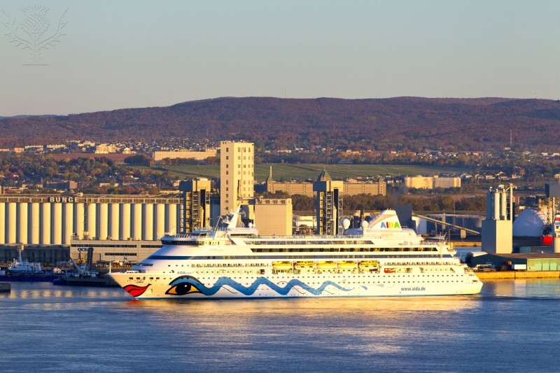
Barrett & MacKay / All Canada Photo / Universal Images Group / Rights Managed/ For Education Use Only

Slide 14
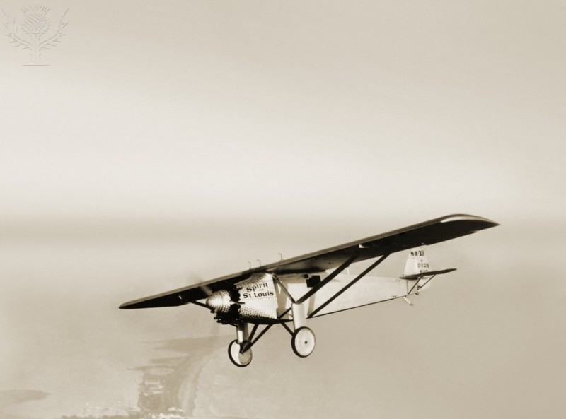
akg-images / Universal Images Group Rights Managed/ For Education Use Only

Slide 15
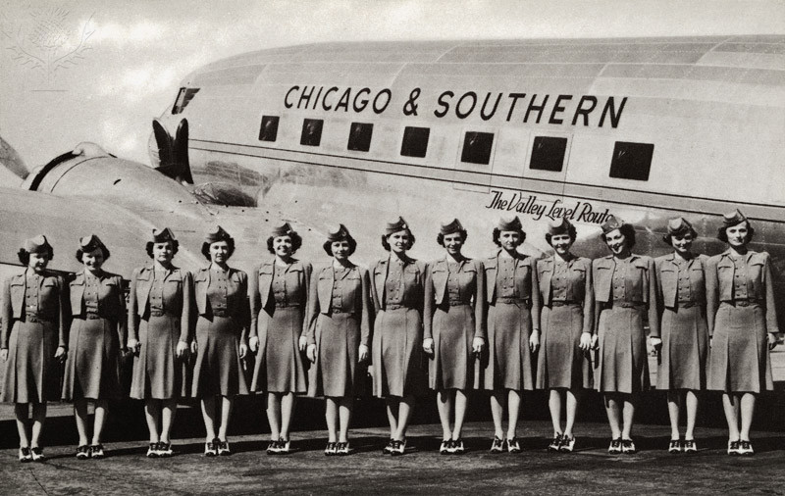
Lake County Discovery Museum / Universal Images Group / Rights Managed / For Education Use Only

Slide 16
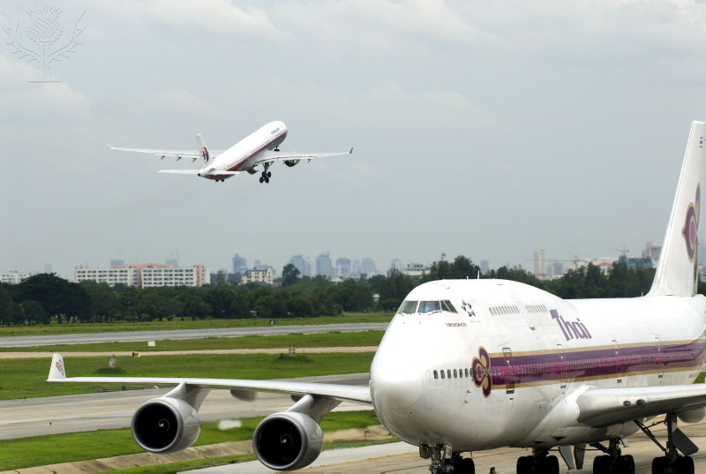
Rod Porteous / Robert Harding World Imagery / Universal Images Group / Rights Managed / For Education Use Only

Slide 17
Dan Kitwood / Getty Images News / Getty Images / Universal Images Group / Rights Managed / For Education Use Only

