Slide 1
Chemistry in art
Works of Georges Seurat & Chuck Close

Slide 2
Notes:
Teacher will ask students if they recognize this painting
Teacher will ask students to tell her about the picture

Slide 3
GEORGES SEURAT
Born in Paris in December of 1859.
Most famous for his painting, Sunday
The technique of pointillism is used to make his paintings shimmer with brilliance.
Notes:
Teacher will introduce how Seurat was the first to use this idea of pointillism.

Slide 4
pointillism
uses small, distinct dots of pure color applied in patterns to form an image

Slide 5
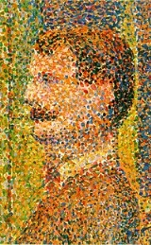
Notes:
Teacher will introduce these two pieces of Seurat’s paintings up-close
Teacher will share that the idea of pointillism can be used in different ways, before moving to the next slide

Slide 6
Notes:
Teacher will ask students what the picture is showing.

Slide 7
Notes:
Now what do they see…

Slide 8
When we use this idea of pointillism, we are mixing colors not by blending them together but by placing different colors side by side!
Chemistry in Art

Slide 9
Notes:
Since students are likely getting the hang of how pointillism works, the teacher will have them Think Pair Share about what the eye might be made of
Teacher will elicit student responses

Slide 11
CHUCK CLOSE
Chuck Close is mostly associated with the style of painting called Photorealism. Photorealist frequently used a grid technique to enlarge a photograph and reduce each square to formal elements of design.
Notes:
Introduce Chuck Close as a different type of artist, but the idea behind his art can be related to Seurat’s.

Slide 12
Notes:
Teacher will ask them how this looks like it was done.
Each grid is its own little work of art.

Slide 13
What happens is an optical mixing of colors.
Chemistry in Art
Notes:
Teacher will ask students what the word optical reminds them of to see if they can figure out the meaning.
Teacher will discuss how your eyes “blend” the colors together.
Teacher will as students if they could think of a way to create the illusion of the color purple if there was not purple paint and Mrs. Edwards told you that you could not stir colors together.

Slide 14
Another example: we may place clusters of red dots and surround them with yellow dots.
Chemistry in Art

Slide 15
Chemistry in Art
Up close we will see red and yellow, but from a distance, we will see orange.

Slide 16
Notes:
Teacher will have the students Think Pair Share about what they think this is a picture of.

Slide 17
Up close, a Pointillist painting can look slightly confusing, but as the viewer backs away, the picture comes into focus.
Chemistry in Art

Slide 19
Chemistry in Art
eyes and mind
blend the dots of color
like pixels on a computer screen
Notes:
Teacher will tell the students this is because the eyes and mind work together to blend the dots of color into a smooth picture, much like people interpret pixels on a computer screen as a single image.

Slide 21
How does all of this connect to physical mixtures????
Chemistry in Art
Notes:
Teacher will have students discuss question at their tables.
Think about mixing salt and sand.
From far away, could you tell there were two different grains in the jar?

Slide 22
Let’s try out this idea of pointillism!

Slide 23
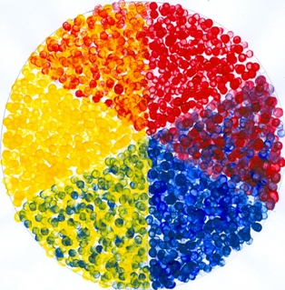
Notes:
Teacher will explain the picture and let students know it will be left up until everyone gets started.

