Slide 1
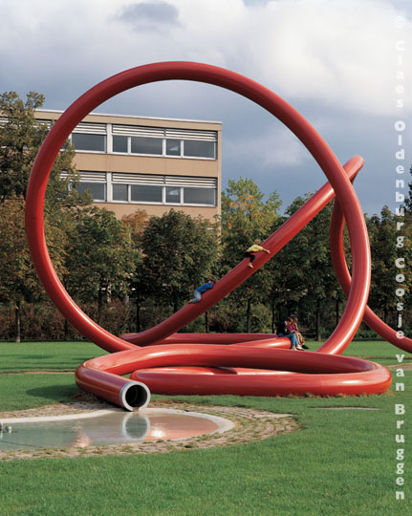
Kinetic or Potential Energy?
CLAIM Make a claim about the energy you see in the artwork. Claim = an explanation or an interpretation of some aspect of the artwork |  | SUPPORT Identify support for your claim Support = Things you see, feel and know that support your claim |  | QUESTION Ask a question related to your claim. Question = What’s left hanging? What isn’t explained, What new reasons does your claim raise?
Claes Oldenburg: Gartenschlauch Stühlinger Park, Freiburg im Breisgau, Germany
Notes:
Kinetic art is art that contains moving parts or depends on motion for its effect.^{[1]} The moving parts are generally powered by wind, a motor or the observer. Kinetic art encompasses a wide variety of overlapping techniques and styles.
see cool example at http://vimeo.com/channels/kineticartprojects
Kinetic sculptures are examples of kinetic art in the form of sculpture or three dimensions. In common with other types of kinetic art, kinetic sculptures have parts that move or that are in motion. Sound sculpture can also, in some cases, be considered kinetic sculpture. The motion of the work can be provided in many ways: mechanically through electricity, steam or clockwork; by utilizing natural phenomena such as wind or wave power; or by relying on the spectator to provide the motion, by doing something such as cranking a handle.
http://en.wikipedia.org/wiki/Kinetic_art

Slide 2
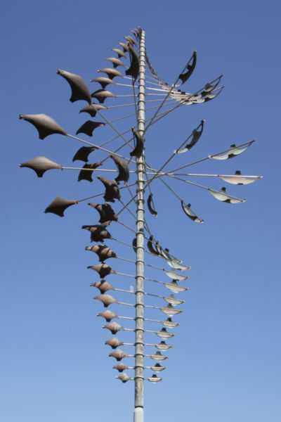

Slide 3
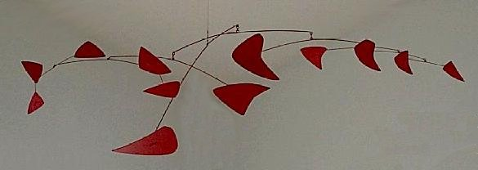
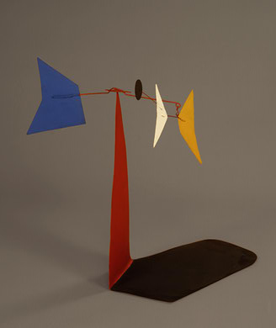
Notes:
A mobile is a type of kinetic sculpture constructed to take advantage of the principle of equilibrium.
http://www.npg.si.edu/exhibit/calder/index.html
Alexander Calder, "Red Mobile", 1956. Painted sheet metal and metal rods, Montreal Museum of Fine Arts.

Slide 4
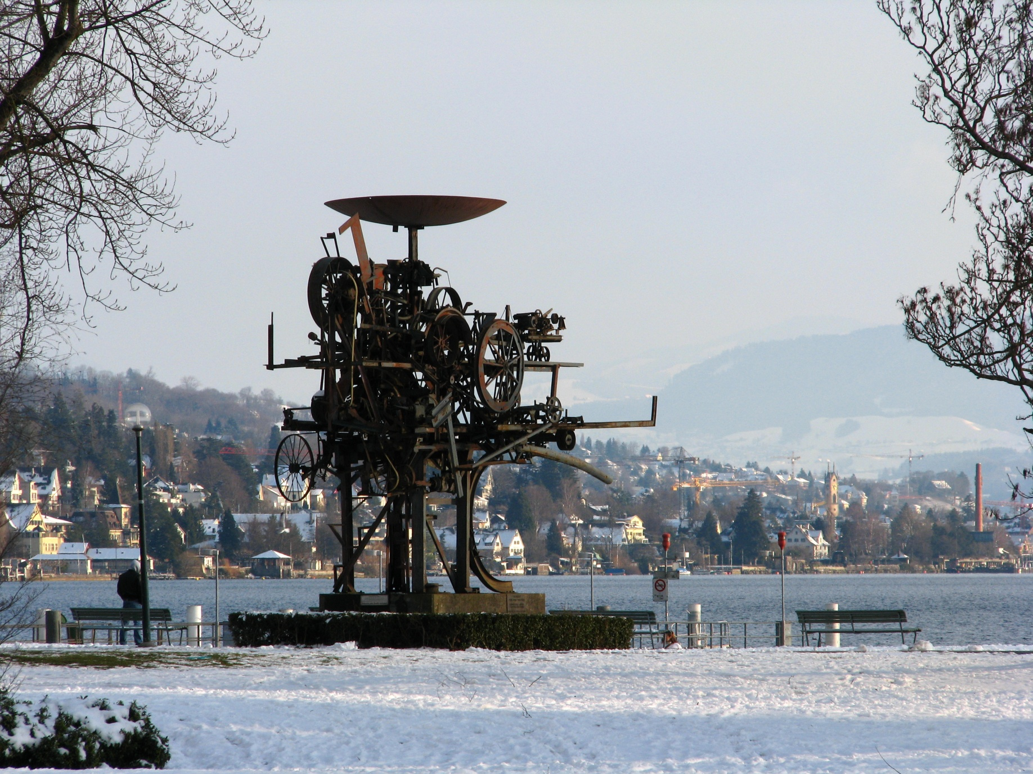
Notes:
Jean Tinguely's fountain Heureka in Zürich-Seefeld (Zürichhorn)

Slide 5
Notes:
National Offshore Powerboat 1982 Racing Circuit
1982 Stephen Frykholm Born: Seattle, Washington 1942

Slide 6
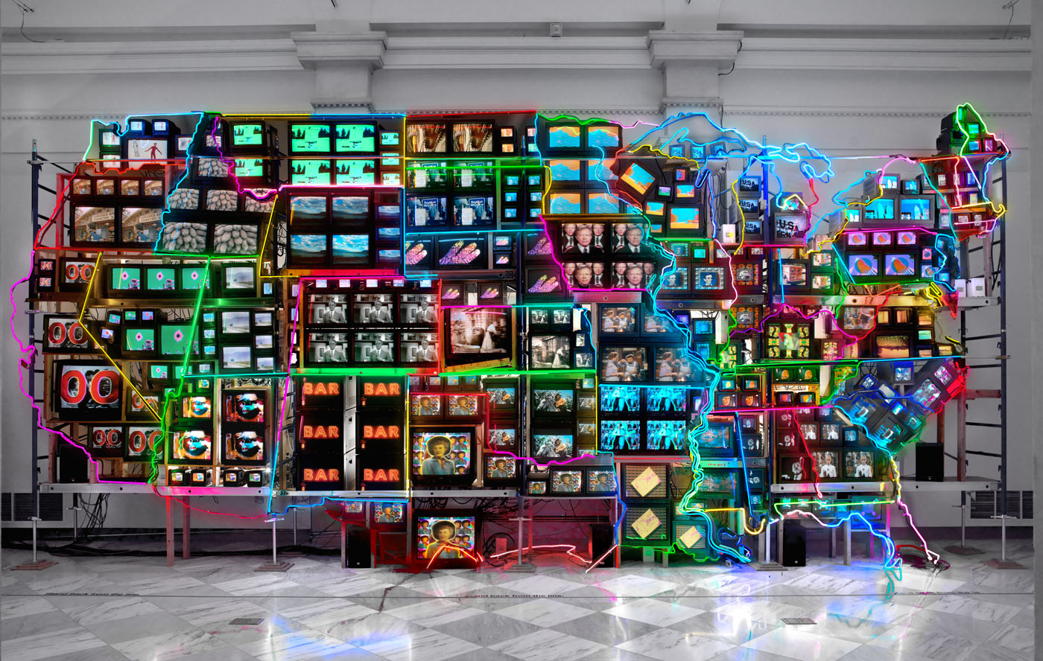
Notes:
Electronic Superhighway: Continental U.S., Alaska, Hawaii
1995 Nam June Paik Born: Seoul, Korea 1932 Died: Miami Beach, Florida 2006 fifty-one channel video installation (including one closed-circuit television feed), custom electronics, neon lighting, steel and wood; color, sound

Slide 7
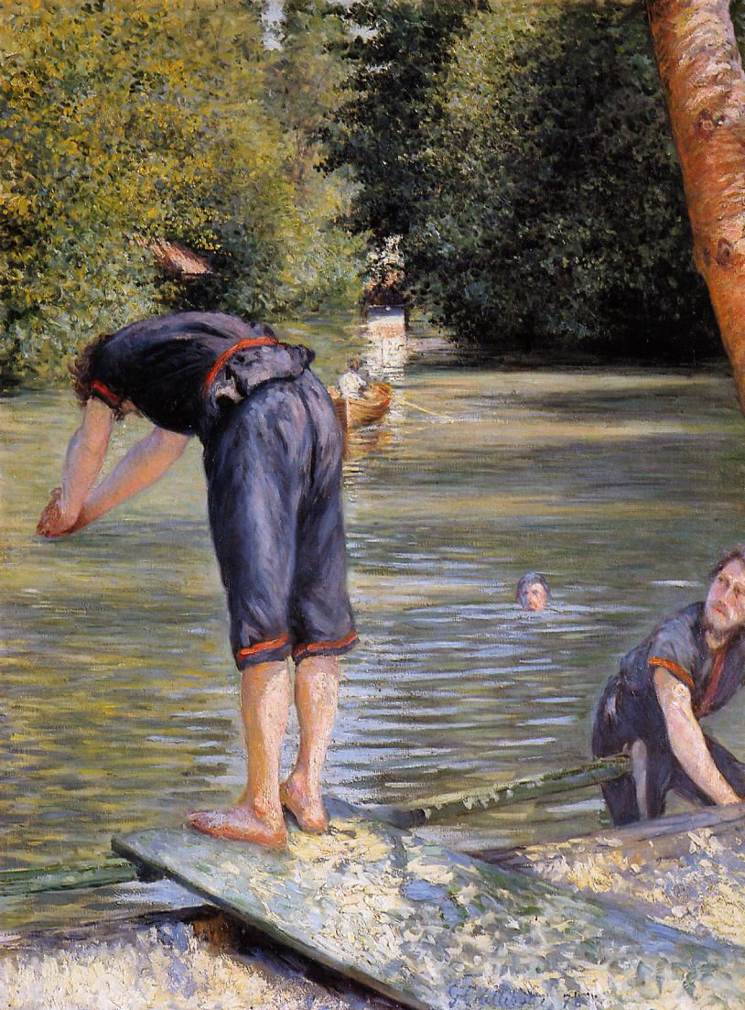
Notes:
Bathers
1878
by Gustave Caillebotte

Slide 8
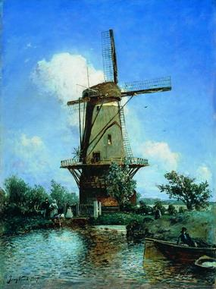
Notes:
Windmill near Delft
1857
by Johan Jongkind

Slide 9
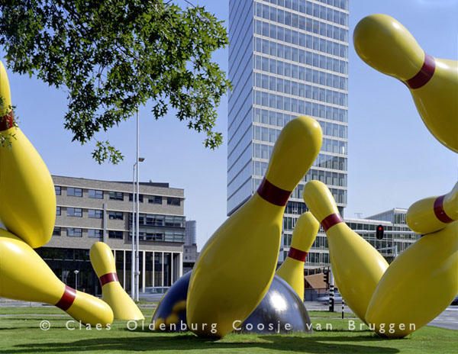
Notes:
Claes Oldenberg Flying Pins Intersection of John F. Kennedylaan and Fellenoord, Eindhoven, the Netherlands
SEE MORE! http://oldenburgvanbruggen.com/largescaleprojects/lsp.htm

Slide 10
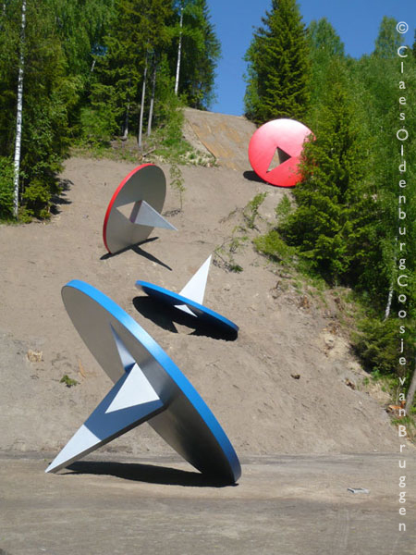
Notes:
Claes Oldenberg Tumbling Tacks

Slide 11
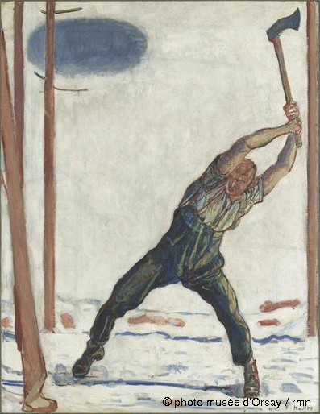
Notes:
The Lumberjack
1910
by Ferdinand Hodler

Slide 12
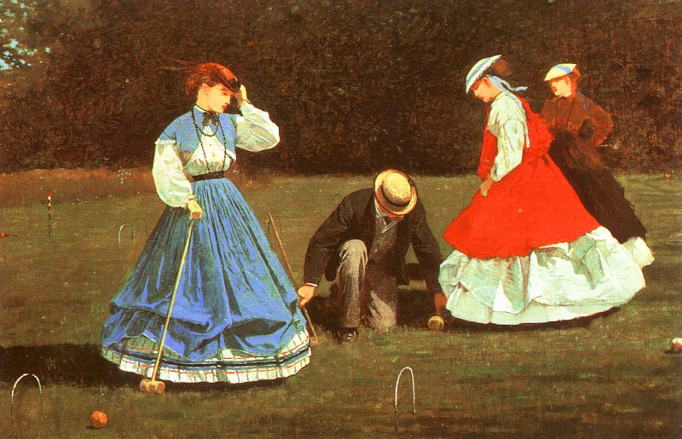
Notes:
The Croquet Game
1866
by Winslow Homer

Slide 13
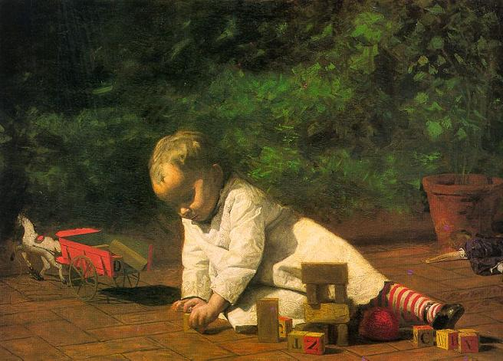
Notes:
Baby at Play
1876
by Thomas Eakins

Slide 14
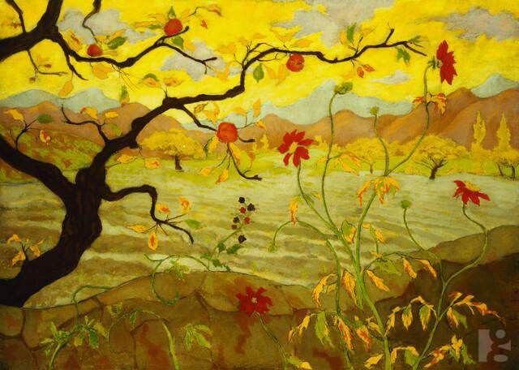
Notes:
Apple Tree with Red Fruit
Date unknown
by Paul Ranson

