Slide 1

A World of Resources
Created/ Modified by DeMarco/ Klenkel
Cape St. Claire Elementary

Slide 2

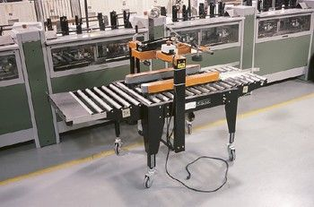
Types of Resources
Notes:
There are three kinds of resources: human resources are…..
Capital resources are…..
Today we will be reading and analyzing an expository piece about the third type of resource.
T

Slide 3
Outcomes:
The student will sequence expository text and identify cause and effect relationships in order to infer consequences and implications related to the consumption of natural resources.
The student will explain environmental factors related to resource consumption and analyze their impact on our world. (CCSS 6.0 ES)

Slide 4

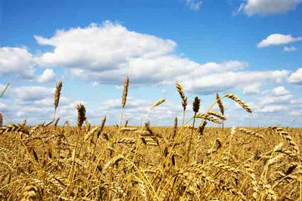
Vocabulary
Inorganic resource – nonliving, such as rocks, water, and air
Organic resource – living or once living

Slide 5
A1: Sequencing
List the order in which classification of natural resource was discussed in the text
On poster paper, create a visual representation of each type of classified resource with your group.
Notes:
Poster paper needed. If time allows, collages could even be created.

Slide 6
A2: Cause and Effect
What would be the effect of humans consuming, or using, a renewable resource at a faster rate than it can replenish itself?
Create a visual or Thinking Map to illustrate this relationship.
Use evidence from the text to support your answer.

Slide 7
A3: Consequences and Implications
  Independently think and record your thoughts:
  What would be the consequences of using all the Earth’s nonrenewable resources?
  Give specific examples to support your thoughts.
Team Talk:
  Discuss your thoughts and examples.
  What implications for our lives could these consequences bring about? Is there anything we could do about any them?

