Slide 1
Presentation Modified By:
3rd Grade Cape St. Claire, AACPS 2014- 2015

Slide 2
Artist
By Caitlin Graham
Grades 6-8

Slide 3
Let’s review!
elements
of poetry

Slide 4
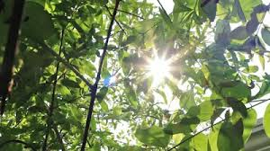
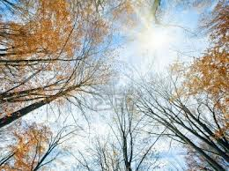
Literary Elements
Artist C1
You read
I read
Turn and Talk: How is the sun like an artist?
Using crayons, draw what the first two lines of the poem would look like.

Slide 5
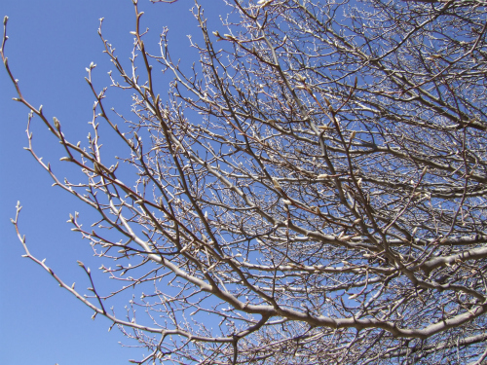
Inference
Artist C2
What do you infer is the reason the sun cannot paint anymore?

Slide 6
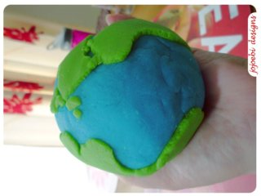
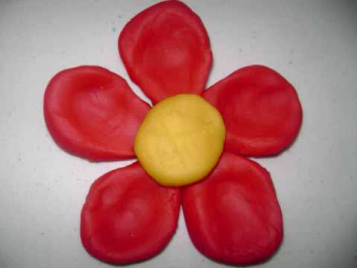
Theme
Artist C3
How do you think the author feels about nature? Use text support.
Use play dough to create a symbol that would represent the theme of this poem.
beauty
preservation

