Slide 1
Poetry and Prose
Let’s compare and contrast!
Created/ Modified by:
3rd Grade CSCE, AACPS, 2014

Slide 2
What is the difference between prose and poetry?
poetry
prose

Slide 3

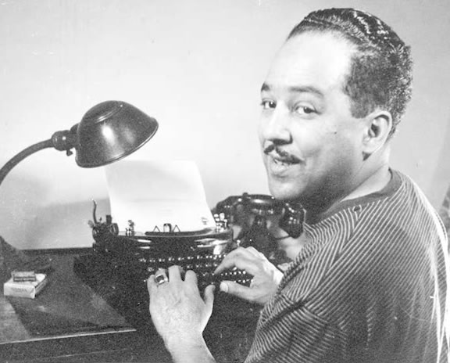
City
By Langston Hughes

Slide 4
Literary Elements C1
You read
I read
Use markers to create a list of words or phrases that describe the city.
How does the author use those words and phrases to put a picture in your head? What do you “see” ? Why?
Illustrate your vision of the poem based on the descriptive language used.

Slide 5
Inference C2
“In the evening the city/ goes to bed/hanging lights/ about its head”
What does the author mean by these lines?
What can be inferred?

Slide 6
Inference C2
Select which answer below best describes the quote. Explain using phrases from the text.
It is a starry night.
It is dark except for the streetlights.
The author wants to sleep with a nightlight above his head.
There are always lights on in the city.

Slide 7


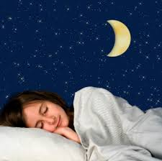
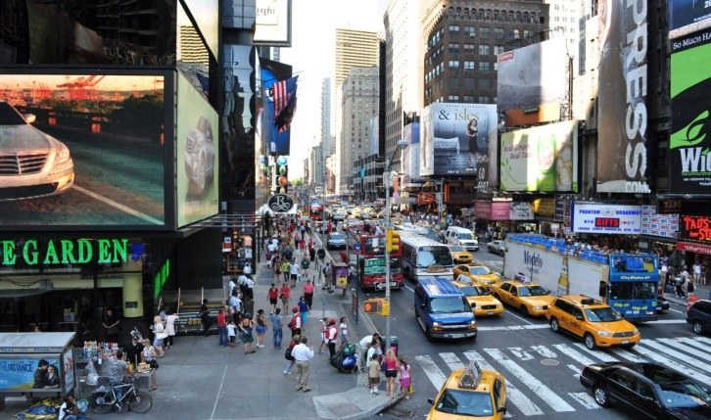
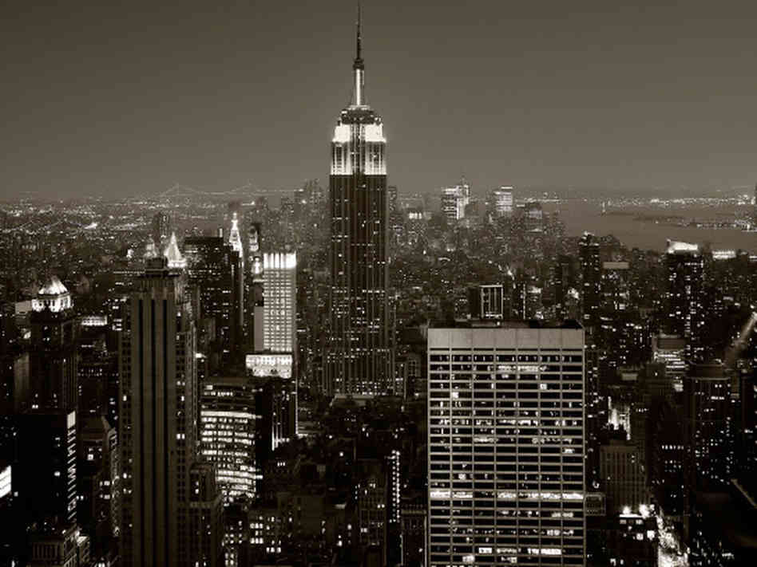
Theme C3
How does the title give the reader a clue about the main idea of the poem? Explain using words from the poem.
Work with a partner to create a bumper sticker that shows the theme of the poem.

