Slide 1
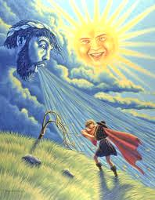
The North Wind and the Sun
Originally told by Aesop

Slide 2
What is a fable?
A fable is a short fiction story that teaches a moral, or lesson.

Slide 3

What are the elements of a fable?
short fiction story
main characters are often animals that talk and act like humans (personification).
teaches a moral or a lesson

Slide 4
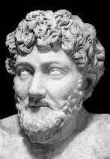
Who is Aesop?
Aesop was an ancient Greek storyteller. He lived 2,500 years ago, around 550 BC.
Some say he was a slave who so delighted his master with his stories that Aesop was given his freedom.
There are no records to prove that Aesop ever wrote anything down. Fortunately, many years after his death, people started to write down the fables Aesop collected, so they could be more easily shared.

Slide 5
The North Wind and the Sun
Originally told by Aesop
Partner read
Read together
Briefly discuss characters, plot, problem, moral

Slide 6
A1 Sequencing
Draw pictures showing what happened when the young wind blew the first time and then the second time.
Wrapped his coat around him
Held his coat more tightly

Slide 7
A2 Cause and Effect
Create a one sided multi-flow map that shows the effect of the wind blowing forcefully on the traveler.
Wind blowing forcefully on the traveler.
Held his coat more tightly instead of taking it off as the wind had wanted

Slide 8
A3 Consequences and Implications
Turn and Talk – What are 2 ways the sun and the wind tried to influence the traveler?
Class discussion – Why do you think the sun’s method was more effective?

Slide 9
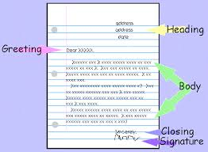
A3 Consequences and Implications
Take on the role of the traveler. Write a friendly letter to the North Wind, from the traveler telling, him what he could have done differently.

Slide 10
A3 Consequences and Implications sample letter
January 26, 2014
Dear North Wind,
Using more force to try to blow off my coat just made me hold it tighter. I don’t like being forced to do things that I don’t want to do. Next time you could have blown more gently, with a nice, pleasant breeze, and I would have taken my coat off to enjoy the soft caress of your wind.
The sun gently persuaded me to take off my coat because I was feeling too warm. It was my choice to take off my coat. I believe persuasion is more effective than force.
Sincerely,
The traveler

