Slide 1
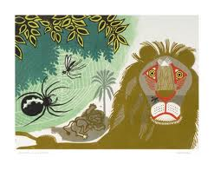
The Lion and the Gnat
Originally told by Aesop

Slide 2
Review
What are the elements of a fable?
How can you determine the theme of a fable?

Slide 3
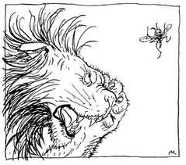
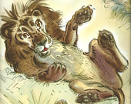
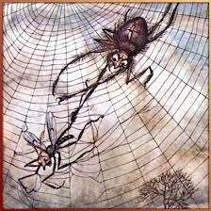
Sequencing
Draw three scenes in sequence that show the main events from the story. Title each scene.

Slide 4
Cause and Effect
What caused the gnat to get caught? What effect did it have on him? Show your ideas on your poster.

Slide 5
Consequences and Implications
What do you see as consequences of the following situations in life:
-Being smaller than other creatures?
-Being larger that other creatures?
- Being too clever?
- Being too proud?

