Slide 1
The Tap Dancer
A Fable About a Horse

Slide 2
Outcomes:
The students will identify and support the main idea by making inferences.
The students will describe the characteristics of a fable by analyzing one.

Slide 3
Fables
What are the characteristics of a fable?
Let’s make a Thinking Map to brainstorm our ideas.

Slide 4
The Tap Dancer
Read the fable independently please.
Let’s read it together now!

Slide 5
Rung 1: Character Traits
Write down as many character traits you can think of for the horse on the Ladder Organizer!

Slide 6
Rung 1: Character Traits
Share your character traits with your group and, using the poster paper, create a Thinking Map to show them.
What type of Thinking Map would work?

Slide 7
Rung 2: Making Inferences
What evidence or details in the story tell you that the horse was serious about becoming a great tap dancer?

Slide 8
Rung 2: Making Inferences
Underline the evidence!
Now, with your group, discuss your evidence.

Slide 9
Rung 3: Main Idea
In the top rung on your organizer, write down the most important idea from the story.
Now, with your group, discuss your ideas.

Slide 10
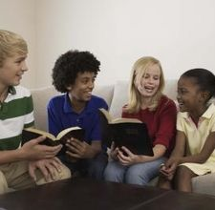
Rung 3: Main Idea
As a group, decide which idea is the most important one and write that on the sentence strip please.

Slide 11

Thinking about Main Ideas
What did we do to in order to help us think of a main idea for the story?

Slide 12
What is a fable?
Let’s revisit our Thinking Map about fables.

Slide 13
Journal Fun!
Write a journal entry about one of the following:
Describe a time you practiced and practiced to become better at something.
Is there something you are not as good at as you would like? Describe what it is and your plan to becoming better.

