Slide 1
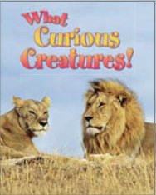
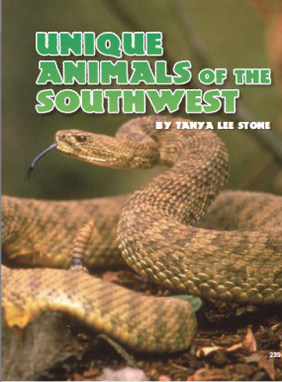
Create a Double Bubble to compare Unique Animals of the Southwest with What Curious Creatures.
Which selection did you like best? Why?

